Slide 1
Thinking Critically With Psychological Science

Slide 2
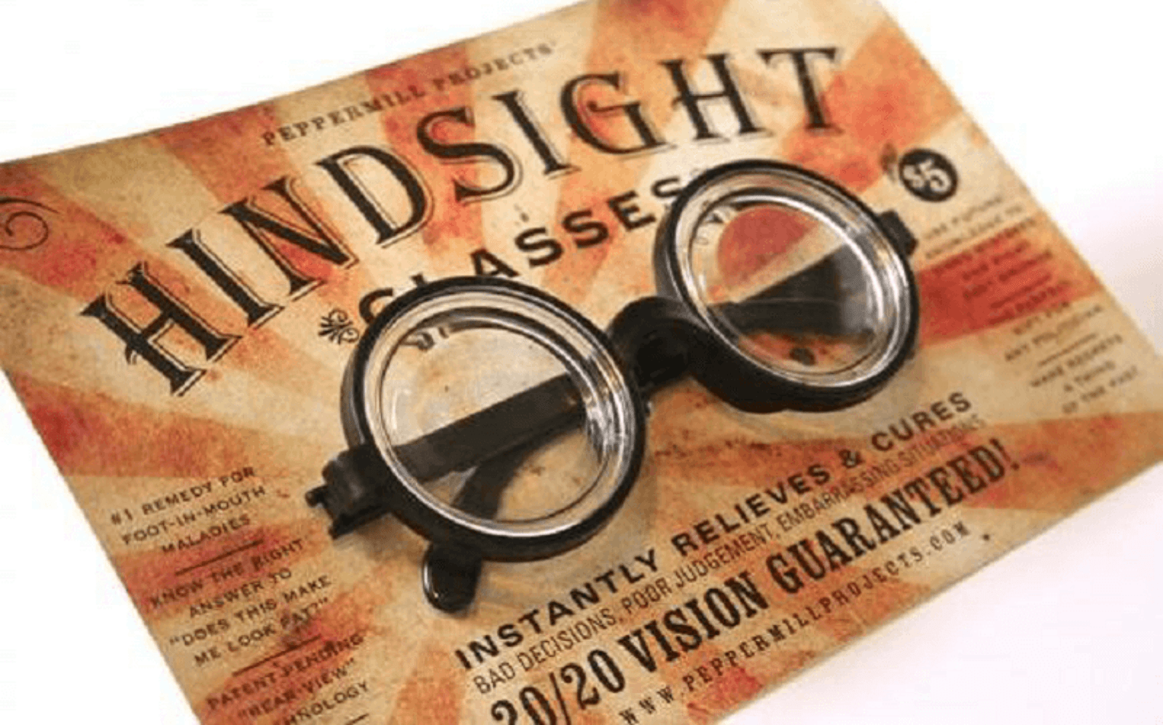
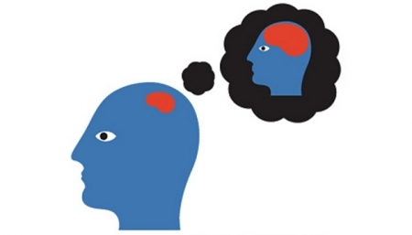
The Limits of Intuition and Common Sense
After 9/11, it seemed obvious that the U.S. intelligence analysts should have taken advance warnings more seriously.
Hindsight Bias- the tendency to believe after learning an outcome, that one would have foreseen it. (I-knew-it-all-along phenomenon)
  After 9/11, it seemed obvious that the U.S. intelligence analysts should have taken advance warnings more seriously.
  Overconfidence- the tendency to be more confident than correct
    Experts in predictions of political, economic, & military situations followed for 5 years learned that those who felt more than 80% confident were right less than 40% of the time.

Slide 3

The Scientific Attitude
Psychologists persistently ask two questions:
  What do you mean?
  How do you know? (Show me the evidence)
  Critical Thinking – examines assumptions, discerns hidden values, evaluates evidence, and assesses conclusions

Slide 4
The Scientific Method
  Scientific method – systematic observation, measurement, and experiment to formulate or test hypotheses
  Psychologists create theories
  Theories produce testable predictions (hypothesis)
  Hypothesis – specific & testable description of the expected outcome - leads to research and observations
  Empirical data – evidence that comes from observation, experience, and experimentation
  Validate theory or refine it

Slide 5
The difference between theory and hypothesis
Theory – coherent explanation or interpretation of facts and observations that have been identified in past studies
Well-established principle
Product of repeated testing of hypotheses or observations
Can predict general events
Generally accepted and extensively tested
Hypothesis – a testable prediction
For individual studies
Makes specific prediction about specific set of circumstances
Speculative guess that has yet to be tested

Slide 6
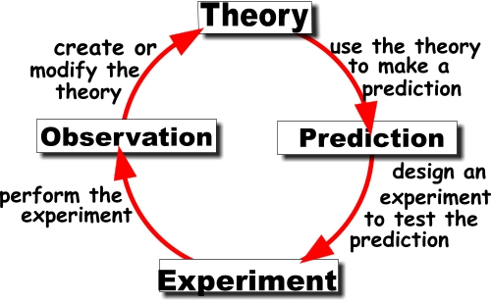

Slide 7
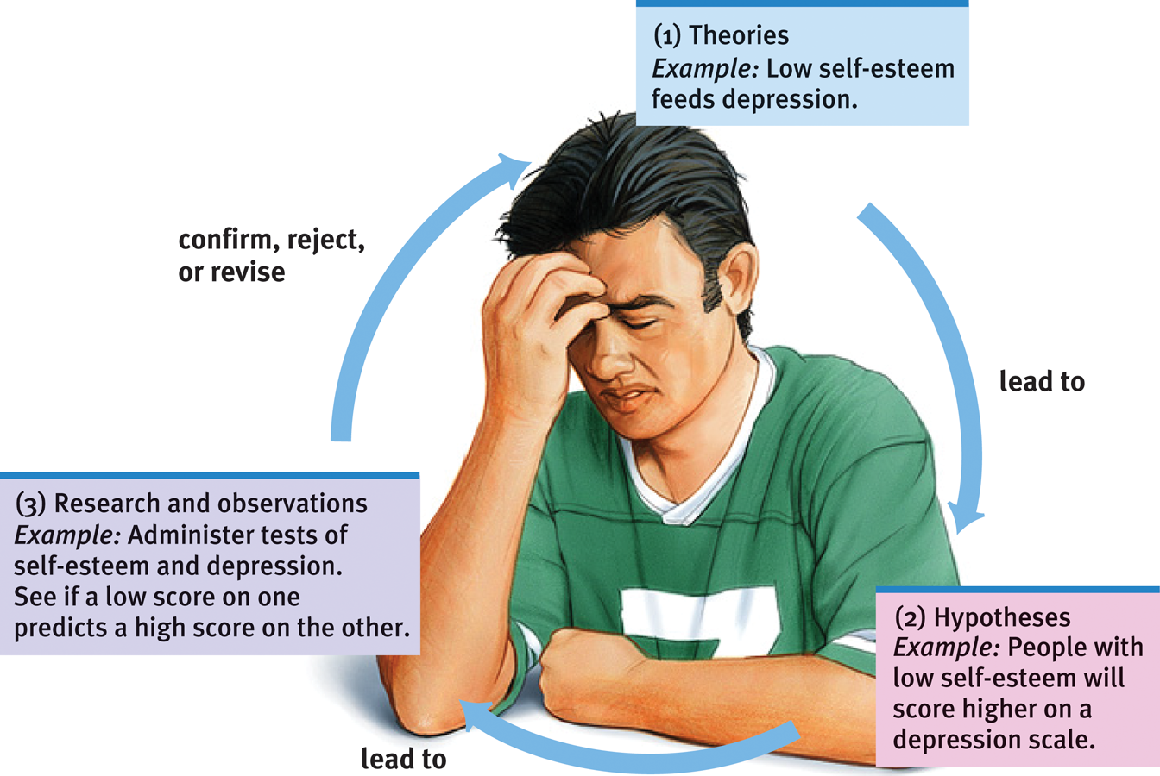
Research Process
Figure 1.2 The scientific method
Myers: Exploring Psychology, Eighth Edition
Copyright © 2011 by Worth Publishers

Slide 8
Scientific Method
Psychologists report their research with precise operational definitions of concepts that allow anyone to replicate their observations.
Operational definition – clear, detailed statement about the exact procedures used to define research variables
Replication – repeat the essence of a research study, get similar results

Slide 9

Descriptive Studies – Case Study
Usually examines one individual in depth in hopes of reveling
things true of us all.
Advantages:
  Can examine in-depth
  Can be used to study rare phenomena
  Sometimes the only ethical way to study an idea
  Disadvantages:
  Can mislead us if the individual being studied is atypical.
  Usually rely on a single investigator’s findings…we have no way of assessing the reliability or validity of their observations or interpretations
  No two cases are alike – may see another case like that again

Slide 10
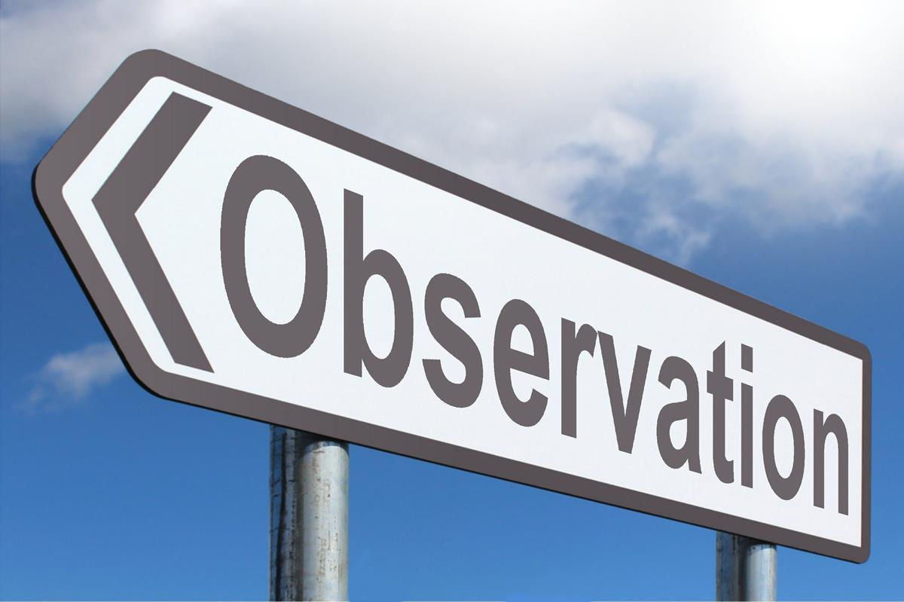
Descriptive Studies – Naturalistic Observation
Observing and recording behavior in naturally occurring situations – no interference, just watch
Advantages:
  Get to see authentic behavior in a naturally occurring situation, not a laboratory
Disadvantages:
  Can’t control the environment or interfere
  Can’t explain behaviors, just describes
This Photo by Unknown Author is licensed under CC BY-SA

Slide 11

Descriptive Studies – Surveys
Advantages:
Cheap to administer
Gather a lot of info about people quickly
Disadvantages:
Wording can affect responses
People can lie
Social desirability bias – participants feel obligated to answer questions with socially favorable opinions
False consensus effect – overestimating how others share our beliefs and behaviors
Sampling error – may not represent the entire group – use random sampling

Slide 12
Correlation & Causation
Correlation – a measure of the extent to which two factors vary together and thus how well either one predicts the other.
Correlation Coefficient – the mathematical expression of the relationship ranging from -1 to +1
  A weak correlation is close to 0
  No correlation is 0
  The closer you are to 1, the more correlated two things are.

Slide 13
Correlation
When one trait or behavior accompanies another, we say the two correlate.
Indicates strength
of relationship
(0.00 to 1.00)
Correlation
coefficient
r =
+
0.37
Indicates direction
of relationship
(positive or negative)
Notes:
OBJECTIVE 8| Describe positive and negative correlations and explain how correlational measures can aid the process of prediction.

Slide 14
Scatterplots
Scatterplot - graph comprised of points that are generated by values of two variables.
  The slope of the points shows the direction, while the amount of scatter shows the strength of the relationship.

Slide 15
Correlation & Causation
Positive Correlation- Both variables move in the same direction (up or down)
Examples:
The more we study, the better our grades (both go up).
The less we study, the lower our grades (both go down)
Perfect positive
correlation (+1.00)

Slide 16
Correlation & Causation
Negative Correlation- One variable moves up and one variable goes down.
  A negative correlation has nothing to do with its strength or weakness
Example:
The more I brush my teeth, the fewer number of cavities.
The less time a person spends on social media, the more productive he or she is.
Perfect negative
correlation (-1.00)

Slide 17
Are these positive or negative correlations?
The more young children watch TV, the less they read.
The more sexual content teens see on TV, the more likely they are to have sex.
The longer children are breast-fed, the greater academic achievement.
The more often adolescents eat breakfast, the lower their body mass.

Slide 18
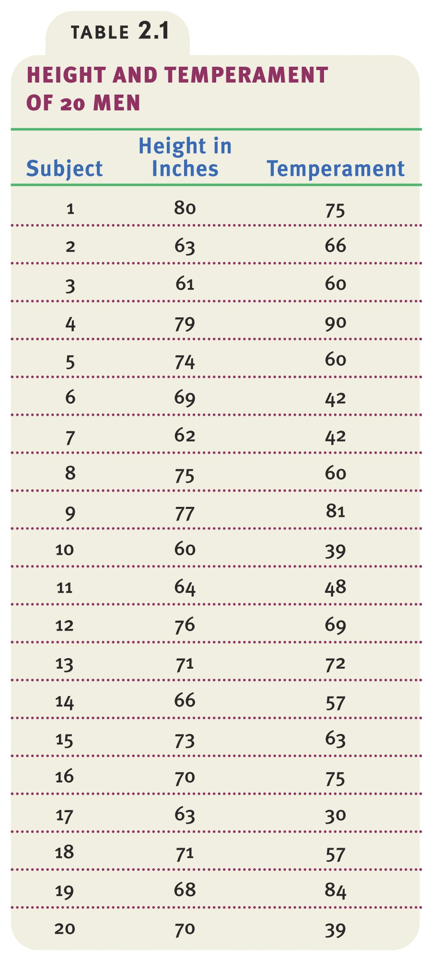
Data showing height and temperament in people.

Slide 19
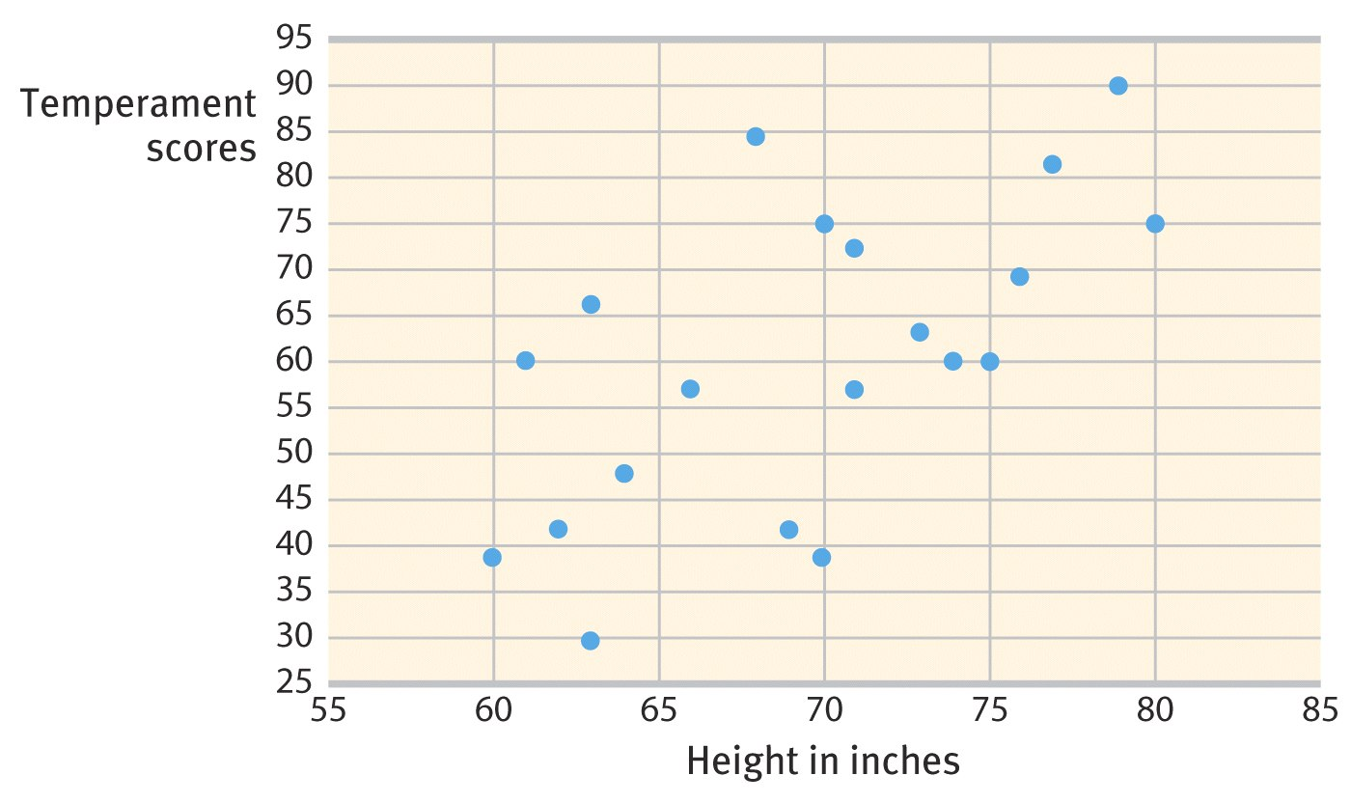
The scatterplot below shows the relationship between height and temperament in people. There is a moderate positive correlation of +0.63.

Slide 20
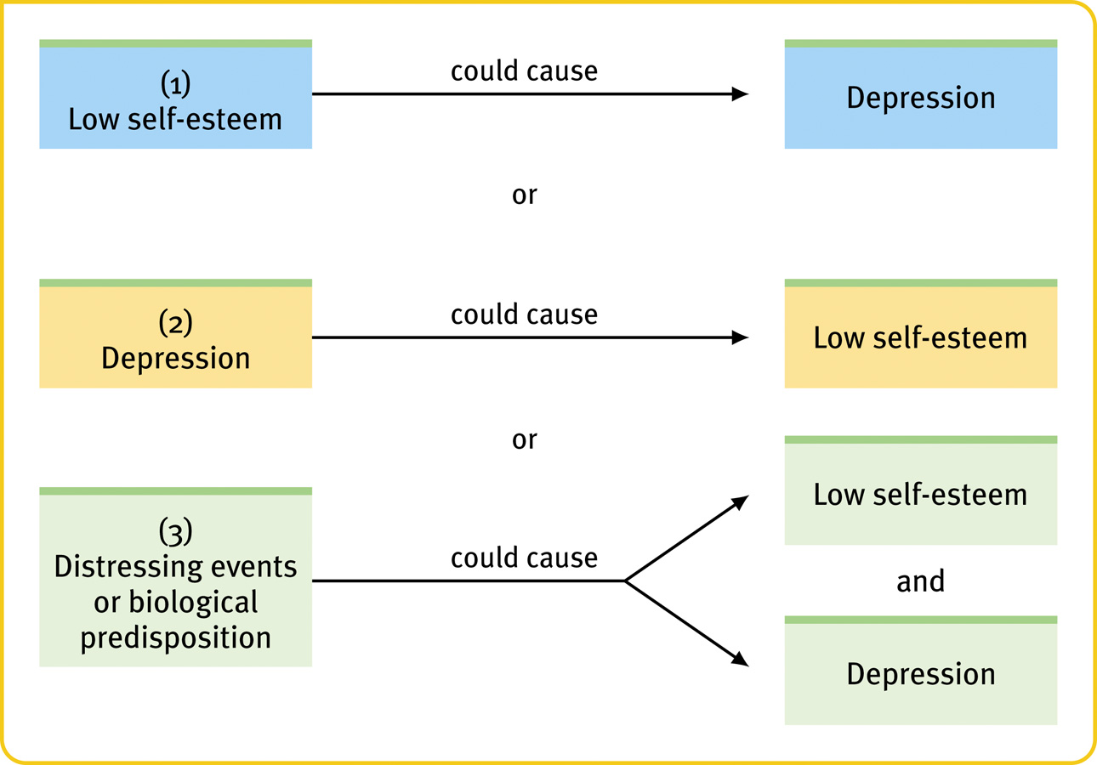
Correlation and Causation
Correlation indicates the possibility of a cause-effect relationship, but it does not prove causation.
or
Notes:
OBJECTIVE 9| Explain why correlational research fails to provide evidence of cause-effect relationships.

Slide 21
      Illusory Correlations
The perception of a relationship where none exists.
When we believe there is a relationship between two things, we may notice & recall confirming instances more than disconfirming instances
Examples:
      Infertile couples become pregnant after adopting
      More babies are born during full moons.
      Superstitions
      Stereotypes

Slide 22
Regression toward the mean
The tendency for extreme or unusual scores or events to fall back (regress) toward the average
  Average results are more typical than extreme results
  Extraordinary happenings tend to be followed more by ordinary ones.
Example: Students who score much higher or lower on an exam than they usually do are likely, when retested, to return to their average.

Slide 23
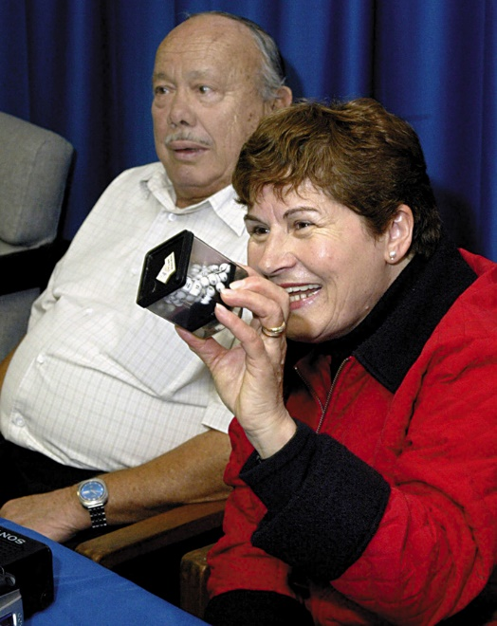
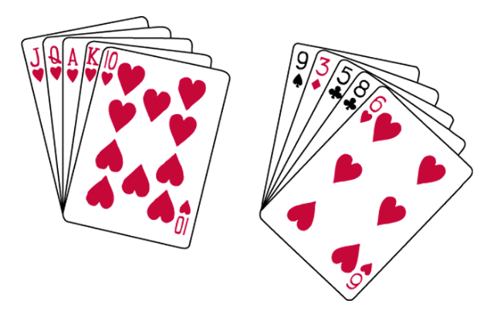
Order in Random Events
Given random data, we look for order and meaningful patterns.
Your chances of being dealt either of these hands is precisely the same: 1 in 2,598,960.
Angelo and Maria Gallina won two California lottery games on the same day.
Random sequences, streaks, and patterns do occur, but they equal out over time and trials

Slide 24
Experimentation- Exploring Cause and Effect
Like other sciences, experimentation is the backbone of psychology research. Experiments isolate causes and their effects.
Experiments enable a researcher to focus on the possible effects of one or more factors by:
  Manipulating the factors of interest
  Holding constant (“controlling”) the other factors
Unlike correlational studies, an experiment manipulates a factor to determine its effect.
Notes:
OBJECTIVE 12| Explain how experiments help researchers isolate cause and effect.

Slide 25
Selecting Human Participants
Representative sample – selecting participants from the general population that closely match the population being studied.
  Necessary if the researcher wants to generalize findings
  Cross-sectional sample – selecting participants who differ on one key characteristic such as age, income level, or geographic location at one specific point in time.
  Longitudinal study – a study that examines the same group of individuals over an extended period of time.
    Very lengthy and expensive to track for a period of time.

Slide 26
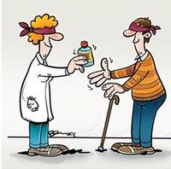
Building Confidence in Research Findings
Blind - Participant is unaware of placement in experimental or control group
Double-blind - Neither the researcher nor the participants know whether they receive treatment or a placebo.
  Used to control for confounding variables
Placebo Effect – experimental results caused by expectations alone

Slide 27
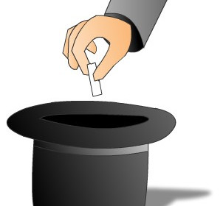
Building Confidence in Research Findings
Random Assignment reduces pre-existing differences between groups by selecting participants by chance for both experimental & control groups (used for comparison)
  Roughly equalizes the two groups in age, attitudes, and every other characteristic
Double-blind procedure and random assignment build confidence in research findings by reducing the risk of researcher bias.

Slide 28
Experimentation
Experimental group - receives the treatment
Control group - does not receive the treatment

Slide 29
Experimentation
Independent Variable - a factor manipulated by the experimenter.
The effect of the independent variable on the dependent variable is the focus of the study.
Example: When examining the effects of breast feeding upon intelligence, breast feeding is the independent variable.
Notes:
OBJECTIVE 14| Explain the difference between an independent variable and a dependent variable.

Slide 30
Experimentation
Dependent Variable - a factor that may change in response to an independent variable.
Impact can be measured
In psychology, it is usually a behavior or a mental process.
Example: In our study on the effect of breast feeding upon intelligence, intelligence is the dependent variable.

Slide 31
Experimentation
Confounding Variable - A factor other than the independent variable that might produce and effect in the experiment.
Examples:
  Participant bias – subjects act in ways that they think the experimenter wants them to act
  Experimenter bias – experimenter’s action influencing the outcome of the experiment

Slide 32
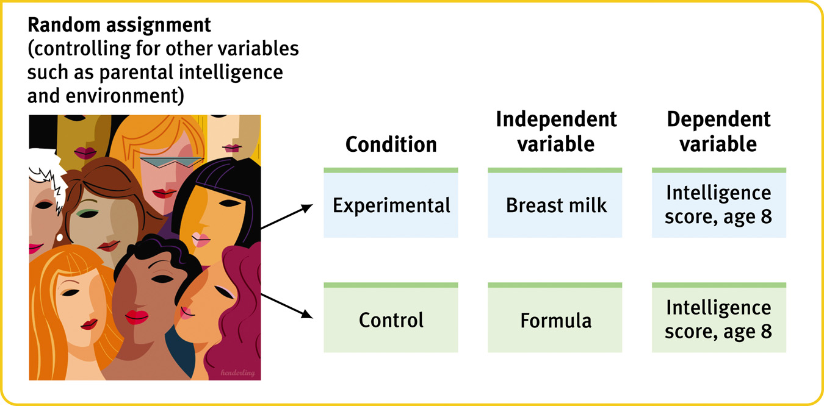
Experimentation - Summary of Steps

Slide 33
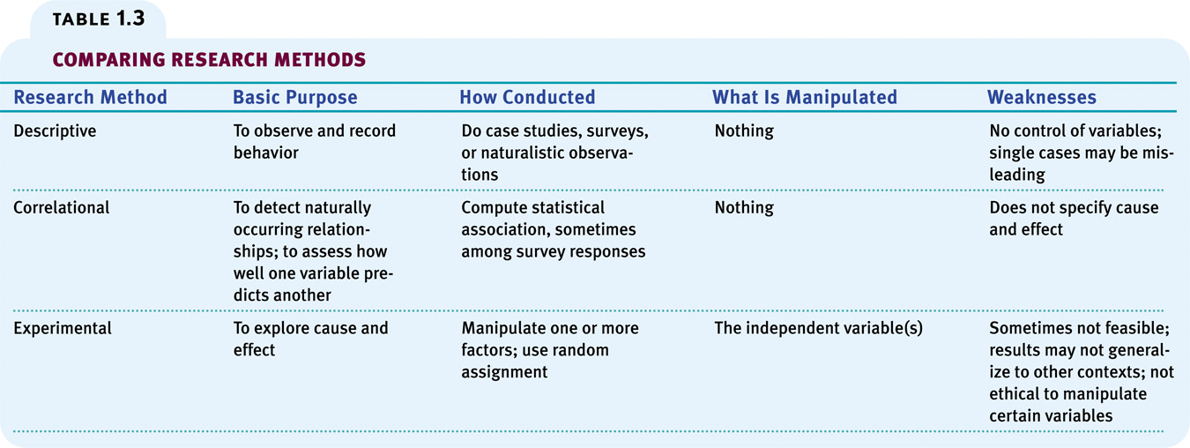

Slide 34
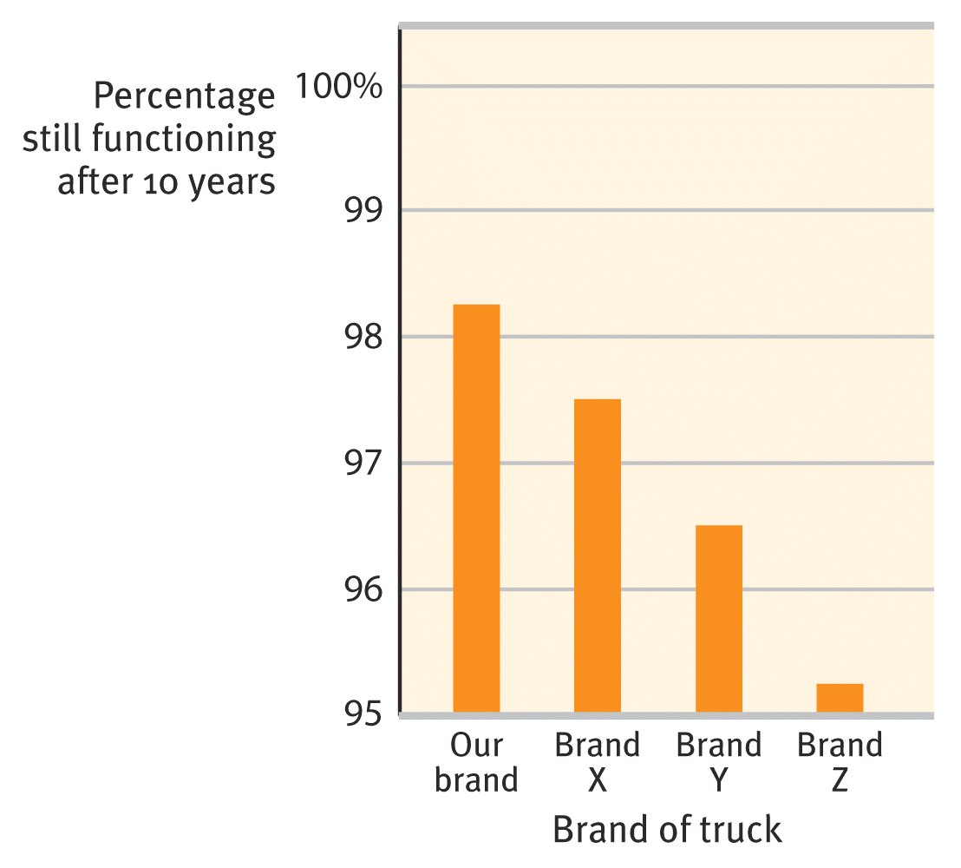
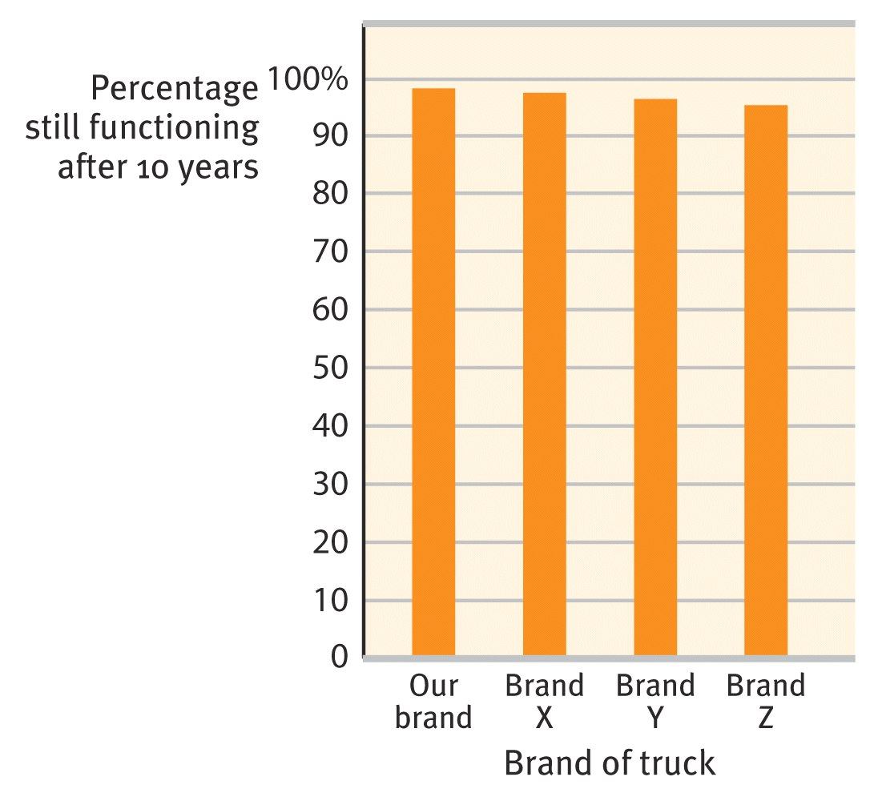
Describing Data
A meaningful description of data is important in research. Misrepresentation may lead to incorrect conclusions.
Notes:
OBJECTIVE 16| Explain how graphs can misrepresent data.

Slide 35
Measures of Central Tendency
Mean
  Average score
  Extreme scores have a greater impact on the mean than on the mode or median
Median
  Score that divides a frequency distribution exactly in half (50th percentile), so that the same number of scores lie on each side
Mode
  Most frequently occurring score

Slide 36
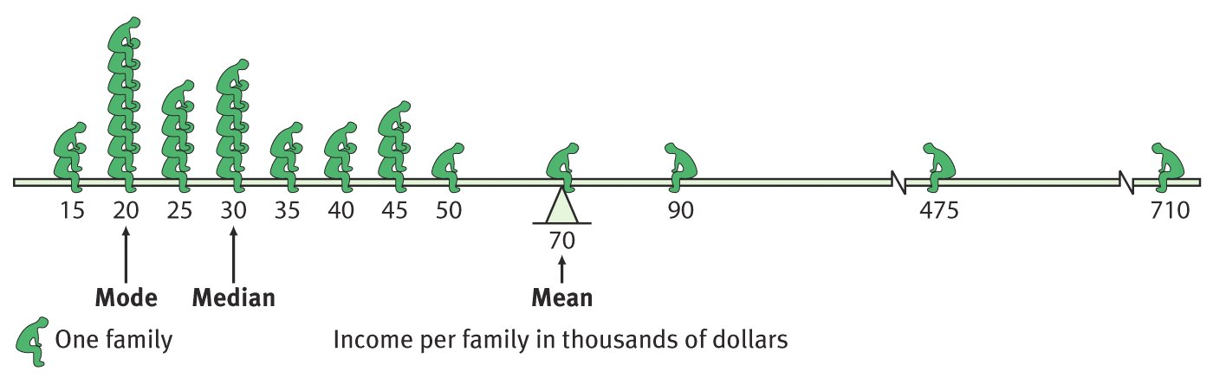
Measures of Central Tendency
POINT TO REMEMBER: Always note which measure of central tendency is reported. If it’s the MEAN, consider whether a few atypical scores could be distorting it.

Slide 37
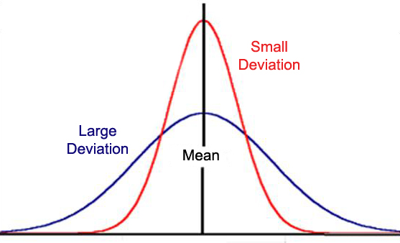
Measures of Variation
Reflects how similar or diverse the scores are.
Range - The gap between the lowest & highest scores (subtract the smallest value from the largest)
  Weakness of the range is that you are only computing two data points.
  Provides a poor estimate of variation because the range can be affected by extreme scores.
    Example: 20, 15, 15, 15, 10, 10, 5 Range = 20-5

Slide 38
Measures of Variation
Standard Deviation (SD) – a standard measurement of how much the scores in a distribution deviate (vary) from the mean
The most widely used measure of variation
The larger the standard deviation the greater the differences between the people or groups
Mean is a good statistic, but standard deviation gives us even more data to help give better conclusions

Slide 39
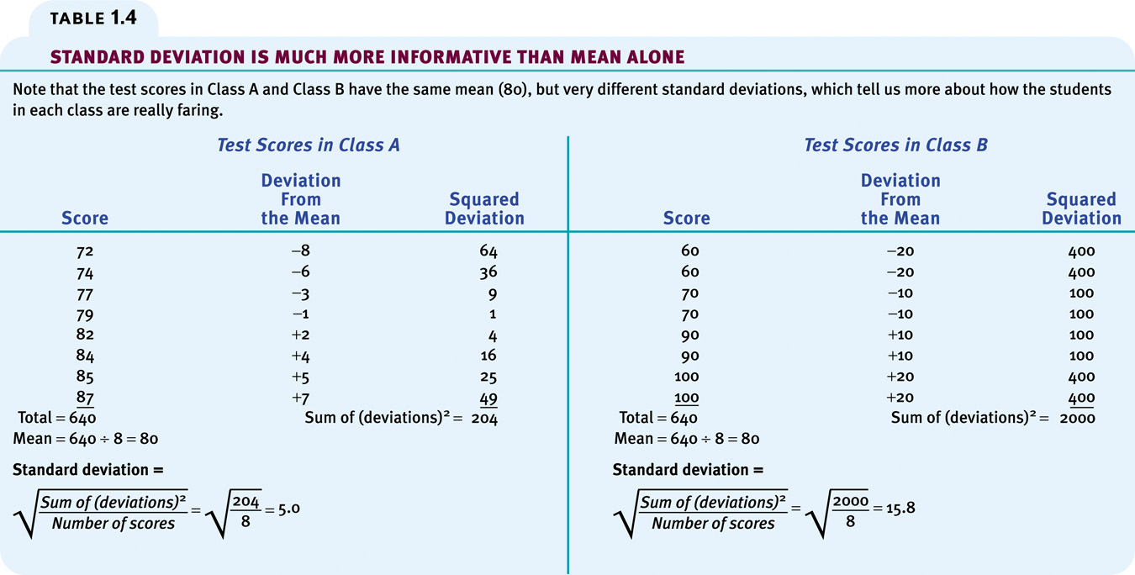

Slide 40
Normal Distribution (Bell Curve)
The percentage of scores that fall at or above the mean is 50…the percentage that fall below (or at) the mean is also 50

Slide 41
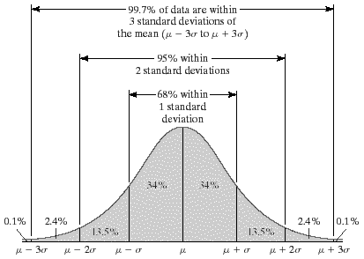
Normal Distribution 68-95-99.7 Rule
68% of scores fall within one SD
95% of scores fall within two SD
99.7% of scores fall within three SD

Slide 42
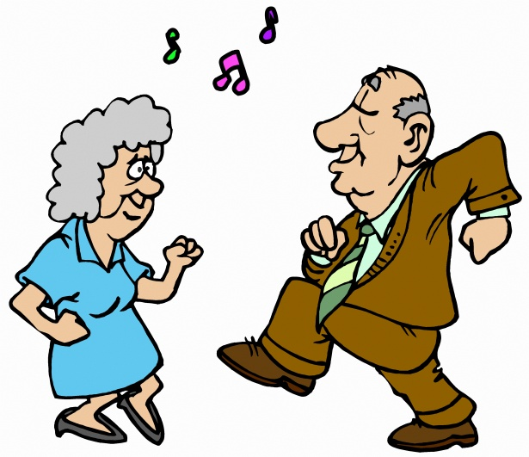

Normal Distribution Mnemonic
1 sixty-eight year old threw a huge birthday party for 2 ninety-five-year-olds. The 3 went all out for the event, hiring radio station 99.7 to DJ the party.

Slide 43
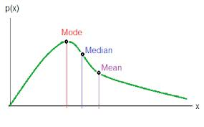
Positively Skewed Distributions
Contain a large # of scores on the low end of the scale (looks like “P” lying on back)
Mean is higher than the median
  Thus the median is a better representation of central tendency in positively skewed distributions

Slide 44
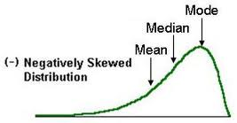
Negatively Skewed Distributions
Contain a large # of scores on the high end of the scale
Mean is lower than median
  Thus the median is a better representation of central tendency in a negatively skewed distribution

Slide 45
Inferential Statistics
Most experiments are conducted with a small sample of subjects.
Psychologists want to generalize the results from their small sample to a larger population
Inferential statistics are used to determine how likely it is that a study’s outcome is due to chance and whether the outcome can be legitimately generalized to the larger population from the sample selected
    How reliable and statistically significant are the differences?

Slide 46
How do we know whether an observed difference can be generalized to other populations?
Keep in mind three principles:
Representative samples are better than biased samples.
Less variable observations are more reliable than those that are more variable.
  An average is more reliable when it comes from scores that have low variability
More cases are better than fewer cases.
  Averages based on many cases are more reliable
Notes:
OBJECTIVE 19| Identify three principles for making generalizations from samples.

Slide 47
When is an observed difference significant?
Statistical significance - measure of how likely the result of the experiment is due to the manipulation of the independent variable or due to chance.
Significance is reported as a P value – the probability of getting experimental results.
Lower than .05 or the chances of something occurring by chance is less than 5%
The smaller the p-value, the more significant the results (can never be “0”)

Slide 48
APA Ethical Guidelines – Animal Research
Any type of academic research must first propose the study to the ethics board or institutional review board (IRB) at the institution for approval.
Must have a clear scientific purpose
Must answer a specific important scientific question
Animals chosen must be best-suited to answer the question at hand
Animals must be cared for and housed in a humane way
Animal must be acquired legally from accredited companies
Experimental procedures must be designed to employ the least amount of suffering feasible

Slide 49
APA Ethical Guidelines – Human Research
Institutional Review Board (IRB) – ensures safety of those participating in research studies
Informed consent – no coercion
Deception – acceptable when the researcher feels it is necessary for the efficacy of the study
Debriefing
Confidentiality & Anonymity
Protection from harm & discomfort

