Slide 1
Learning Principles and Applications
Chapter 2

Slide 2
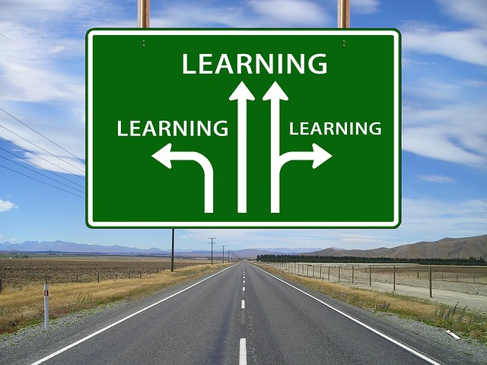
Are there different types of learning? If so, explain.
How do we learn?

Slide 3
Learning; Principles and Applications
Learning A relatively permanent change in behavior that results from an experience
3 Basic types of learning
Classical Conditioning
Operant Conditioning
Modeling (Observation)

Slide 4
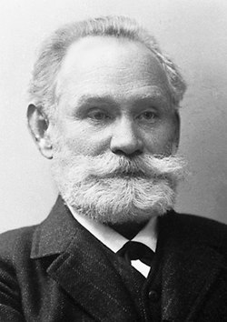
Classical Conditioning – Pavlov’s Experiment
Ivan Pavlov - Russian physiologist, who in the 1900’s, discovered the principle of classical conditioning by studying the effects of digestion.
Classical Conditioning - a type of learning in which a neutral stimulus triggers a response after being paired with another stimulus that naturally triggers that response.

Slide 5
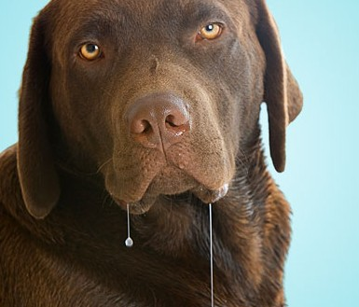
Before conditioning:
Neutral Stimulus: (tuning fork) Nothing to do with the response to food
Unconditioned Stimulus: (food) A stimulus that naturally and automatically triggers an unconditioned response.
Unconditioned Response: (salivation) The unlearned, automatic response to an unconditioned stimulus.

Slide 6
Once conditioning is complete:
Conditioned Stimulus: (tuning fork) A once neutral event that has come to elicit a given response.
Conditioned Response: (salivation) Learned response to a previously neutral conditioned stimulus.
Note - Conditioning is most reliable and effective when the conditioned stimulus was presented about a half second before unconditioned stimulus.

Slide 7
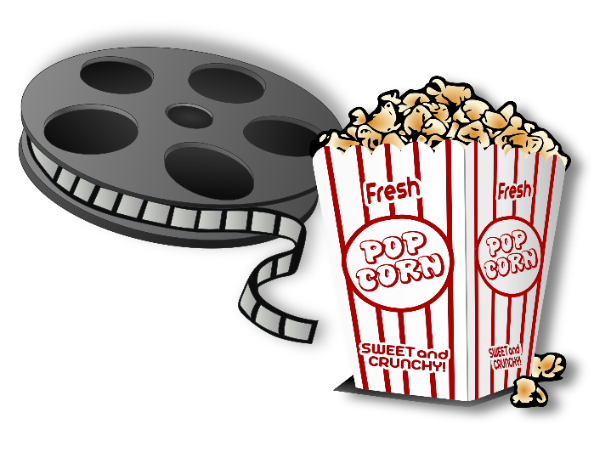
Classical Conditioning Practice:
Whenever you watch a scary movie, you always eat popcorn. Now you find that just eating popcorn makes you feel scared.
Determine the following:
Unconditioned Stimulus (UCS)
Unconditioned Response (UCR)
Conditioned Stimulus (CS)
Conditioned Response (CR)

Slide 8
Classical Conditioning Practice:
People receiving chemotherapy often vomit during or shortly after the procedure. After several chemotherapy sessions, people begin feeling sick at the sight of the treatment room.
Determine the following:
Unconditioned Stimulus (UCS)
Unconditioned Response (UCR)
Conditioned Stimulus (CS)
Conditioned Response (CR)

Slide 9
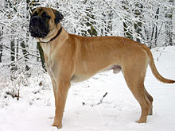
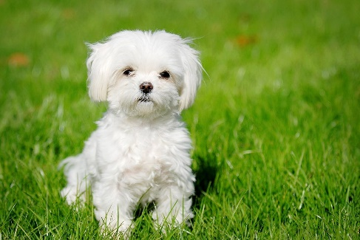
General Principles of Classical Conditioning
Generalization: The tendency, once a response has been conditioned, for stimuli similar to conditioned stimulus to elicit similar responses (ex. circles & ovals)
Discrimination: The ability to distinguish between a conditioned stimulus and similar stimuli that do not signal an unconditioned response. (ex. circle vs. oval)

Slide 10
General Principles of Classical Conditioning
Acquisition – the first stages of learning when a response is established; the period when the stimulus comes to evoke the conditioned response
Extinction – the gradual disappearance of a conditioned response because the reinforcement is withheld or because the conditioned stimulus is repeated presented without the unconditioned stimulus.
Spontaneous Recovery – the reappearance of an extinguished conditioned response after a pause

Slide 11
Classical Conditioning & Human Behavior
Used as a treatment for bedwetting (bell and pad)
Taste aversion - a learned response to eating spoiled or toxic food. When taste aversion takes place, you avoid eating the foods that make you ill.
Used in a study to keep coyotes away from sheep
Classical conditioning provides information that is helpful to survival
Helps to predict what is going to happen

Slide 12
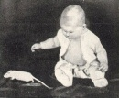
The Case of Little Albert
John B. Watson and his assistant Rosalie Rayner showed how fear could be conditioned.
The experiment was done at Johns Hopkins University in 1920.
Controversial – They did not extinguish Albert’s fear when the experiment was done

Slide 13
Classical vs. Operant Conditioning
Classical Conditioning
Operant Conditioning
Always a specific stimulus (UCS) that elicits the desired response
USC does not depend on learner’s response
Learner responds to its environment
No identifiable stimulus; learner must first respond, then behavior is reinforced
Reinforcement depends on learner’s behavior
Learner actively operates on its environment

Slide 14
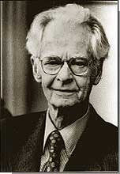
Operant Conditioning
Learning from the consequences of behavior - reward or punishment
Many people operate in society through rewards
B.F. Skinner - psychologist most closely related to operant conditioning
believed most behavior is influenced by one’s history or rewards and punishments

Slide 15
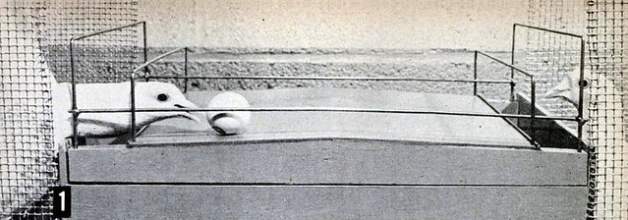
Operant Conditioning cont.
Positive Reinforcement- an action will be more likely to happen again if something positive happens as a consequence (E.L. Thorndike – Law of Effect).
Allows a response to be strengthened, if immediately following a particular response.

Slide 16
Schedules of Reinforcement
Ratio schedules are based on number of correct responses
Fixed-ratio schedule; reinforcement in which a specific number of correct responses is required before reinforcement can be obtained.
Example – Worker who gets paid by the job or volume of work completed
Variable-ratio schedule; a different number of responses is required before reinforcement can be obtained.
Example - playing a slot machine

Slide 17
Schedules of Reinforcement
Interval schedules are based on the amount of time between reinforcers
Fixed-interval schedule; a specific amount of time must elapse before a response will elicit reinforcement
Variable-interval schedule; changing amounts of time must elapse before a response will obtain reinforcement each time. Less consistent

Slide 18
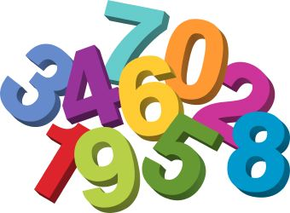
Partial Schedules of Reinforcement
Ratios = a number of responses
Interval = a time period elapsed
Fixed = remains the same, predictable
Variable = changes or varies, unpredictable

Slide 19
Fixed Schedules
Variable Schedules
Fixed Ratio – reinforcement after a fixed or set number of responses
Fixed Interval – reinforcement of first response after a fixed amount of time has passed
Variable Ratio – reinforcement after a varying number of responses
Variable Interval – reinforcement of first response after varying amounts of time

Slide 20
Reinforcers
Reinforcer – anything that increases the frequency of an immediately preceding behavior
Primary reinforcers- A stimulus that satisfies a natural need (water, food, sleep)
Secondary reinforcers- (conditioned) A stimulus that becomes reinforcing through its link with a primary reinforcer (smile, praise, money)

Slide 21
Aversive Control - Unpleasant consequences that affect our behavior
Negative Reinforcement- An action you take to avoid punishment or something unpleasant. A painful stimulus is removed and increases the frequency of the behavior.
Negative Reinforcement follows and takes away or negates an aversive stimulus
Ex: Smoke detector chirping

Slide 22
Types of negative reinforcement
Escape conditioning- A person’s behavior causes an unpleasant event to stop (child whining)
Avoidance conditioning- A person’s behavior has the effect of preventing an unpleasant situation from happening (no longer eat brussel sprouts)

Slide 23
Punishment- A behavior is decreased or is not repeated
Note - Punishment tells you what not to do; reinforcement tells you what to do.
Positive Punishment - presenting a negative consequence (stimulus) after an undesired behavior is exhibited, making the behavior less likely to happen in the future.
Example - During a meeting or while in class, your cell phone starts ringing. You are lectured on why it is not okay to have your phone on.

Slide 24
Punishment
Negative Punishment - happens when a certain desired stimulus/item is removed after a particular undesired behavior is exhibited, resulting in the behavior happening less often in the future.
Example - Siblings get in a fight over who gets to go first in a game or who gets to play with a new toy. The parent takes the game/toy away.

Slide 25
Disadvantages in using aversive stimuli to change behavior
Can lead to unwanted side effects (rage, fear, etc.)
People learn to avoid the person delivering the aversive consequences = less chance to correct the behavior
Example - Children learn it’s not okay to swear at home, but it’s okay to swear elsewhere
More likely to suppress rather than eliminate the behavior

Slide 26
Reinforcement = give something to increase behavior
Punishment = undesirable event to decrease or stop behavior
Positive - give reward, something pleasurable (+)
Negative - removal unwanted stimulus to strengthen behavior (-)
Positive – give something undesirable (+)
Negative = take something desirable away (-)

Slide 27
Factors that Affect Learning
Feedback - Finding out the results of an action or performance
Without feedback you may repeat same mistakes
Transfer - A skill you already learned can help learn a new skill
Positive Transfer- Previously learned responses help you learn a new task
Ex: Know how to speak Spanish - helps you learn Italian
Negative Transfer- A previously learned task hinders learning
Ex: An American driving in England - steering wheel/drive on opposite side

Slide 28
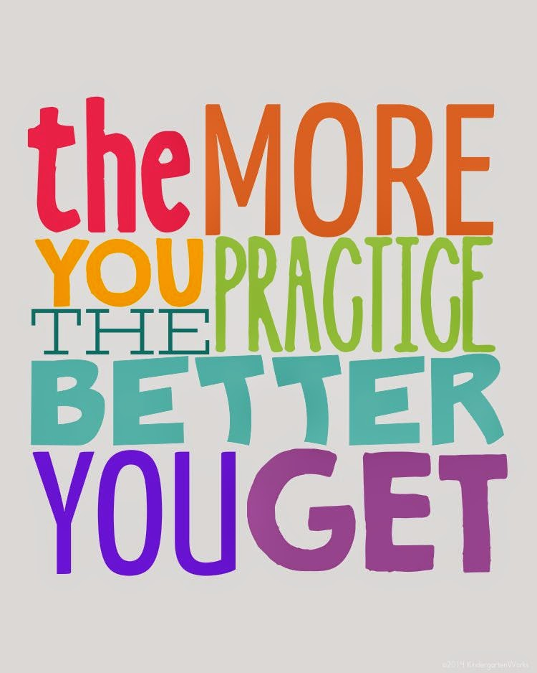
Factors that Affect Learning
Practice – The repetition of task, helps bind responses together
Takes time and should practice over time - not all at once
Can be physical or imagined (mental practice)

Slide 29
Learning Strategies
Learning To Learn - Harry Harlow demonstrated that animals can learn.
Harlow’s monkey learned to strategize when seeking out food.
In school you acquire a general strategy for learning

Slide 30
Learning Strategies
In order to be motivated to try hard, people have to feel that their actions make a difference
Learned Laziness
If rewards come without effort, a person learns to do little or no work
Learned Helplessness
If pain comes no matter how hard one tries, a person gives up
Success attributed to luck rather than skill

Slide 31
Learned Helplessness
Martin Seligman believed that learned helplessness is one major cause of depression.
When people are unable to control events in their lives, they may:
be less motivated to act and eventually stop trying
experience a lowered self-esteem
feel depressed

Slide 32
Learned Helplessness – Martin Seligman
Stability - Result of permanent characteristics.
“I have never done well in Psych, and I never will!”
Globality - is not specific, but general.
“I’m just dumb!” as opposed to “I am no good at Psych!”
Internality - Rather than blaming an external factor, they blame themselves and their own inadequacies.
“I am not smart enough to take Psych!”

Slide 33
Learning Complicated Skills
Shaping – A process in which reinforcement is used to sculpt new responses out of old ones
Response Chains – responses that follow one another in a sequence in order to learn a skill.
Response chains are organized into larger response patterns.
Must learn to perform all of the subordinate skills first in order to make a large skill possible.

Slide 34
Learning The process by which experience or practice results in a relatively permanent change in behavior or potential behavior
Classical
Conditioning
The type of learning in which a response naturally elicited by one stimulus becomes to be elicited by a different formally neutral stimulus
Operant
Conditioning
The type of learning in which behaviors are emitted to earn rewards or avoid punishments
Social Cognitive Learning Theory
The type of learning in which behaviors are learned by observing a model
We are here
Pavlov, Watson, Garcia
Thorndike, B.F. Skinner
Albert Bandura
Reinforcement and Punishment
Modeling and Vicarious Learning
UCS, UCR, CS, CR

Slide 35
Social Learning and Cognitive Learning
Social learning consists of cognitive learning and modeling
Involves how people make decisions and act upon the information available to them
Cognitive learning focuses on how information is obtained, processed, and organized

Slide 36
MODELING –
The behavior of others simply increases the chances that we will do the same thing.
Learning doesn’t necessarily occur. We just perform old responses that we otherwise might not be using at the time.
Example: Walking down the hall and many students are looking up at the ceiling…chances are you will also look up at the ceiling.
Clap when others clap

Slide 37
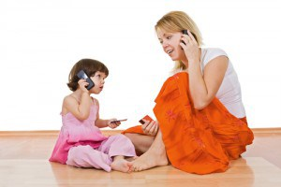
Modeling –
Observational Learning or Imitation –
Learning that takes place by having the learner observe someone else perform a task or tasks
Shows how new responses can be learned without shaping and conditioning
Example: A young child watches parents pick up a ringing phone and say “Hello.” The child then picks up his play phone and says, “Hello”.
Albert Bandura – Bobo doll experiment

Slide 38
Modeling –
Disinhibition- If an observer watches someone else engage in a threatening activity without being punished, the observer may engage in same behavior
Example: If you are fearful of snakes and then watch several people handle snakes without being injured, you may then be less afraid of snakes

Slide 39
Behavior Modification
Behavior Modification – the systematic application of learning principles to change people’s actions or feelings
May use classical conditioning, operant conditioning, or social learning
Series of well-defined steps:
Define the problem
Identify the goals and/or target behavior
Select a strategy
Design a data recording system
Evaluate the strategy
Change/adjust the strategy (if needed)

