Slide 1
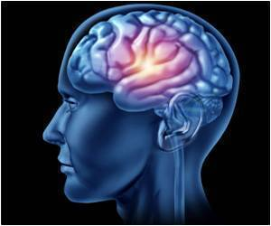
Neuroscience and Behavior
Chapter 2 – The Brain

Slide 2
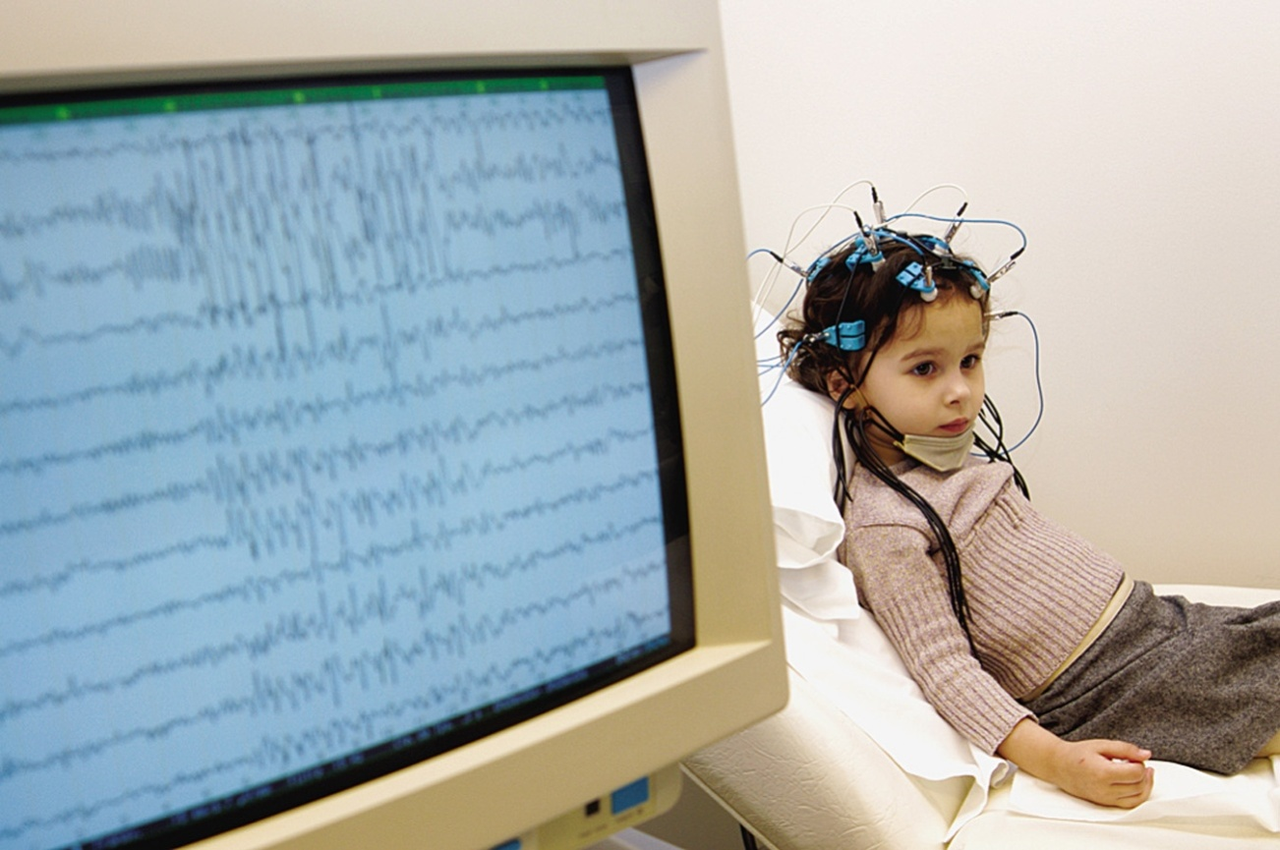
Studying the Brain
Clinical Observations
Lesion – Tissue destruction – Can occur naturally or we can selectively destroy clusters of normal or defective brain cells
Electroencephalogram (EEG) – Electrodes measure electrical waves sweeping across surface of the brain – electrodes placed on the scalp

Slide 3
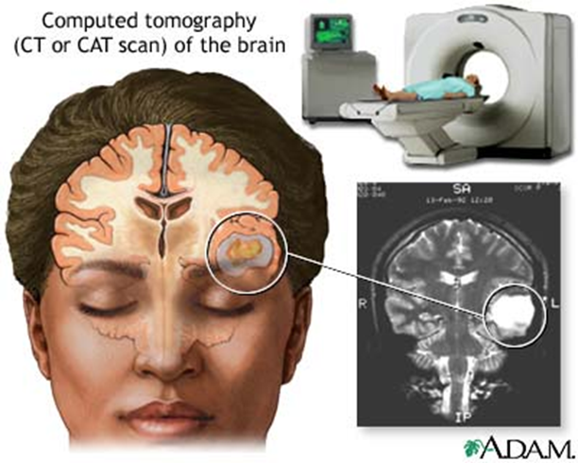
Studying the Brain
Computerized Axial Tomography (CT or CAT-scan)
  Uses X-rays taken from different angles
  Often show the size & locations of brain abnormalities caused by tumors, blood vessel defects, blood clots, strokes and other problems.
  Can’t view the mental processes
Notes:
CT (computed tomography) scan ----The CT scan is the modern name for the CAT scan- this examines the brain by taking X-ray photographs that can reveal brain damage

Slide 4
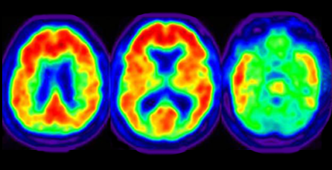
Studying the Brain
Positron emission tomography (PET) scan – visual display of brain activity
Injected with low & harmless dose of radioactive glucose.
Maps the brain at work - Shows the brain’s consumption of glucose; finds brain activity by locating the radioactivity or “hot spots”

Slide 5
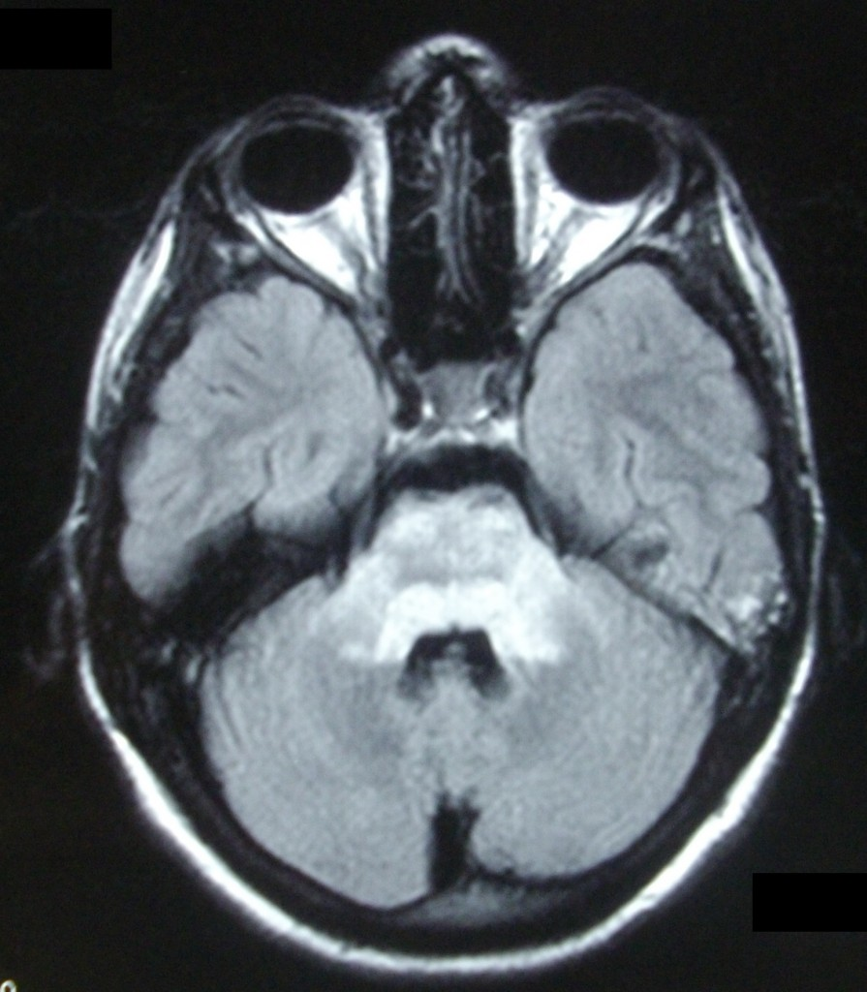
Studying the Brain
Magnetic Resonance Imaging (MRI) – Uses magnetic fields & radio waves to produce computer-generated images that distinguish among different types of soft tissue
Allows us to see structures in the brain (doesn’t reveal functions)
Head put in strong magnetic field. Aligns atoms in brain, then disorients them, measures detectable signals as they move back into place

Slide 6
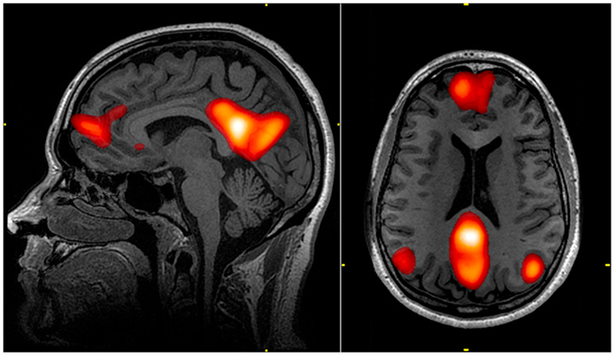
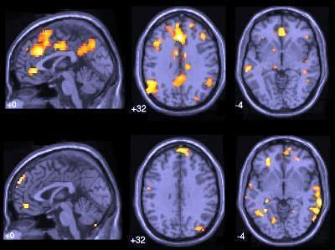
Studying the Brain
Functional MRI (fMRI) – technique for revealing blood flow and, therefore, brain activity by comparing successive MRI scans
Can reveal functioning as well as structure
Active part of brain = more blood there
Those parts light up during certain mental functions
Gives insight into how brain divides jobs among different parts of brain

Slide 7
Studying the Brain
Differences between CT Scan & MRI
CT scans use X-rays
MRI scans use powerful magnetic fields and radio frequency pulses to produce detailed pictures
Differences between normal and abnormal tissue is often clearer on an MRI image than a CT.
No radiation in an MRI scan, but it can be a noisy exam and takes longer than a CT

Slide 8
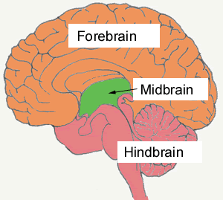
Inside the Brain
Divided into 3 parts:
  Hindbrain – most primitive part – responsible for our basic life functioning (heartbeat, digestion, arousal, balance)
  Midbrain – sends signals from the hindbrain to the forebrain – helps process info relating to the senses
  Forebrain – last part of the brain to form – most complex – regulates emotions, hunger, formation of long-term memories, growth hormones, & sense of smell

Slide 9
Older Brain Structures
Brainstem - the oldest & innermost region, beginning where the spinal cord swells and enters the skull.
  Responsible for automatic survival functions
  Medulla – base of brainstem
    controls basic life support functions heartbeat, blood pressure, and breathing
    Regulates reflexes such as swallowing, sneezing, etc.

Slide 10
Older Brain Structures
  Pons – above the medulla
    mass of nerve fibers that help relay messages from the cortex & cerebellum
    involved in facial movement, sleep & arousal
  Reticular Formation – finger-shaped nerve network and cross-wiring area, extends from spinal cord to the thalamus
  filters and relays info from body to brain
    Involved in arousal – wake & sleep

Slide 11
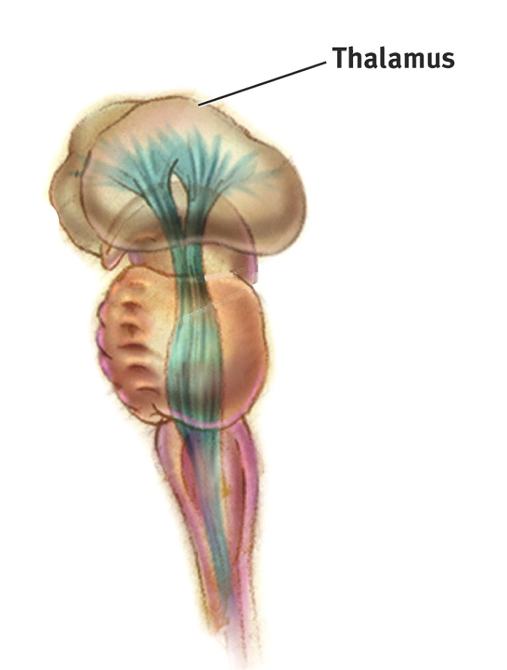
Older Brain Structures
Thalamus – top of brain stem, egg-shaped structure
“Gateway to the cortex”
Sensory switchboard of the brain
Receives sensory signals (except smell) from the spinal cord and sends them to brain regions associated with seeing, hearing, tasting, touching

Slide 12
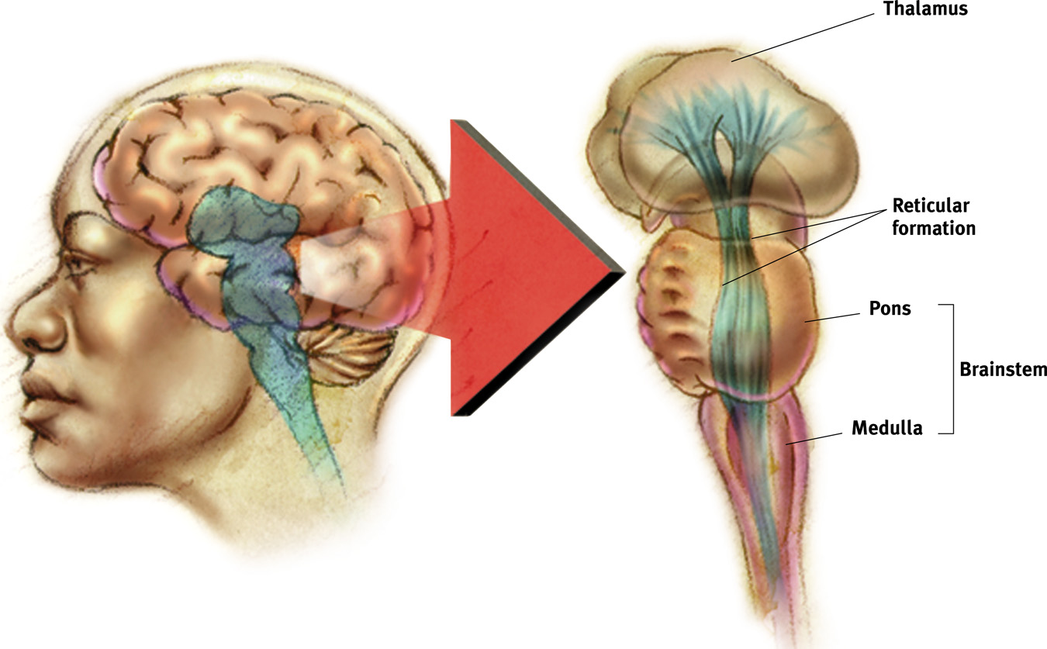
Figure 2.16 The brainstem and thalamus
Myers: Psychology, Eighth Edition
Copyright © 2007 by Worth Publishers

Slide 13
Older Brain Structures
Cerebellum – “little brain” – two lobes attached to the rear of the brainstem
Helps coordinate voluntary movements and balance

Slide 14
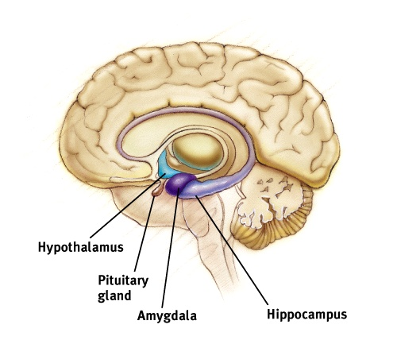
Older Brain Structures - The Limbic System
The Limbic System includes the hypothalamus, amygdala, and the hippocampus
Doughnut-shaped system of neural structures at the border of the brainstem
Core of the forebrain
Regulates memory, fear, aggression, hunger, & thirst

Slide 15
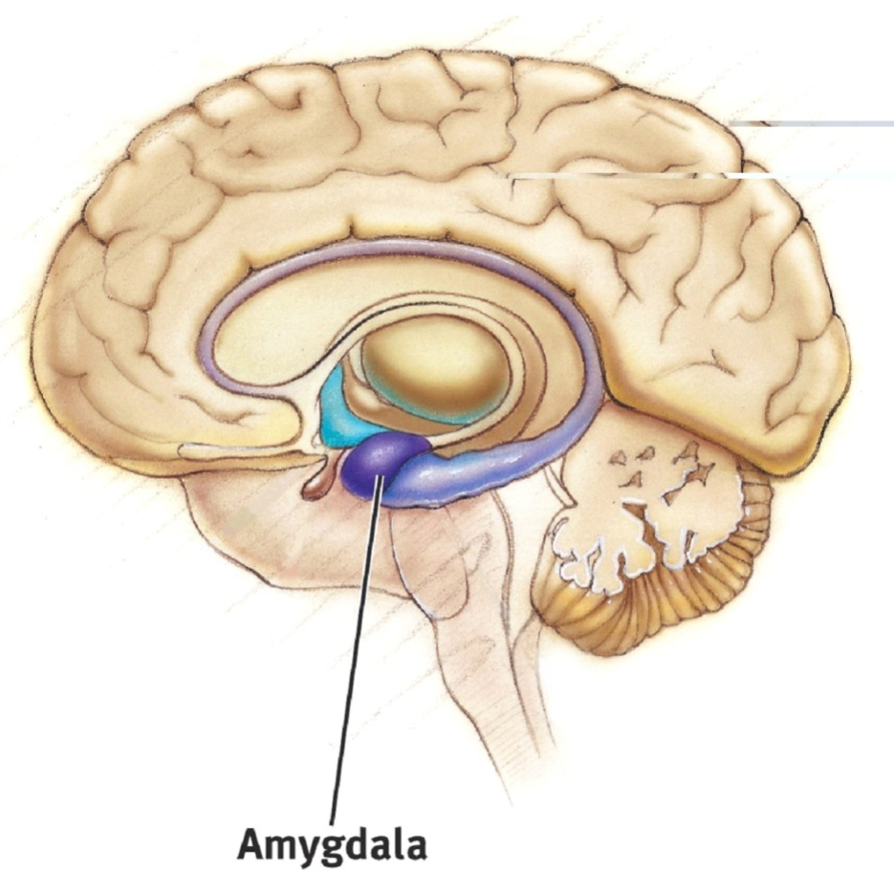
Older Brain Structures - The Limbic System
Amygdala – a ring of structures at the border of the brainstem and cerebrum (lima bean shaped)
Associated with emotional processing such as fear, aggression and drives for food and sex
Coordinates fight or flight response

Slide 16
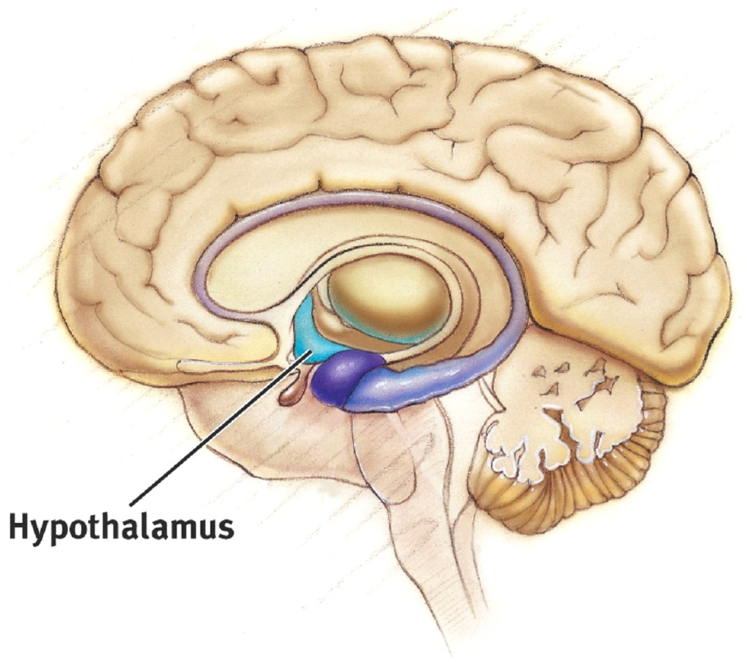
Older Brain Structures - The Limbic System
Hypothalamus – sits just below the thalamus
Links the brain to the endocrine system through control of the pituitary gland = hormone release
Involved in motivation & homeostasis
Regulates body functions - hunger, thirst, body temp, biological rhythms

Slide 17
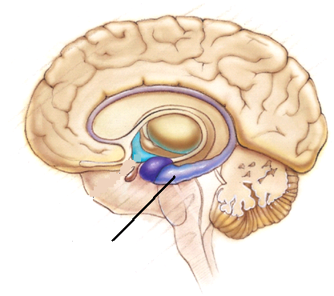
Older Brain Structures - The Limbic System
Hippocampus
Enables the formation of long term memory - “file cabinet”
Involved in the storage & retrieval of memories located elsewhere in the brain
Largest concentration of acetylcholine – lack of = Alzheimer’s
Hippocampus

Slide 18
Structure of the Cortex
Cerebrum – topmost layer of the brain; the bulbous cap over the limbic system
Cerebral Cortex – layer of thin, gray matter covering the cerebrum (wrinkles are called fissures)
  Most highly evolved part of the human brain – enables perceiving, thinking, & speaking
Cerebral hemispheres – the left and right side of the cerebral cortex
Corpus callosum – large bundle of axons that connects the two hemispheres; relays info between the two

Slide 19
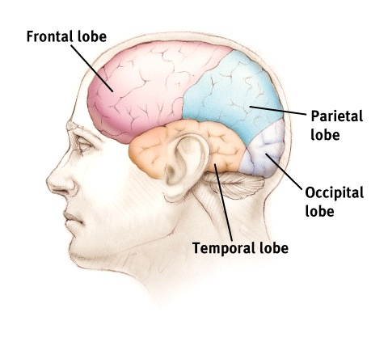
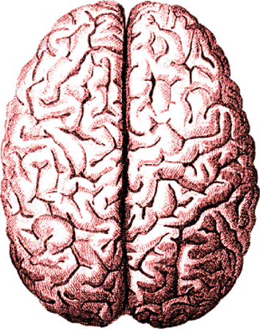
Structure of the Cortex
Part of the cerebrum, the two large hemispheres comprising 85% of brain weight
The cerebral cortex is made up of four lobes

Slide 20
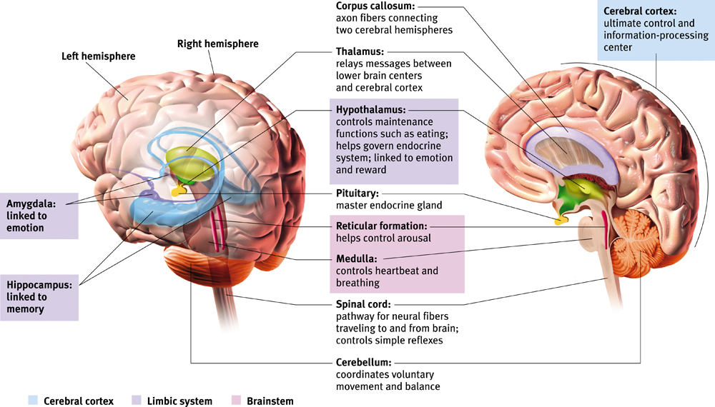

Slide 21
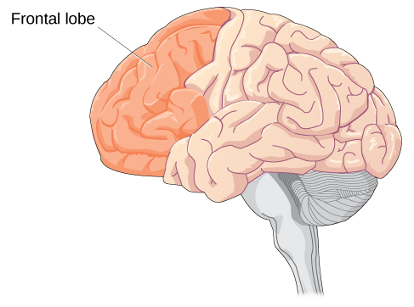
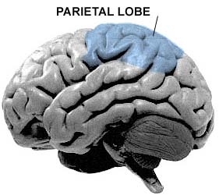
Structure of the Cortex
Parietal Lobes - (top to rear head)
Frontal Lobes - (forehead)
  Receives & processes sensory information
  Integrates in the visual senses from the occipital lobe
  Contains sensory cortex – registers & processes body touch and movement sensations
  Most evolved, largest lobe
  Controls the motor cortex – voluntary muscle movements
  Involved in planning, making judgements, creative thinking, emotional control

Slide 22
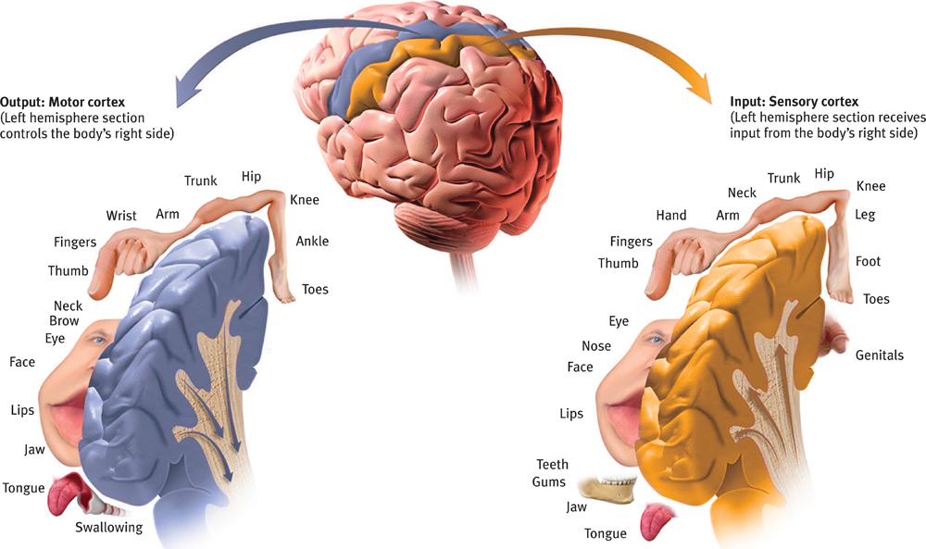

Slide 23
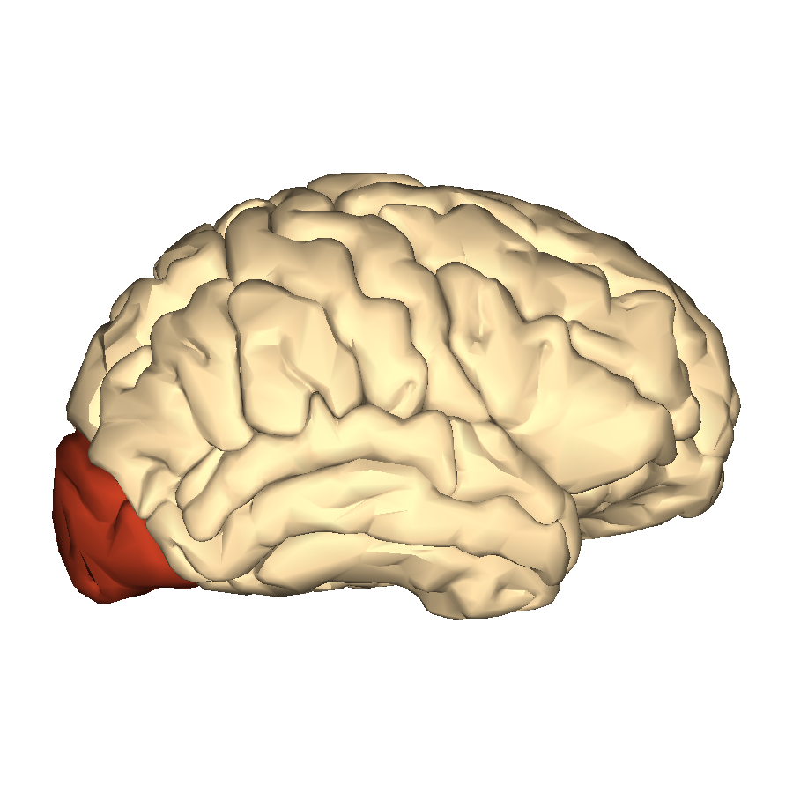
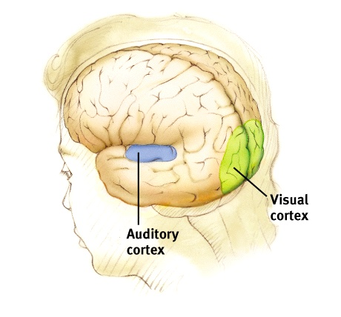
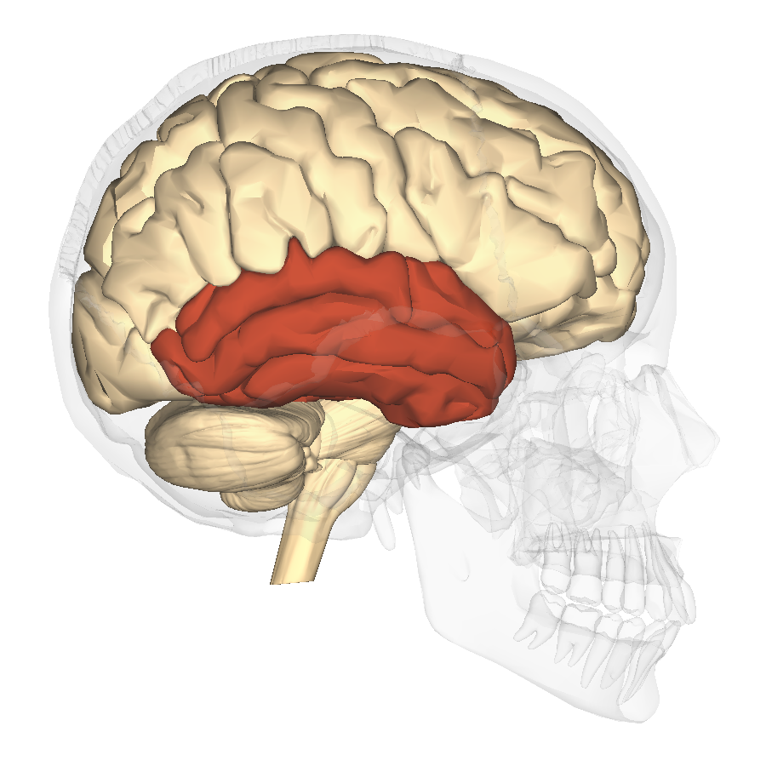
Structure of the Cortex
Temporal Lobes – (side of head, above ears)
Occipital Lobes - (back of head)
  Visual cortex - Processes visual information
  Damage = Vision problems
Process sound sensed by our ears
Interpreted in Auditory Cortex

Slide 24
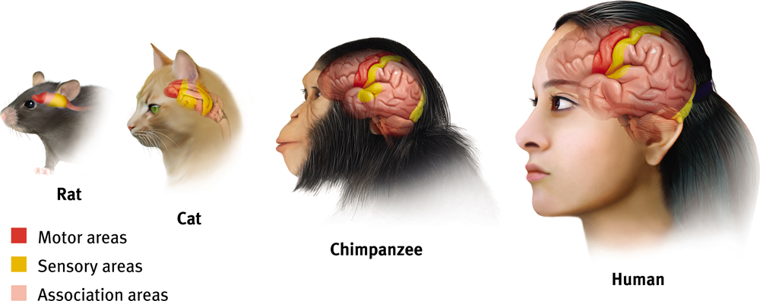
Structure of the Cortex
Association Areas – large areas of cerebral cortex that haven’t been specifically labeled for anything motor or sensory (present in all 4 lobes)
Interpret, integrate, & act on info. processed by the sensory areas
Responsible for higher level mental functions: Learning, remembering, thinking, speaking, planning, forming judgments

Slide 25
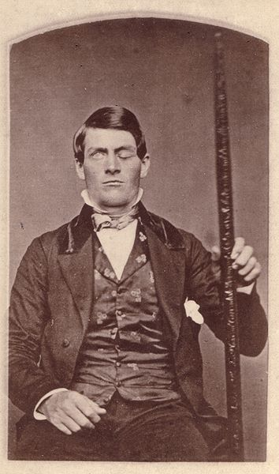
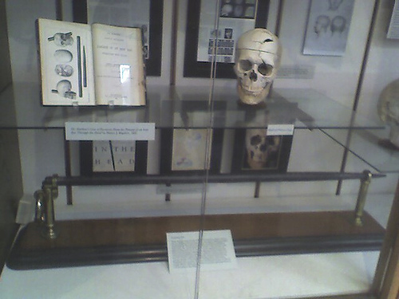
Phineas Gage
A 19th century American railroad construction foreman
In 1848, survived an accident in which a large iron rod was driven completely through his head, destroying much of his brain's left frontal lobe
The first case suggesting that damage to specific regions of the brain might affect personality and behavior.

Slide 26
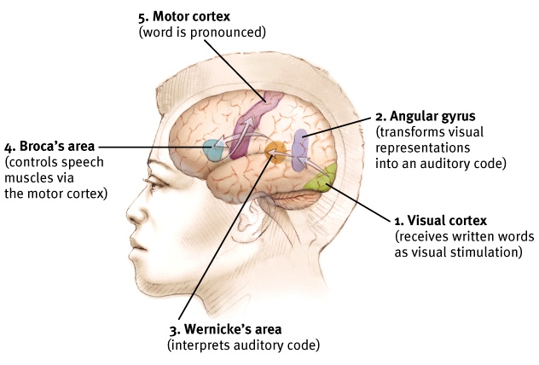
Language

Slide 27
Language Acquisition Areas
Aphasia – impairment of language usually caused by damage to the Broca’s area or the Wernicke’s area.
Broca’s area – left frontal lobe; responsible for transferring thoughts into spoken language
  Damage = inability to speak coherently
Wernicke’s area – left temporal lobe; responsible for transferring spoken words into thoughts
  Damage = inability to understand spoken language
  Angular gyrus – an area of the left occipital lobe that transforms visual representation into an auditory code

Slide 28
Language Acquisition Areas

Slide 29

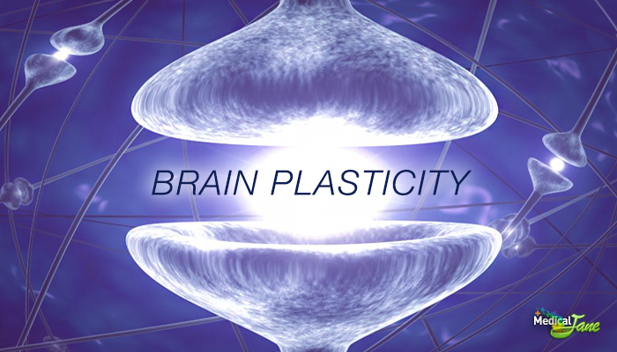
Plasticity
Severed neurons usually do not regenerate, but some neural tissues can reorganize in response to damage.
Plasticity refers to the brain’s ability to modify or reorganize its neural pathways after some types of injury or illness.
Neurogenesis is the formation of new neurons.
When we are young our brains are more plastic.

Slide 30
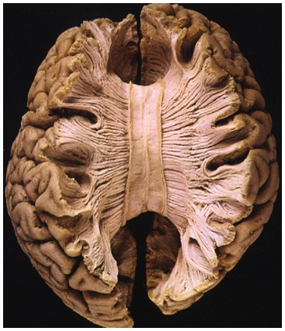
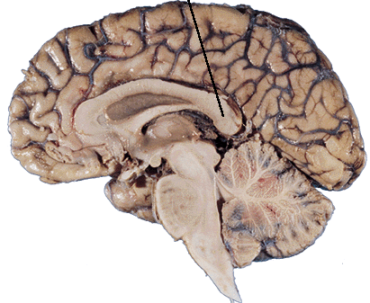
Splitting the Brain
A form of psychosurgery in which the two hemispheres of the brain are isolated by cutting the connecting fibers between them (mainly those of the corpus callosum).
Roger Sperry conducted research on this procedure to help people suffering from grand mal seizures

Slide 31
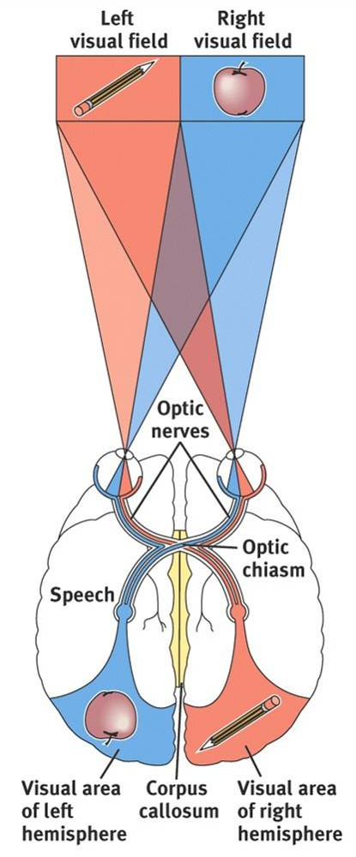
Splitting the Brain
The 2 hemispheres compliment each other
Info from left half of vision field goes to right hemisphere; info from right half goes to left
Each receives sensory info from both the right & left visual fields
Data transmitted to the other hemisphere via the corpus callosum…but not in a person with a severed corpus callosum

Slide 32
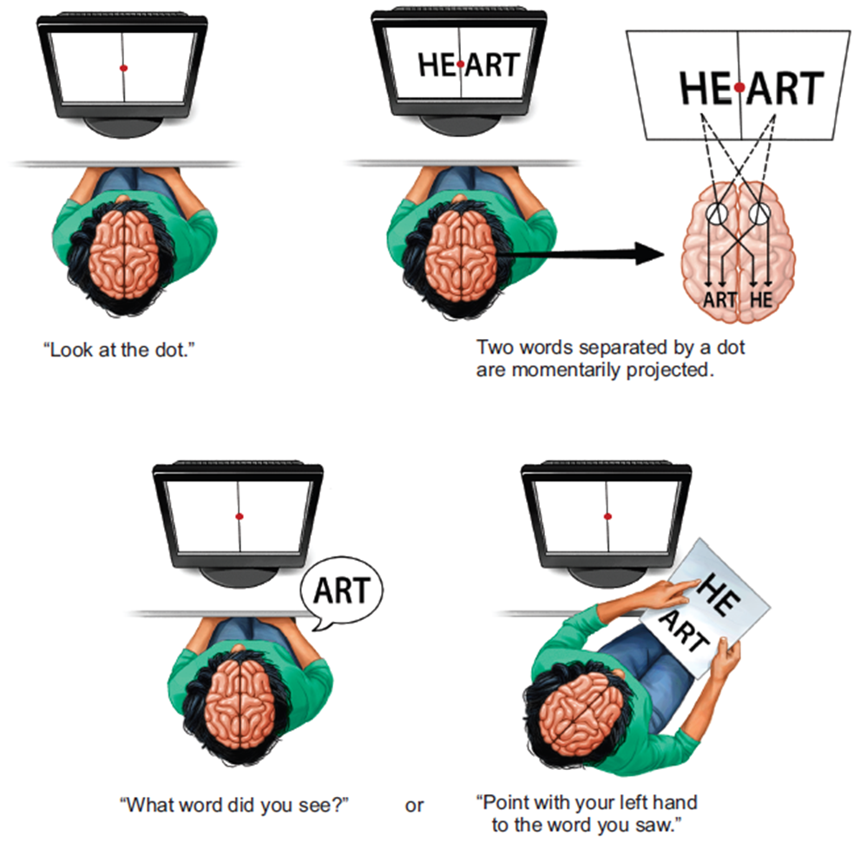
Splitting the Brain
Sperry & Gazzaniga - tested split-brain patients
HE-ART flashed on screen
HE goes to right hemisphere, ART to left
Patients said they saw ART (speaking = Broca’s in the left hemisphere)
But pointed w/ left hand to HE (right visual field communicates with left part of body)

Slide 33
Splitting the Brain
With a split brain, both hemispheres can comprehend & follow an instruction.
Gazzaniga – concluded that the conscious left hemisphere is an “interpreter” that constructs theories to explain our behavior
Left hemisphere more active when a person deliberates over a decision
Right hemisphere better than left at recognizing faces, perceiving emotion, and expressing emotion
Researchers say people choose the one on the right, because the right hemisphere, which is skilled in emotion processing, receives info from the left half of each face (the left half looks happier on the one on the right)

Slide 34
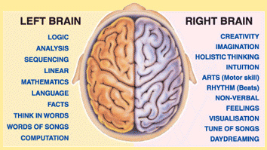
Hemispheric Differences
Hemispheric specialization – lateralization
Our brain is divided into two hemispheres, but both work together equally.
No activity in which only 1 hemisphere is truly, responsible
Logic is not confined to only the left hemisphere
Creativity is not only in the right
No one is purely left or right-brained

Slide 35
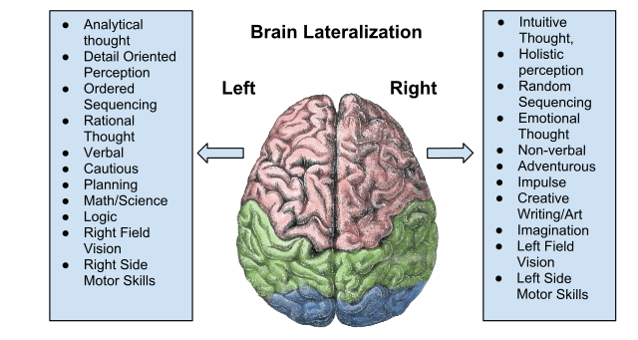
The Divided Brain

Slide 36
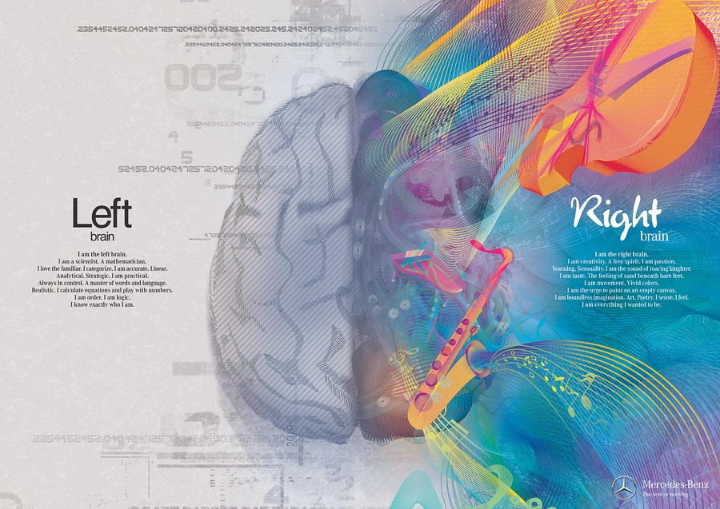
The Divided Brain
Brain scans show normal individuals engage their right brain when completing a perceptual task and their left brain when carrying out a linguistic task
Left hemisphere is good at making quick, literal interpretations of language
Right hemisphere excels in making subtle inferences
Notes:
OBJECTIVE 5-9| Describe split-brain research, and explain how it helps us to understand the functions of our left and right hemispheres.
Right Hemisphere – fusiform gyrus – recognize familiar faces. Survival skills

Slide 37

Brain Organization & Handedness
90% of humans are right-handed
The 10% of left-handers show less predictable patterns of hemispheric dominance
Causes?
  Genetics?
  Fetal testosterone levels?
  Learned?
  Handedness and sexual orientation?

