Slide 1
Chapter 7:
Altered States of Consciousness

Slide 2

Consciousness -
Is a state of awareness
Can range from alertness to non-alertness
A person who is not aware of what is going on is in an altered state of consciousness

Slide 3
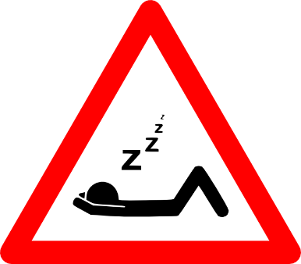
What is Sleep?
Characterized by lack of mobility or unresponsiveness to the environment
  A state of altered consciousness, characterized by certain patterns of brain activity and inactivity
  Vital to mental health
  Restorative – allows the brain to recover from exhaustion and stress while the body conserves energy.

Slide 4
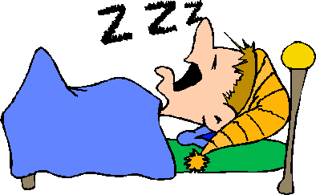
Studying Sleep
Has been very difficult until recently
A researcher can not have a sleeping person report without waking them; thus making the study invalid
EEG or electroencephalography is a device that records the electric activity of the brain

Slide 5
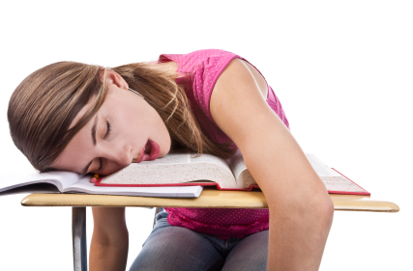
Stages of Sleep: Stage 1(NREM1)
Lightest level of sleep – “just drifting”
Pulse slows and muscles relax
Breathing becomes uneven and brain waves grow irregular
Lasts for 5 -10 minutes
Transition between wakefulness & sleep
EEG brain waves marked by the presence of alpha and theta waves

Slide 6
Stages of Sleep – Stage 2 (NREM2)
Brain waves shift from low-amplitude, high frequency to high-amplitude, low frequency waves (this pattern means you have entered this stage)
Eyes roll slowly from side to side
Slight decrease in body temperature
Breathing & heart rate become more regular
Usually lasts about 20-30 minutes
50% of sleep time in this stage

Slide 7
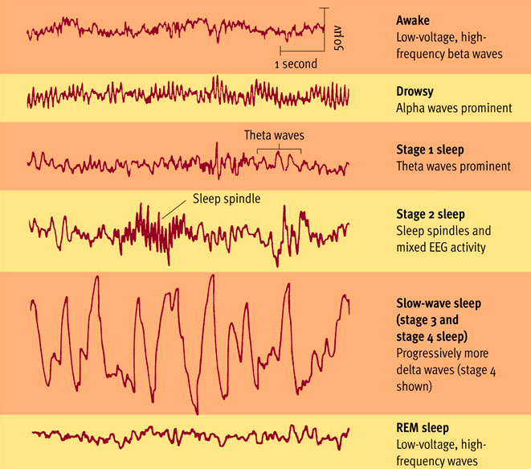
Stages of Sleep – Stage 3 (NREM3)
Characterized by large-amplitude delta waves which begin to sweep your brain almost every second
Note: At no point in your sleep, does the brain become totally inactive.

Slide 8
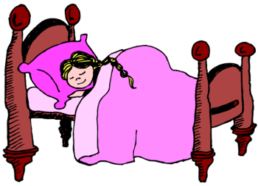
Stages of Sleep – Stage 3(NREM3)
Deepest sleep of all – state of oblivion
Very difficult to awaken – would feel disoriented
Muscles relax
Blood pressure & breathing rate drop
Sleepwalking, bedwetting, talking out loud most likely to occur

Slide 9
Stages of Sleep
Stages 1-3 known as “quiet sleep”
Stages 1-3 also referred to as NREM (Non-Rapid Eye Movement)
75% of sleep time is spent in stages 1- 3
Deep sleep is important to your physical or psychological well-being
Go through sleep cycles every 90 minutes
4 -5 cycles each night

Slide 10
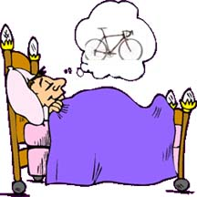
Stages of Sleep - REM
Called “active” sleep or paradoxical sleep
Characterized by rapid eye movements and a high level of brain activity
Large muscles in arms & legs paralyzed
Pulse rate and breathing become irregular
Dreams take place during this stage
Lasts for 15-45 minutes
REM sleep becomes longer
towards morning

Slide 11
How much sleep?
Your will spend 1/3 of your life sleeping
Varies from individual to individual and from time to time in your life
Circadian rhythm- is a biological clock that is genetically programmed to regulate physiological responses within a time period of 24-25 hours
Without any environmental cues, people have still kept their circadian cycle

Slide 12
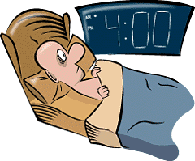
Sleep Disorders - Insomnia
The failure to get enough sleep at night in order to feel rested the next day
Some people with this disorder rarely get more than and hour or two of uninterrupted sleep
Anxiety, depression, overuse of alcohol or drugs can cause insomnia

Slide 13
Sleep Disorders – Sleep Apnea
Affects more than 12 million Americans
A disorder in which a person has trouble breathing while sleeping
Usually caused by a physical problem rather than mental stress
Specific kind of snoring that may occur hundreds of times per night
Each episode lasts 10-15 seconds and ends suddenly, usually with a physical movement of the body

Slide 14
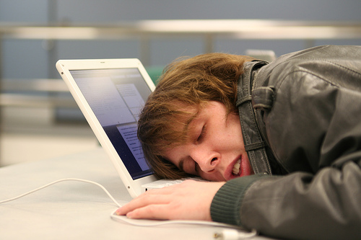
Sleep Disorders - Narcolepsy
Is a condition characterized by suddenly falling asleep or feeling very sleepy during the day
May have sleep attacks during the day
Victims usually have a problem with work, leisure, and interpersonal activities
Prone to accidents

Slide 15
Sleep Disorders – Nightmares & Night Terrors
Nightmares - Unpleasant dreams that occur during REM sleep
Night terrors -
  Sleep disruptions that occur during Stage 3 sleep, involving screaming, panic, or confusion
  Last from 5-25 minutes
  Involve rapid heart rate, screaming, sweating, and confusion
  Usually have no memory of them

Slide 16
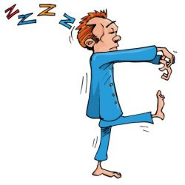
Sleep Disorders – Sleepwalking
Walking or carrying out behaviors while asleep
Mostly associated with children (usually will outgrow it)
Usually harmless, unless the victim falls or hurts himself
Person may walk or do other
things without any memory
of doing so

Slide 17
Sleep Disorders – Sleep Talking
A common sleep disruption
Can occur in REM and NREM sleep
The sleep talker sometimes pauses as if he or she is having a conversation
You can engage in a conversation with a sleep talker

Slide 18
Sleep Disorders – Sleep Paralysis
Inablilty to movie or speak as one goes from sleep to wakefulness
May be experienced by 20-60% of people
Visual & auditory hallucinations often occur and may include a sense of an evil presence, and a sense of breathlessness
More likely to occur towards morning
May be caused by sleep deprivation, stress, or disruption of sleep schedule

Slide 19

Dreams
Dreams are the mental activity that takes place during sleep.
Time spent in REM sleep increases during the night - last dream is likely to be the longest & the one most likely to be remembered
Emotions experienced in dreams are often negative or unpleasant – anxiety, anger, sadness, etc…
  Some dreams are negative enough to be considered nightmares.

Slide 20
Dream Theories
Wish Fulfillment (Sigmund Freud) – dreams are a way to express unconscious wishes that may be unacceptable to the conscious mind
Activation-Synthesis Theory – neural activity occurs periodically during sleep to stimulate the brain; dreams are a way to make sense of these random neural firings

Slide 21
Dream Theories
Information-Processing Theory – dreams are a way to make sense of what we encounter during the day
Physiological Function – Dreams provide our sleeping brain with stimulation to help develop and preserve the brain’s neural pathways
Cognitive Theory – Dreams are a part of brain maturation and cognitive development.

Slide 22

Hypnosis
A form of altered consciousness in which people become highly suggestible to changes in behavior and thought.
  Participants are NOT put to sleep – form of trance.
  Hypnosis has uses in medical and therapeutic settings.
      Memory can be aided or enhanced
      Pain can be eliminated or reduced
      Problems can be revealed and insight gained

Slide 23
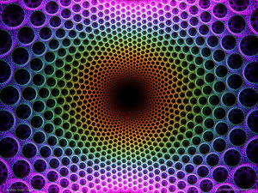
Hallucinations
Perceptions that have no direct external cause – seeing, hearing, smelling, tasting, or feeling things that do not exist (Usually involve color)
Caused when entire nervous system becomes aroused.
Can occur during:
  Hypnosis
  Meditation
  Certain drugs or withdraw from a drug
  Psychological breakdown
  Normal conditions

Slide 24
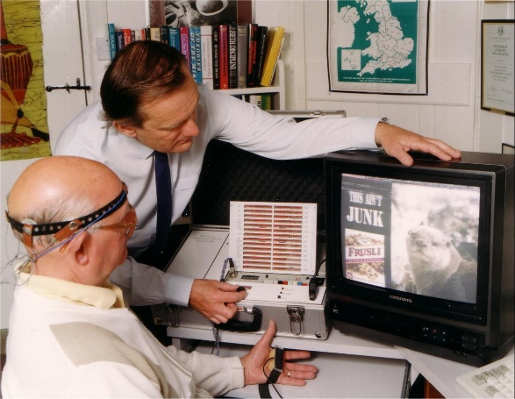
Biofeedback
Uses machines to tell people about very subtle moment-to-moment changes in the body
Learns to control internal physiological processes with the help of feedback. (Feedback makes learning possible.)
  Learn to control processes such as:
      heart rate
      blood pressure
      skin temperature
      sweat-gland activity

Slide 25

Meditation
Focusing attention on an image or thought to clear the mind and produce relaxation.
  Can help lower blood pressure, heart rate, and respiration rate.
  Basic elements of the relaxation response:
    Quiet environment
    Comfortable position
    Mental device – mantra or object
    Passive attitude

Slide 26
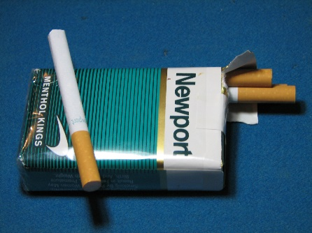


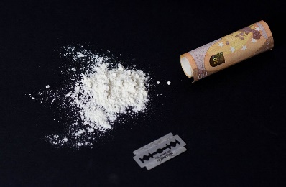
Psychoactive Drugs
  Interact with the central nervous system to alter a person’s mood, perception, and behavior.
  Range from stimulants (caffeine in coffee/cola) to depressants (alcohol) to hallucinogens (marijuana and LSD).
  Enter the blood stream and are taken up in target tissues in various parts of the body

Slide 27
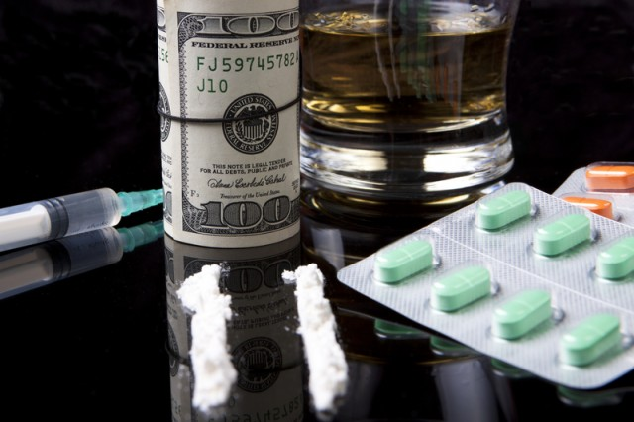
Psychoactive Drugs –
Dependence & Addiction
  Addiction – compulsive craving for a substance despite adverse consequences
  Physical Dependence - A physiological need for a drug; may experience withdrawals when the drug is not used
  Psychological Dependence - Psychological need to use a drug….”I will feel better when I drink.”

Slide 28

Psychoactive Drugs –
Dependence & Addiction
Tolerance - User needs more drugs to get the desired effect
Withdrawal - discomfort and distress felt with the discontinued use of a drug (headaches, shaking, etc.)

Slide 29

Marijuana (Canabis)
  Psychedelic
  Tetrahydrocannabinol (THC) - active ingredient
  Some studies suggest that it is more damaging to the lungs than cigarette use.
  Use increased in the 60’s & 70’s, then declined
  Long-term use could lead to psychological dependence

Slide 30
Effects of Marijuana
Effects vary from person to person
Disrupts memory formation, making it difficult to carry out mental and physical tasks.
Impaired coordination
Sensory experiences may be heightened
Sense of time distorted
Can heighten unpleasant experiences

Slide 31

Hallucinogens
  Substances that cause
  hallucinations
  Also called psychedelics because they create a loss of contact with reality.
  Found in plants throughout the world
  Exact chemical effects on the brain unknown.
  Some seem to mimic the activity of certain neurotransmitters

Slide 32

LSD
Potent psychedelic drug that produces distortions of perception and thought
Best known & most studied of the hallucinogens
Most potent – doesn’t take much
Impairs thinking but users feel they are thinking more clearly & logically than before

Slide 33

LSD
LSD trips can lasts from 6-14 hours
User may encounter distortions in familiar objects, distortion of time
Single stimulus may become the focus of attention for hours
May lead to panic attacks and flashbacks

Slide 34
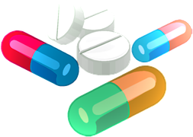
Opiates (Narcotics)
    Includes opium, morphine, heroin, codeine, Vicodin, and OxyContin
    Sedatives that depress activity in the central nervous system
    Used to reduce pain and induce sleep
    Causes impaired thinking and coordination
    Highly addictive

Slide 35


Alcohol
  Most widely used and abused mind-altering substance in the U.S.
  Encouraged by social expectations, traditions, and advertising
  Depressant that impairs the brain’s normal functioning

Slide 36
Alcohol
  Effects depend on the amount, frequency, and body weight of the drinker.
  Most immediate effect is general loss of inhibitions
  Additional effects:
  slurred speech & blurred vision
              impaired judgment, reaction time, & coordination
              impaired emotional control
              Prolonged heavy use can lead to permanent brain and liver damage

Slide 37
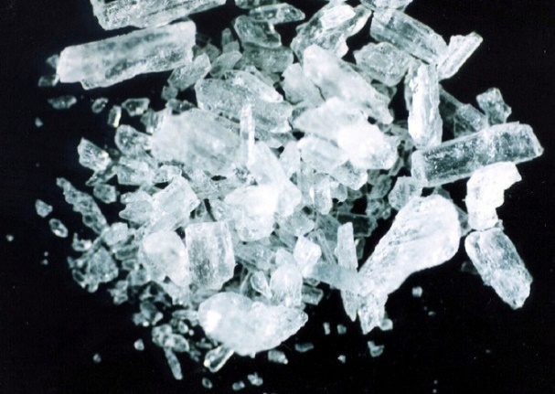


Stimulants
Includes amphetamines, crystal meth, Ritalin, cocaine, caffeine, nicotine
Induce alertness – reduce fatigue
Elevate mood & heart rate
Highly addictive
May cause loss of appetite

Slide 38
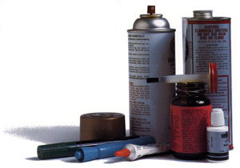
Inhalants
Class of psychoactive substances whose volatile vapors are subject to abuse
Can cause shortness of breath, dizziness, nausea, fainting, headache, coma
Many unknowns about long-term effects

Slide 39
Drug & Alcohol Abuse
  Reasons for abuse:
    to fit in
    relieve boredom
    forget about problems
    gain self-confidence,
    relax or feel good
  Risks of abuse:
      danger of death or injury
      damage to health
      legal consequences
      destructive behavior and loss of control.

Slide 40
Drug & Alcohol Treatment
  Treatment requires the individual to
    1) admit they have a problem
    2) enter a treatment program or get therapy
    3) join a support group to help reduce the possibility of a relapse.

