Slide 1
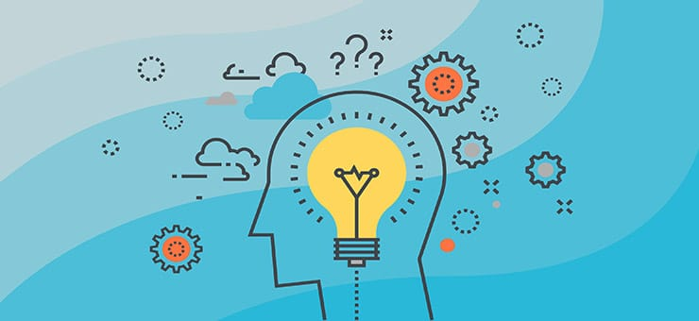
Chapter 10: Thinking and Language

Slide 2
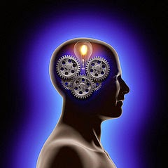
Thinking
Cognition – all the mental activities associated with thinking, knowing, remembering, and communicating
Cognitive Psychologists study these mental activities, including the logical and illogical ways we create concepts, solve problems, make decisions, and form judgments

Slide 3
Thinking - Concepts
Concepts – mental groupings of similar objects, events, ideas, and people – they share a common feature
Concepts make life easier; they simplify things into classifications
  Example – concept of a chair – 4 legs, seat, for sitting
We simplify things when thinking about everything in the world.

Slide 4
Thinking - Concepts
To further simplify things, we organize concepts into hierarchies
Think of major cities, organized first into sectors, then neighborhoods, and then into individual streets.

Slide 5
Thinking - Prototypes
Prototypes – a mental images or best example that incorporates all the features associated with a category
We match new items to an existing prototype to provide a quick and easy method for putting things into categories
Examples:
  Prototype of triangles = anything with 3 sides
  Prototype of birds – small, feathered, flying, come from eggs

Slide 6
Thinking - Prototypes
Move away from our prototype, and categories may have fuzzy boundaries
Fruit? Fish? Bird? Ball?

Slide 7
Thinking – Solving Problems
Trial and Error
Algorithms – methodical, step-by-step procedures that guarantee a solution for solving a problem
    Takes time
  Heuristics – simple thinking strategy that often allows us to make judgements and solve problems efficiently (rule of thumb strategy – mental shortcut)
      Usually speedier but also more error-prone than algorithms
                Ex. SPLOYOCHYG

Slide 8
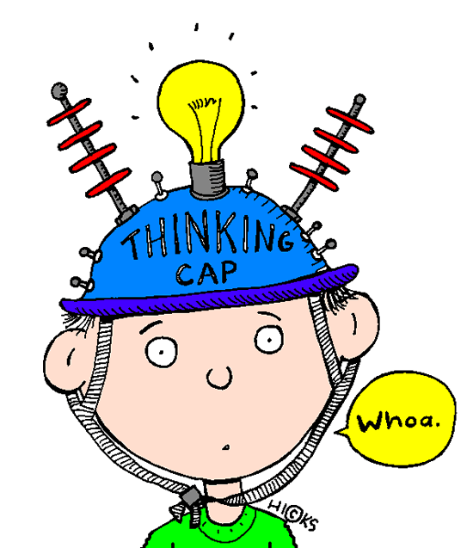
Solving Problems - Creativity
Creativity – the ability to use information in a way that results in new, original thinking
Robert Sternberg’s 5 Components of Creativity:
    Expertise - well developed base of knowledge
    Imaginative thinking skills - provide the ability to think in novel ways, recognize patterns, and to make connections
    A venturesome personality - seeks new experience, tolerates ambiguity & risk
    Intrinsic Motivation - driven more by interest, satisfaction, and challenge than external pressures
    A Creative Environment

Slide 9
Solving Problems - Kinds of Thinking
Convergent thinking - systematic and logical attempt to reach a specific goal
    Relies heavily on symbols, concepts, and other rules
    Deliberate and purposeful – 1 correct answer
Divergent thinking – thinking without a goal or a plan; ability to consider many different options & think in novel ways
    Depends more on imagery and feelings
    Often done when relaxing – may provide insights
Metacognition – thinking about thinking; active awareness of our thought process

Slide 10

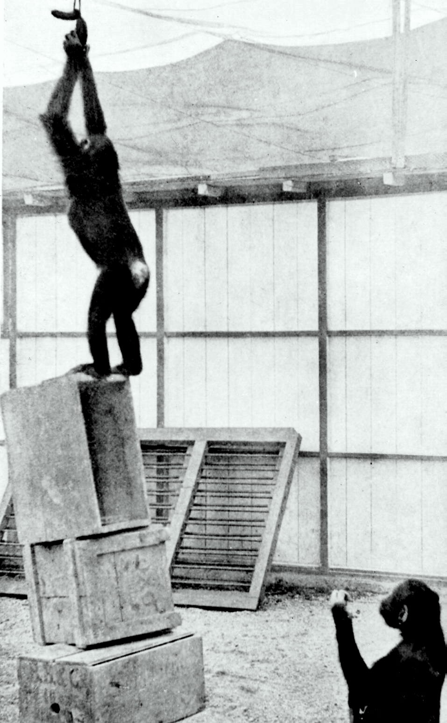
Thinking – Solving Problems
Insight – a sudden and often novel realization of the solution to a problem
  Not strategy based
  Sudden flash of inspiration – the “Aha moment”
  Research shows a burst of right temporal lobe activity when solutions occur with sudden insight.
  Wolfgang Kohler – human not only creatures to display insight (Sultan the chimpanzee)

Slide 11
Thinking – Obstacles to Solving Problems
Many cognitive tendencies that we think are taking us in the right direction can often give us wrong answers.
Confirmation Bias and Fixation often lead us astray.
  Confirmation Bias – tendency to search for info that confirms our preconceptions
    We seek evidence verifying our ideas more eagerly than evidence that might refute them
      Example: You are in a debate or argument with a friend and you deliberately point out evidence that proves your point and try to overlook or not notice evidence that counters your argument.

Slide 12
  Thinking – Obstacles to Solving Problems
Confirmation Bias –

Slide 13
Thinking – Obstacles to Solving Problems
Fixation – The inability to see a problem from a fresh perspective by employing a different mental set.
  Fixation constrains our perceptions of objects and limits our thinking.
Types of Fixation – Mental Set and Functional Fixedness
    Mental Set – predisposes how we think; the tendency to approach a problem in one particular way, especially a way that has been successful in the past
    Example: O-T-T-F-?-?-? E-O-E-R-E-X-N-?
Sometimes what worked in the past hinders our ability to find new solutions.

Slide 14
Thinking – Obstacles to Solving Problems
Functional Fixedness – Our tendency to think of things only in terms of their usual functions; impeding our problem solving
Example: How would you mount the candle on a bulletin board using these materials?

Slide 15
Thinking – Obstacles to Solving Problems
How would you arrange six matches to form four equilateral triangles?

Slide 16

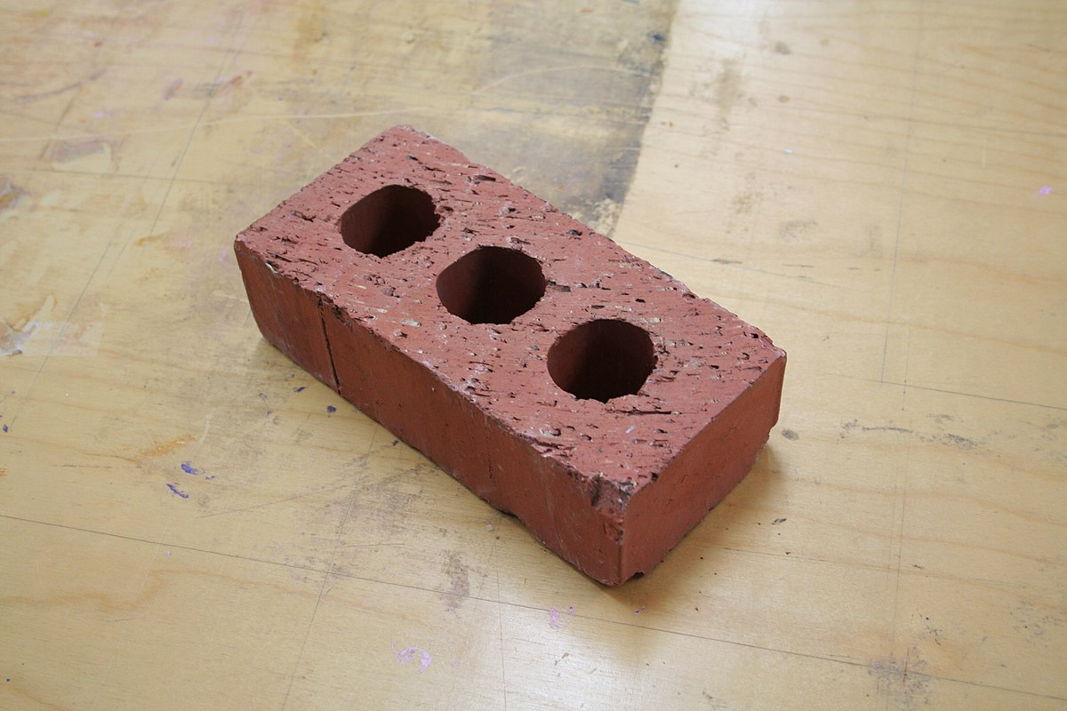
Functional Fixedness??
How many uses can you find for these items?

Slide 17


Thinking – Using and Misusing Heuristics
Our mind’s automatic processing uses heuristics to make quick judgment decisions, but sometimes quick decisions can lead us to make bad decisions.
Representative Heuristic – rule of thumb for judging the likelihood of things in terms of how well they seem to match or represent particular prototypes or stereotypes
  May lead one to ignore other relevant information.

Slide 18
Thinking – Using and Misusing Heuristics
Representative Heuristic – Examples
You see a really tall person and assume that they play basketball because they fit your prototype of a basketball player.
Linda is 31, single, outspoken and very bright. She majored in philosophy in college. As a student she was deeply concerned with discrimination and other social issues, and she participated in antinuclear demonstrations. Which statement is more likely?
              A. Linda is a bank teller.
              B. Linda is a bank teller and active in the feminist movement.

Slide 19
Thinking – Using and Misusing Heuristics
Availability Heuristic – Estimating the likelihood of events based on their availability in the memory
  If instances come readily to mind (perhaps because of their vividness), we presume such events are common.
    Examples: airplane crashes, terrorist attacks, school shootings
    Example: Casinos make a big deal about even small wins so that we are more likely to remember them than the losses which occur more often.

Slide 20
Thinking – Using and Misusing Heuristics

Slide 21
Availability Heuristic
Which causes more deaths per 100,000?
All accidents or strokes?
Blood poisoning or suicide?
Homicide or diabetes?
Motor vehicle accidents or colorectal cancer?
Leukemia or Drowning?

Slide 22
Availability Heuristic
Which city has the higher crime index?
Chicago or Baltimore?
Manhattan or Gary, Indiana
Boston or Flint?
Montreal or Hot Springs?
San Francisco or Durham?

Slide 23
Availability Heuristic Example

Slide 24

Thinking - Overconfidence
Overconfidence – The tendency to be more confident than correct; to overestimate the accuracy of our knowledge and judgments
• We fail to appreciate our potential for error
• Often happens right after a test you have taken – we tend to overestimate our performance
  • Example - American confidence before Vietnam, Iraq
  Example – Students estimating how quickly they can complete an assignment

Slide 25
Thinking - Overconfidence
Warning people against overconfidence doesn’t do much to reduce the overconfidence.
Value of overconfidence – People who err on the side of overconfidence live more happily, find it easier to make tough decisions, and seem more credible.
People learn to assess their accuracy more realistically if given prompt, clear feedback on the accuracy of their judgements.

Slide 26
Thinking – Framing Decisions
Framing – The way an issue is posed can significantly affect decisions and judgements.
Examples:
      Ground beef described as 75% lean vs. 25% fat
      10% of people will die undergoing this surgery vs. 90% survival rate
      People express more surprise when a 1 in 20 event happens than when an equivalent 10 in 200 event happens.
      “Aid to the needy” vs. “welfare”

Slide 27
Thinking – Framing Decisions
People who understand the power of framing can use it to influence important decisions
  Example: $150 coat in store X marked down to $100 vs same coat in store Y regularly priced at $100
To scare people, frame risks as numbers, not percentages
  Example: Chemical exposure is projected to kill 10 of every 10 million people.

Slide 28

Thinking – Belief Bias & Belief Perseverance
Belief Bias – The tendency for one’s preexisting beliefs to distort logical reasoning
  Sometimes make invalid conclusions seem valid or valid conclusions seem invalid
  We find it easier to accept conclusions that agree with our opinions
Belief perseverance – Our tendency to cling to our beliefs in the face of contrary evidence (often fuels social conflict)
  Once our beliefs form and get justified, it takes more compelling evidence to change them than it did to create them.

Slide 29
Thinking – Intuition
Intuition – an effortless, immediate, automatic feeling or thought
Fast, unreasoned – not explicit, conscious reasoning (gut feeling)
An innate inclination toward a particular behavior, as opposed to a learned response.
It is noticeable enough to be acted on (if one chooses to) without us being fully aware of the underlying reasons for its occurrence.
Allows us to react quickly and usually adaptively (instinct vs reason).

Slide 30
Thinking - Intuition
Good for some things like reading emotions in faces, but not so good at others, such as assessing risks.
Relying on gut feelings doesn’t always lead to good decisions.
Smart thinkers will welcome their intuitions but also check them against valuable evidence.

Slide 31
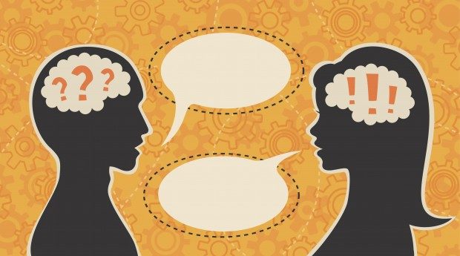
Language
Language – Our spoken, written, or signed words and the ways we combine them as we think and communicate
Allows us not only to communicate, but to transmit civilization’s accumulated knowledge across generations. Allows us to know what we haven’t seen.
Unique to humans; “the jewel in the crown of cognition”
Your brain makes your mouth make noises, sending air waves to another person’s ear. They hear it and process it.
Transfer meaning from one mind to another

Slide 32

Language Structure - Phonemes
Three building blocks: Phonemes, Morphemes, Grammar Structure
Phonemes – set of basic sounds, smallest distinctive sound unit
Example: bat = b, a, t
Of 500 languages, 869 different phonemes in basic speech. No one language uses them all.
English uses 40, others half or double that

Slide 33
Language Structure - Phonemes
Changes in phonemes produces changes in meaning
Example: b….t (bat, but, bait, bit, boat, etc.)
Same letter can represent multiple phonemes
Example: letter “a” in cake vs. cat
People who grow up learning one set of phonemes usually have difficulty pronouncing those of another language.
Sign language also has phoneme-like building blocks defined by hand shapes and movements.

Slide 34
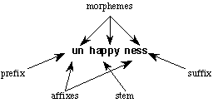
Language Structure - Morphemes
Morphemes – The smallest unit of language that carries meaning
Most morphemes are combinations of two or more phonemes (I, a, plural s ending – phonemes that are also morphemes)
Can be a prefix or suffix: Pre– and –ed have meanings
Examples: Overreact has 3 morphemes = Over / re / act

Slide 35

Language Development - Grammar
Grammar – Systems of rules (semantics and syntax) that enable us to communicate with and understand others
Semantics – Set of rules we use to derive meaning from morphemes, words, and even sentences
  Example: adding –ed to the end of word means it is past tense
  Syntax – rules for ordering words into grammatically sensible sentences in a given language
      Example: adjectives before nouns in English – We say white house instead of house white

Slide 36
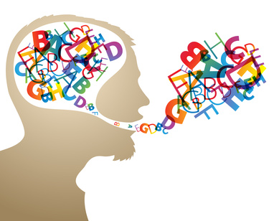
Language Development
Between birth and high school graduation, you learn 60,000 words (average 10 per day)
You spoke in original and grammatically meaningful sentences before you could add 2+2
You can adapt your language to your social context
You know your culture’s rules for speaking and listening

Slide 37

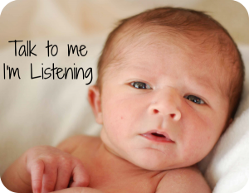
Language Development
Language development mirrors language structure – moves from simple to complex
Infants – without language - in fantis
By 4 months, babies can discriminate speech sounds, can read lips and faces, can recognize the shape of a mouth when we make ah or ee sounds
Receptive language – babies’ ability to comprehend speech
Productive language – babies’ ability to produce words – matures after receptive language

Slide 38
Language Development
Babbling stage – (about 4 months) spontaneously utter a variety of sounds
  Not an imitation of adult speech
  Includes sounds from various languages and sounds that do not occur within the household
  About 10 months, babbling begins to resemble sounds and intonations characteristic of the household language

Slide 39
Language Development
One-word stage - (around 1st birthday) have learned that sounds carry meanings
If trained, can associate a word with an object or person
Begin to use sounds to communicate meaning – usually contain only one syllable – ma or da
Single word may equal a sentence – “Doggy!” may mean “Look at the dog out there!”
About 18 months, word learning expands from about a word a week to word a day

Slide 40
Language Development
Two-word stage – (before 2nd birthday) begin using two-word sentences
Telegraphic speech – early form of speech that contains mostly nouns and verbs (like a telegram)
    Examples: “Want juice,” “Get toy”
Follows the rules of syntax – words are in a sensible order
  Example: big doggy rather than doggy big
  Eventually begin to speak in longer phrases

Slide 42
Language Development – Nature vs. Nurture
B.F. Skinner – Behavioral Theory (Operant Conditioning)
Language is developed by reinforcement and modeling or imitation
    Associate sights of things with sounds of words
    Imitate the words and syntax of others
    Child is reinforced with success, smiles, hugs when says something right

Slide 43
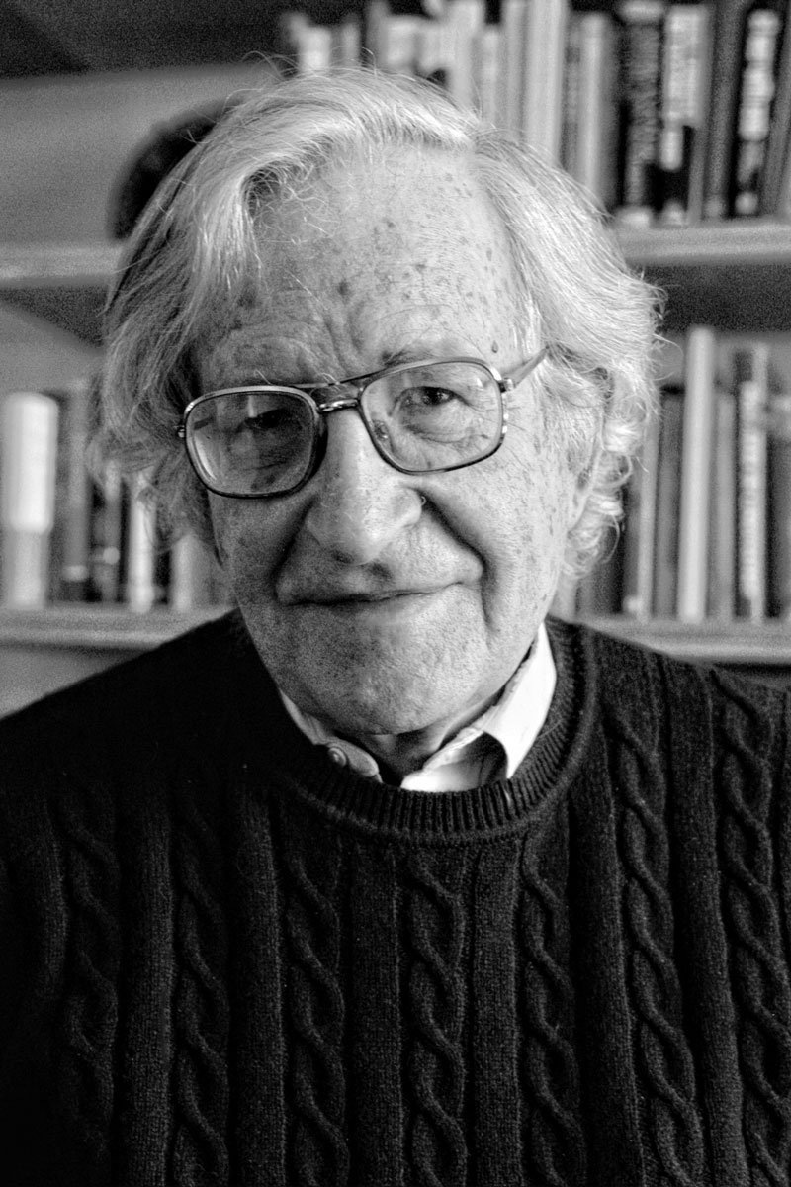
Language Development
Noam Chomsky (Linguist) – Inborn Universal Grammar
Language will occur naturally given adequate nurture
Our capacity for developing language is natural and quick because we all come “pre-wired” with a “language acquisition device” to use language.
There is a universal grammar that underlies all human language – same grammatical building blocks (nouns, verbs, etc.)
We naturally start speaking in nouns

Slide 44
Language Development
Chomsky disagreed with Skinner’s theory – oversimplified
Doesn’t explain how children learn so many words and phrases so quickly that are never conditioned or modeled.
They generate sentences they have never heard, sometimes with errors
They tend to learn language at different developmental times which supports that some language development is innate

Slide 45
Language Development
Infants have the ability to learn statistical aspects of human speech
They can discern word breaks and statistically analyze which syllables go together
They can detect the difference between syllable patterns which suggests they come with a built-in readiness to learn grammar

Slide 46
Language Development
Critical period – a critical or sensitive period of childhood to master certain aspects of language
After age 7, our window for learning certain aspects of language begins to close
After the critical period closes, learning a 2nd language is difficult
Children have little or no accent compared to adults
Adults can master basic words and word order, but never become as fluent as native speakers with subtle grammar rules.

Slide 47
Language Development
If children have not been exposed to enough language after age 7, they have difficulty mastering a language
    Example: Deaf children that get cochlear implants at age 2 develop oral speech better than if received at age 4
    Those not exposed to either spoken or sign language during their early years lose their ability to master any language.
    Conclusion – When a young brain does not learn any language, its language-learning capacity never fully develops.

Slide 48
Language Development
    Benjamin Whorf (linguist) – Linguistic determinism hypothesis – language determines the way we think
    We think differently in different languages – not all cultures share the same words.
    Example: the idea of self has different words and meanings in English than it does in Japanese or Korean.
    Thinking develops hand-in-hand with language – Difficult to think about or conceptualize certain abstract ideas without language.

Slide 49
Language Development
Thinking in Images –
  Sometimes we think in images, especially with procedural memory
  Olympic athletes use mental practice as a part of training
  Brain imaging shows that imagining a physical activity triggers action in the same brain areas that are triggered when actually performing the activity.
  Final thought – Thinking affects our language, which then affects our thought.

