Slide 1
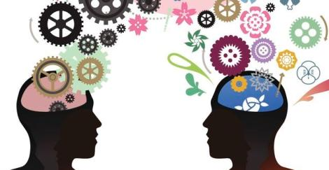
Chapter 11: Intelligence

Slide 2
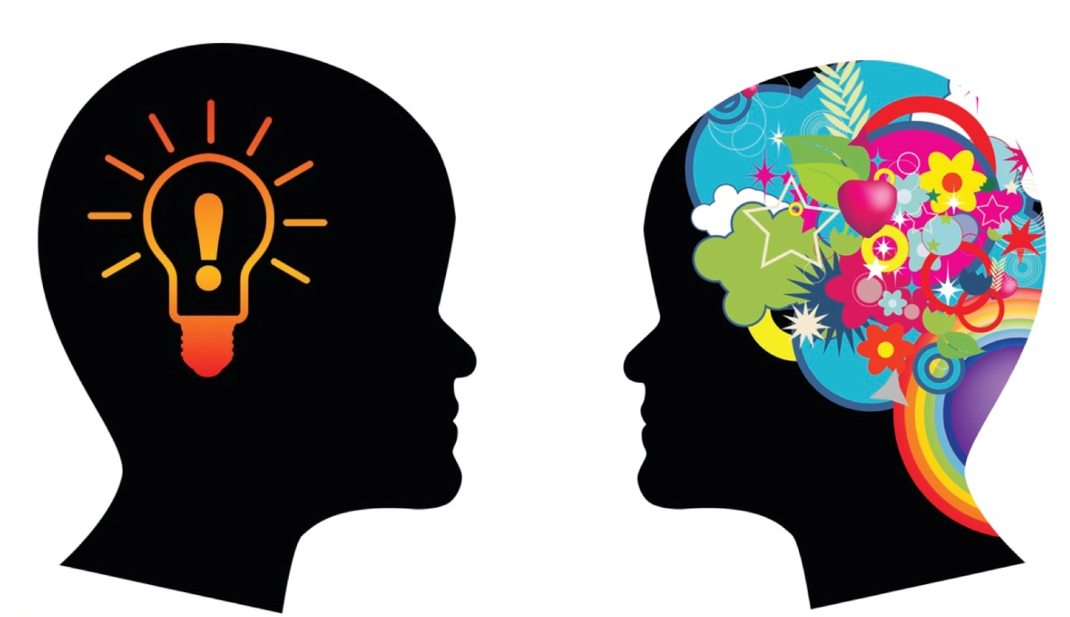
What is intelligence?
Intelligence is a socially constructed concept, not a thing.
IQ (intelligence quotient) is not fixed or objective – Don’t reify intelligence
Intelligence – mental ability to learn from experience, solve problems, and use knowledge to adapt new situations.

Slide 3
Theories of Intelligence
Charles Spearman (early 1900’s)
Noticed scores on tests of cognitive abilities were positively correlated – People who do well on one do well on others.
Used factor analysis – a statistical method used to show the relationship between variables in intelligence.
Believed that there was a single intelligence (general intelligence) called the g factor – If you were intelligent in one area, you were intelligent in other areas
Idea of a general mental capacity expressed by a single score

Slide 4
Theories of Intelligence
L.L. Thurstone
Believed that Spearman oversimplified intelligence – one type of intelligence was not enough.
Did not rank his subjects on a single intelligence scale, but found correlations in clusters of primary mental abilities
Believed that each person has seven primary mental abilities – sets of independent abilities that each person possesses in varying degrees

Slide 5
Theories of Intelligence - L.L. Thurstone
Thurstone’s 7 Primary Mental Abilities:
  Word fluency
  Verbal comprehension
  Spatial ability
  Perceptual speed
  Numerical ability
  Inductive reasoning
  Memory
  Small tendency for those who excelled in one cluster to score well on the others –some evidence of g-factor

Slide 6
Theories of Intelligence
Howard Gardner – Multiple Intelligences
All people possess a number of intellectual potentials (intelligences), each of which involves a different set of skills
Based his theory on people who suffered traumatic brain injuries – damage to one area does not affect all cognitive abilities
Studied people with savant syndrome – cognitive impairments in certain areas but have one or more abilities that are displayed on a genius level

Slide 7
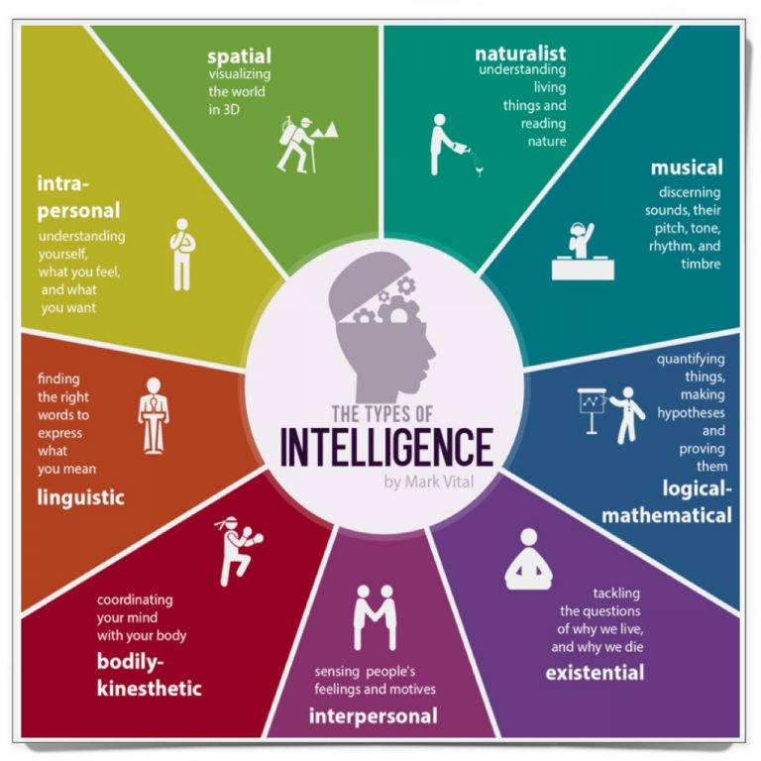

Slide 8
Gardener’s Multiple Intelligences

Slide 9
Theories of Intelligence
Robert Sternberg –Triarchic Theory of Intelligences
Consists of 3 types of intelligences;
  Analytical Intelligence (book smarts) – person’s accumulated knowledge gained through school
    Creative Intelligence – ability to generate new ideas and adapt to new situations
    Practical Intelligence – (street smarts) ability to interact with one’s environment – everyday tasks

Slide 10
Emotional Intelligence
The ability to perceive, understand, manage, and use emotions
Four components:
  Perceive emotions (recognize them in faces, music, stories)
  Understand emotions (predict them and how they change and blend)
  Manage emotions (how to express them in varied situations)
  Use emotions to enable adaptive or creative thinking

Slide 11
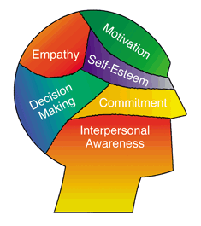
Emotional Intelligence
Emotionally intelligent people are self-aware
Can read others’ emotions
Know what to say in certain situations
Have exhibited modestly better job performance
Often are more successful in career, marriage, and parenting situations

Slide 12
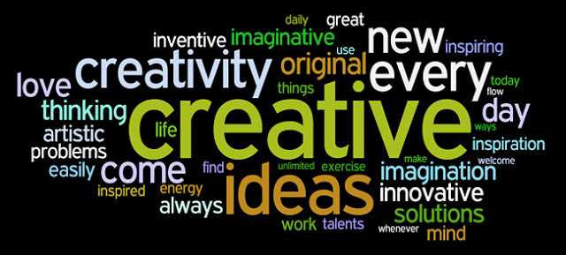
Creativity
Ability to generate novel ideas or products - often goes hand-in-hand with intelligence
Convergent thinking – narrowing down a single best solution or answer to a problem (tested by intelligence tests)
Divergent thinking – Ability to generate multiple solutions to a given problem – “think outside the box”

Slide 13
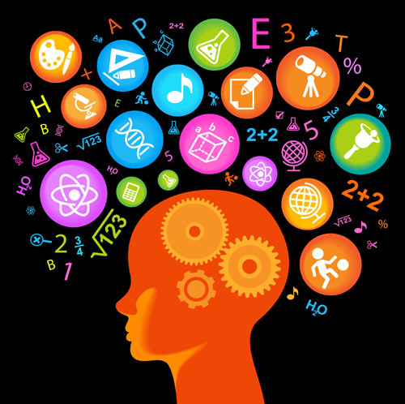
Creativity
Five Components of creativity:
    Expertise
    Imaginative thinking skills
    Venturesome personality
    Intrinsic motivation
    Creative environment

Slide 14
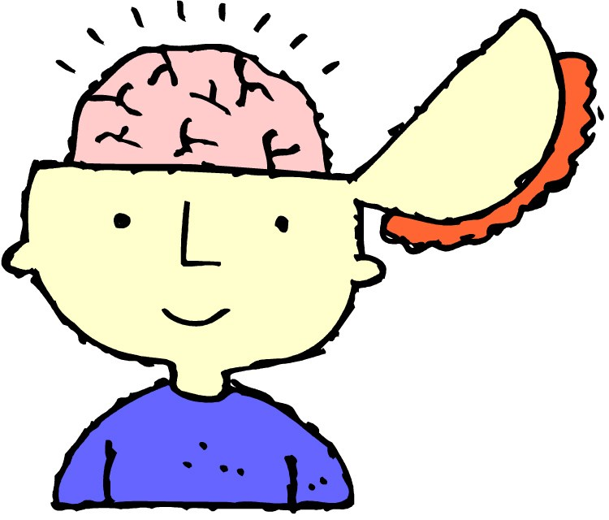
Brain size and Complexity
There is a slight positive correlation between brain size and intelligence scores
Intelligence is due to the development of neural communications in response to the environment
Highly intelligent people die with more synapses and gray matter

Slide 15
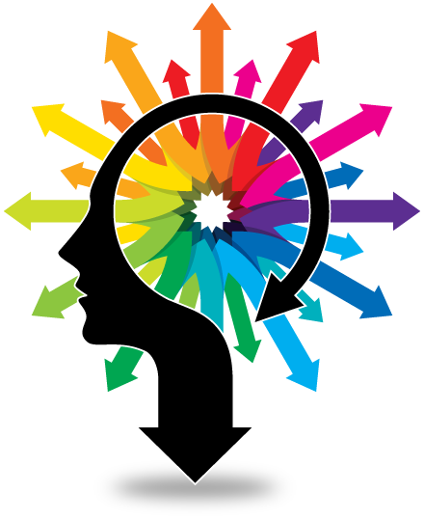
Perceptual and Neurological Speed
People who perceive stimuli quickly tend to score somewhat higher on intelligence tests
People who score high on intelligence tests tend to retrieve information from memory more quickly

Slide 16
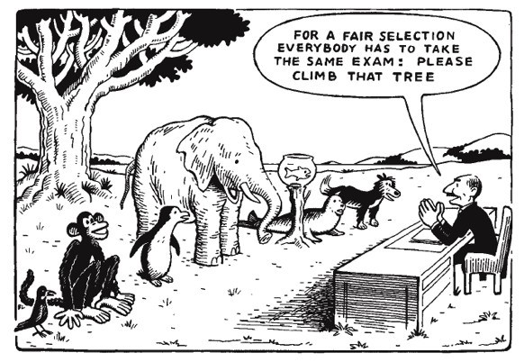
Assessing Intelligence
Intelligence is whatever intelligence tests measure.

Slide 17
Assessing Intelligence – Alfred Binet
Modern intelligence testing - beginning of the 20th century, French government required all children to attend school.
Alfred Binet – hired to study differences between children’s intellect and identify children needing special attention.
Believed that intelligence can be determined by a mathematical formula.
Categorized items by age that a typical child could respond correctly

Slide 18
Assessing Intelligence – Alfred Binet
  Developed mental age – the chronological age typical of a given level of performance
  When chrono. age & mental are equal, considered “regular” intelligence
  Problem – as one gets older, mental age does not change, causing intelligence scores to decrease
  Binet feared results would be used to label children and limit their opportunities.

Slide 19
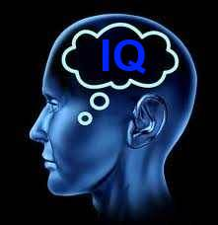
Assessing Intelligence – Lewis Terman
Stanford University professor noticed that Binet’s IQ test worked poorly with California children
Adapted and revised Binet’s test – added items for adults and revised the scoring procedure
Name this revision the Stanford-Binet
Most widely used intelligence test until the Weschler test came along

Slide 20
Assessing Intelligence
William Stern - German psychologist who developed the formula for IQ or Intelligence Quotient
IQ = Mental Age ÷ Chronological Age x 100
        85-114 = Average (68% of test takers)
        115-129 = Above average
        130-144 = Gifted (2.3% of test takers)
        145-159 = Genius (less than 1% of test takers)
        70 or lower = intellectually challenged
Most current intelligence tests no longer compute an IQ

Slide 21
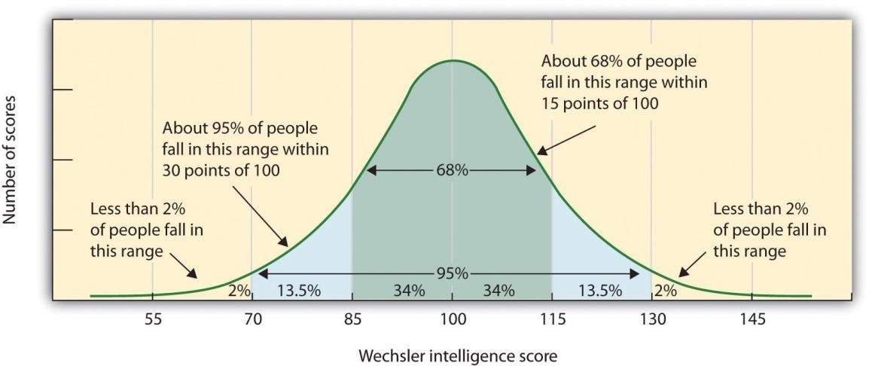
Normal Distribution of Intelligence Scores

Slide 22
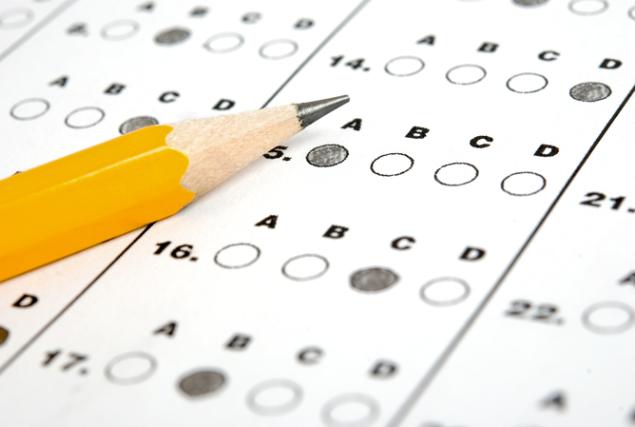
Modern Tests of Mental Abilities
Aptitude tests – intended to predict your ability to learn a new skill (SAT, ACT, GRE)
Achievement tests - intended to reflect what you have learned (Exams in school, AP test)
Factors that influence your score:
    Your achieved vocabulary
    Your aptitudes for learning and test taking
Most tests, whether labeled aptitude or achievement, assess both ability and acquired knowledge.

Slide 23
Assessing Intelligence – David Wechsler
Took Stanford-Binet as an immigrant child and was labeled “feeble-minded”
Developed most widely used IQ test Wechsler Adult Intelligence Scale (WAIS) and the Wechsler Intelligence Scale for Children (WISC)
Created two separate tests containing 11 subtests:
    Verbal test – word definitions, math, memory
    Performance tests – 7 subtests that require manipulating objects, assembling picture

Slide 24
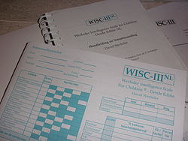
Assessing Intelligence – David Wechsler
WAIS & WISC yield an overall intelligence score and separate scores for verbal comprehension, perceptual organization, working memory, and processing speed
Large discrepancies in scores alert examiner to possible learning problems or brain disorders
Provides clues to cognitive strengths

Slide 25
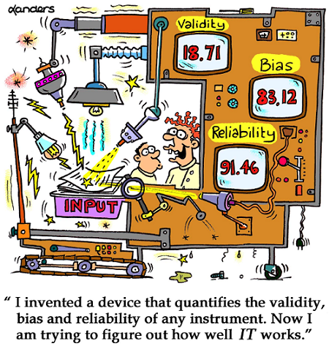
Principles of Test Construction
To be widely accepted, tests must meet three criteria. They must be:
        Standardized
        Reliable
        Valid

Slide 26
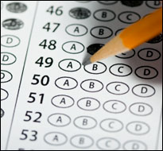


Principles of Test Construction
Standardization – the process of defining meaningful scores relative to a pretested group (standardization group)
    Everyone takes the same test under the same conditions.
    Allows scores to be compared statistically.
Helps eliminate possible bias of those giving or scoring the test, making it objective?....

Slide 27
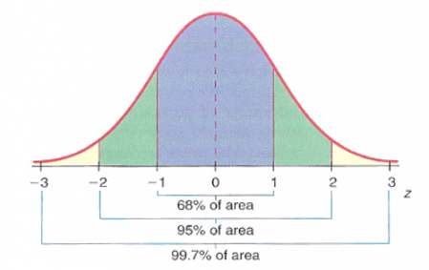
Principles of Test Construction
Bell-Shaped Curve – Standardized tests produce a normal distribution of test scores
symmetrical, bell-shaped curve
majority will fall within 30 points + or – of the middle (100)

Slide 28
The Flynn Effect
Worldwide phenomenon of increase in intelligence test scores – cause unknown

Slide 29
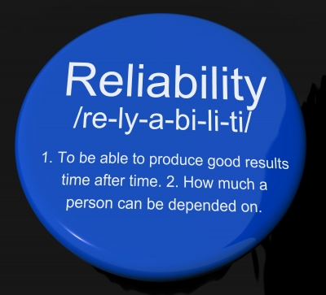
Principles of Test Construction - Reliability
  Reliability = the degree to which a test can be repeated with the same results (consistent)
Methods for checking for reliability:
  Test-Retest Reliability – group takes same test twice
  Split-Half Reliability – correlation calculated between person’s 2 scores on comparable halves of the test
  Alternative Form Reliability – use another similar test

Slide 30

Principles of Test Construction - Validity
Validity = The extent to which the test actually measures what it is supposed to measure or predicts what its supposed to predict – It’s accurate!
Types of validity:
  Content validity – tests what was supposed to be tested; content of the test is fair (course exam)
  Predictive validity – the test should accurately predict the outcome or behavior that it is designed to predict

Slide 31
Principles of Test Construction – Predictive Validity
Aptitude tests must have predictive validity - they predict future achievement
Criterion – The behavior (future college grads) that a test (SAT) is designed to predict; thus, the measure used in defining whether the test has predictive validity
Predictive power is fairly strong in the early years (ages 6-12) but later weakens
When we validate a test using a wide range of people but then use it with restricted range of people, it loses much of its predictive validity - SAT & GRE are less successful in predicting success for this reason

Slide 32
Principles of Test Construction
Keep in mind that reliability does not ensure validity!
If you used an inaccurate tape measure to measure height, your report would have high reliability but low validity

Slide 33
Stability or Change?
Can we observe infants and determine future intelligence? At what age can we start predicting?
  By age 4 we can reliably test and predict future scores
  By age 7, test scores stabilize but aren’t always fixed
  The consistency of scores over time increases with the age of the child.

Slide 34
Extremes of Intelligence
Intellectual disability – (formerly mental retardation)
    Limited mental ability – IQ of 70 or below
    Varies from mild to profound
    Difficulty in adapting to demands of life
    1% of population
    50% more males than females
Down Syndrome – physical cause
    Caused by extra chromosome 21
    Intellectual disability and associated physical disorders

Slide 35
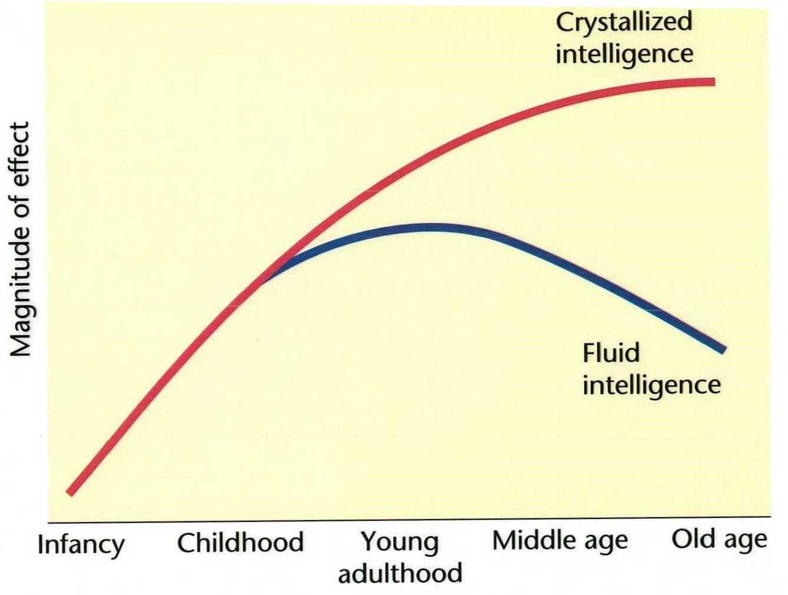
Aging and Intelligence
Cross sectional studies compare people of different ages at the same point in time
Longitudinal studies follow and re-test the same cohort over a period of years
Fluid intelligence – our ability to reason speedily and abstractly; tends to decrease with age, especially during late adulthood
Crystalized intelligence – our accumulated knowledge and verbal skills; tends to increase with age

Slide 36
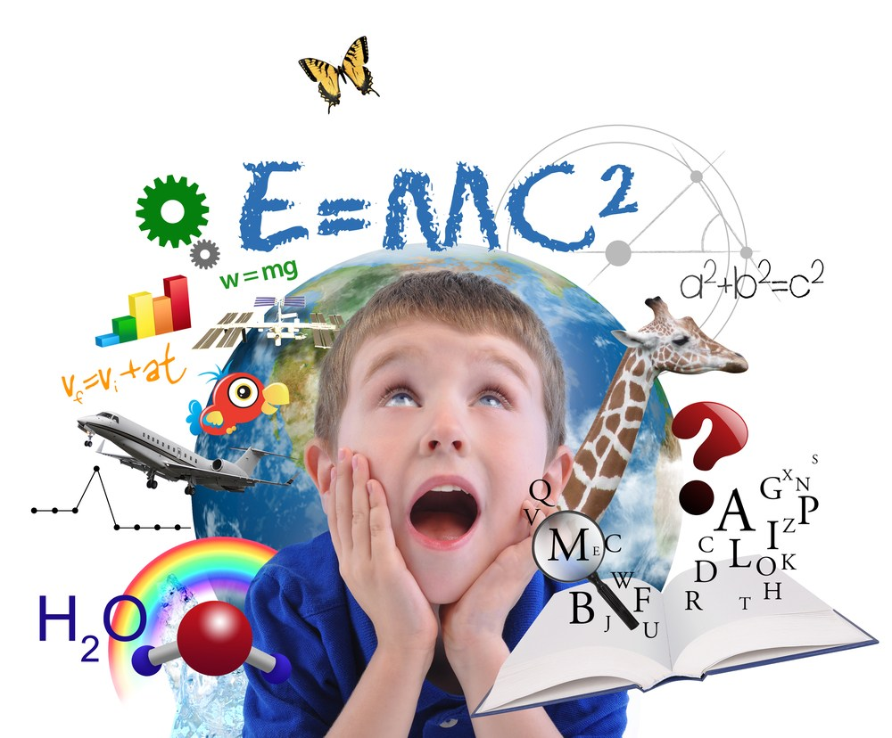
Extremes of Intelligence
Lewis Terman - California study of more than 1500 children with IQ’s over 135 – found children were not maladjusted later in life
  Healthy, well-adjusted, and unusually successful academically
  Sometimes more isolated and introverted, but most thrive

Slide 37
Extremes of Intelligence
Should there be segregated education?
Many children who are intellectually challenged are now mainstreamed
Gifted children receive academic enrichment not available to 95% of other students
Criticisms:
  Tracking by aptitude may promote segregation and prejudice and widen the achievement gap
  Self-Fulfilling Prophecy – label may influence children to live up to the expectation

Slide 38
Genetic Influences on Intelligence
Twin researchers have said that 50% to 70% of intelligence score variation can be attributed to genetic variation
  Heritability – the extent to which differences among people are attributed to genetic factors
Brain scans show that there is similar gray matter volume in identical twins
Researchers have found gene clusters that influence variations in intelligence
Adopted children’s intelligence scores become more like those of their biological parents

Slide 39
Genetic Influences on Intelligence – Twin and Adoption Studies

Slide 40
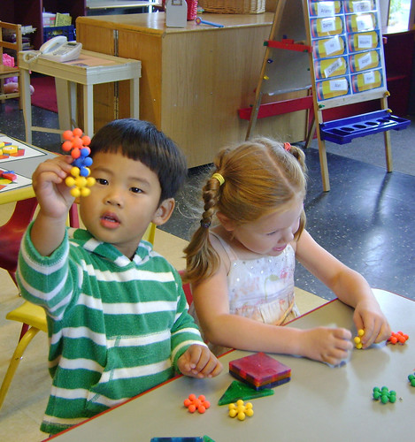
Environmental Influences on Intelligence
Malnutrition, sensory deprivation, and social isolation can slow cognitive development
Schooling is an intervention that does dramatically increase intelligence
School and intelligence enhance income later in life
Early childhood education programs increase children’s readiness for school, and lead to increased intelligence

Slide 41
Gender Similarities & Differences
Genders are mostly similar in intelligence, but females are better at:
  • Spelling
  • Verbal ability: Verbal fluency & remembering
  • Nonverbal memory: Remembering and locating objects
  • Sensation: Touch, taste, and odor
  • Emotion-detecting ability
  • Math computation

Slide 42
Gender Similarities & Differences
Males scored higher at problem solving and spatial ability – may be evolutionary
Males have an advantage in physics and computer science
Greater male variability – Men’s ability scores vary much more than women
Boys outnumber girls at the high and low extremes of intelligence

Slide 43
Ethnic Similarities & Differences
Racial groups do differ in average intelligence scores
High scorers are more likely to attain higher levels of education & income
The bell curve for white Americans is centered around 100
The bell curve for African Americans is centered around 85
Evidence suggests environmental differences are largely responsible
Access to schools and education leads to differing scores on intelligence tests.
Individual differences within a race are much greater than differences between races

Slide 44
The Question of Bias
Test is biased if performance differences are caused by cultural experiences
Some intelligence test questions make middle-class assumptions
Should we blame the test or the lack of life experience and the negative environment they grow up in?
In terms of predictive validity, researchers found that major U.S. aptitude tests are not biased – they test what they are supposed to test and can predict future behaviors

Slide 45
Stereotype Threat
Our expectations & attitudes can influence our perceptions & behaviors
If you feel apprehensive, it effects your test taking abilities and test scores

