Slide 1
Chapter 1 Introducing Psychology

Slide 2
Before you read:
A psychologist is a person who…
Define psychology.
In what ways do you think studying psychology might benefit you?

Slide 3
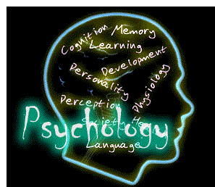
Psychology -
Psychology is defined as a scientific study of behavior and mental processes.

Slide 4
Overview of Psychology
Psychology- the scientific study of behavior and
mental processes of humans and animals
Psychologists study common behaviors and feelings
Cover everything people think, feel, and do
Many different approaches are necessary to understand the depth of psychology and provide useful insight into behavior
Psychiatrists are medical doctors and psychologists are not.

Slide 5
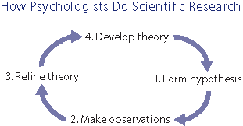
The Scientific Basis of Psychology
Psychologists agree that the study of behavior must be systematic
Rely on the scientific method:
Identify a problem or question
Form a hypothesis (educated guess)
Collect data through observation and experiment
Analyze data
Theory- complex explanation based on findings

Slide 6
The Goals of Psychology
Description- gather information about the behavior
Explanation- seek to explain why behavior is occurring
Prediction- Using knowledge they can predict subsequent behaviors
Control- influence or control behavior
Basic Science- Research (long term goals) Pursuit of knowledge for its own sake
Applied Science- Looking to solve more immediate problems using psychological principles

Slide 8
Specialty Fields in Psychology
Clinical & Counseling Psychology-Most popular, often called psychotherapist. Help people deal with personal problems. Use applied science
Personality, Social & Developmental Psychology- conduct research – use basic science. Create personality test, study groups, conduct polls and surveys.
Educational/School Psychology- deal with teaching children and young adults; intelligence, memory, problem solving & motivation.
Community Psychology- Work in a mental health or social welfare agency. May help run mental health clinics operated by the government or private organizations.

Slide 9
Specialty Fields in Psychology cont.
Industrial/Organizational Psychology- Study and develop methods to boost production, improve working conditions, train people and reduce accidents.
Experimental Psychology- They are the basic scientists. Test, study, and observe various behaviors.
Forensic Psychology- Work with the dealings of the legal system

Slide 10
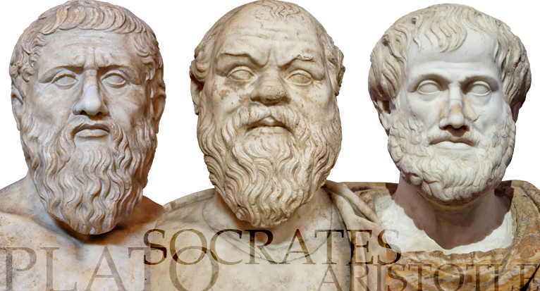
Brief history of Psychology
Study of behavior began with ancient Greek philosophers
Decided people’s lives dominated by own mind not so much by the gods
Relied on observation to understand their world
17th Century - Dualism- Belief that mind and body are separate and distinct
Renè Descartes – argued that a link exists between mind and body, work together to create a person’s experiences

Slide 11
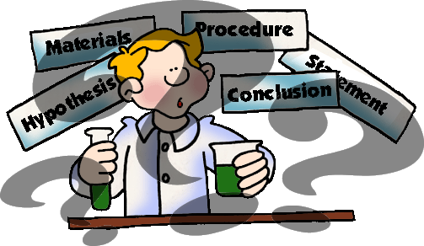
History of Psychology cont.
Modern science combined philosopher’s ideas with observations and inventiveness of practical people.
Psychology as a science began in the 19th century, 100-120 years ago

Slide 12
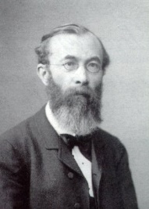
Wilhelm Wundt
Believed to be the father of psychology as a science
Started the Laboratory of Psychology in 1879 in Leipzig, Germany
Tried to map out the basic structure of the thought process
Introspection - method of self-observation used to collect info about the mind
Structuralism – study of the elements of consciousness

Slide 13
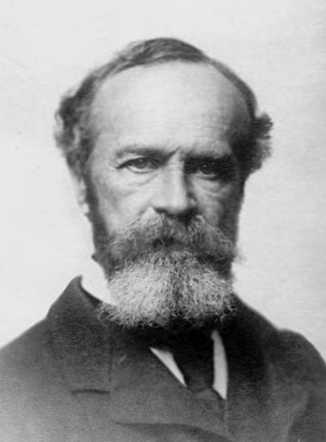
William James
Often called “Father of Psychology” in the U.S.
Professor at Harvard
Wrote Principles of Psychology – 1st psychology textbook
Functionalism – focuses on how the mind functions to adapt the individual to the environment
Speculated that thinking, feeling, learning, remembering serve to help us survive as a species.

Slide 14
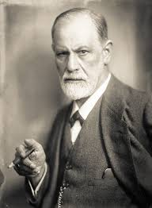
Sigmund Freud
Best known and most controversial.
Believed we are motivated by unconscious instincts & urges that are not available to the conscious mind
Psychoanalyst – a psychologist who studies how unconscious motives and conflicts determine human behavior
Free Association – patient says whatever comes to mind
Dream analysis – applied the same concept to dreams

Slide 15
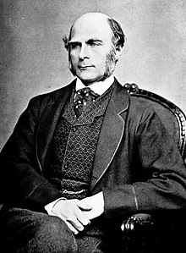
Sir Francis Galton
Believed heredity influences a person’s abilities, character and behavior,
Failed to consider people’s exceptional environments and socioeconomic advantages
Developed procedures that are still used for personality and intelligence testing
Raised the question of whether behavior is determined by heredity or environment

Slide 16
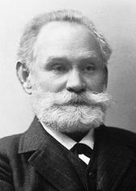
Ivan Pavlov
Behaviorist – Stressed investigating observable behavior
Won Nobel prize 1904 for the “conditioned reflex”
Famous for his work with salivating dogs (Classical conditioning)
Determined that behavior is a product of prior experience - conditioning

Slide 17
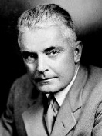
John B. Watson
Defined behaviorist position
Felt all behavior, even instinctive behavior, is the result of conditioning and occurs because the proper stimulus is presented
Psychology should only concern itself with observable facts of behavior
“Little Albert” experiment

Slide 18
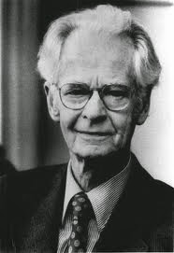
B.F. SkinneR
Refined and popularized Behaviorism
Attempted to show how his laboratory techniques can be applied to society
Popularized techniques of shaping- the systematic dispensing of rewards & punishments to guide an organism’s response. (Operant Conditioning)
Wrote Walden Two which portrayed a Utopian society
Teaching Machine –programmed learning, forerunner of computer-assisted instruction

Slide 19
Abraham maslow & Carl Rogers
Humanism – describe human nature as active and creative rather than passively reacting to external stimuli
Believe the mind is able to influence and change the world in which functions
Stress individual choice and free will
Emphasize individual potential for growth (Self Actualization)

Slide 20
Maslow’s hierarchy of Needs

Slide 21
Cognitive Approach
Believe that some of the processes that govern human and animal behavior are internal - Focus on how we process, store, and use information
Behavior is more than a simple response to a stimulus; it is influenced by a variety of mental processes.
Our minds perceive and interpret our world, think about problems, and assess our knowledge of ourselves and others

Slide 22
Chapter 1 Test Review
Format – 30 questions (Multiple Choice)
Study your “Key Terms” handout - terminology, timeline and specialty fields handout
Review the “Concepts and Vocabulary” questions (p. 18)
Know who the following people are and what they are associated with
René Descartes Sigmund Freud John B. Watson
Wilhelm Wundt Sir Francis Galton B.F. Skinner
William James Ivan Pavlov Abraham Maslow

