Slide 1
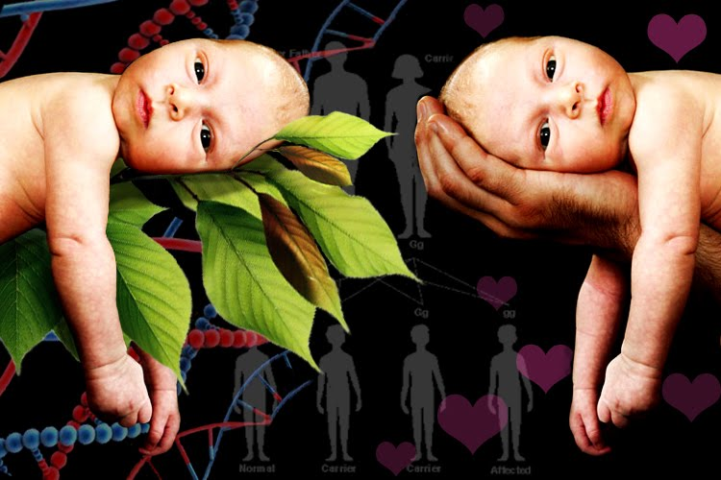
Chapter 3
Nature, Nurture, and Human Diversity

Slide 2

Nature vs. Nurture
What is the nature vs. nurture controversy?
Give three examples of how “nature” has contributed to the person you have become.
Give three examples of how “nurture” has contributed to the person you have become.
Which do you feel contributes more to a child’s behavior?

Slide 3
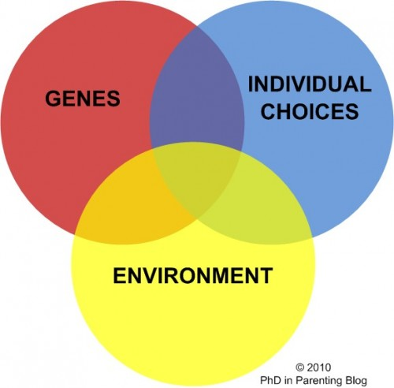
Behavior Genetics: Predicting Individual Differences
Behavior Genetics is the study of our differences and the relative effects of heredity and environment on our individual differences in behavior & mental processes
Methods used:
  Twin studies
  Adoption studies
  Temperament studies

Slide 4
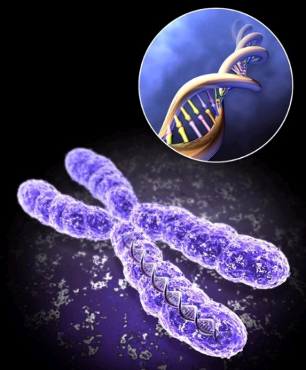
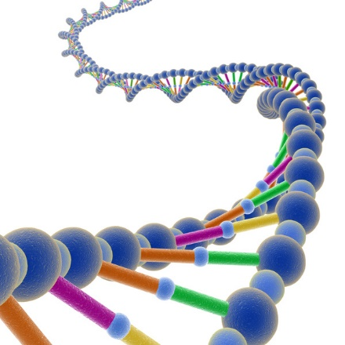
Genes: Our Biological Blueprint
Chromosomes - threadlike structures made of DNA molecules that contain the genes.
23 from mom, 23 from dad = 46
DNA - a complex molecule containing the genetic information that makes up the chromosomes.
Genes - Units of heredity that make up the chromosomes. Every human is close to being your clone, sharing 99.9% of your DNA.
Genome – the complete instructions for making an organism.

Slide 5
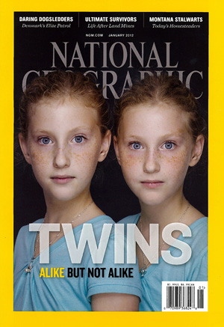
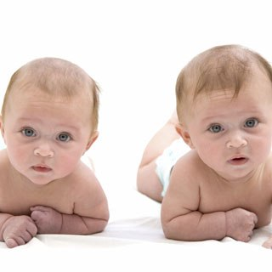
Studies that support genetic influence:
Identical twins studies – show they are more alike than fraternal twins in abilities, personality traits & interests
Separated twin studies – show remarkable similarities in life choices of (Genes influence personality).

Slide 6
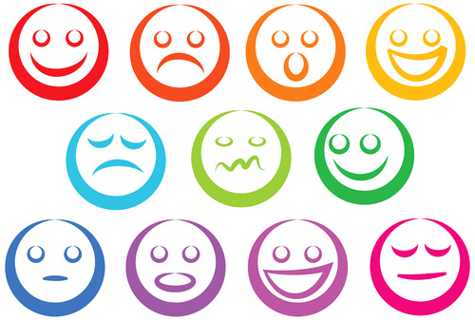
Studies that support genetic influence cont.:
Adoption Studies - show adoptees’ traits bear more similarities to their biological parents than their care-giving adoptive parents.
Temperament Studies - Temperament seems to be biologically based & tends to remain stable throughout life.

Slide 7
Twin Studies
Identical twins: single fertilized egg, 2 genetically identical organisms, natural human clone
Fraternal twins: separate fertilized eggs, no closer than older and younger brother or sister, but share the fetus

Slide 8
Twin Studies
The Jim twins
Identical twins separated at birth for almost 40 years
First ever separated twin study (Bouchard)
After this many more twin studies, finding such shared traits as:
  Tastes, physical attributes, interests, fears, personality
Identical twins raised together have more similar personalities

Slide 9
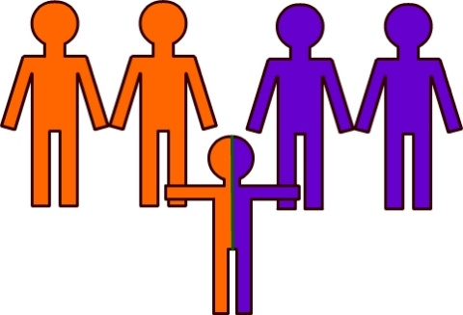
Adoption Studies
Creates 2 sets of relatives – biological & adoptive
For any given trait, we can study whether adopted children are more like biological parents (nature) or adoptive parents (nurture)
Studies prove personality traits don’t depend on environment
Parents do influence their children’s attitudes, values, manners, faith, and politics

Slide 10
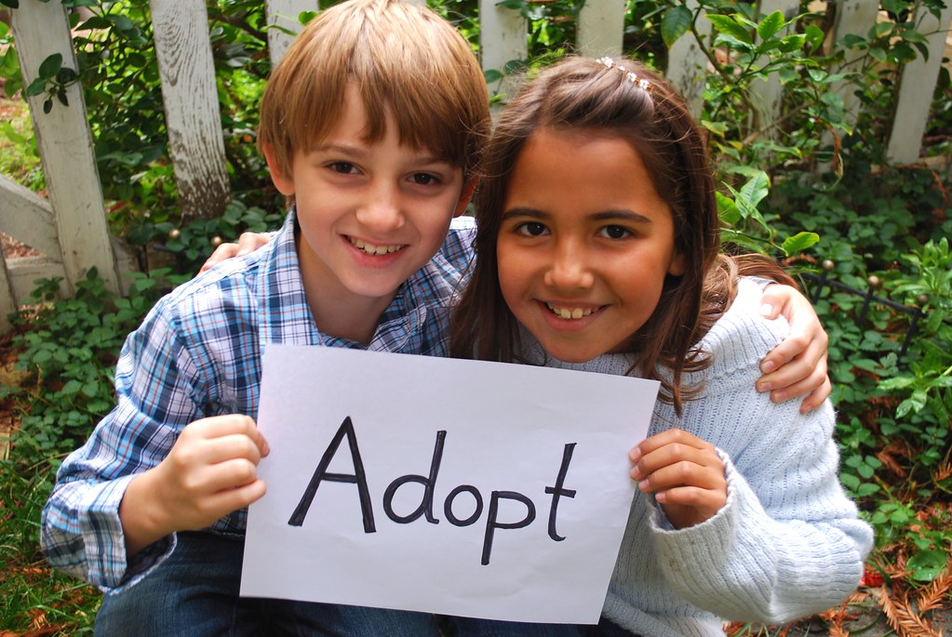
Adoption Studies
Adopted children thrive:
Homes have fewer family problems
Grow up to be more caring & altruistic
Score higher on intelligence tests than biological parents
Grow into happier & more stable adults

Slide 11
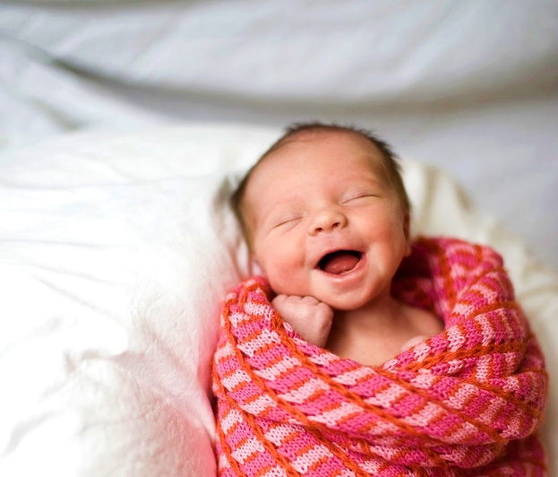
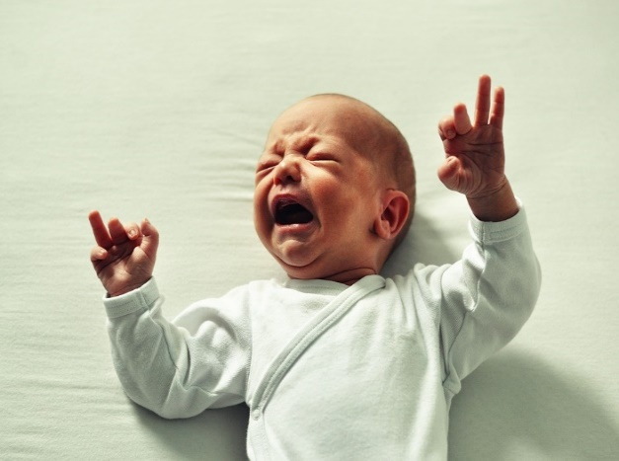
Temperament Studies
Temperament – a person’s characteristic level of emotional reactivity and intensity (examples - anxious, irritable, easy-going, reserved, etc.)
Apparent soon after birth and continues relatively unchanged into adulthood
Compared with fraternal twins, identical twins may have similar temperaments – indicates temperaments may be biologically rooted

Slide 12
Heritability
The mathematical proportion of variation among people that we can attribute to genetic influence, not due to their environment
Heritability is a direct correlation
  It has a coefficient from 0 to 1 (or 0% -100%)
  The more heritable a disease or trait is, the more the differences between people can be associated with genetic variation.
Remember: The more similar the environment, the higher the percentage of heritability!

Slide 13
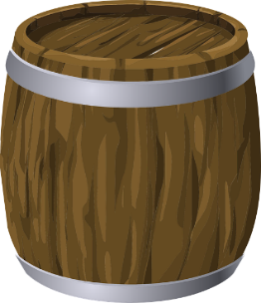
Heritability Example
Take four boys from different families.
From birth, put them in barrels, feed them through a tube, in exact same environment.
At age 12, release them from barrels and give them an IQ test.
Because their environment has been identically controlled, any differences in IQ scores are accounted for by genetics, making intelligence heritable.

Slide 14
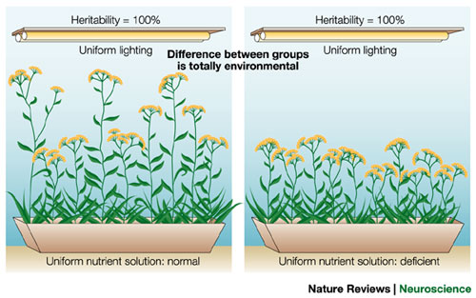

Slide 15

Nature vs. Nurture
Influence of adaptation – adapting to our environment.
Nature and nurture work together
Genes are self-regulating – genes react differently to different environments
We all have a gene that can lead to depression if triggered by certain stress.
By itself, no depression, so it needs to be triggered.
Human differences result from nature & nurture – but some people might be more genetically predisposed to be more at risk than others for some disorders

Slide 16
Molecular Genetics
Subfield of biology that studies the molecular structure & function of genes
Goal is to find some of the many genes that influence normal human traits.
Geneticists try to find the genes that put people at risk for certain diseases
Prenatal screening
Pros and cons

Slide 17
Evolutionary Psychology
Evolutionary Psychologists study human nature through Darwin’s theory of Natural Selection
  Focus mostly on what makes us alike as humans.
  Goal is to understand human behavior that is universally aimed at the passing of one's genes into the next generation.
Natural Selection – the idea that the range of inherited traits that lead to increased reproduction & survival will most likely be passed on to succeeding generations.

Slide 18
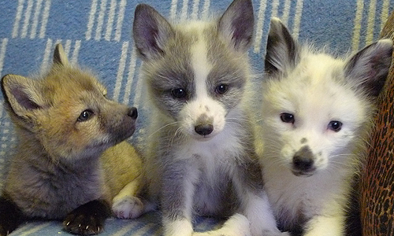
Evolutionary Psychology
Certain biological & behavioral variations increase chances of reproducing, surviving, and contributing more offspring and future generations
  Mutations - a random error in gene replication that leads to change
Then those new offspring are even more likely to survive. Thus, over time, population characteristics adapt and change, and the strongest traits are passed down
Dmitry Belyaev – Fox breeding

Slide 19
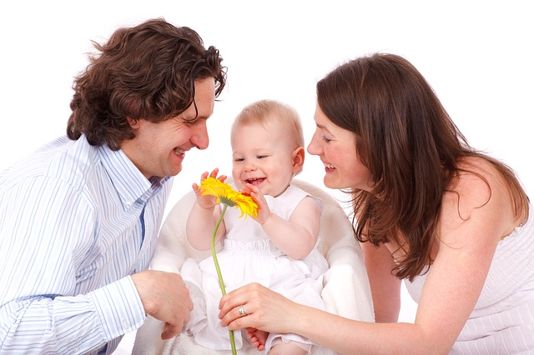
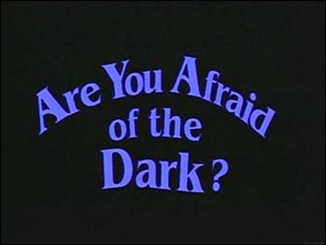
Evolutionary Psychology
Together, genes and experience wire the brain.
Our adaptive flexibility in responding to different environments contributes to our fitness – our ability to survive & reproduce.
Examples:
                We fear dangerous animals
                We fear the dark
                We love our own children

Slide 20
Evolutionary Psychology
Behaviors that contribute to survival are found throughout cultures
  Think about when you watch people interact how you can sometimes tell what people are talking about even if they are speaking a language you don’t know…
Emotions can be cross cultural
Understanding the difference between a smile and frown helped us to survive thousands and millions of years ago

Slide 21
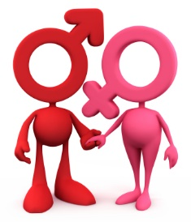
Evolutionary Psychology – Gender Differences
Men & women genetically adapted same way over time, except in behaviors related to reproduction
Studies suggest men have a stronger tendency towards sex
      more sex drive
      more thoughts about sex
      initiate sex more
      more likely to perceive a women’s friendliness as a desire for sex

Slide 22
Evolutionary Explanation – Mating Preferences
Men are attracted to youthful, healthy fertile appearing women, smooth skin, youthful shape suggesting childbearing years.
Women attracted to mature, healthy-looking men, mature, dominant, bold, & affluent suggests capacity to support & protect.
Nature selects behaviors that increase the likelihood of sending one’s genes into the future.

Slide 23
Critiquing the Evolutionary Process
Often start with an effect and work backward to propose an explanation
Concerns about the social consequences of evolutionary psychology
Critics maintain that evolutionary psychologists underestimate cultural expectations and socialization.

Slide 24
Parents and Early Experiences

