Slide 1
Chapter 6: Perception
Pages 237-244

Slide 2
Perception
The Human brain puts images together because it has learned to expect things; sometimes the data might get a little confused.
We may see an illusion because we know what we are expected to see, even though part of a picture or design may not be completely there. The basis of this is in how we perceive things.

Slide 3
Perception
TV shows us a continuous flow of still pictures, one right after the other.
Your eyes, along with your brain, fill in all of the empty spots.
Our brain has learned to expect movement.
Our brain can fill in all of the missing pieces and the pictures on the TV appear to be moving, even though they really aren’t!

Slide 4

Look at a computer screen very closely for a minute or two.
Your computer screen is made up of tiny red, green, and blue dots.
The illusion here is that you see more than just red, green, and blue dots; you see thousands of different colors.
Our brains put the red, green, and blue dots together to make the colors!

Slide 5
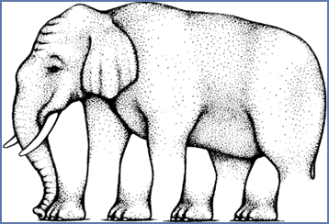
Do you trust your counting abilities?
How many feet does this elephant have?

Slide 6
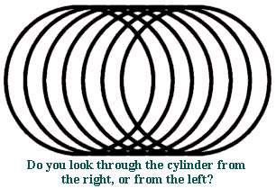
Your brain puts many circles together to form cylinder
Notes:
Brain puts many circles together to form cylinder.

Slide 7
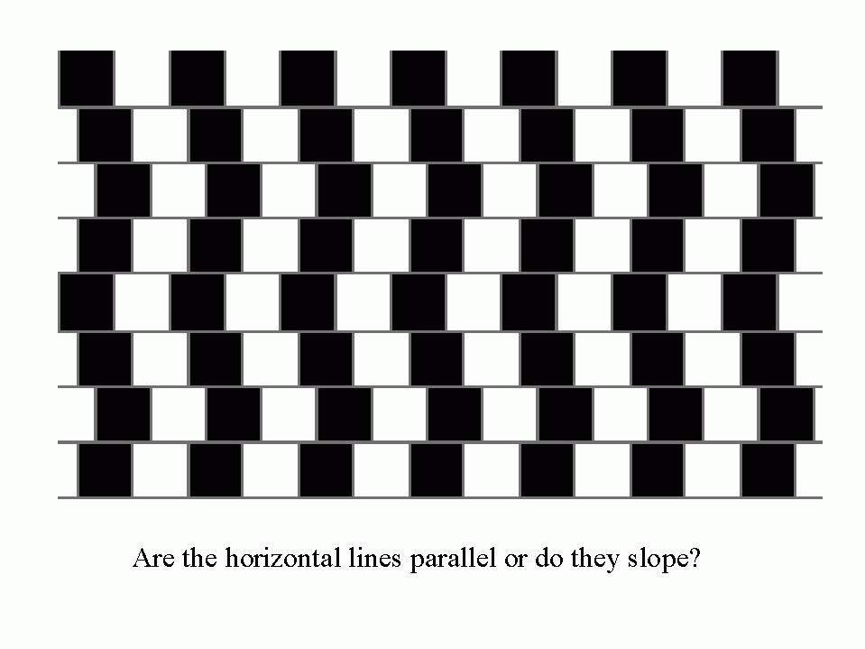
Notes:
conflicting local and global image features.

Slide 8
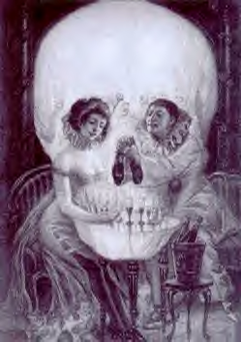
Do you see a couple or a skull?

Slide 9
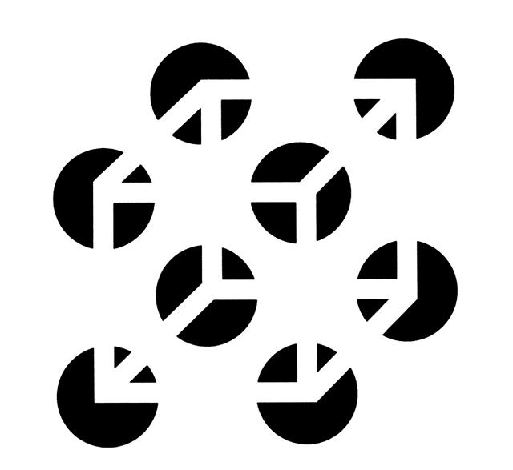
Necker cube
You know that alternative interpretations of this cube are possible, but you can consciously experience only one at any moment

Slide 10
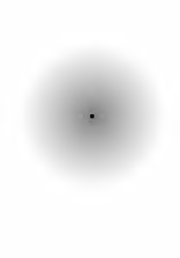
Keep staring at the black dot. After a while
the gray haze around it will appear to shrink.
Notes:
WHY?

Slide 11
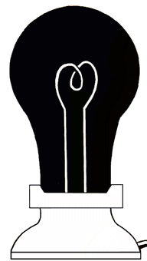
Stare at the black light bulb for at least 30 seconds.
Then immediately stare at a white area on the screen
or at a sheet of paper. You should see a glowing light bulb!
Notes:
WHY?

Slide 13
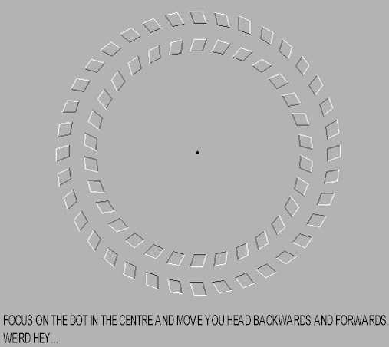
Rotating Wedge Illusion

Slide 14
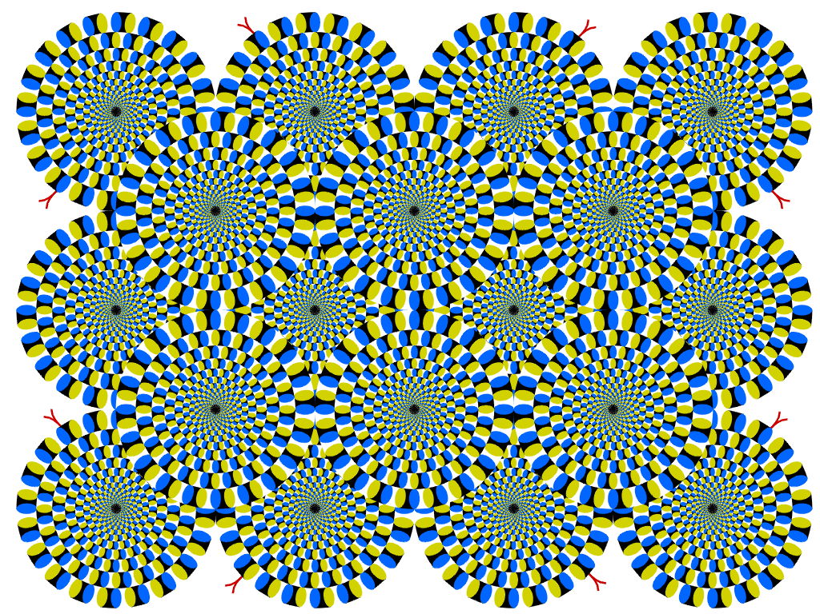
Spontaneous Motion Illusion

Slide 15
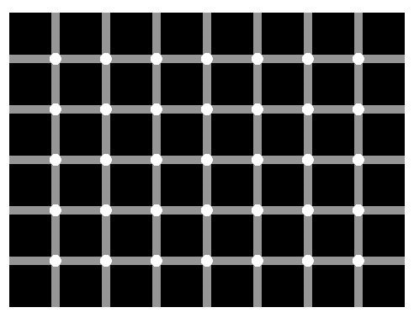
Notes:
HERMANN GRID
These blobs can be explained by reference to receptive fields and lateral inhibition. Excited ganglion cells in eye……too scientific for me to explain. Google it if you want more info!

Slide 17
Perceptual Organization
How do we form meaningful perceptions from sensory information?
We organize it!
We must perceive objects as distinct from their surroundings, see them as having a meaningful and constant form, and discern their distance and motion.
Notes:
Preview Question 16: How did the Gestalt psychologists understand perceptual organization?

Slide 18
Perceptual Organization
Gestalt Psychology- group of German psychologists interested in how the mind organizes sensations into perceptions
Gestalt – When given a cluster of sensations, we tend to organize them into a gestalt – a “form” or a “whole”
“In perception, the whole may exceed the sum of its parts”
Involves both bottom-up and top-down processing

Slide 19
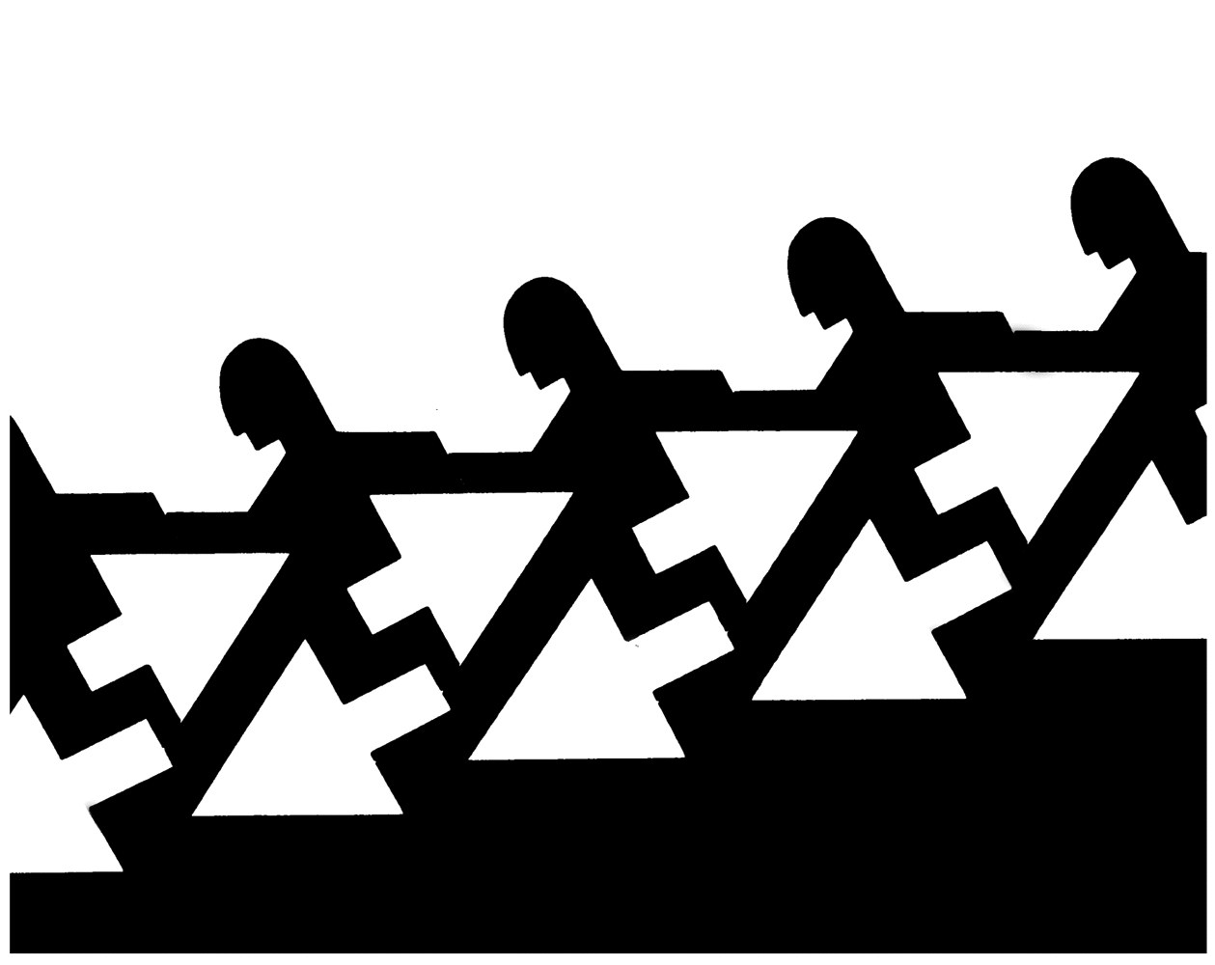
Form Perception – Step 1: fIgure and Ground
Ability to distinguish between the figure as the foreground and the ground as the background
The figure-ground relationship continually reverses
Notes:
Preview Question 17: How do figure-ground and grouping principles contribute to our perceptions?

Slide 20
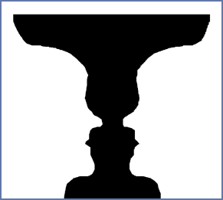
Figure-ground
What you see depends on whether you define the background as white or black.
Figure – what you attend to
Ground – everything else

Slide 21
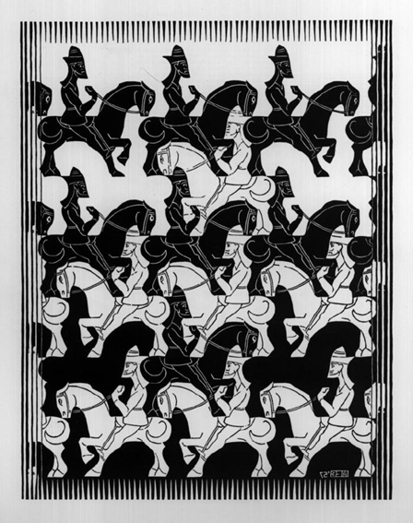
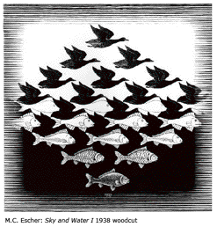

Slide 22
Form Perception - Step 2: Grouping
After distinguishing figure from ground, we now have to organize the figure into meaningful form.
Our mind follows certain rules for grouping stimuli together.
These rules were identified by the Gestalt psychologists.

Slide 23
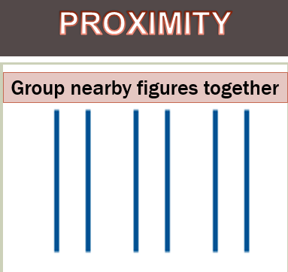
Form Perception - Step 2: GroupinG
  Proximity - Tendency to perceive objects that are close together as belonging together
  We see 3 sets of 2 lines rather than 6 separate lines.

Slide 24
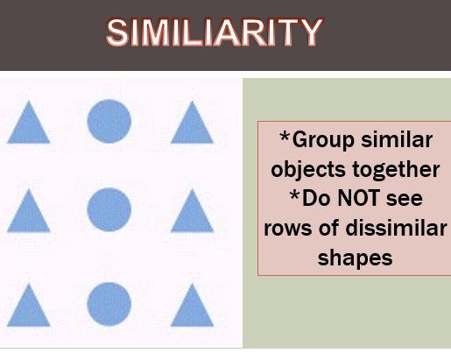
Form Perception - Step 2: Grouping
  Tendency to group similar objects together to make a whole

Slide 25
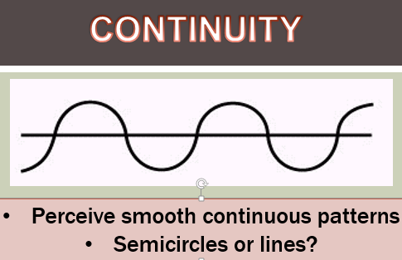
Form Perception - Step 2: Grouping
Continuity - Tendency to see an object continuing despite an obvious break

Slide 26
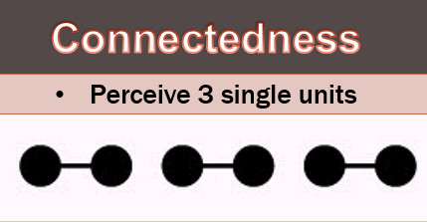
Form Perception - Step 2: Grouping
  Connectedness - Tendency to see objects that are uniform and linked as one unit
  Because they are uniform and linked, we perceive the two dots and the line between them as a single unit.

Slide 27
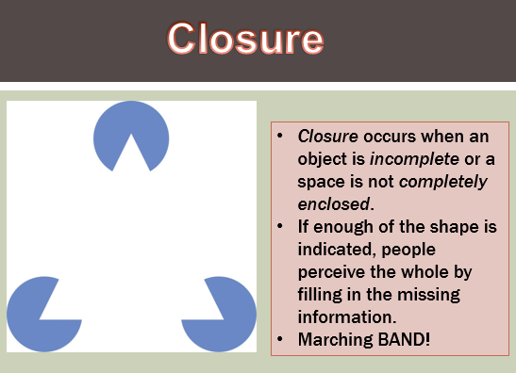
Form Perception - Step 2: Grouping
  Closure - Tendency to fill in the gaps to complete a whole object
The triangle is not there! We perceive it.
Close the circles, you stop seeing the triangle!

Slide 28
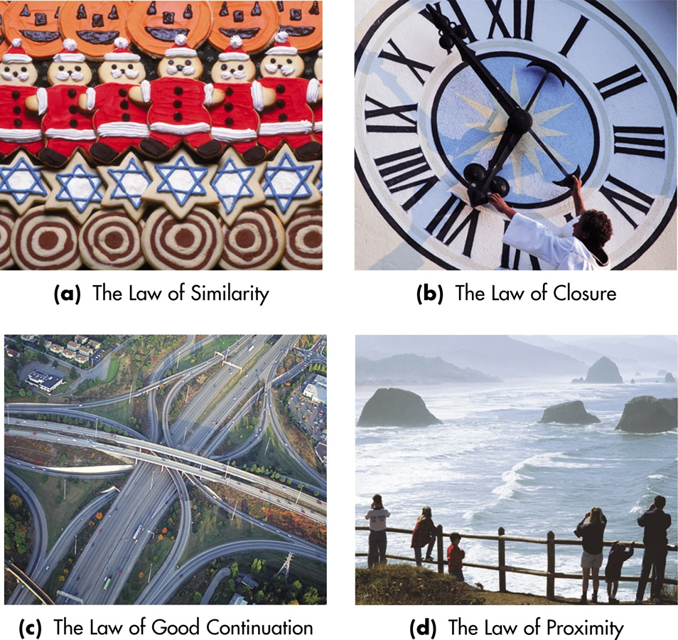
More Gestalt

Slide 29
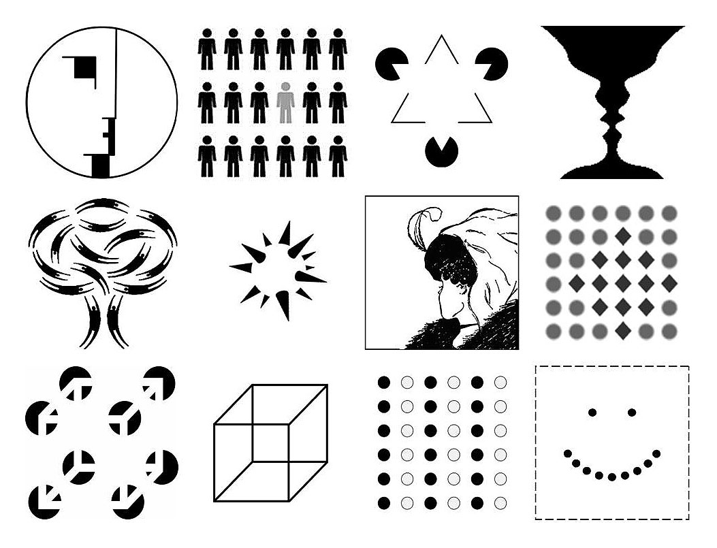

Slide 30
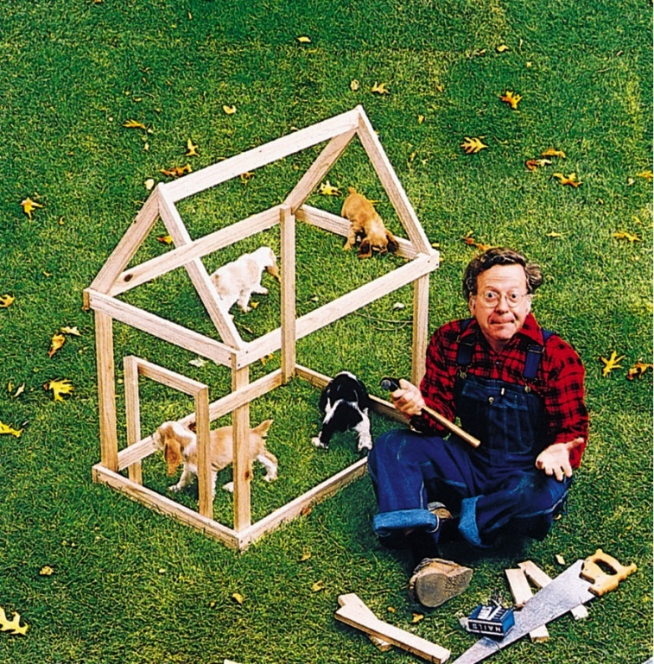
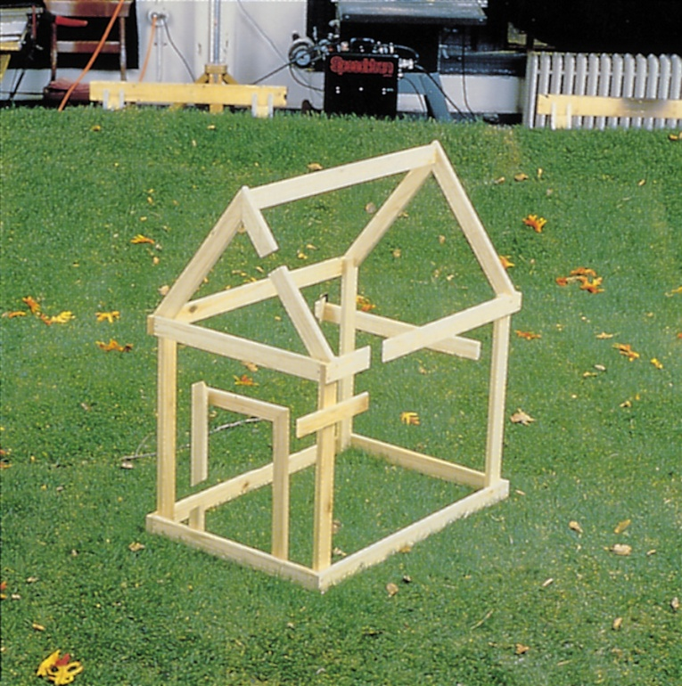
Grouping & Reality
Although grouping principles usually help us construct reality, they may occasionally lead us astray.
Both photos by Walter Wick. Reprinted from GAMES
Magazine. .© 1983 PCS Games Limited Partnership

