Slide 1
Chapter 6: Perception
Pages 245-250

Slide 2
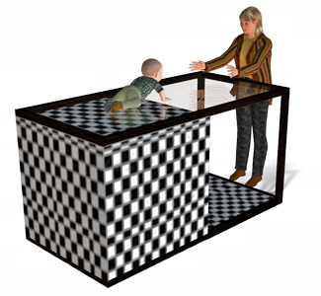
Depth Perception: The Visual Cliff Experiment
Depth perception – the ability to see objects in three dimensions, although the images that strike the retina are two-dimensional - enables us to judge distances.
Gibson and Walk (1960) suggested that human infants (crawling age) have depth perception. Even newborn animals show depth perception.
Notes:
Preview Question 18: How do we see the world in three dimensions?

Slide 3
Depth Perception – Binocular Cues
Binocular Cues – depth cues, such as retinal disparity and convergence, that depend on the use of two eyes
Retinal disparity – by comparing images from two eyes, the brain computes the difference, the greater the distance between the two images, the closer the object
3-D movies rely on retinal disparity
Convergence - muscles rotate inward when viewing an object nearby; the greater the inward strain, the closer the object

Slide 4
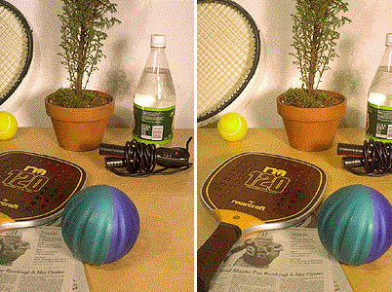
Two views of the same scene. The first shows what we would see if we closed our right eye; the second, what we would see if we closed our left eye.

Slide 5
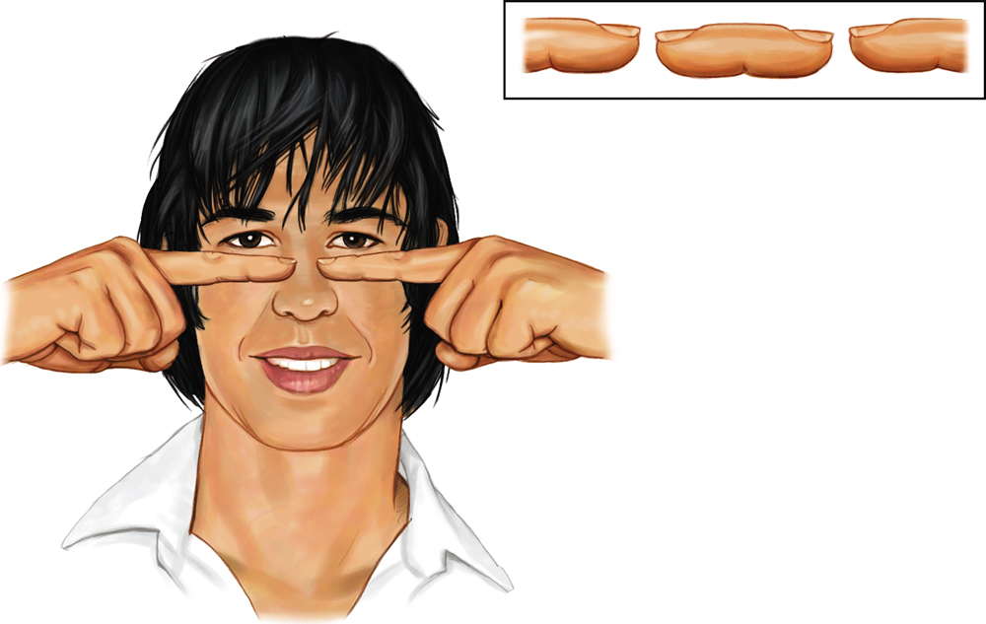
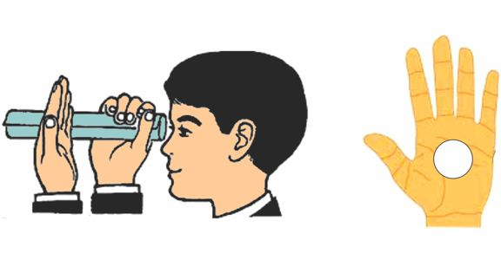
Try this!
Point your two index fingers toward each other, about half an inch apart & 5 inches in front of your eyes. Stare above your fingers.
You will see a “finger sausage” as shown in the inset.
Roll a sheet of paper into a tube. Look through tube with right eye.
Hold up left hand next to tube. Continue to focus ahead.
You should see a hold in the palm of your hand!

Slide 6
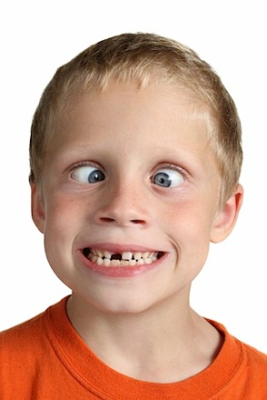
Binocular cues
.
Convergence:
Your two eye balls focus on the same object. In doing so they converge.
The angle of convergence is smaller when the eye is fixating on far away objects.
In simple terms: YOUR EYES TURN IN TOWARD EACH OTHER!
Try this!
Hold your index finger in front of your nose and move it away and toward yourself.
Notice what your eyeballs are doing….
Try this with a partner; watch his/her eyes.

Slide 7
Monocular Cues
Depth cues, such as interposition and linear perspective, available to either eye separately
Monocular cues provide size, distance and location information

Slide 8
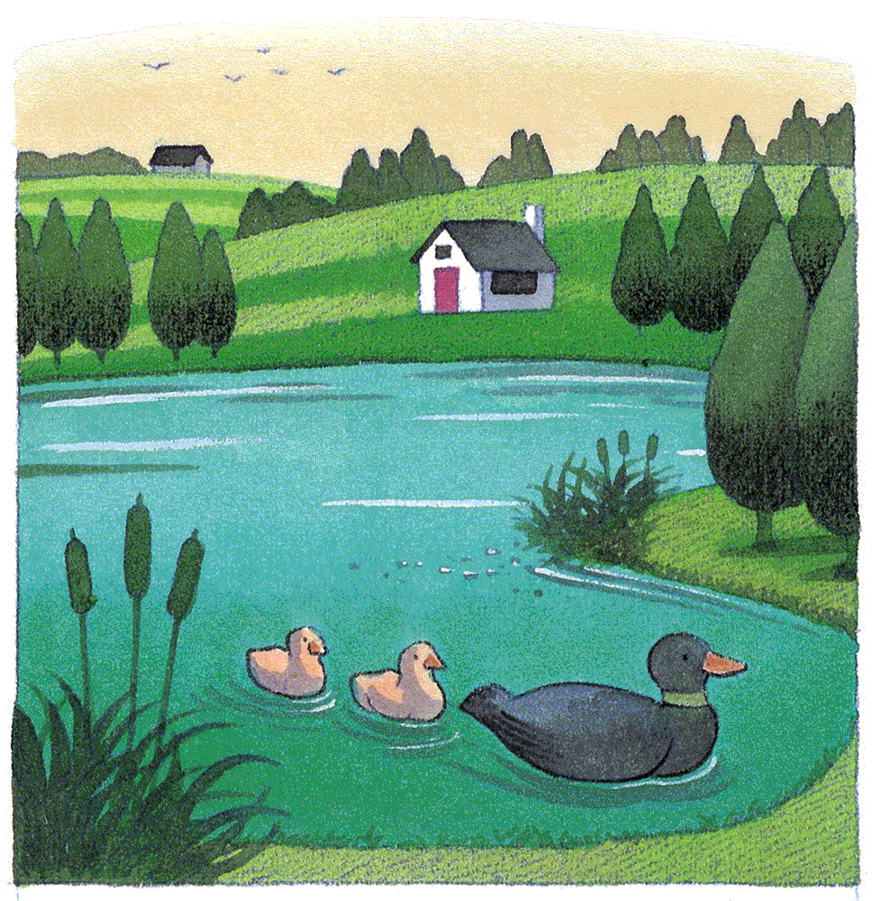
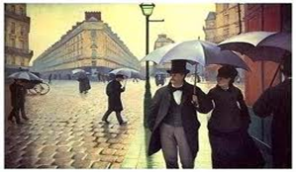
Monocular Cues
Relative Size: If two objects are similar in size, we perceive the one that casts a smaller retinal image to be farther away.

Slide 9
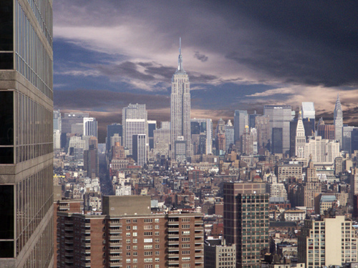
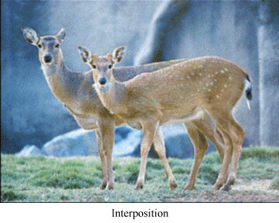
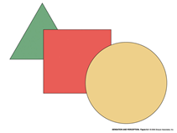
Monocular Cues
Interposition: Objects that block other objects tend to be perceived as closer.

Slide 10
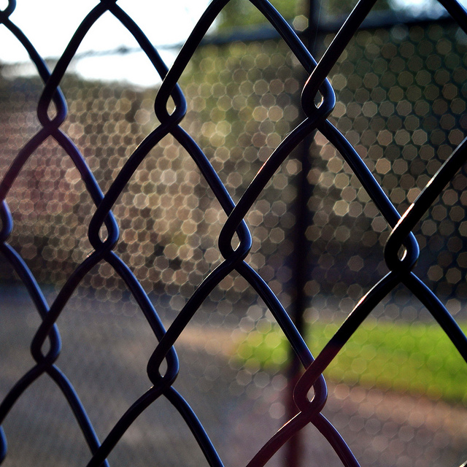
Monocular Cues
Relative Clarity: Because light from distinct objects passes through more light, we perceive hazy objects as farther away than sharp, clear objects.

Slide 11
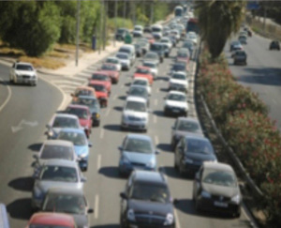
Monocular Cues
Relative Height: We perceive objects that are higher in our field of vision to be farther away than those that are lower.

Slide 12
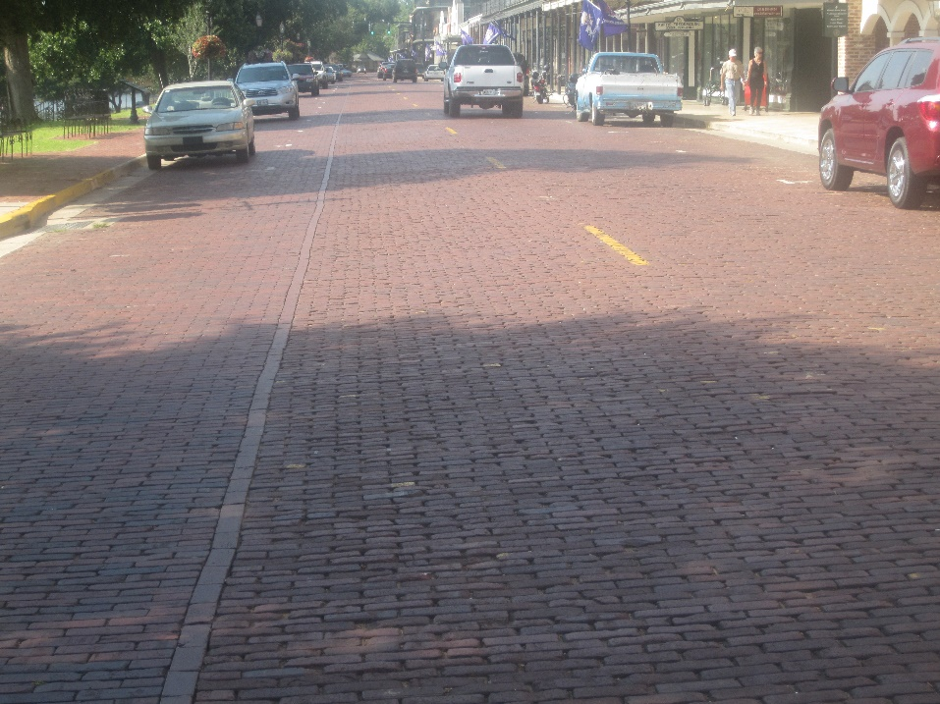
Monocular Cues
Texture Gradient: There is a gradual change in appearance of objects from coarse to fine. The closer the object is, the clearer the gradient, or degree of detail. The farther away it is, the smoother and less detailed the texture becomes.

Slide 13
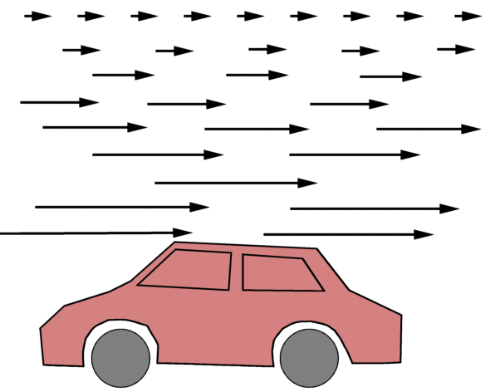
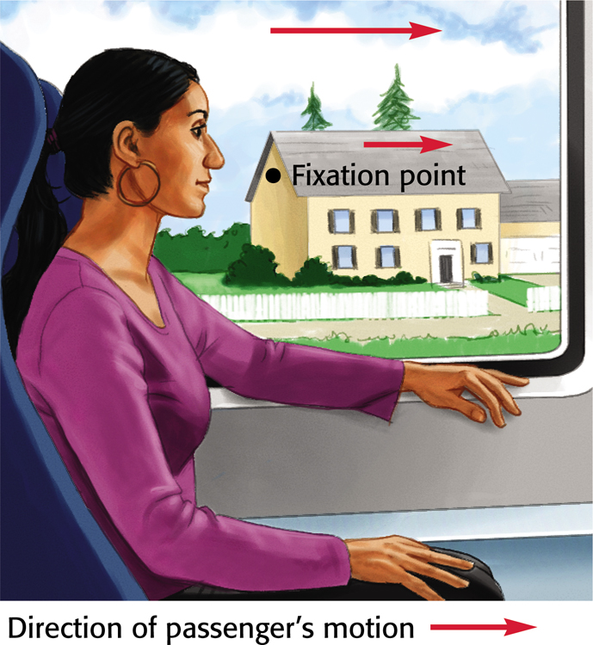
Monocular Cues
Relative motion: Objects beyond the fixation point appear to move with you; objects in front of the fixation point appear to move backward—the further they are from the fixation point, the faster they seem to move
Notes:
Preview Question 19: How do we perceive motion?

Slide 14
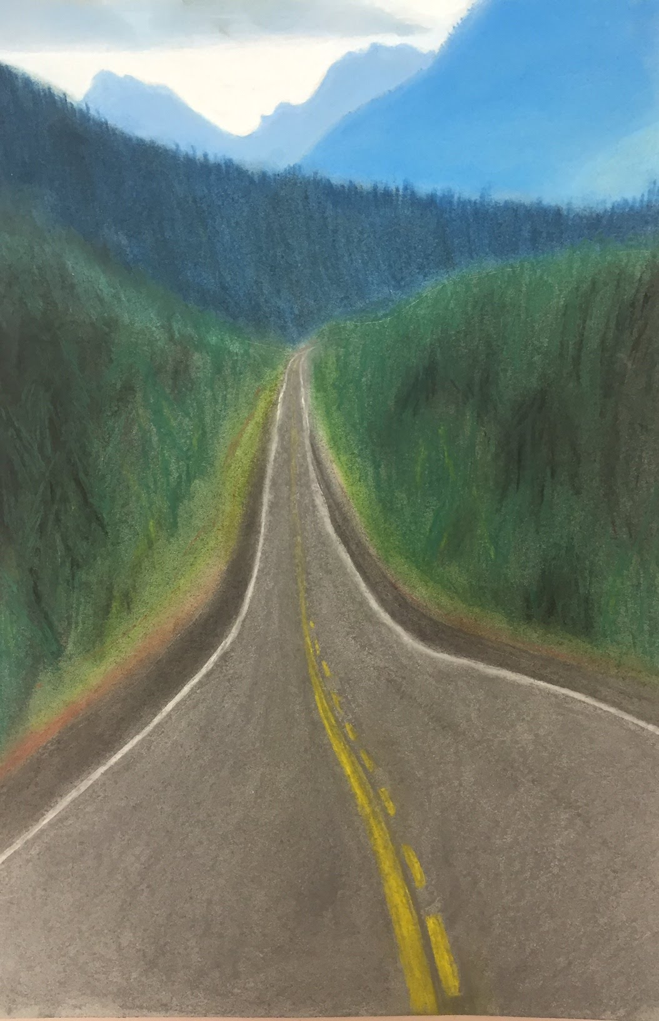
Monocular Cues
Linear Perspective: Parallel lines, such as railroad tracks, appear to converge in the distance. The more the lines converge, the greater their perceived distance.

Slide 15
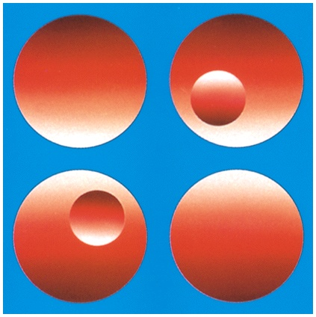
Monocular Cues
Light and Shadow: Nearby objects reflect more light into our eyes than more distant objects. Given two identical objects, the dimmer one appears to be farther away
Shadows are also clues because our brains assume that light comes from above.

Slide 16
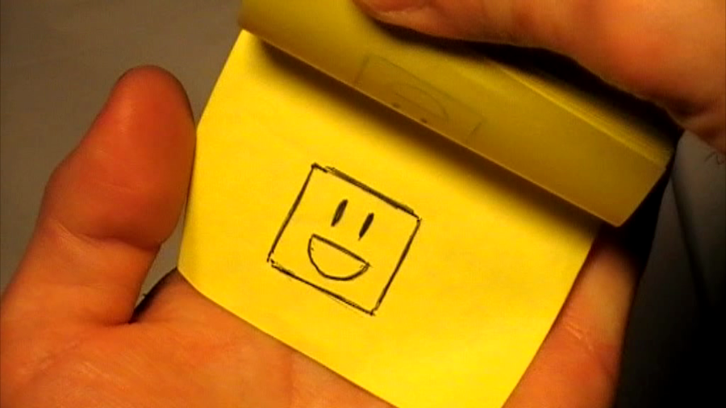
Movement Perception - Stroboscopic Movement
Seeing a rapid series of slightly different images right after the other as movement!
Examples: Movies, cartoons, or a flipbook

Slide 17
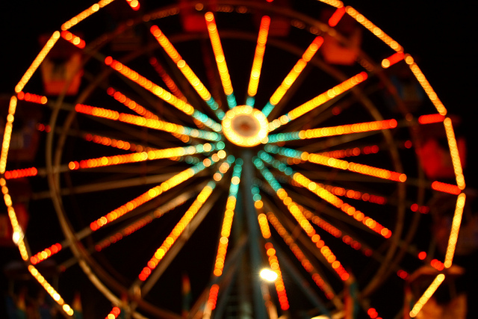
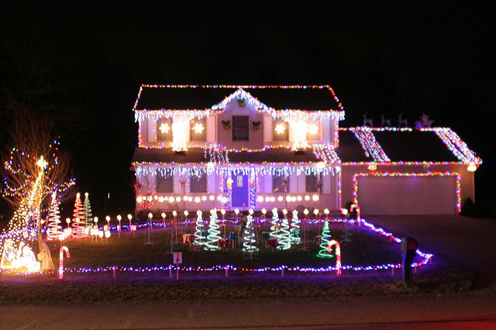
Movement Perception - Phi phenomenon
Two adjacent stationary lights blink on and off in quick succession.
We perceive it as a single light moving (Ex. a moving arrow)

