Slide 1
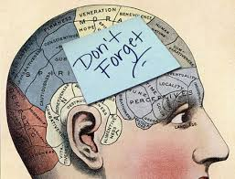
Chapter 9: Memory
AP Psychology

Slide 2
Memory
Memory – the persistence of learning over time through the storage and retrieval of information
“You are what you remember” – your storage of past experiences in your brain makes who you are today
Without memory, you would live in a constant “present;” loved ones would be strangers; you would have to learn every easy task from scratch each day; you would be a stranger to yourself

Slide 3
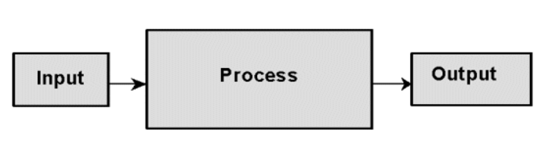

Information Processing Model of Memory
According to this model, forming memories involves:
    Encoding – getting info. into our brain in a usable format
    Storage – manipulation & rehearsal of info. so that it can be retained
    Retrieval – get the information back out
    Similar to a computer’s information processing system.

Slide 4
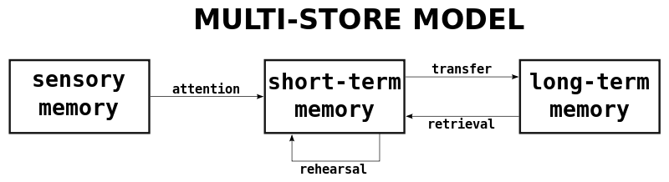
Atkinson-Shiffrin Three-Stage Model
According to this model, forming memories involves 3 separate systems characterized by time frames:
    Sensory memory –fraction of a second to several seconds
    Short-term memory - up to 30 seconds
    Long-term memory – relatively permanent

Slide 5
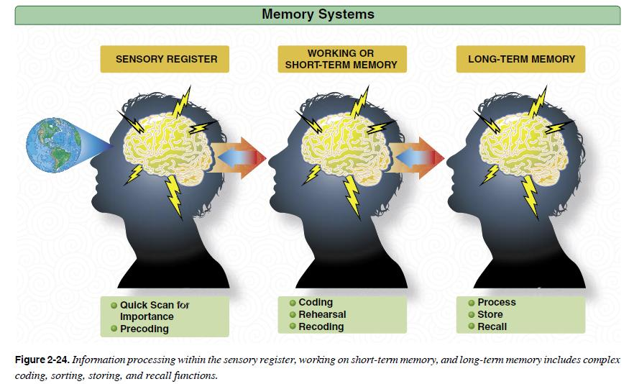

Slide 6
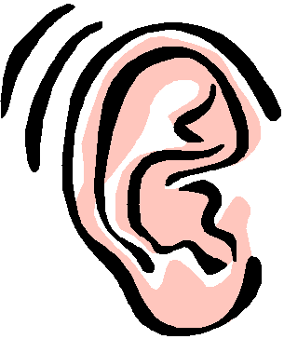

Sensory Memory
The immediate, very brief recording of sensory information in the memory system.
  As you experience your world, your brain operates in parallel or dual processing
  Info. is held in sensory memory for less than a second – most will leave our brains unless we tend to it
  Includes both echoic (auditory) and iconic (visual) memory

Slide 7
Information Processing
George Sperling’s Memory Experiment –
  Presented a series of 9 letters in 3 rows for a brief moment.
  Revealed that we have a fleeting photographic memory
  Iconic memory (Visual sensory memory) – Our eyes register an exact representation of what we see for a split second
  Echoic memory (Auditory sensory memory) If attention is elsewhere, sounds & words can be recalled within 3-4 seconds
Notes:
How presentation will benefit audience: Adult learners are more interested in a subject if they know how or why it is important to them.
Presenter’s level of expertise in the subject: Briefly state your credentials in this area, or explain why participants should listen to you.

Slide 8

Short-Term Memory (Working Memory)
Consists of information we are currently working with and are aware of in our consciousness
  Temporary = 10-30 Seconds
  Limited to 7 +/- 2 units of info. (Magical Number Seven - George Miller)
  Limit can be expanded through chunking (grouping)
  Use maintenance rehearsal (repeating) to prolong its presence in STM
  The info will be stored in long-term memory or forgotten.

Slide 9
Encoding Information
Automatic processing - unconscious encoding of incidental information, such as:
        space
        time
        frequency
        well-learned info such as word meanings
    Doesn’t interfere with ongoing activities.

Slide 10


Encoding Information
Effortful Processing - encoding that requires attention and conscious effort – for learning novel information
Often produces durable & accessible memories
Strategies include rehearsal, chunking, mnemonics, and hierarchies
  Rehearsal - the conscious repetition of information, either to maintain it in consciousness or to encode it for storage

Slide 11

Encoding Information
  Next-in-line effect – (encoding error) when we are next in line, we focus on our own performance & fail to process the last person’s words
  Spacing effect - the tendency for distributed study or practice to yield better long-term retention than is achieved through massed study or practice (cramming).
      Distributed practice = better long term recall!
    Overlearning – even after we learn material, additional rehearsal increases retention

Slide 12
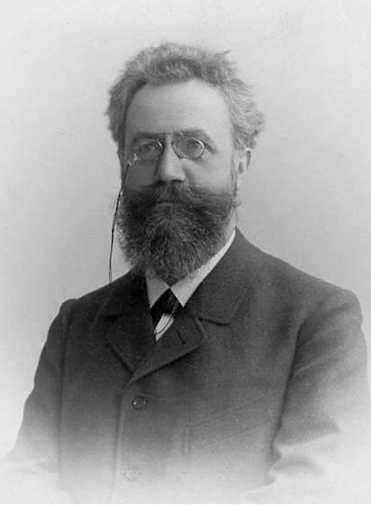
Encoding Information
Herman Ebbinghaus – pioneering researcher in verbal memory
The amount remembered depends on the time spent learning and what we do while learning.
It is important to continue to rehearse course material even after you know it – overlearn!
The more time we spend learning novel information, the more we retain.

Slide 13
Ebbinghaus Retention Curve
The more times he practiced a list of nonsense syllables on day 1, the fewer repetitions he required to relearn it on day 2.
Practice makes perfect!

Slide 14

Encoding Information
Serial position effect – we tend to remember the first and last items on a list better than those in the middle
  Primacy effect – predicts that we are more likely to recall the first items on a list
  Recency effect – refers to our ability to recall last items because they are still in working memory

Slide 15
Encoding Meaning – Levels of Processing
  Encoding can be influenced by levels of processing or the manner in which we engage with information
  Shallow processing – trying to memorize something without attaching meaning to it,
      superficial level – only memorizing
      physical & perceptual features are analyzed
  Deep processing – involves elaborative rehearsal along with meaningful analysis of the ideas and words being learned
      Involves elaboration – the formation of a number of different connections to a stimulus
      Self-Reference effect - relating it to what you already know

Slide 16
Encoding Meaning
Types of encoding for verbal information:
Visual encoding – visual appearance of the letters or images
  (Shallow processing)
Acoustic encoding – the sound of the words
  Rhyming aphorisms – “If the glove doesn’t fit, you must acquit”
Semantic encoding – the meaning of the words
  Deeper, semantic processing
  Produces better recognition later
  Rephrasing what we read & hear into meaningful terms helps memorizing
  Self-reference effect – better recall for info that is relevant to us

Slide 17
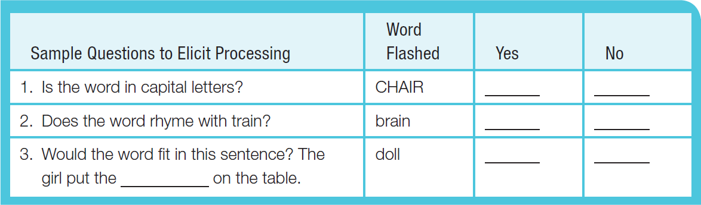
Encoding Meaning
Craik & Tulving experimented to compare the 3 types of encoding.
Flashed a word at people and then asked a question that required people to process the words.

Slide 18
Encoding Meaning

Slide 19

Information Processing Model of Memory
Long-term memory - the relatively permanent and limitless storehouse of the memory system
Types of Long-Term Memory
  Declarative (Explicit) – require conscious thinking (effortful processing) to recall information – specific facts & experiences that we know & can verbalize
      Episodic – personal memories, things you have done, learned, experienced – your life story
      Semantic – general knowledge about the world –
        Important facts, rules, meanings, etc.

Slide 20

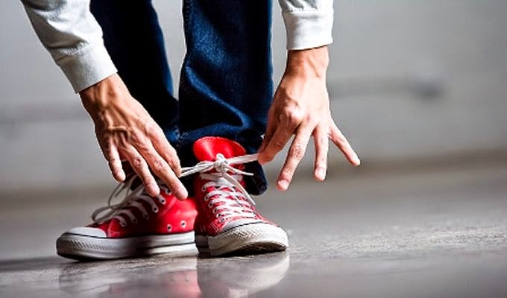
Information Processing Model of Memory
  Types of Long-Term Memory cont.
  Nondeclarative (Implicit) – things that you know that you can show by doing (affected by prior experience)
    Involves automatic processing - unconscious retrieval
    Procedural memory – involves motor & cognitive skills that we can do automatically
    Classical & Operant Conditioning effects – learned associations between stimuli

Slide 21
Long Term Memories
Declarative (Explicit) Memories:
Facts
General Info
Processed in the Hippocampus
Implicit Memory (Procedural):
Memory for Actions
Motor Skills
Emotional Memories
Conditioned
Stored and Processed in the Cerebellum
Episodic Memory:
Info about YOU
YOUR life story
Things you’ve done,
learned, experienced
Semantic Memory:
Facts
Rules
General Info
Not chronological
*Prospective Memory
*Eidetic Memory
Notes:
Prospective Memory - memory for future events
Eidetic - TRUE photographic memory

Slide 22
Storing Memories in the Brain – Synaptic Changes
Memories do not reside in single, specific spots
Memory Trace - Nerve cells communicating memories through synapses (to understand memory, we study these synapses)
Experience modifies neural pathways – they form & strengthen
Serotonin – neurotransmitter released when learning occurs – synapses become more efficient at transmitting signals

Slide 23

Storing Memories in the Brain – Synaptic Changes
Long-term potentiation (LTP) – an increase in a neuron’s firing potential after brief, rapid stimulation
  Your brain LITERALLY changing
  Neurons become more efficient
  Neural path “better connected” and “stronger paths”
  Neural basis for memory and learning
Memory-boosting drugs – researching ways to help Alzheimer’s patients or other forms of memory loss

Slide 24
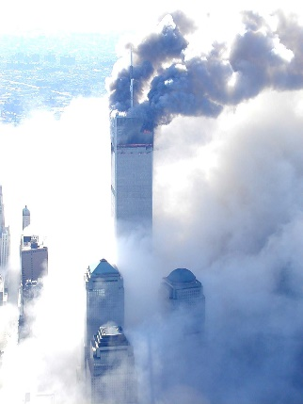
Storing Memories in the Brain - Stress Hormones
When stressed or emotional, more glucose becomes available to fuel brain activity
Amygdala boosts activity and available proteins in memory-forming areas of the brain.
Stronger emotional experiences = stronger, more reliable memories (ex. Traumatic experiences)
Prolonged stress corrodes memory formation – corrodes neural connections
Flashbulb memory - a clear memory of an emotionally significant moment or event

Slide 25

Storing Implicit and Explicit Memories
Amnesia – loss of memory
  Amnesia victims might know how to do something (implicit memory), but not be able to declare what we know (explicit memory).
  Their behavior challenges the idea that memory is a single, unified, conscious system
Retrograde Amnesia - can’t remember what happened before a certain date.
Anterograde Amnesia - can’t transfer working memory to long-term memory.

Slide 26
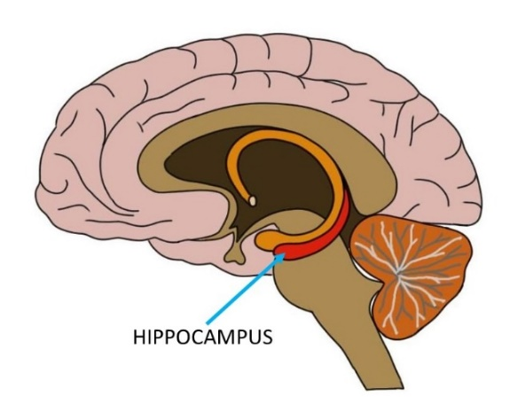
Storing Implicit and Explicit Memories
Hippocampus – helps process explicit memories for storage (names, images, events)
  Location where the brain temporarily stores the elements of a remembered episode (pathway to the cortex)
  Transfer of info from short-term memory to long-term explicit memory
  Infantile amnesia – We don’t have explicit memories of life until around age 3-4 because the hippocampus is one of the last of the brain structures to mature

Slide 27
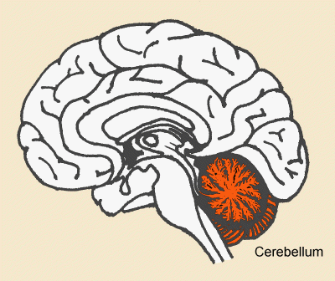
Storing Implicit and Explicit Memories
Cerebellum stores implicit (procedural) memories
Responsible for certain motor reflexes
Plays a key role in forming and storing the implicit memories created by classical conditioning

Slide 28
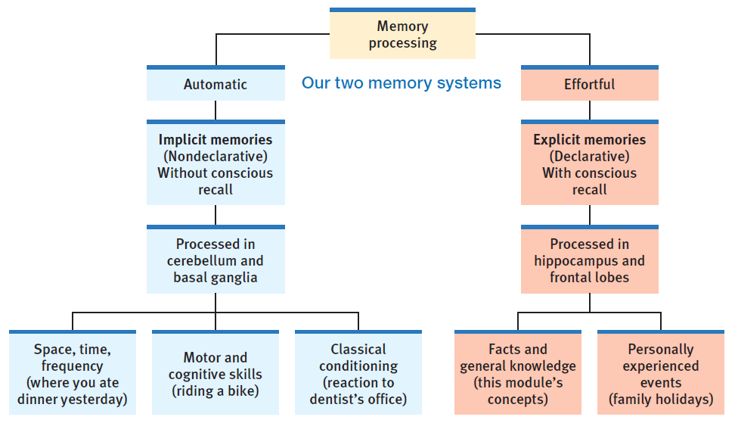
Memory Storage

Slide 29


Retrieval: Getting Information Out
Recall – ability to retrieve information not in conscious awareness
  Ex. Short answer, essay questions
Recognition – measure of memory in which person need only identify items previously learned
  Ex. Multiple choice tests, police lineup, high school classmates

Slide 30
Retrieval: Getting Information Out
Memory is stored in a web of interconnected associations
Retrieval cues – clues or hints (anchor points) that help trigger a long-term memory
  More cues = better chance of finding the info
  EX: courtroom scene – “let me refresh your memory…”
Mnemonic devices serve as decent cues, but best come from associations formed at exact moment of encoding a memory – Tastes, smells, sights, visual cues evoke good retrieval
Mentally placing yourself back in the moment helps retrieval
Context-dependent memories - Put yourself back in the context in which you learned it, you will be primed to recall or recognize easier

Slide 31
Retrieval: Getting Information Out
Priming – awakening of particular associations (often unconsciously)
Tip-of-the-tongue phenomenon – info is stored in long-term memory but retrieval cue is not strong enough
Déjà Vu - That “eerie sense that you have experienced something before.”
  Your current situation cues past experiences that are very similar to the present one - your mind gets confused.

Slide 32
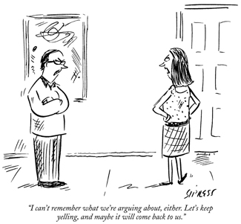
Retrieval: Getting Information Out
Emotions can be retrieval cues
If we return to an experienced emotion, it might trigger or prime us to think about an old experience again
State-dependent memory - If we learn something new in one state of mind, we better recall it later if we return to that state of mind

Slide 33
Retrieval: Getting Information Out
Mood can serve as a retrieval cue.
Mood-congruent memory – the tendency to recall experiences that are consistent with one’s current good or bad mood
  EX: Having a bad day, you think of other bad days
  EX: When you’re mad at your parents or teachers, you remember them as horrible parents or teachers

Slide 34

Forgetting
Schacter’s 7 ways our memories fail us:
Three Sins of Forgetting
  Absent-mindedness – inattention to details
    EX: our mind is elsewhere when we put down our phone
  Transience – storage decay over time
    EX: unused information fades – your memories of kindergarten
  Blocking – inaccessibility of stored information
    EX: That actor’s name is on the tip-of-the-tongue but you can’t get it out

Slide 35

Forgetting
Schacter’s 7 ways our memories fail us:
Three sins of distortion
  Misattribution – confusing the source of information
    EX: put word’s in someone else’s mouth, think a dream was real
  Suggestibility – lingering effects of misinformation
    EX: “Did the teacher call you stupid?” becomes false reality
  Bias – belief-colored recollections
    EX: current feelings about something may color our recalled initial feelings
• One Sin of intrusion
  Persistence – unwanted memories
    EX: haunted by images of traumatic events

Slide 36
Forgetting – Why we can’t remember
  Sometimes we fail to encode so the info never enters our long-term memory
  Older age can effect encoding efficiency
  We selectively attend to only a few stimuli
Ebbinghaus Forgetting Curve – Forgetting is at first rapid then levels off over time (study of the duration of stored memories)
    EX: Spanish
Why?
  Storage decay – gradual fading of physical memory trace (memories may fade over time)
  Accumulation of learning disrupts our retrieval

Slide 37
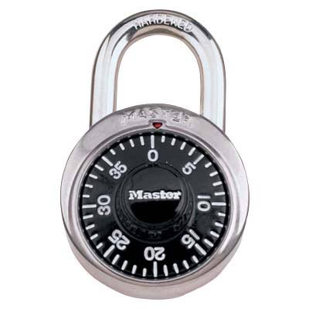

Retrieval Failure - Interference
Proactive interference – (Previous) the disruptive effect of prior learning on the recall of new information.
  EX: last year’s locker combination, old passwords, old address, driving a new car - prevent you from remembering new info
  Note - Positive transfer – old info can facilitate learning of new info.
Retroactive interference – (Recent) the disruptive effect of new learning on the recall of old information.
  EX: can’t remember old phone number, last year’s students, algebra 2, last chapter’s terms

Slide 38

Misinformation & Imagination Effects
We often construct our memories as we encode them, and we may also alter our memories as we retrieve them.
Misinformation effect – after exposure to subtle misinformation, many people misremember
Over time, it may become impossible to discriminate between real memories and suggested memories
We fill in the gaps with guesses and assumptions (confabulation)
Other’s vivid retelling of an event can often implant false memories

Slide 39
Misinformation & Imagination Effects
Elizabeth Loftus – leading memory construction experimenter
In an experiment, asked eyewitnesses:
  A: “How fast were the cars going when they hit each other?
  B: “How fast were the cars going when they smashed into each other?”
Many reported seeing broken glass when they didn’t. (Leading question)

Slide 40
Source Amnesia (Source Misattribution)
Source amnesia occurs when we attribute a memory to the wrong source.
Examples:
  We may hear something and later recall that we saw it or were there
  Thinking that something you imagined really happened.
We retain the memory of an event, but not the context in which we acquired it

Slide 41
Discerning True and False Memories
We can’t be sure whether a memory is real by how it feels.
False memories created by suggested misinformation and misattributed sources may feel as real as true memories and may be very persistent.
Cognitive Interview technique – witnesses are asked to visualize the scene. After witness tells in detail, detectives can ask evocative follow-up questions.
Accurate recall increases

Slide 42

Children’s Eyewitness Recall
Memories can be “enhanced” by leading questions that can plant false memories
Children are highly suggestible
When less leading questions are asked, more accurate information is given
Children’s frontal lobes are not fully matured and are more susceptible to false memories

