Slide 1
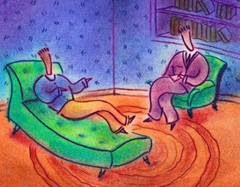
Methods of Therapy
Chapter 17
Notes:
NOTE:
To change the image on this slide, select the picture and delete it. Then click the Pictures icon in the placeholder to insert your own image.

Slide 2
Treatment of Psychological Disorders
2 main categories of mental health treatment:
Psychotherapy – for learning-related disorders such as phobias.
  Re-learn how to alleviate learned problems
Biomedical Therapy – for biologically influenced disorders such as schizophrenia.
  Medication or medical procedure

Slide 3
Treatment of Psychological Disorders
May choose to use a biopsychosocial approach and draw from a variety of techniques.
Eclectic Approach – an approach to psychotherapy which is a blend of approaches, depending on the problem of the client

Slide 4
Psychotherapy
Psychotherapy – Treatment involving psychological techniques; consists of interactions between a trained therapist and someone seeking to overcome a psychological difficulty or achieve personal growth.
Includes psychoanalytic, humanistic, behavioral, and cognitive therapies – used 1 on 1 or in groups of people

Slide 5
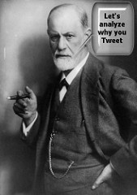
Psychoanalysis
Sigmund Freud – 1st of the psychological therapies
Freud believed the patient’s free associations, resistances, dreams, and transferences – and the therapist’s interpretations of them – released previously repressed feelings, allowing the patient to gain self-insight.
Attributes our thoughts and actions to unconscious motives and conflicts
Presumes that healthier, less anxious living is possible when energy previously devoted to id-ego-superego conflicts is released.

Slide 6
Psychoanalytical Techniques
Free Association - involves the client speaking freely about any topic or image that comes into his her mind
Resistance - when the client unconsciously tires to block the process of revealing repressed memories - this leads to revealing conflicts
Interpretation - during free association the therapist offers insight to and explanations of the client’s thoughts, remarks and actions

Slide 7
Psychoanalytical Techniques
Dream interpretation - involves identifying and separating the manifest content (portion of the dream that is consciously remembered), and the latent content (the impulses, wishes, and fantasies) which help to gain insight into the unconscious
Transference - occurs when the patient unconsciously transfers emotions linked with other relationships to the analyst - most important technique

Slide 8
Contemporary Psychodynamic Therapy
Criticisms – expensive, time-consuming, interpretations can’t be proven or disproven
Short-term psychodynamic therapy - more common now
  clients get quicker diagnosis and are not required to go for more than a few months – (emphasis still on the unconscious)
Interpersonal therapy - another psychodynamic approach
  focuses on current relationships instead of spending too much time on the past

Slide 9
Humanistic Therapy
Belief that people are inherently good and are motivated to grow psychologically
Emphasizes striving for and reaching human potential
Believe a person’s self-concept (thoughts of themselves) is the most important feature, and given the right environment, the self-concept can grow

Slide 10
Humanistic Therapy
Differ from the psychoanalytic perspective in 3 ways:
  Focus on fostering growth instead of relieving illness
  Focus on the present and future instead of the past
  Emphasize conscious thought as opposed to the unconscious
Carl Rogers, once a psychodynamic therapist, was upset with how formal and detached psychoanalysis had become and as a result became a humanistic therapist.
  Wanted to establish a therapeutic environment that encouraged growth and self-discovery by the client

Slide 11
Humanistic Therapy
Assumptions:
Treatment is an encounter between equals (not “cure” by “expert”)
Clients improve on their own, given the right conditions (conditions promote awareness, acceptance, emotional expression)
Ideal conditions established by feeling fully accepted/supported as human beings
Clients remain responsible for choosing how they think/behave

Slide 12
Humanistic Therapy
Client-centered or person-centered therapy:
Allows client to decide what to talk about without direction (non-directive therapy), judgment, or interpretation
Rogers encouraged therapists to exhibit a genuine, accepting, empathic environment to facilitate the client’s growth
Active listening – Empathic listening in which the listener echoes, restates, and clarifies what the person expresses

Slide 13
Behavior Therapy
Psychodynamic therapy – people fix problems by gaining insight into their unconscious minds
Humanistic therapy – people fix problems as they get in touch with their feelings
Behavior therapy –
  Doubts healing power of self-awareness
  Assumes behaviors are the problems
  Applies learning principles to eliminate an unwanted behavior (classical & operant conditioning)
  Learned behaviors (phobias or anxiety) are replaced by constructive behaviors

Slide 14
Behavior Therapy
Counterconditioning – learning of a new conditioned response that is more effective than the original learned response
Two types – exposure therapies & aversive conditioning:
    Exposure Therapy – treat anxieties by exposing people to the things they fear and avoid (Mary Cover Jones - Peter & the rabbit)
  Aversive Conditioning – associates an unpleasant state with an unwanted behavior

Slide 15

Behavior Therapy
    Types of exposure therapy:
    Systematic Desensitization – type of counterconditioning that associates a pleasantly relaxed state with gradually increasing anxiety-triggering stimuli (Commonly used to treat phobias)
    Virtual reality exposure therapy – allows clients to experience their fears in a controlled computerized setting without real-world context

Slide 16
Behavior Therapy
Aversive conditioning – seeks to condition an aversion to something the client should avoid (the reverse of systematic desensitization)
  Associates the unwanted behavior with unpleasant feelings (ex. Alcoholism)
  Criticisms of aversive conditioning:
    May only work short-term
    Cognition influences conditioning – people can discriminate between the aversive situation and all other situations

Slide 17
Behavior Therapy
Behavior modification therapists believe that maladaptive behavior can also be modified through consequential actions
Operant Conditioning – used to reinforce desired behaviors and to withhold reinforcement for undesired behaviors
Positive reinforcements - Set up contingencies (rules) that specify behaviors to be strengthened through reinforcement of closer and closer approximations

Slide 18
Behavior Therapy
Token economies - a token (positive reinforcement) is given after a desired behavior is performed (often used in rehab or institutional setting)
  Can be exchanged for desired items/activities
  Used by parents, schools, daycares, hospitals

Slide 19
Cognitive Therapy
Aaron T. Beck, originally trained as a psychoanalyst, developed cognitive therapy (CT)
Cognitive therapy - Teaches people new, more adaptive ways of thinking and acting
  Based on the assumptions that our thoughts intervene between events and our emotional reactions
  Seeks to reverse people’s negative about themselves, their situations, and their futures

Slide 20
Cognitive Therapies
Cognitive-Behavioral Therapy – therapy that combines cognitive (self-defeating thinking) and behavior (changing behavior) therapies.
  Attempts to alter thoughts as well as the actions
  Especially effective in treating OCD, anxiety, or depression

Slide 21
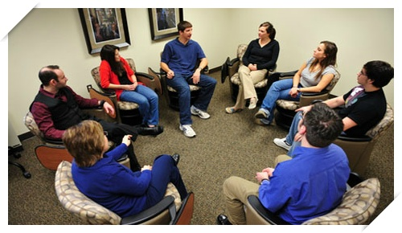
Group and Family Therapies
Advantages of group therapy:
  Saves time & money
  Learn other’s have the same problems too
  Receive feedback as they try out new ways of behaving
  Group therapy works well with alcoholics (AA)
Family Therapy – view’s an individual’s behavior as guided by or directed at other family members
  tries to improve communication and relationships in this “system”

Slide 23
Evaluating Psychotherapeutic Approaches
A meta-analysis gathers large amounts of data from a variety of sources and then presents the data in a single report
Cognitive, behavior, and interpersonal therapies effective for treating depression
Cognitive, behavior, and exposure therapies good for treating phobias, panic disorders, and OCD
Cognitive-behavior therapy good for treating eating disorders
Behavior modification good for treating bed-wetting
Psychoanalysis good for treating borderline personality disorder, and substance abuse disorders

