Slide 1
The Body and Behavior

Slide 2
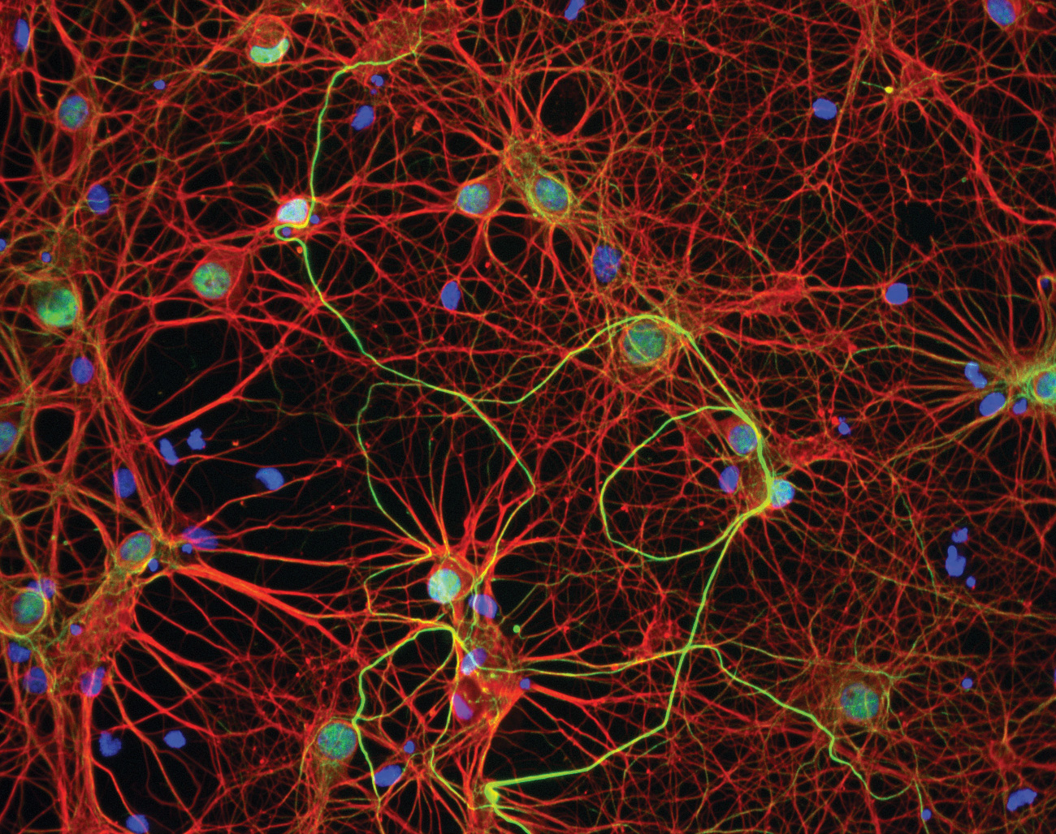
Neurons and Brain Communication
Messages to and from the brain travel along the nerves, which are strings of long, thin cells called neurons.
Neurons –
  Basic building blocks of the nervous system
  There are many different types
  Human brain has about 86 billion neurons
  The body’s info system is built from billions of interconnected neurons.

Slide 3
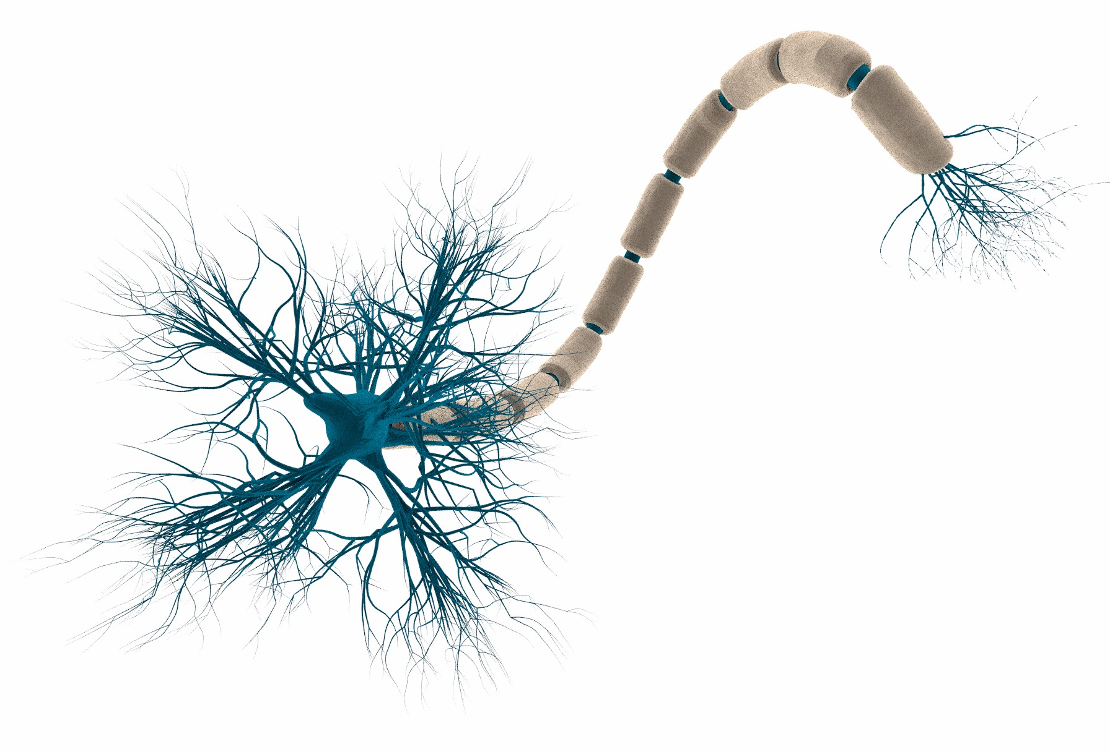
Structure of the Neuron
Soma - Cell body; contains the nucleus
Dendrites – short, thin fibers that receive impulses from other neurons & send them down the cell body
Axon – carries info away from the cell body, passes messages along to other neurons, muscles, or glands
Myelin Sheath - Fatty tissue that insulates & protects the axon, speeds the transmission of impulses
Axon Terminal – branches at end of the axon
Nodes of Ranvier - Small gaps on the axon

Slide 4
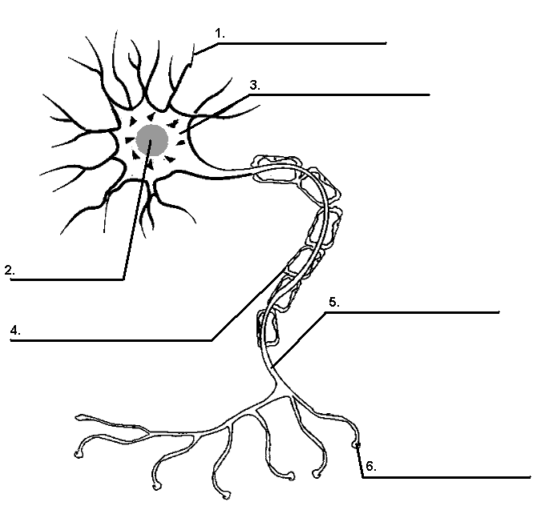
Structure of the Neuron
Dendrites
Nucleus
Soma (Cell body)
Myelin sheath
Axon
Axon terminals

Slide 5
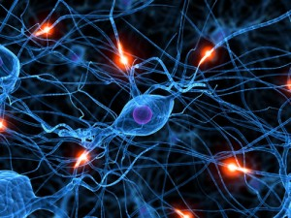
Neural Communication
Synapse- The junction across which a nerve impulse passes from an axon terminal to a neuron, a muscle cell, or a gland cell.
Vesicles - Containers for neurotransmitters
Neurotransmitters – Chemical messengers that send info between neurons
Synaptic Gap- The tiny gap/space between the two neurons
Action Potential - An impulse or electrical charge that travels down the axon

Slide 6
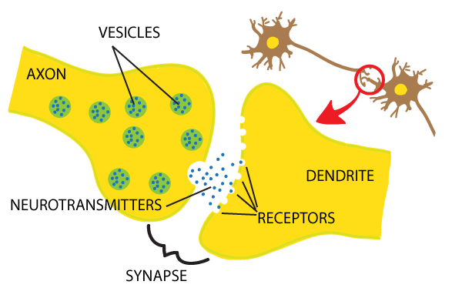
Neural Communication

Slide 7
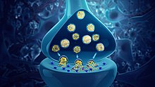
Neurotransmitters
Each neurotransmitter travels a designated route in the brain and has a particular effect on behavior and emotions.
Neurotransmitters & how they influence us:
Acetylcholine - (ACh) Enables muscle action, learning, and memory.
  The deterioration of ACh cause Alzheimer’s disease.
Dopamine – Pleasure chemical – related to reward and motivation
  Also influences fine motor coordination, learning & attention
  Too little = Parkinson’s Disease…Too much = Schizophrenia

Slide 8
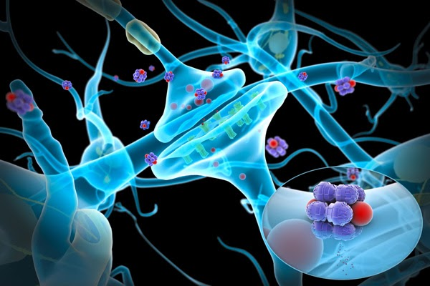
Neurotransmitters
Serotonin - Affects mood, hunger, sleep, and arousal
  High levels = happiness
Norepinephrine - Helps control alertness and arousal
  Active in our response to danger
Endorphins - Natural, opiate like neurotransmitters linked to pain control and to pleasure

Slide 9
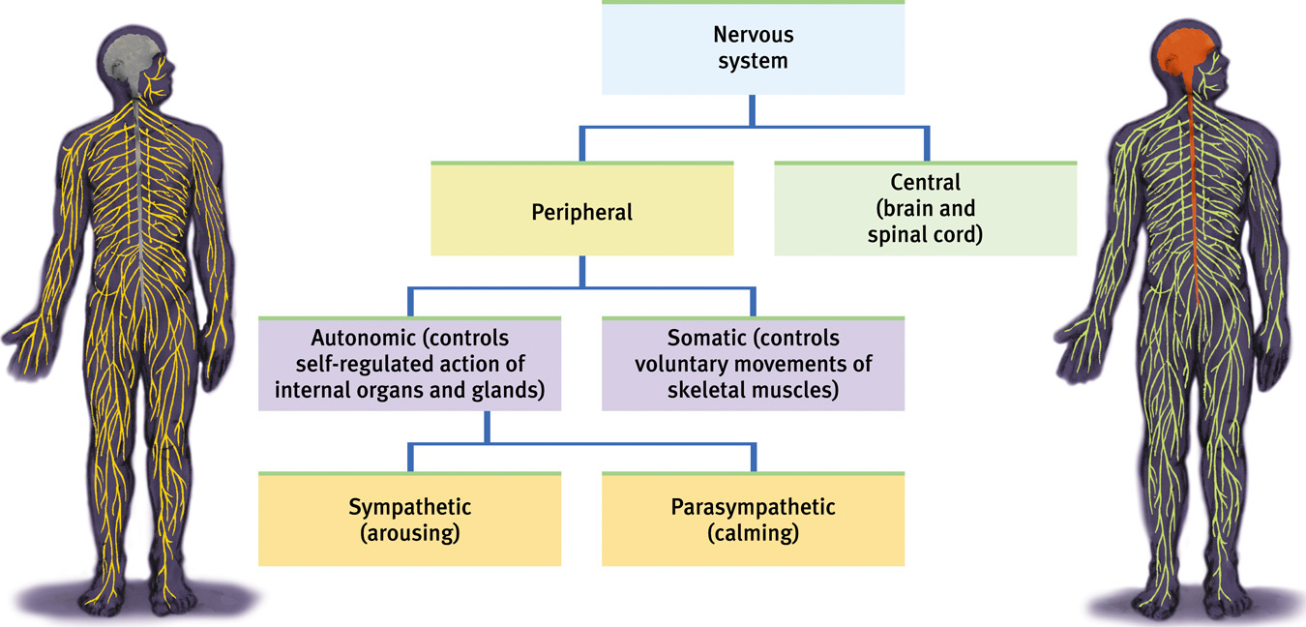
The Nervous System
The body’s speedy, electrochemical communication network, consisting of all the nerve cells of the peripheral and central nervous system.

Slide 10
The Nervous System
Central Nervous System (CNS) – Master control system, includes brain and spinal cord
Peripheral Nervous System – The sensory and motor neurons that connect the CNS to the rest of the body
Autonomic Nervous System – Self-regulated action of internal organs & glands, heartbeat, digestion
Sympathetic Nervous System – Arouses the body
Parasympathetic Nervous System – Calms the body
Somatic Nervous System – Enables voluntary control of skeletal muscles (walk, run, talk, etc.)

Slide 11
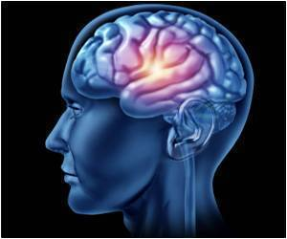
The Brain
Most demanding organ of the body (uses 25% of our nutrients)
Uses about 20% of all your oxygen
Runs on 20 watts if electrical power
Average brain weighs 3 about pounds

Slide 12
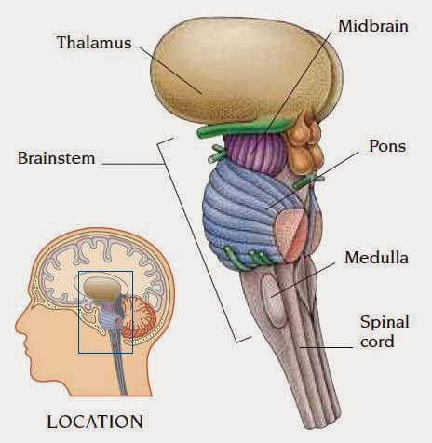
The Brainstem
Oldest part and central core of the brain
Begins where the spinal cord swells as it enters the skull
Consists of the midbrain, pons, and medulla
Controls basic life-support functions such as heartbeat, breathing, circulation, & swallowing

Slide 13
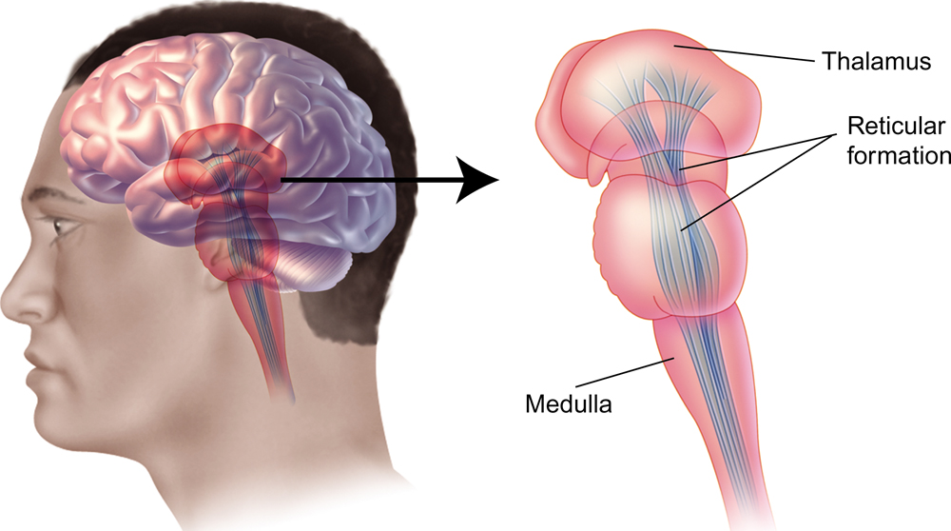
The Brainstem
Medulla – located at the base of the brainstem – blends into the spinal cord
  Automatic reflex center - Controls heart rate, breathing, coughing, vomiting, swallowing
  Damage = death

Slide 14
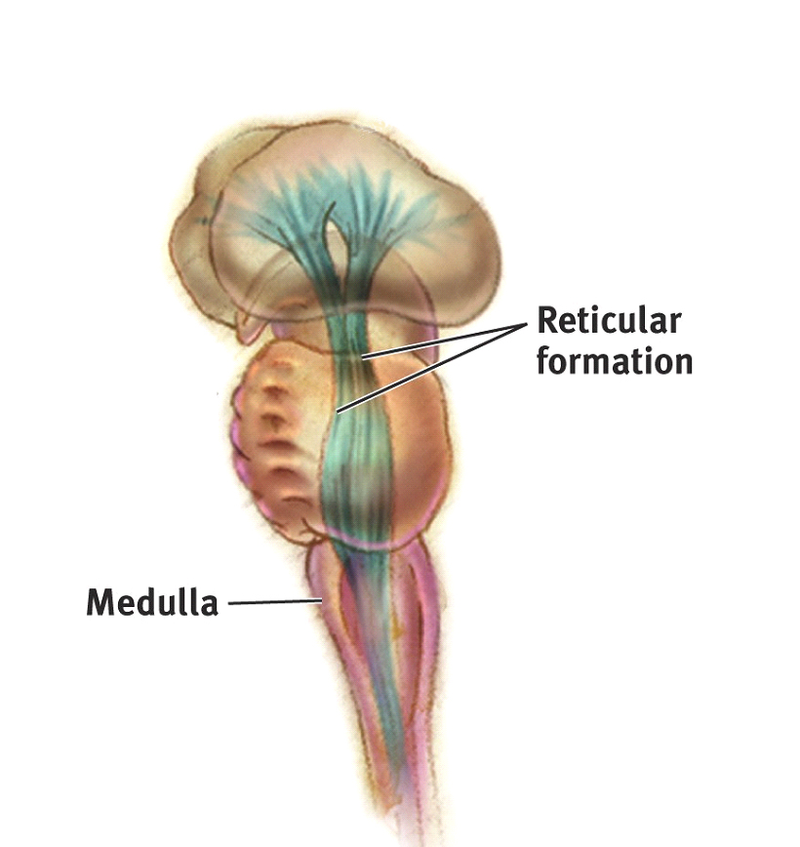
The Brainstem
Reticular formation – nerve network located at the base of the brain just inside the spinal cord
Regulates how active or sleepy your brain is
Anesthesia works on this part of the brain
Permanent damage = coma

Slide 15
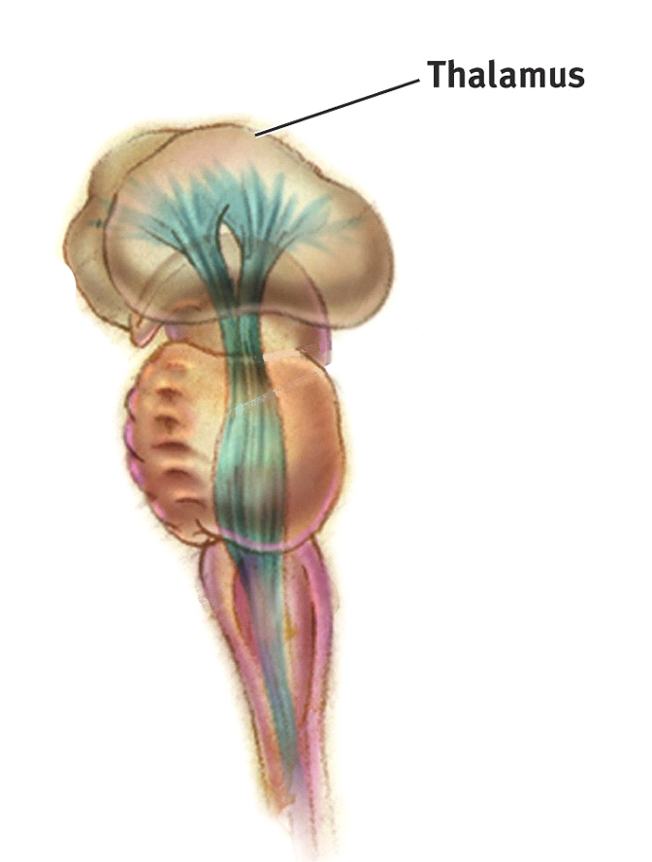
The Brainstem
**Pons – (means “bridge”)
Involved with arousal – sleep and wakefulness
Controls automatic functions like respiration
Involved in relaying sensory information between the cerebrum and cerebellum
Pons

Slide 16
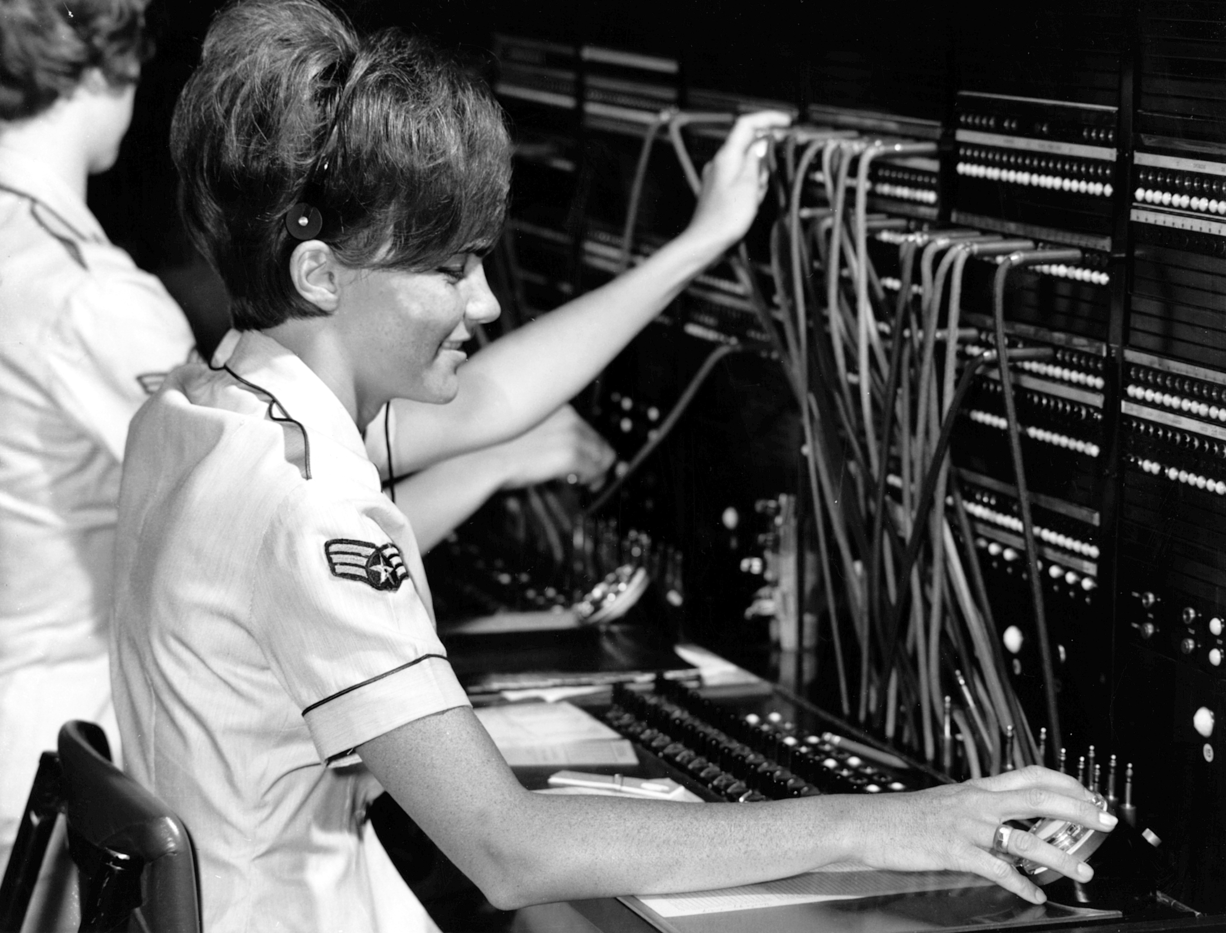
The Brain
Thalamus – “inner chamber” is located at the top of the brainstem in the middle of the brain.
Brain’s sensory switchboard – processes all senses except smell
Relays all sensory signals to appropriate areas in the cortex

Slide 17
The Brain
Cerebellum – “little brain” attached to the rear of the brainstem
Primary role - coordination of voluntary movements & balance
Controls memories for knowing how to use your body for things
  Sequence of programming
  Calculates speed and direction

Slide 18
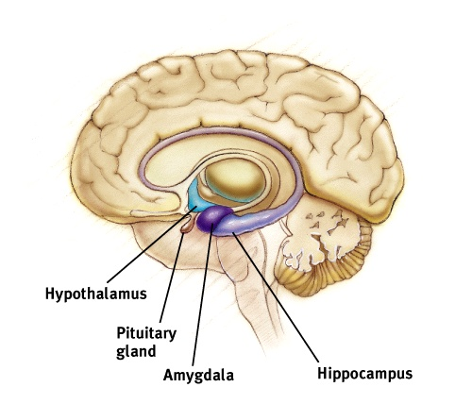
The Brain
Limbic System – ring of structures at the border of the brainstem & cerebral cortex
Consists of the hypothalamus, hippocampus, & amygdala
Helps regulate memory, fear, aggression, hunger, & thirst

Slide 19
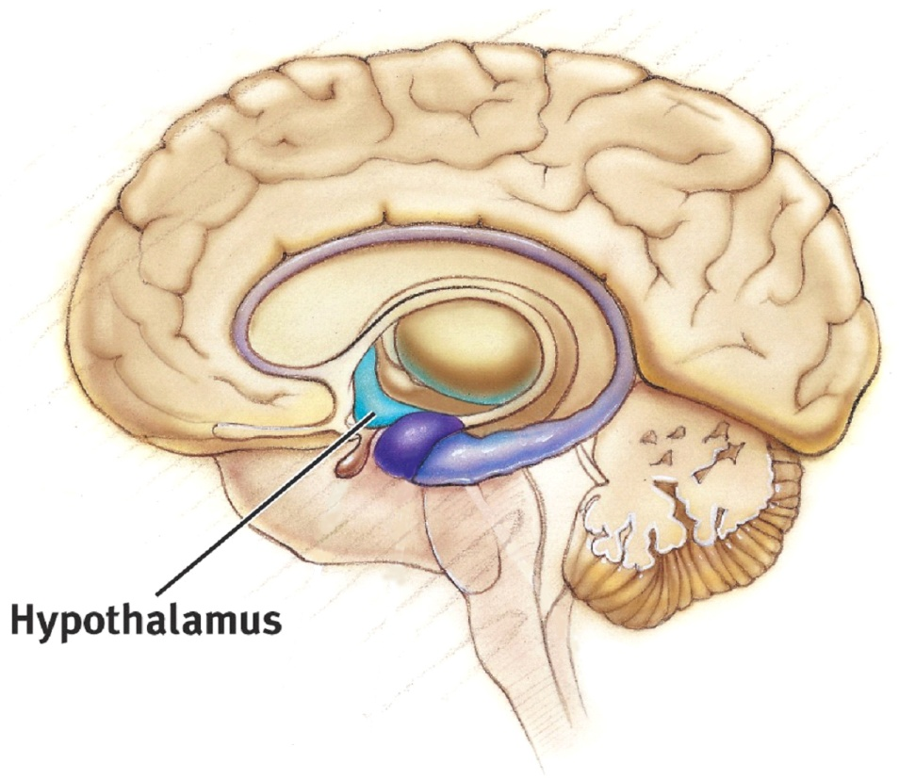
The Brain
Hypothalamus – (“hypo” = below) pea-sized structure lying beneath the front of the thalamus
Helps maintains homeostasis – keeps body’s activities balanced – hunger, thirst, fight or flight reaction, body temperature
Controls rage, pleasure, sexual desires
Helps control the endocrine system by giving directions to the pituitary gland.

Slide 20
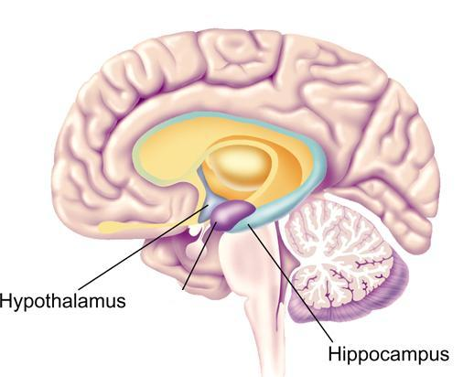
The Brain
Hippocampus – (shaped like a seahorse) – wraps around the back of the thalamus
Helps process new memories for permanent storage

Slide 21
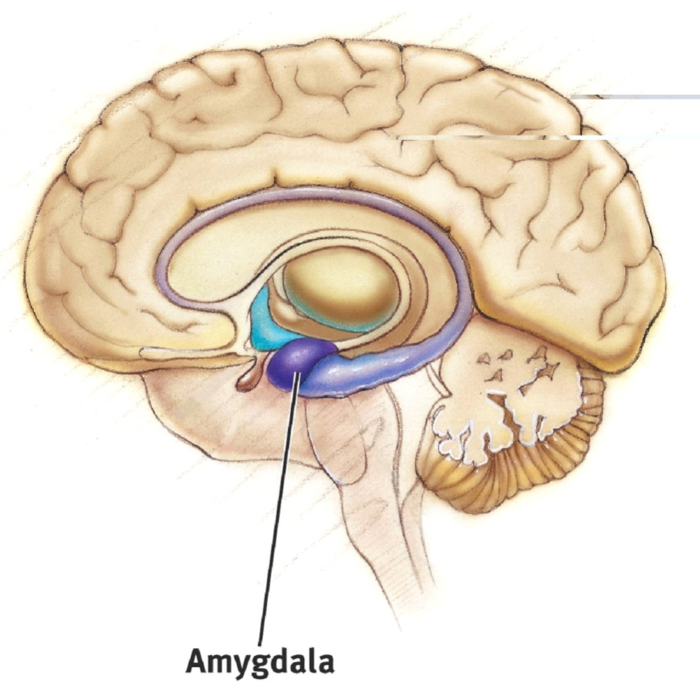
The Brain
Amygdala – 2 almond-shaped clusters located at the border of the brainstem
Controls emotional responses such as fear or anger
Coordinates “fight or flight” response

Slide 22
The Brain
Cerebral Cortex – the brain’s wrinkled outer surface
  Intricate fabric of interconnected neurons makeup the body’s ultimate control and information-processing center
  “cerebral” means higher thinking; “cortex” means bark
  Responsible for thinking, calculating, organizing, & creativity
  2/3 of the brain’s nerve cells are here; 80% of the brain’s weight
  Sets humans apart from other species
  Divided into 4 lobes by fissures (deep
    grooves)

Slide 23
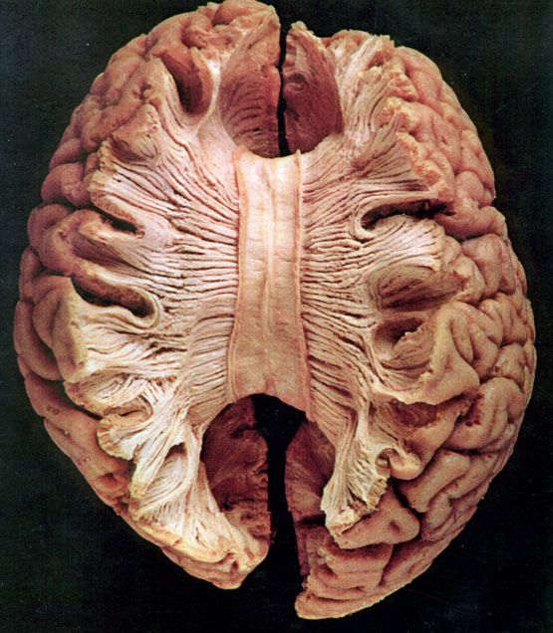
The Brain
Corpus Callosum – large band of neural tissue connects the left and right hemispheres of the brain
Allows the two halves to communicate with each other
Sometimes cut to prevent seizures

Slide 24
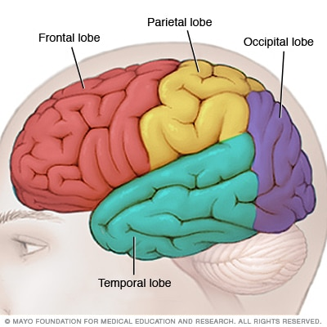
The Brain
Frontal Lobe – located behind the forehead
  Controls largest voluntary muscle movement (includes motor cortex)
  Controls advanced cognitive abilities – judgement, planning, reasoning
  Personality
  Emotional reactions
  Damage could cause change in personality – Phineas Gage

Slide 25
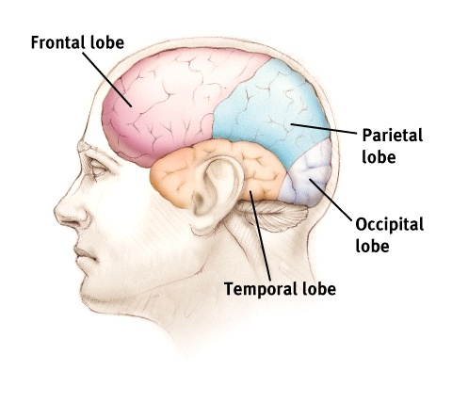
The Brain
Parietal Lobe – processes sensory info related to taste, touch, pressure, temperature, pain, & body movement
Includes the somatosensory cortex
If damaged = inability to feel sensation of touch

Slide 26
The Brain
Occipital Lobe – processes visual information
Temporal Lobe – processes sound; language and speech comprehension systems located here

Slide 27
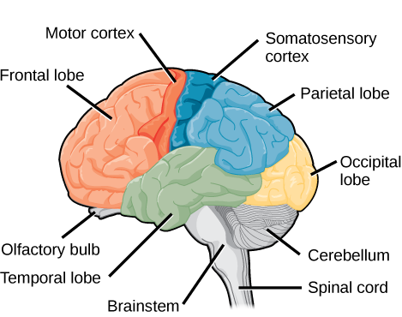
The Brain
Motor Cortex – (the rear edge of the frontal lobes) controls voluntary movements of your body parts
Somatosensory Cortex – (front of the parietal lobe, just behind the motor cortex) registers and processes body sensations

