Slide 1
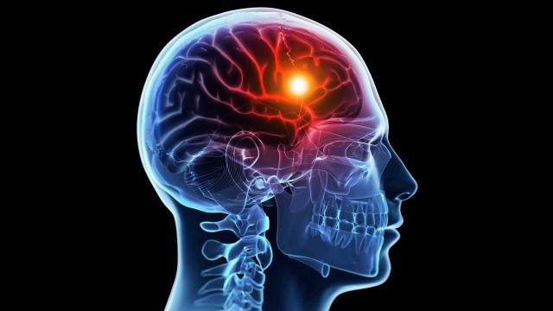
Neuroscience and Behavior
Chapter 2

Slide 2
Psychology and Biology
Everything psychological is simultaneously biological.
Everything going on in our mind coincides with something going in in our body
We are bio-psycho-social systems. Biological, psychological and social systems interact to produce our mind & behavior

Slide 3
Biological Psychology
Biological Psychology – the study of the links between biology and behavior, between biological activity and psychological events
Phrenology – Franz Gall - early theory that bumps on the skull could reveal our mental abilities and our character traits.

Slide 4
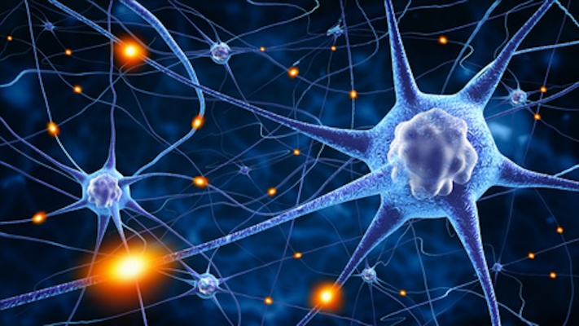
Neurons
Neurons – the basic building block of the nervous system
Can be different sizes and shapes, all share similar structure, & function in a similar way.
Three main tasks:
  Receive information from the neurons that feed it.
  Carry information down its length.
  Pass the information on to the next neuron.

Slide 5
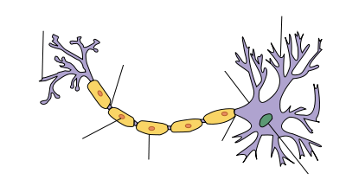
Neurons
Three categories based on neuron location and function:
    Sensory (Afferent) Neurons – transmit information from the spinal cord to the brain
    Motor (Efferent) Neurons – transmit information from the brain to muscles and glands
    Interneurons – make up the central nervous system and communicate internally between the sensory and motor neurons
Sensory
Afferent
Motor
Efferent

Slide 6
Basic Structure of a Neuron
Dendrite - “receiver” part of the neuron
Consists of finely branched fibers that accept most of the incoming messages from other cells and conducts them toward the cell body

Slide 7
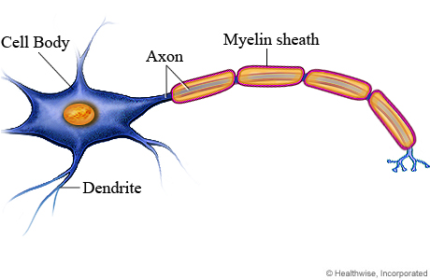
Basic Structure of a Neuron
Soma – cell body encasing the nucleus that produces neurotransmitter substances and helps protect the nucleus
Nucleus – centerpiece of a neuron that contains the DNA information determining how a neuron will fire

Slide 8
Basic Structure of a Neuron
Axon - neural impulses are passed away from the cell body to other neurons, muscles, or glands
Axon hillock – gatekeeper structure that determines whether info. will proceed down the neuron

Slide 9
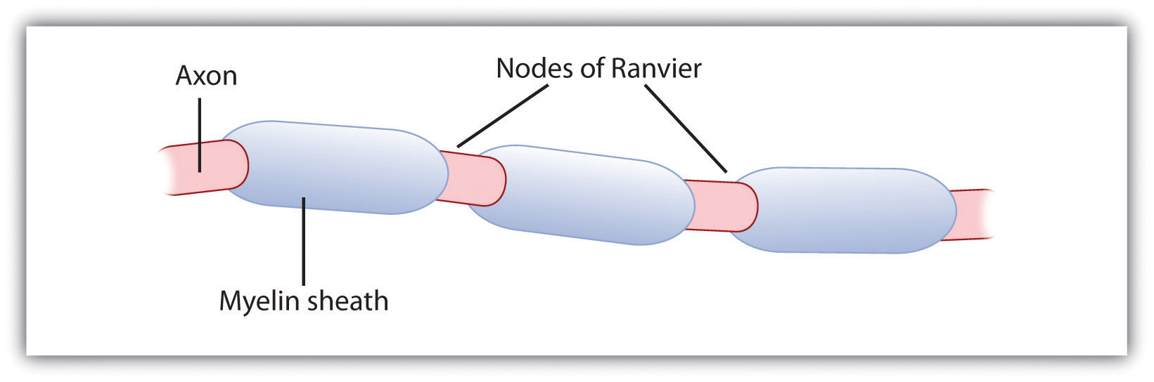
Basic Structure of a Neuron
Myelin sheath – layer of fatty tissue that insulates or protects the axons of some neurons and helps speed their impulses.
    If myelin sheath deteriorates – MS
Nodes of Ranvier – gaps within the myelin sheath that help to speed up the impulses

Slide 10
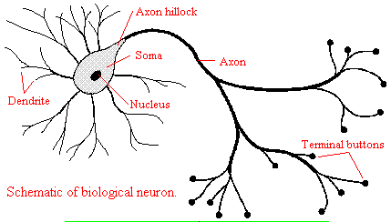
Basic Structure of a Neuron
Axon terminal buttons – ending part of a neuron where neurotransmitters are stored and released.
    Form junctions with other cells
    Synapse/synaptic cleft – gap between dendrites of one neuron and axon of another neuron

Slide 12
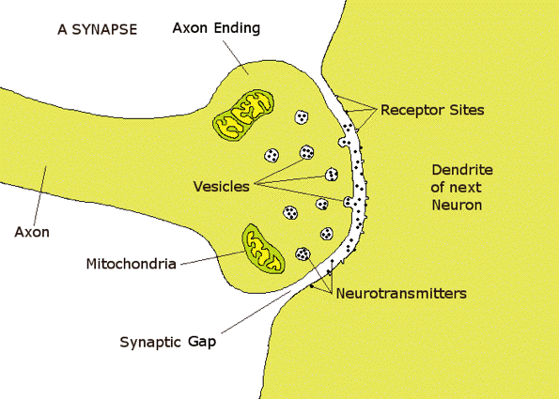

Slide 13
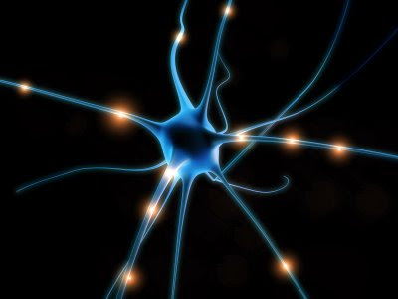
Neural Communication
Neurons communicate when information travels along the axon in the form of an electrical charge
Action potential – a neural impulse caused by a brief electrical charge that travels down an axon

Slide 14

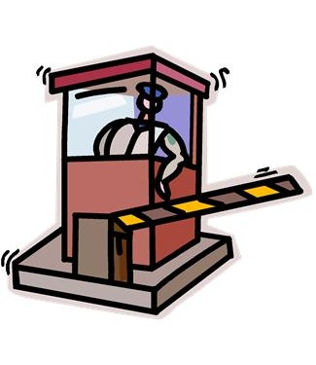
Neural Communication
Resting Potential – more negative ions (electrically charged atoms) are inside the neuron than outside (-70 mv – millivolts)
Neuron is not transmitting information (similar to a compressed spring)
The neuron is said to be polarized when negatively charged ions exist within the axon
The system wants to balance charges, but the selectively permeable membrane is closed in this state. It blocks positive sodium ions.

Slide 15
Neural Communication
Neuron receives information from thousands of other neurons
– Some excitatory (like pushing the gas pedal)
– Others are inhibitory (like pushing the breaks)
If the excitatory signals outnumber the inhibitory signals, the neuron reaches the threshold.
Threshold – minimum amount of stimulation necessary to generate an action potential (above -55 mv)
Analogy: To pull the trigger of a gun, it takes a certain threshold of finger pressure to fully squeeze it and force the trigger to shoot

Slide 16
Neural Communication
Once the action potential is released, there is no going back.
All-or-none response - The axon either “fires” or it does not
  A stronger stimulus, like a slap, can trigger more neurons to fire and to fire more often, but not any stronger.
  Analogy: Squeezing a trigger harder won’t make the bullet go faster.

Slide 17
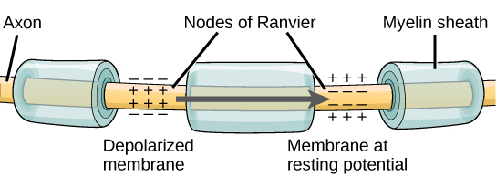
Neural Communication
When the neuron fires, positively charged sodium & potassium ions pass through the membrane and down the axon causing depolarization
Depolarization is the initial movement of the action potential where the action passes from the resting potential in the cell body into the action potential in the axon.

Slide 18
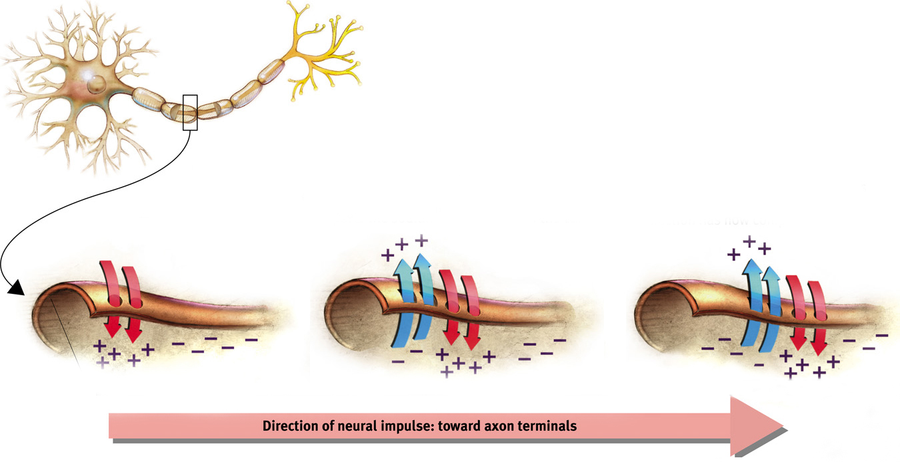
Neural Communication

Slide 19
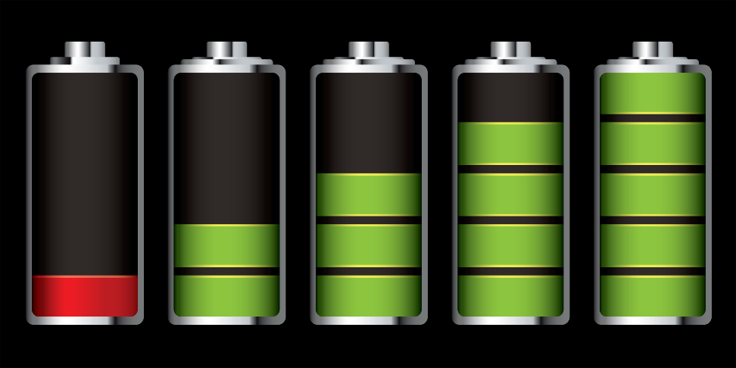
Neural Communication
Refractory period – after the neuron fires, it is not able to fire another action potential until returning back to polarization (recharge)
  Analogy: waiting for the flash to recharge on a disposable camera before you can take another picture.
  A pump in the cell membrane transports the positively charged sodium ions back out of the cell so that it can return to resting potential.

Slide 20
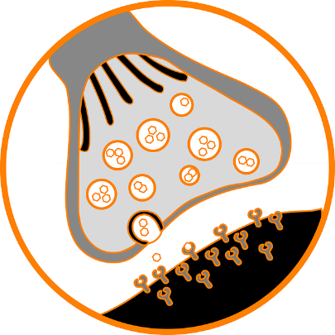

Neural Communication
Neurons do not actually touch each other to pass on information.
Synapse - The gap between the dendrites of one neuron and the axon of another neuron
Neurotransmitters - chemicals messengers that carry information across the synapse.
If they have the right fit, the transmitters fit into the receptors like a key into a lock.
Reuptake – sending neuron absorbs the excess neurotransmitters left in the synapse.

Slide 21
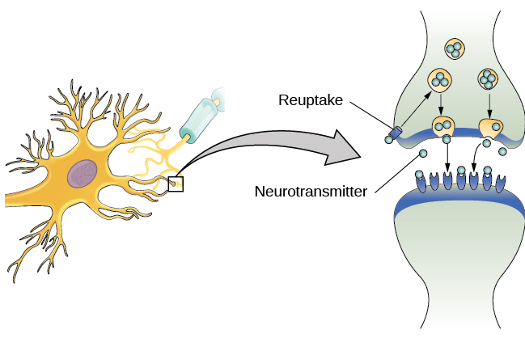
Neural Communication

Slide 22
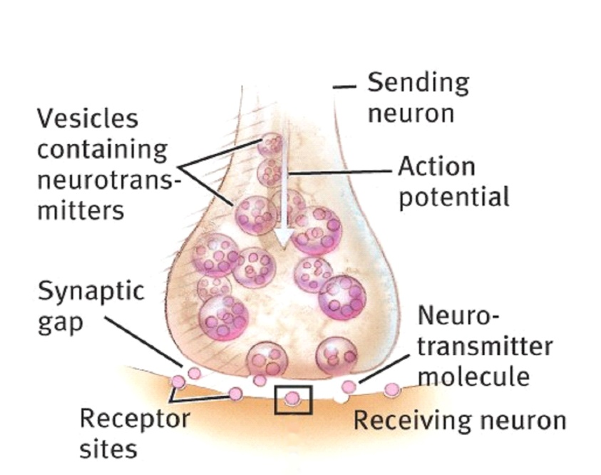
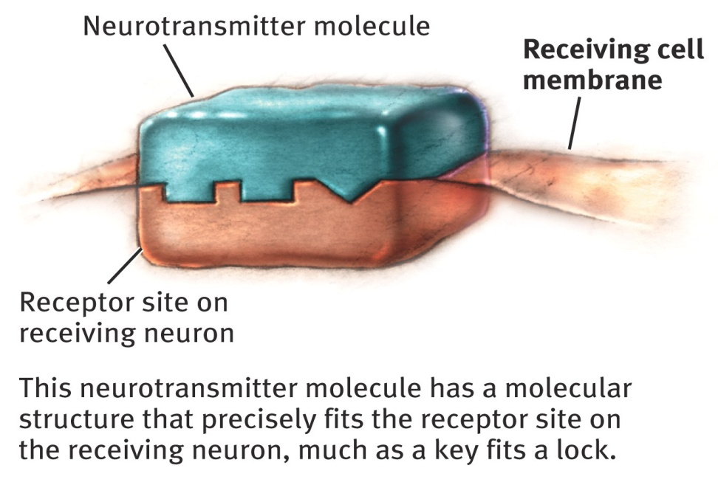
Neurotransmitters

Slide 23
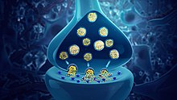
Neurotransmitters
Neurotransmitters are involved in everything from bodily movement to emotion
An imbalance of neurotransmitters may cause maladaptive behavior
Neurotransmitters may be:
  Inhibitory – discouraging the firing of another neuron
  Excitatory –allowing an action potential to occur

Slide 24
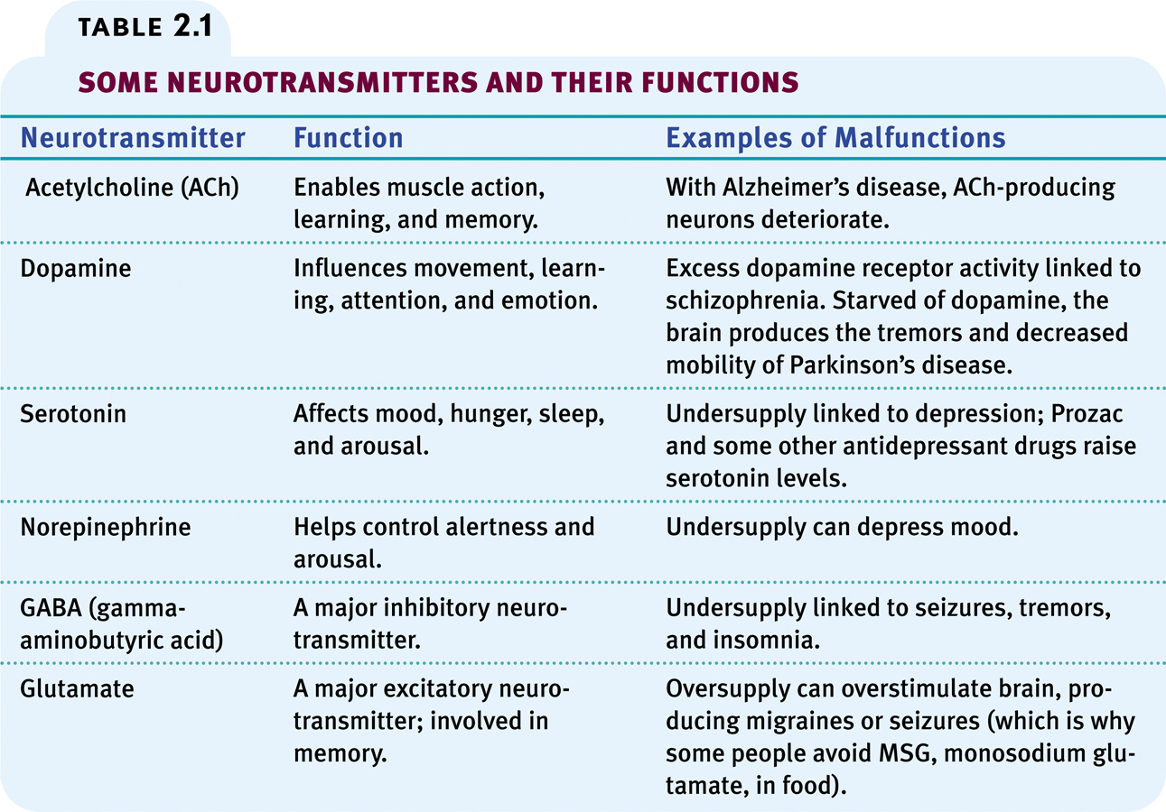
Table 2.1, page 53

Slide 25
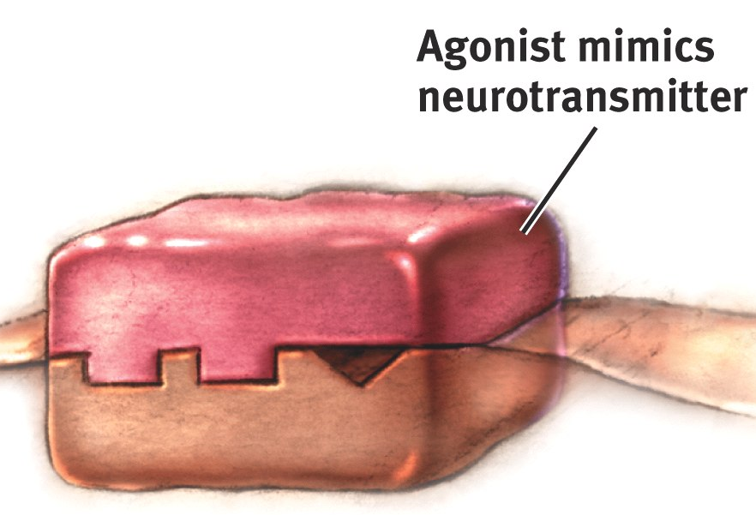
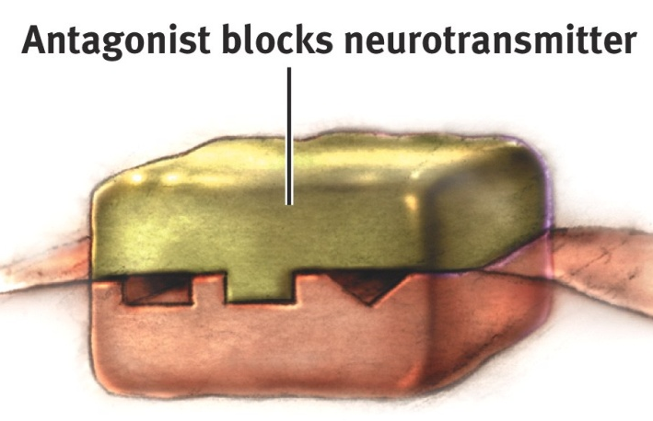
Drugs & Other Chemicals
Drugs and other chemicals affect brain chemistry at the synapses
If it is an agonist molecule it will bind to a receptor and mimic the neurotransmitter’s effect
  Some opiates are agonists and produce a temporary “high” by amplifying normal sensations of arousal and pleasure
If it is an antagonist, the molecule will bind to a receptor and block a neurotransmitter’s function

Slide 26
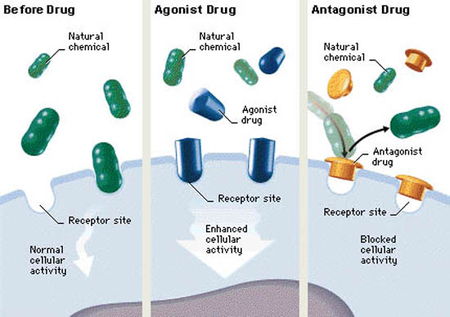
Drugs & Other Chemicals

Slide 27
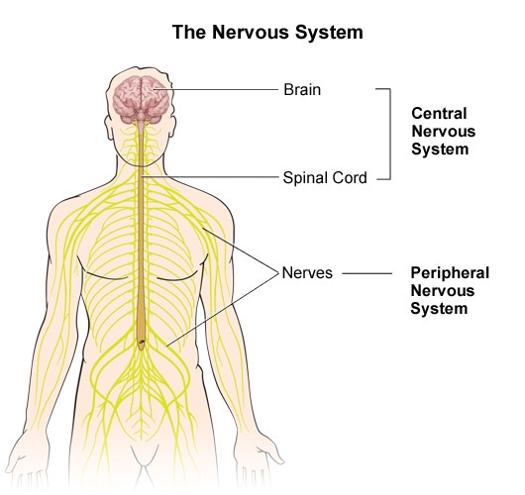
The Nervous System
Nervous System – the body’s speedy, electrochemical communication network consisting of nerve cells
Divided into 2 main branches:
  Central Nervous System (CNS)
  Peripheral Nervous System (PNS)

Slide 28
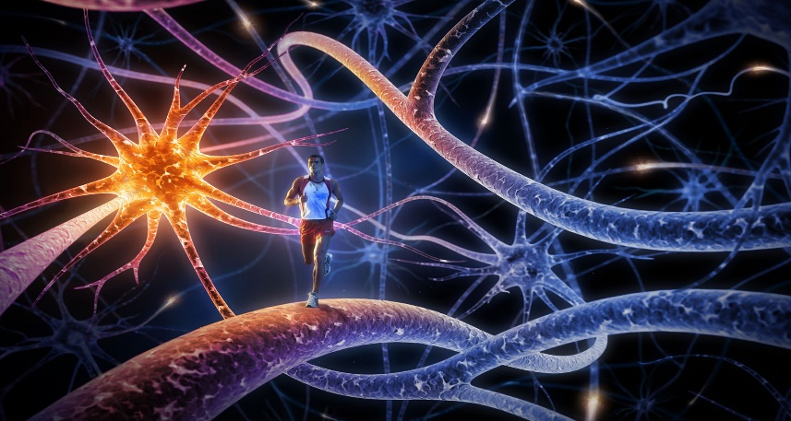
The Nervous System
Information travels in the nervous system via:
    Sensory Neurons (Afferent) – transmit incoming info from the body’s tissues and sensory organs to the brain & spinal cord
    Motor Neurons (Efferent) – transmit information from the brain to muscles and glands, causing movement
    Interneurons – make up the CNS and communicate internally between the sensory inputs and motor outputs
Sensory neurons travel through
Afferent nerves
Motor neurons travel through
Efferent nerves

Slide 29
Glial Cells
The "supporting cells" of the nervous system
Most abundant cell types in the central nervous system.
Glial cells:
    surround neurons and hold them in place
    supply nutrients & oxygen to neurons
    insulate one neuron from another
    destroy and remove dead neurons

Slide 30
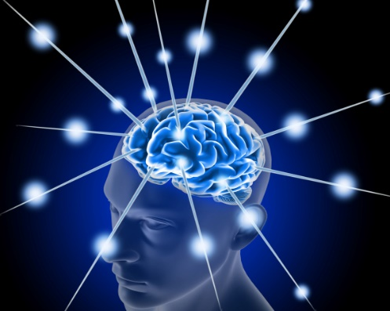
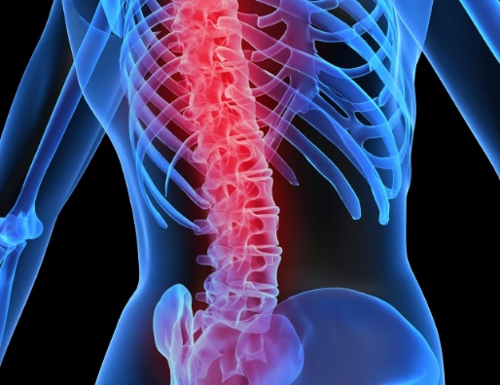
Central Nervous System (CNS)
Brain
Spinal Cord
Enables all functioning
Contains billions of neurons working together in neural networks to facilitate output
As we learn, our networks strengthen
Connects the peripheral nervous system (PNS) to the brain
Handles reflexes (our automatic responses to stimuli)

Slide 31
Peripheral Nervous System (PNS)
Links the CNS with the body’s sense receptors, muscles, & glands
Consists of 2 divisions:
  Somatic nervous system (SNS) – controls voluntary movements
    Sends messages back and forth to brain about sense & movement
  Autonomic nervous system (ANS) – controls involuntary movements (internal functioning – “auto pilot”)
    Dual system – contains sympathetic and parasympathetic nervous systems

Slide 32

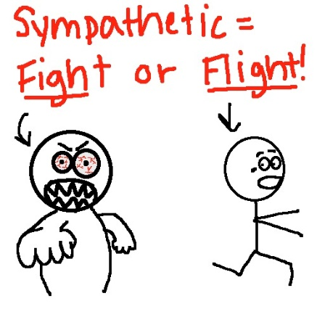
Autonomic Nervous System
Sympathetic Nervous System
Parasympathetic Nervous System
Arouses - “Fight or flight” response
Accelerates heartbeat & raises blood pressure
Slows digestion
Makes you alert & ready for action
Calms
Conserves energy
Decreases heartbeat
Lowers blood sugar

Slide 33
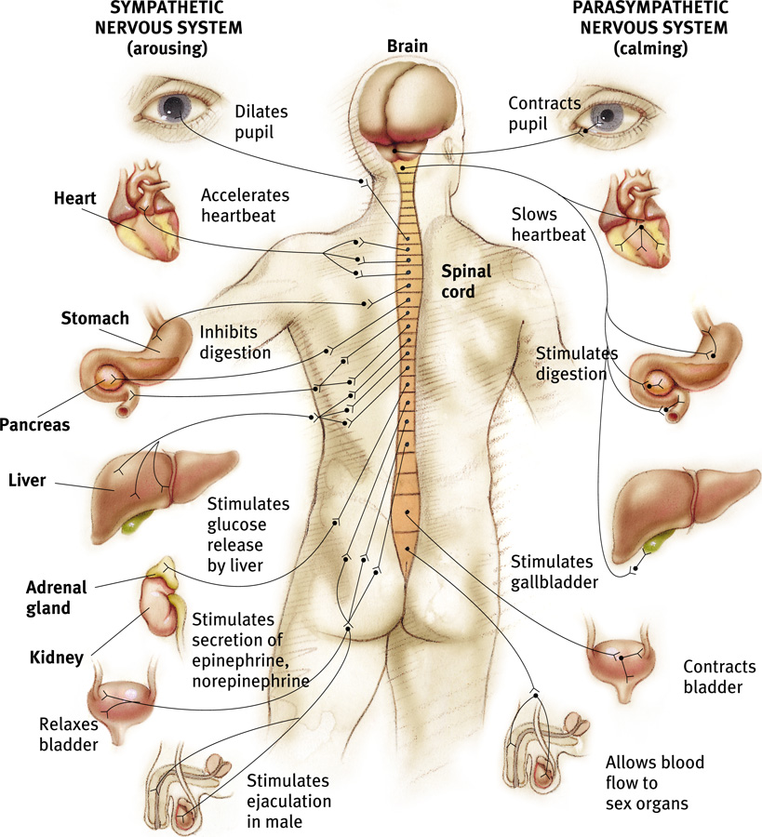
Autonomic Nervous System

Slide 34
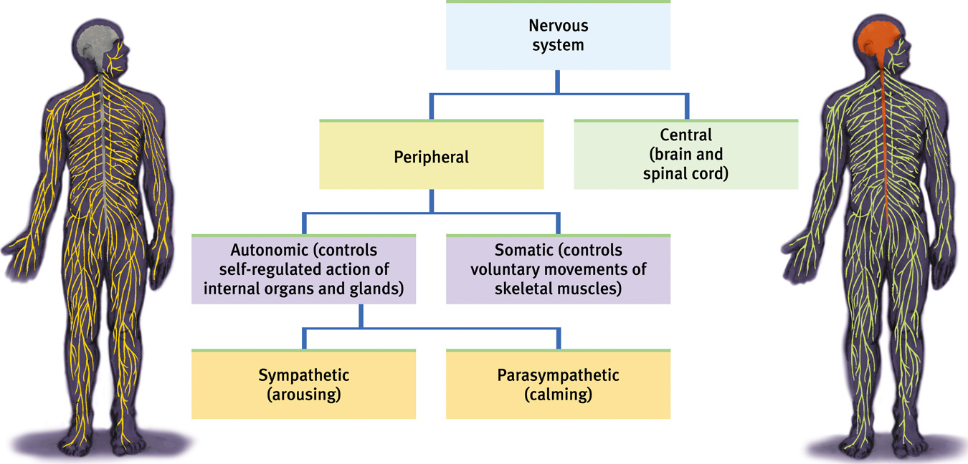
The Nervous System

Slide 35
Reflexes
Reflex – simple, automatic response to a sensory stimulus
  Simple spinal reflexes - part of the CNS response
    Composed of single sensory neuron & a single motor neuron, often communicate through an interneuron
    the spine moves the muscles in response as soon as the sensory information reaches the spine
    Does not involve the brain
    Example – knee-jerk response

Slide 36
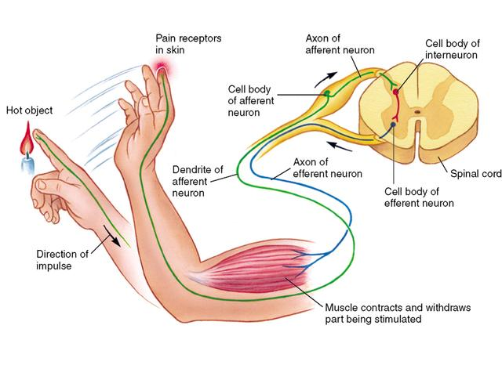
Reflexes
Pain Reflex – sensory neurons carry the incoming info to the spinal cord
  Interneurons activate motor neurons that lead to the muscles
  Runs through the spinal cord and out before your brain receives & responds to the info and causes you to feel pain

Slide 37
A spinal reflex differs from a normal sensory and motor reaction in that
The spine moves the muscles in response as soon as the sensory information reaches the spine (usually the impulse must reach the brain before a response)
Reflex reactions are transmitted along special efferent nerves. In a normal sensory/motor reaction, the spine transmits the information through afferent nerve fibers.
Spinal reflexes are part of the CNS response. Normal sensory/motor reactions are part of the PNS

Slide 38
The Endocrine System
The body’s “slow” chemical communication system
Interconnected with the nervous system – helps coordinate & integrate complex psychological reactions
Regulates such things as growth, reproduction, metabolism, digestion, blood pressure, etc.
Glands secrete hormones – chemical messengers that are produced in one tissue and affect another

Slide 39
The Endocrine System
Under normal (unaroused) conditions, the endocrine system works in parallel with the parasympathetic nervous system to sustain our basic body processes.
In crisis, the endocrine system shifts into a new mode to support the sympathetic nervous system….it releases epinephrine (adrenaline)
– Triggers the “fight or flight” response

Slide 40
The Endocrine System – Pituitary Gland
The most important gland – the “Master Gland”
Controlled by the hypothalamus
Regulates growth & controls all of the responses of the endocrine system
No larger than a pea, and is located at the base of the brain.

Slide 41
The Endocrine System
  Adrenal gland - produces various stress-related hormones (epinephrine & norepinephrine)
      Helps trigger “fight or flight” response
Promotes muscle development
  Pineal gland - helps regulate sleep-wake cycles, produce melatonin
  Pancreas - regulates blood sugar levels (diabetes)
  Thyroid gland - regulates metabolic rate, growth & maturation
  Ovaries - foster female maturation (estrogen & progesterone)
  Testes - foster male sexual maturation - promotes sperm production, produces testosterone

Slide 42
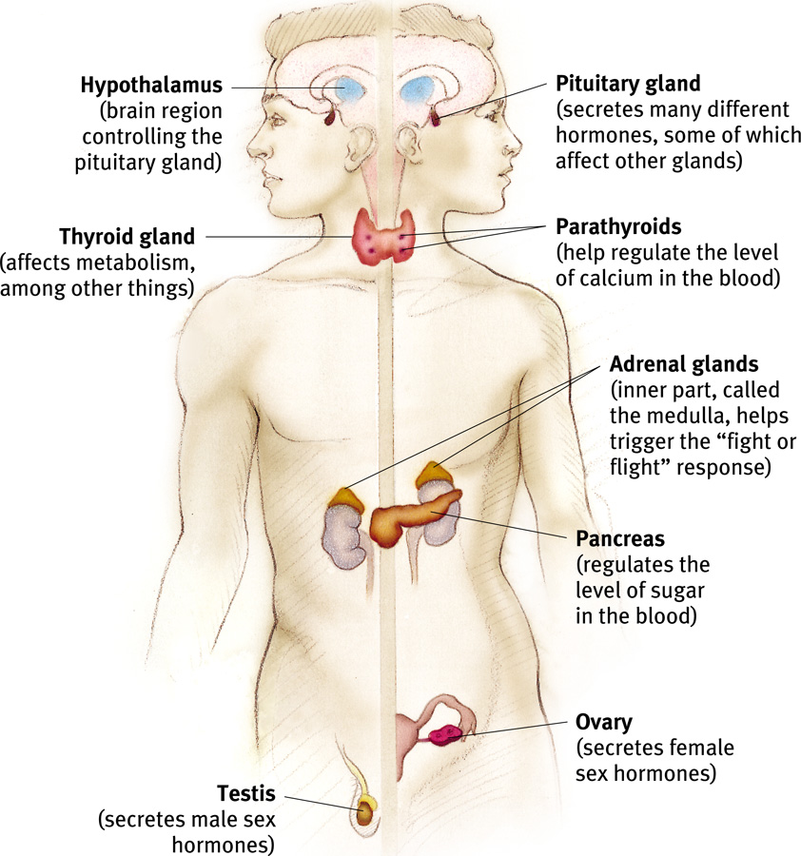
The Endocrine System

Slide 43
Review
Beth is walking to math class. She is feeling stressed about her big test. When Beth arrives to class, the room is warm and she drinks some water to cool off.
For each term below, identify its function as it relates to the above situation.
        Hypothalamus
        Sympathetic nervous system
        Adrenal glands
        Motor neurons

