Slide 1
Learning
Chapter 8

Slide 2
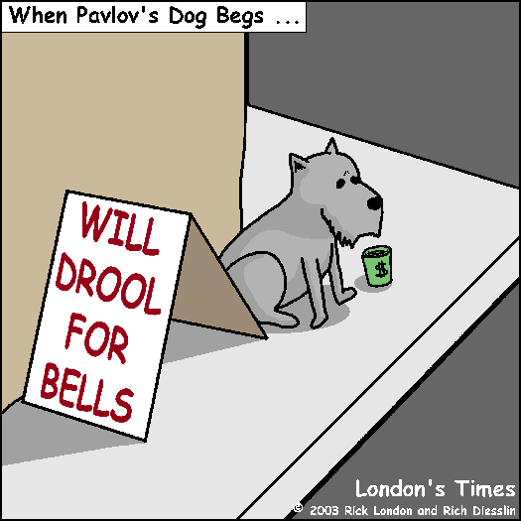
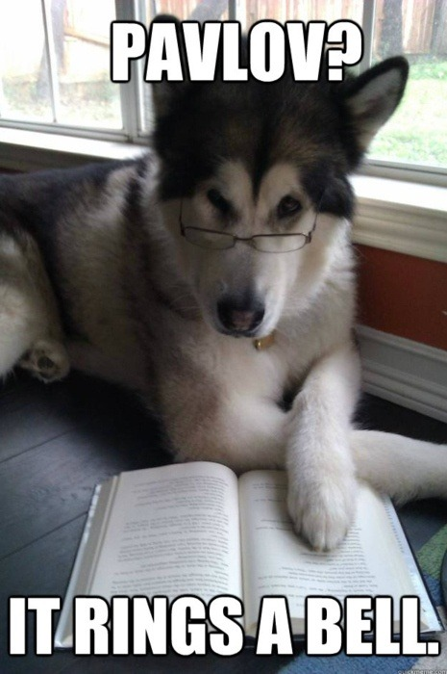
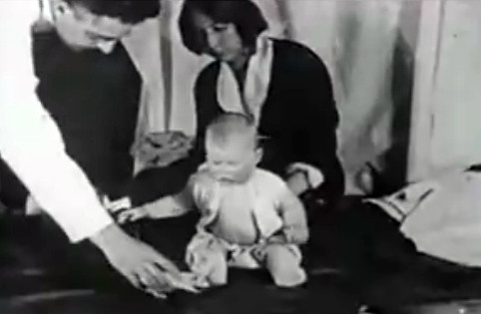
Classical Conditioning

Slide 3
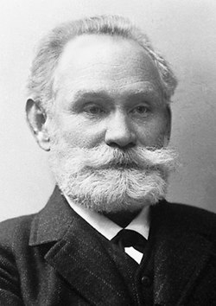
Classical Conditioning – Pavlov’s Experiment
Ivan Pavlov - Russian physiologist, who in the 1900’s, discovered the principle of classical conditioning by studying the effects of digestion.
Classical Conditioning - a type of learning in which a neutral stimulus triggers a response after being paired with another stimulus that naturally triggers that response.

Slide 4
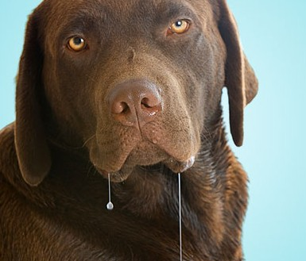
Before conditioning:
  Neutral Stimulus: (tuning fork) Nothing to do with the response to food
  Unconditioned Stimulus: (food) A stimulus that naturally and automatically triggers an unconditioned response.
Unconditioned Response: (salivation) The unlearned, automatic response to an unconditioned stimulus.

Slide 5
Once conditioning is complete:
Conditioned Stimulus: (tuning fork) A once neutral event that has come to elicit a given response.
Conditioned Response: (salivation) Learned response to a previously neutral conditioned stimulus.
Note - Conditioning is most reliable and effective when the conditioned stimulus was presented about a half second before unconditioned stimulus.

Slide 6
General Principles of Classical Conditioning
  Generalization: The tendency, once a response has been conditioned, for stimuli similar to conditioned stimulus to elicit similar responses (ex. circles & ovals)
  Discrimination: The ability to distinguish between a conditioned stimulus and similar stimuli that do not signal an unconditioned response. (ex. circle vs. oval)

Slide 7
General Principles of Classical Conditioning
Extinction – the gradual disappearance of a conditioned response because the reinforcement is withheld or because the conditioned stimulus is repeated presented without the unconditioned stimulus.
Spontaneous Recovery – the reappearance of an extinguished conditioned response after a pause

Slide 8
Classical Conditioning & Human Behavior
  J0hn Garcia showed that aversion or dislike for a food can be conditioned (rats & radiation)
  Taste aversion - a learned response to eating spoiled or toxic food. When taste aversion takes place, you avoid eating the foods that make you ill.
    Used in a study to keep coyotes away from sheep
    Classical conditioning provides information that is helpful to survival
    Helps to predict what is going to happen

Slide 9
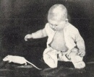
The Case of Little Albert
John B. Watson and his assistant Rosalie Rayner showed how fear could be conditioned.
The experiment was done at Johns Hopkins University in 1920.
Controversial – They did not extinguish Albert’s fear when the experiment was done

Slide 10
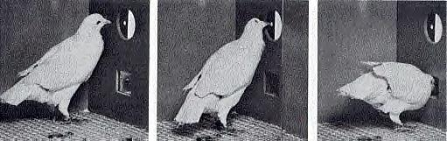

Operant conditioning

Slide 11
Operant Conditioning
Behavior is strengthened if followed by a reinforcer or diminished if followed by a punisher. (Rewards & Punishments)
Classical conditioning involves respondent behavior – occurs as an automatic response to some stimulus
Operant conditioning involves operant behavior – behavior that operates on the environment to produce rewarding or punishing stimuli (Involves learned associations between its behavior & resulting events)

Slide 12
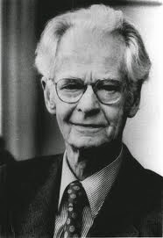
B.F. Skinner
Behaviorism’s most influential and controversial figure
Based on E.L. Thorndike’s law of effect – idea that rewarded behavior is more likely to be repeated (Cat in a puzzle box )
Believed that operant conditioning required a subject to manipulate or operate within the environment
Operant Chamber (Skinner Box) – box with a bar or key that an animal presses or pecks to release a reward of food or water and a measuring device to record responses

Slide 13
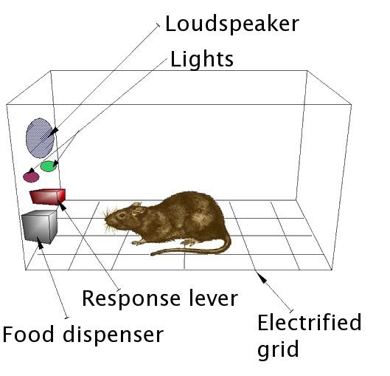
B.F. Skinner
Shaping – reinforcers, such as food, gradually guide an animal’s actions toward a desired behavior
Successive approximations – reward responses that are ever-closer to the final desired behavior, and ignore all other responses

Slide 14
Principles of Reinforcement
Reinforcement – any event that strengthens or increases the frequency of a behavior it follows (vary with circumstance)
Two basic types – Positive & Negative (both increase behavior)
  Positive Reinforcement – (appetitive stimulus) Strengthens a response by presenting a typically pleasurable or desired stimulus after a response
    Food for a hungry animal
    Money (for most people)

Slide 15

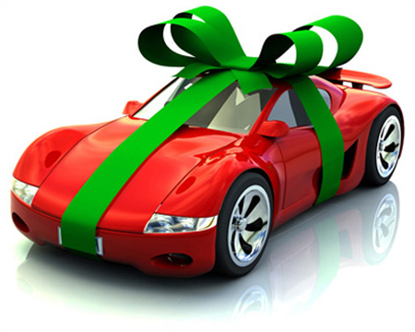
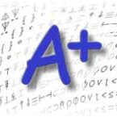

Principles of Reinforcement
Primary Reinforcers – (innate) satisfy a biological need (food, water)
Secondary Reinforcers (conditioned reinforcers) – learned stimulus that gets its power through association with primary reinforcers (money, good grades, praise, smiles)
Humans do respond to reinforcers that are greatly delayed
Part of maturing is learning to delay gratification in order to achieve more valued rewards – Marshmallow test

Slide 16
Principles of Reinforcement
Premack Principle – a person will perform a less desirable activity in order to perform the more desirable activity as a consequence
  The more probable behavior becomes a reinforcer for a less probably one – Examples:
      Eat your dinner and you can have ice cream
      Wash the dishes and you can watch TV
      Come to class and complete all of your week and you can be exempt from exams

Slide 17
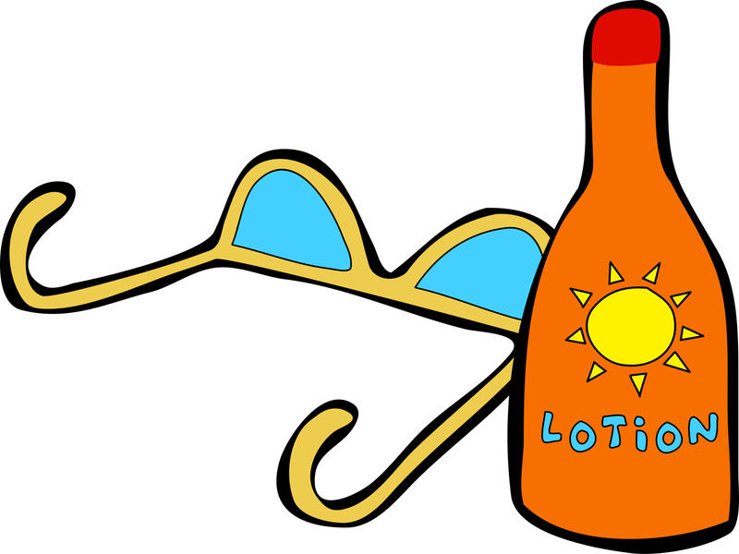


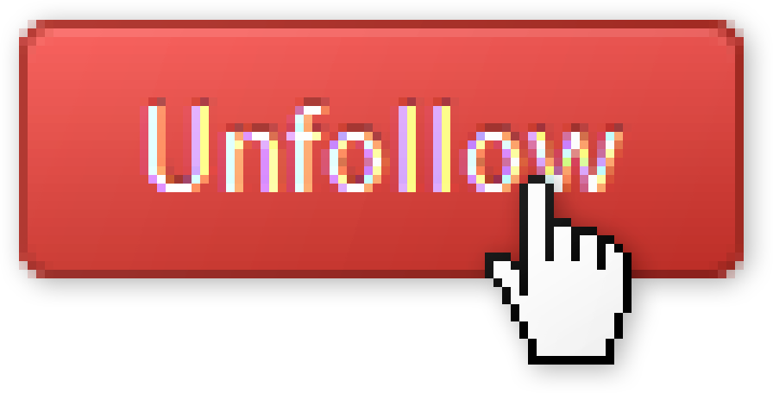
Principles of Reinforcement
      Negative Reinforcement – Strengthens a response by reducing or removing an undesirable (aversive) stimulus – This is NOT PUNISHMENT
          Aspirin for a headache
          Turn off the alarm to stop annoying noise

Slide 18
Principles of Reinforcement
    Aversive Conditioning – learning involving an unpleasant or harmful stimulus or reinforcer
    Two types of learning within negative reinforcement:
    Escape learning – an organism learns to perform an operation to terminate an ongoing, aversive stimulus
        EX. a dog gets shocked and then he escapes it by jumping over the hurdle
    Avoidance learning – an organism learns that it can altogether avoid a negative stimulus by making a particular action before it even begins
        Ex. a dog jumps over a hurdle to avoid an electric shock

Slide 19
Principles of Reinforcement
Learned Helplessness – the feeling of futility and passive resignation that results from the inability to avoid repeated aversive events.
Later, if it becomes possible to avoid or escape the aversive stimulus, it is unlikely that the learner will respond. They have learned that, regardless of their actions, they have no ability to change the outcome.

Slide 20
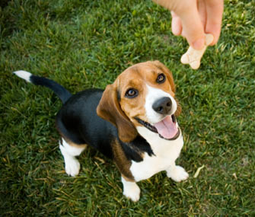
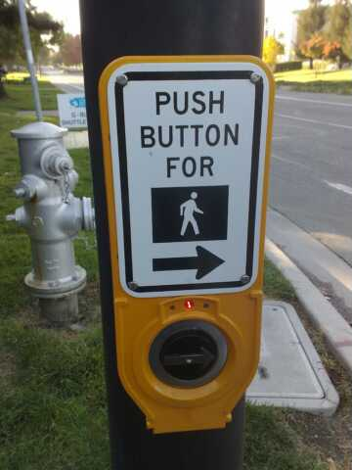
Reinforcement Schedules
Continuous reinforcement – reinforcing the desired response every time it occurs (Learning occurs rapidly)
Partial (Intermittent) reinforcement - responses are sometimes reinforced and sometimes not
    Produces greater persistence and greater resistance to extinction
    4 types of partial reinforcement

Slide 21


Partial Reinforcement Schedules
Ratio schedules are based the number of behaviors being performed
Fixed-Ratio Schedules – reinforce behavior after a set number of responses
    Factory worker gets paid every 30 pieces
    Kohls cash
  Variable-Ratio Schedule – reinforced after an unpredictable number of responses (produces higher rates of responding)
    Gambling or Fishing
    Graded assignments

Slide 22
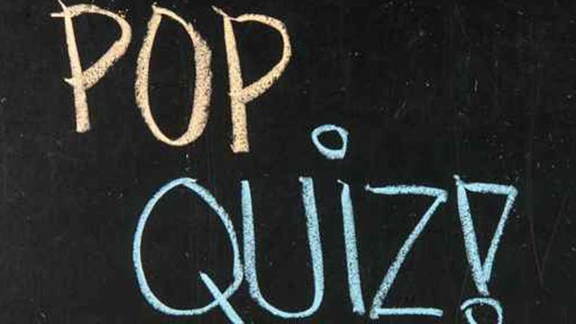
Partial Reinforcement Schedules
    Interval schedules are based on the amount of time elapsed
    Fixed Interval Schedule – reinforces a response only after a specified amount of time has elapsed (produces a choppy start-stop pattern)
    Get paid every two weeks
    End of the card marking every 10 weeks
    Variable-Interval Schedule - reinforces a response at unpredictable time intervals (produce slow, steady responding)
        Someone responds to your social media post
      Variable schedules produce more consistent responding

Slide 23
Fixed Schedules – predictable
Variable Schedules - unpredictable
Fixed Ratio – reinforcement after a fixed or set number of responses
Fixed Interval – reinforcement of first response after a fixed amount of time has passed
Variable Ratio – reinforcement after a varying number of responses
Variable Interval – reinforcement of first response after varying amounts of time

Slide 24



Punishment
Punishment – decreases the behavior that it follows, usually by administering an undesirable consequence or withdrawing a desirable one
Positive Punishment – give something the subject doesn’t like in order to remove or decrease the behavior
    A parking ticket; a time out for child; a detention
  Negative Punishment – remove or take away something desirable to the subject
    Ex. Take a phone away; no television; car keys

Slide 25
Reinforcement = give something to increase behavior
Punishment = undesirable event to decrease or stop behavior
Positive - give reward, something pleasurable (+)
Negative - removal unwanted stimulus to strengthen behavior (-)
Positive – give something undesirable (+)
Negative = take away something desirable (-)

Slide 26
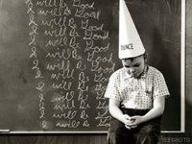
Negatives of Using Punishment
Punished behavior is just suppressed, not forgotten
Punishment teaches discrimination – Child won’t stop cussing, just learns to discriminate and not cuss near mom
Punishment can teach fear – may lead to avoidance
Physical punishment may increase aggression – punisher models aggressive behavior

Slide 27
Cognition and Operant Conditioning
Skinner discounted the importance of cognition & biological predispositions.
Through evolution, animals are biologically predisposed to easily learn behaviors related to their survival as a species. Behaviors contrary to an animal’s natural tendencies are learned slowly or not at all.
Instinctive drift – a conditioned response that drifts back toward the natural (instinctive) behavior of the organism

Slide 28
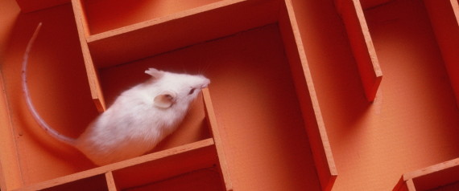
Cognition and Operant Conditioning
Critics - There is more to learning than response & consequence; cognition is at work
Edward Tolman - Rats explored maze for 10 days, then rewarded, finished as quickly as rats who received reinforcers
Latent learning - learning that occurs but is not apparent until there is an incentive to demonstrate it later.
  Learning can take place without the presence of a reinforcer
Cognitive Map - a mental representation of the layout of one’s environment.

Slide 29
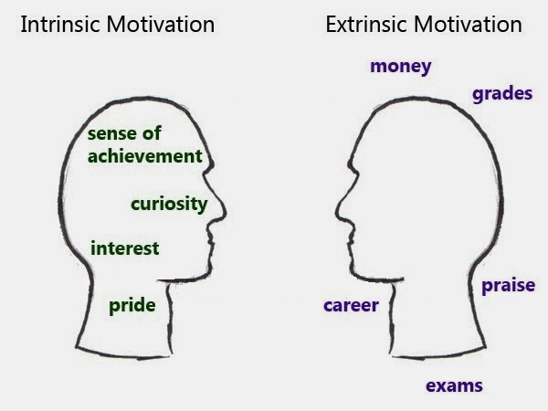

Cognition and Operant Conditioning
More evidence: promising a reward for a task you already enjoy may backfire
  Children promised money for playing with a toy later play with it less than unpaid children
Intrinsic Motivation - a desire to perform a behavior effectively for its own sake.
Extrinsic Motivation - a desire to perform a behavior to receive promised rewards or avoid threatened punishment.

Slide 30
Learning - The process by which experience or practice results in a relatively permanent change in behavior or potential behavior
Classical
Conditioning
The type of learning in which a response naturally elicited by one stimulus becomes to be elicited by a different formally neutral stimulus
Operant
Conditioning
The type of learning in which behaviors are emitted to earn rewards or avoid punishments
Social Cognitive Learning Theory
The type of learning in which behaviors are learned by observing a model
Pavlov and Watson
B.F. Skinner
Albert Bandura
UCS, UCR, CS, CR
Reinforcement and Punishment
Modeling and Vicarious Learning

Slide 31
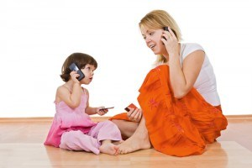
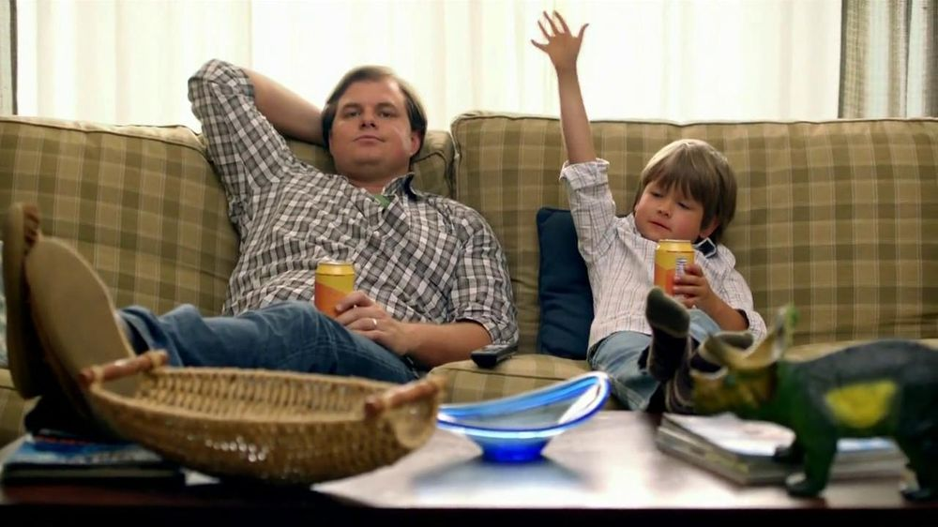
Learning by Observation
Observational learning - learning by observing & imitating others. Also called social learning.
Modeling - the process of observing and imitating a specific behavior.

Slide 32
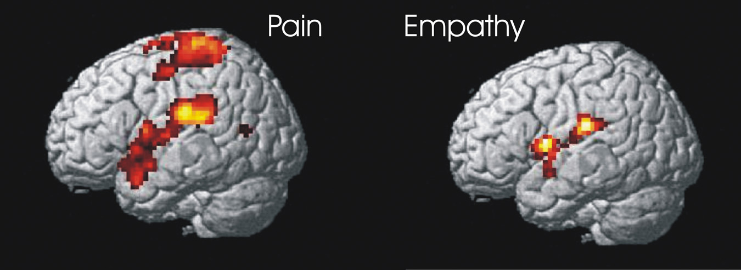
Learning by Observation
Mirror neurons - frontal lobe neurons that fire when performing certain actions or when observing another doing so. The brain’s mirroring of another’s action may enable imitation and empathy.
Our brain generates an inner simulation, enabling us to experience the other’s experience within ourselves
Theory of mind – mirror neurons help children have empathy & to infer other’s mental states

Slide 33
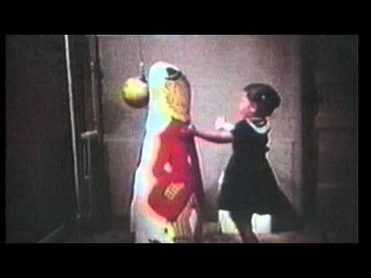
Learning by Observation
Albert Bandura – pioneer researcher in observational learning
Bandura’s Bobo Doll Experiment – We look and we learn

Slide 34
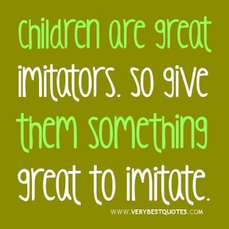
Applications of Observational Learning
Antisocial effects – Observational learning can have negative effects – We can mirror antisocial behavior
Prosocial effects – Positive, constructive, helpful behavior can be modeled by others
We are especially likely to imitate people we perceive as similar to ourselves, as successful, or as admirable
  Parents are powerful models

Slide 35
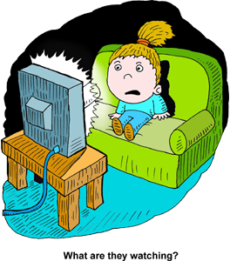
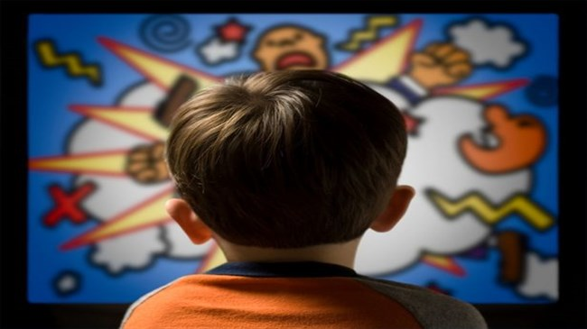
Television and Observational Learning
Correlational evidence shows that observing violence is associated with violent behavior.
BUT correlation is not causation
Experimental evidence also shows that viewers of media violence can experience desensitization – a reduction in emotional arousal and distress when observing violent acts.

