Slide 1
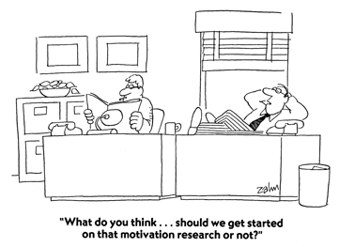
Motivation and Work
Chapter 12

Slide 2

Perspectives on Motivation
Motivation is what drives people to do the things they do; the internal and external factors that direct our behavior

Slide 3
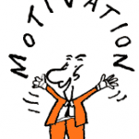
Sources of Motivation
Biological Factors- Autonomic Nervous System
Emotional Factors- panic, fear, anger, love, hatred
Cognitive Factors- perceptions, beliefs, expectations
Social Factors – other people, influence from parents, friends, teachers, TV, Siblings…Factors-

Slide 4
Perspectives on Motivation
There are very close ties between emotions and motivated behaviors.
Sometimes we are motivated by something in our biological makeup that pushes us (nature)
Sometimes there are things in our culture or thought processes that pull us (nurture)
There are four perspectives that psychologists use to explain motivation.

Slide 5
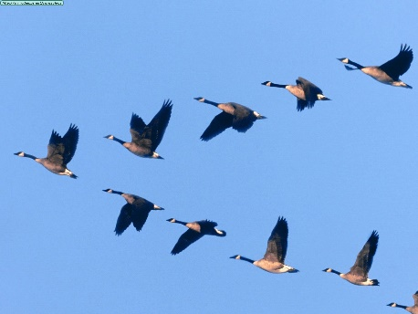
Instinct (Evolutionary) Theory
Instincts - unlearned, innate, and automatic responses to a specific stimulus; Fixed pattern of behavior throughout a species
Instinct theory explains motivation through instinctual behavior
Examples:
  Geese fly south in response to cold weather
  Infants’ rooting and sucking
  newly hatched sea turtles will move toward the ocean

Slide 6
Drive-Reduction Theory
Instinct theory was replaced by Drive-Reduction Theory
Motivation based on desire to reduce internal tension within the body that is caused by biological needs not being met

Slide 7



Drive-Reduction Theory
The aim of Drive-Reduction Theory is to attain homeostasis
Homeostasis – the premise that the body oversees and maintains its internal physiological systems at a constant, stable level (balanced)
  The brain detects this change, alerting the body to respond (ex. Body temperature)

Slide 8
Drive-Reduction Theory
  Need – biological requirement essential to proper body functioning & survival – like water
  Drive – a psychological state of tension or arousal that directs an organism to take action to reduce the drive (ex. thirst, hunger, pain)
  Primary drive: involves needs of the body, such as hunger and thirst
  Secondary (acquired) drive: assist us in attaining the goals of a primary drive; learned through experience or conditioning (ex. money, social approval)

Slide 9


Incentive Theory
We are not just pushed by our need to reduce drives, we are also pulled by incentives
Incentive – a positive or negative environmental stimulus that lures or repels us.
  Example – You may be pushed to eat a peperoni pizza because of an internal drive – hunger, or you might be pulled by an external incentive because it’s tasty.
When there is both a need and an incentive, we feel strongly driven.

Slide 10



Optimal Arousal Theory
People are motivated through curiosity to try new experiences, which causes an increase in arousal

Slide 11

Optimum Arousal Theory
Optimum Arousal Theory suggests that people try to maintain a steady or “optimum” level of arousal through various behavioral activities
  After a boring day (low arousal) may want to do something more exciting at night (high arousal)
  What is optimal varies by person and by task

Slide 12
Optimal Arousal Theory
Yerkes-Dodson Law –states that tasks of moderate difficulty, neither too easy or too hard, elicit the highest level of performance
High levels of arousal for difficult tasks and low levels of arousal for easy tasks are detrimental
Too excited = dumb mistakes

Slide 13
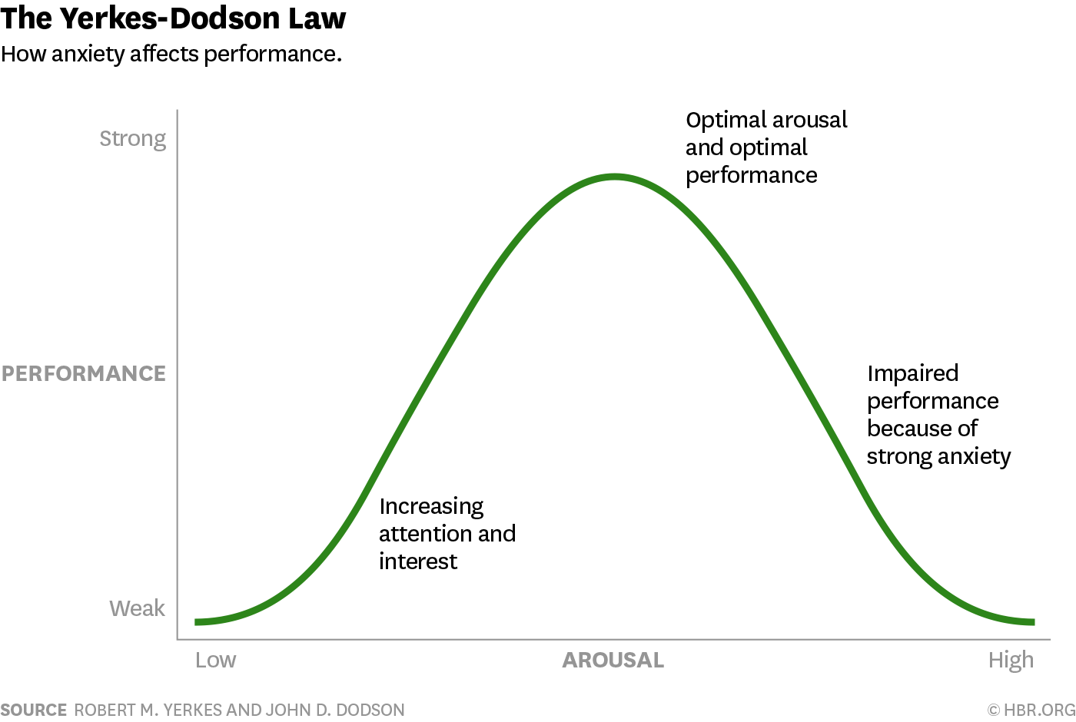

Slide 14
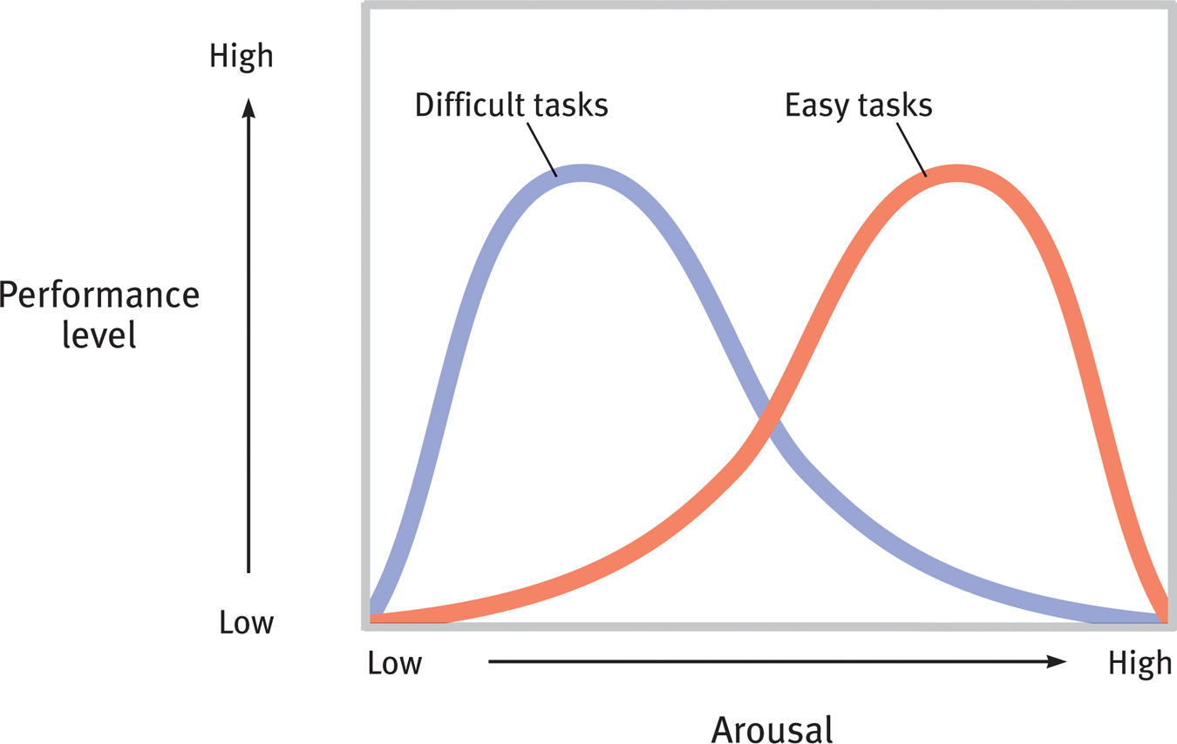
Yerkes-Dodson Law
Newer research suggest optimum arousal levels depend on the task, with more difficult tasks requiring lower arousal for best performance.

Slide 15

Self-Actualization Theory
Humanistic approach – Abraham Maslow
Self-Actualization - the striving and realization of one’s talent and potential.
People seek to build a positive self-concept and are motivated to fulfill their potential

Slide 16
Self-Actualization Theory
Hierarchy of Needs – pyramid of needs, begins with physiological, which must first be satisfied before moving up to next tier – some needs take priority
When lower needs are satisfied, we can focus on higher needs
Higher tiers can become much less important in emergency situations

Slide 17
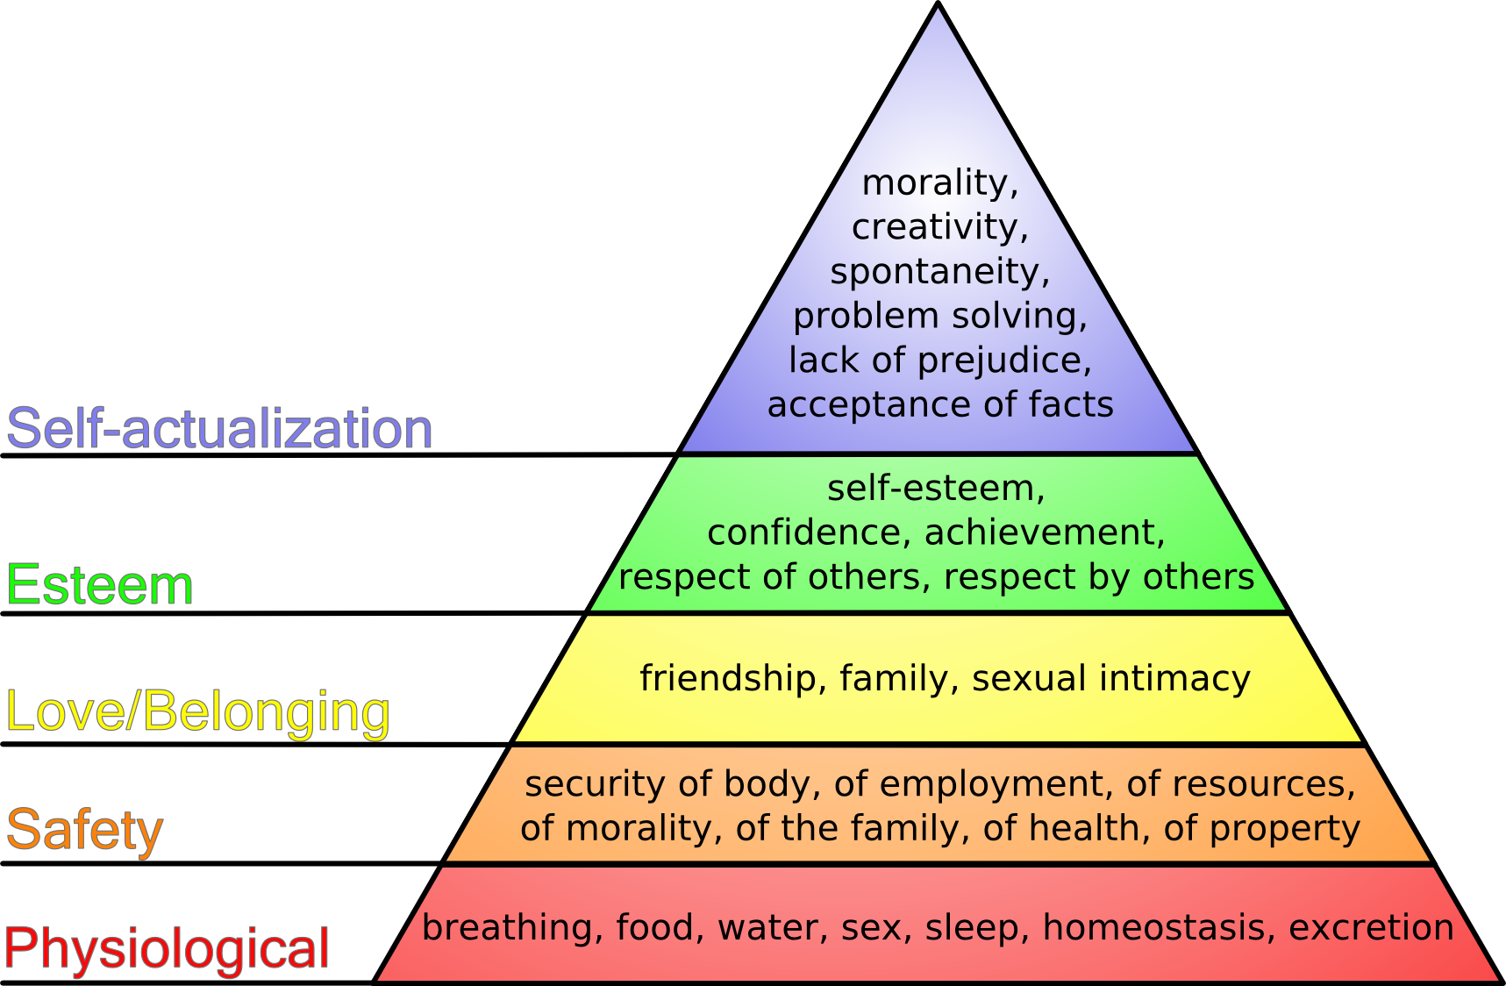
Maslow’s Hierarchy of Needs

Slide 18
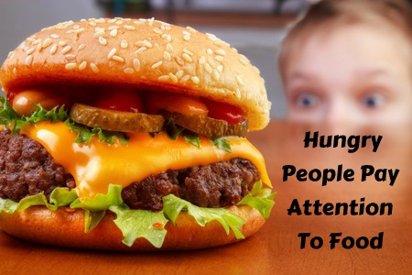
Hunger
Ancel Keys Experiment –
  Physical effects – weight loss, no energy, apathetic
  Psychological effects - food obsessed, lost interest in activities, preoccupied with their unfulfilled basic need
Food and hunger have a
powerful effect on us.

Slide 19
Physiology of Hunger
What triggers hunger? Would hunger persist without stomach pangs?

Slide 20
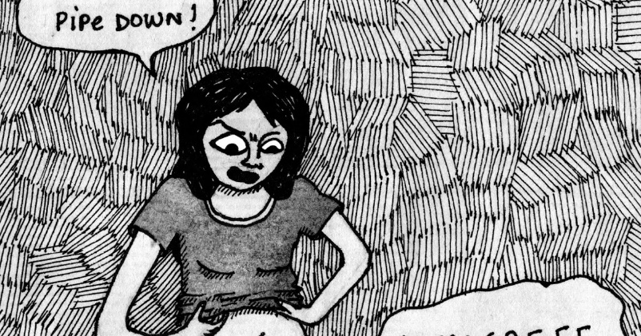
The Physiology of Hunger
Researchers have discovered that there is more to hunger than signals from the stomach
  People who have had their stomachs removed in response to cancer still report feelings of hunger.
  The most important signals that start and stop hunger come from the blood, which the brain monitors

Slide 21
The Physiology of Hunger
Glucose - sugar that circulates in our blood, major source of energy
  When glucose levels drop, we feel hungry
Insulin - hormone used to convert glucose into energy
  When insulin levels rise, glucose levels decrease, causing hunger
Hypothalamus - monitors the body’s appetite hormones, triggers hunger
  Damage to the hypothalamus can create weight difficulties (too much or too little)

Slide 22
The Physiology of Hunger
Two distinct hypothalamic centers help control eating:
  Lateral hypothalamus (LH) – brings on hunger
  Ventromedial hypothalamus (VMH) – depresses hunger
Mnemonic: Large Hunger,
Lingering Hunger vs. Very
Mini Hunger

Slide 23
The Physiology of Hunger – Appetite Hormones
“I’m hungry!” - Stimulate appetite:
Ghrelin - released by empty stomach; sends signals to the brain (LH) when the body needs food
Orexin - hormone produced by the lateral hypothalamus that initiates hunger
“I’m full.” – Signals satiety:
Leptin - Secreted by fat cells; sends signals to the VMH to indicate satiation
Obestatin - secreted by full stomach, sends “I’m full” signals, suppresses hunger
PYY - Digestive hormone, suppresses appetite

Slide 24
The Physiology of Hunger – Set Point Theory
Set Point – a person’s ideal weight that is maintained by increases or decreases in the BMR
  Not widely believed anymore
Basal metabolic rate (BMR) – the body’s resting rate of energy expenditure
Researchers believe that people reach a “settling point,” the level at which a person’s weight settles in response to caloric intake and expenditure

Slide 25
Body Weight
Basal metabolic rate (BMR) regulates the expenditure of energy used to maintain our body’s vital functions
As people age, the BMR slows down
Women have a slower BMR
Exercise speeds up the BMR
Not eating slows down the BMR

Slide 26
Eating Disorders
Anorexia nervosa – characterized by dramatic drop in calories consumed and an obsession with exercise
  (15% or more underweight, yet still feeling fat continues to starve)
  Bulimia nervosa – characterized by periods of binging and purging(eating large amounts of food and purging to get rid of caloric intake)
    Experience bouts of depression and anxiety most severe after binges

Slide 27
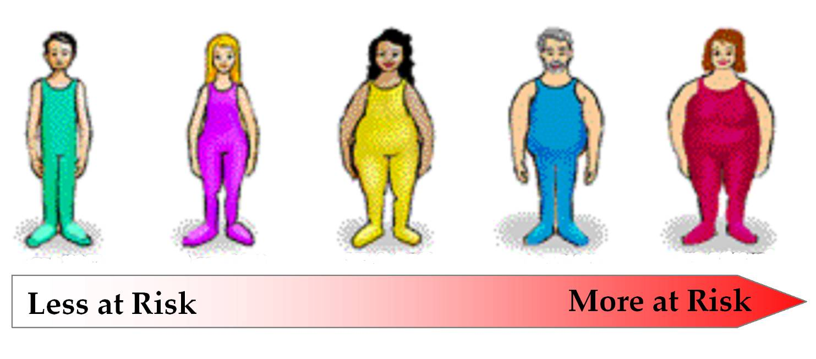
Obesity
A disorder characterized by being excessively overweight.
Increases risk for health issues like cardiovascular diseases, diabetes, hypertension, arthritis, and back problems.
For women, linked to late-life Alzheimer’s and brain tissue loss.

Slide 28
Obesity
BMI (body mass index) is the measure of a person’s weight in proportion to his or her height
    Normal BMI is 18.5–25
    Overweight s 25–29.9
    Severely overweight or obese is above 30
Obese people experience leptin resistance – a reduction of the brain’s responsiveness to leptin, more fat cells, and a higher BMR

Slide 29
Motivation and Work
Psychologists who study work-related behavior
Industrial-organizational (I/O) psychology – apply psychological concepts to optimize the workplace as an effective and productive environment.
  Organizational psychology – a field of I/O that addresses worker satisfaction and productivity
  Personnel psychology – field of I/O that tries to match the right job to the right employee

Slide 30
Achievement Motivation
Henry Murray – one of the first psychologists to study people’s level of achievement
Achievement Motivation – a desire for significant accomplishment, for mastering skills or ideas, for control, and for rapidly attaining a high standard.
Theory that attempts to explain motivations behind more complex tasks

Slide 31
Achievement Motivation
People with high achievement motivation:
  Want challenges – choose moderately challenging tasks (avoid impossible goals)
  Take risks when necessary
  Are satisfied when they succeed
  Not too upset by failure if they tried their best
  Have self-efficacy
  Generally do achieve more

Slide 32

Achievement Motivation
Intrinsic Motivators
Extrinsic Motivators
Rewards we get internally, such as enjoyment or satisfaction.
  According to researchers, intrinsic is better than extrinsic
    Results in higher achievement
Reward that we get for accomplishments from outside ourselves (grades or money or etc..)
Works great in the short run.
Can lead to the overjustification effect
NOTE: Sometimes both work together

Slide 33

Management Theory
Studies of management styles show two basic attitudes that affect how managers do their jobs:
  Theory X – managers believe that employees will work only if rewarded with benefits or threatened with punishment
  Theory Y – managers believe that employees are internally motivated to do good work and policies should encourage this internal motive

Slide 34

When Motives Conflict
Four major types of motivational conflicts:
  Approach-approach conflict – two positive options
  Avoidance-avoidance conflict – two negative options
  Approach-avoidance conflict – whether or not to choose an option that has both positive and negative consequences
  Multiple approach-avoidance conflicts – several alternative courses of action that have both positive and negative aspects

