Slide 1
Chapter 13: Emotion
AP Psychology

Slide 2
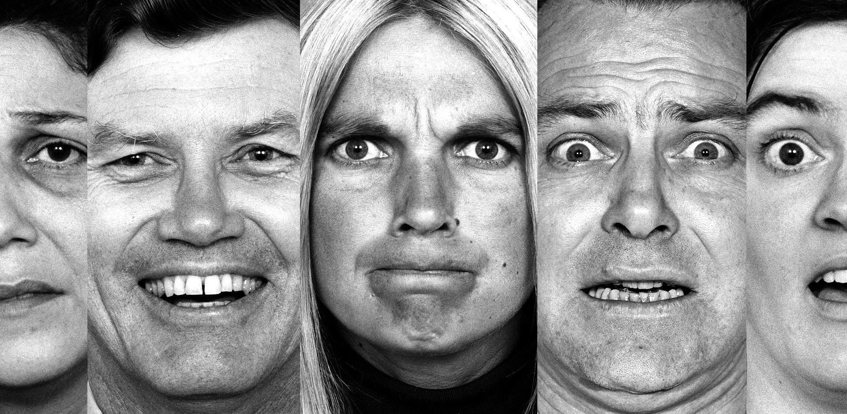
What is emotion?
Emotions – A response of the whole organism involving physiological arousal, expressive behaviors, and conscious experience, including thoughts and feelings
Debate: Chicken or the egg?
  Does physiological arousal come before or after the emotional experience?
  Does cognition (thinking) always come before the emotion?

Slide 3
Theories of Emotion
James-Lange theory – our experience of emotion is the result of our awareness of our physiological responses to emotion-arousing stimuli
  We feel emotion because of biological changes (physiological changes cause emotion)
Example: Your car slides on ice and you struggle to regain control. You notice your heart racing after the incident. Fear follows the body’s response.

Slide 4
Theories of Emotion
Cannon-Bard theory - an emotion-arousing stimulus simultaneously triggers physiological responses and the experience of emotion
Example: Your heart begins to pound as you experience fear
One does not cause the other

Slide 5
Theories of Emotion
Two-factor theory – the Schachter-Singer theory that to experience emotion one must be physically aroused and cognitively label the arousal
Emotional experience requires a conscious interpretation of the arousal

Slide 6
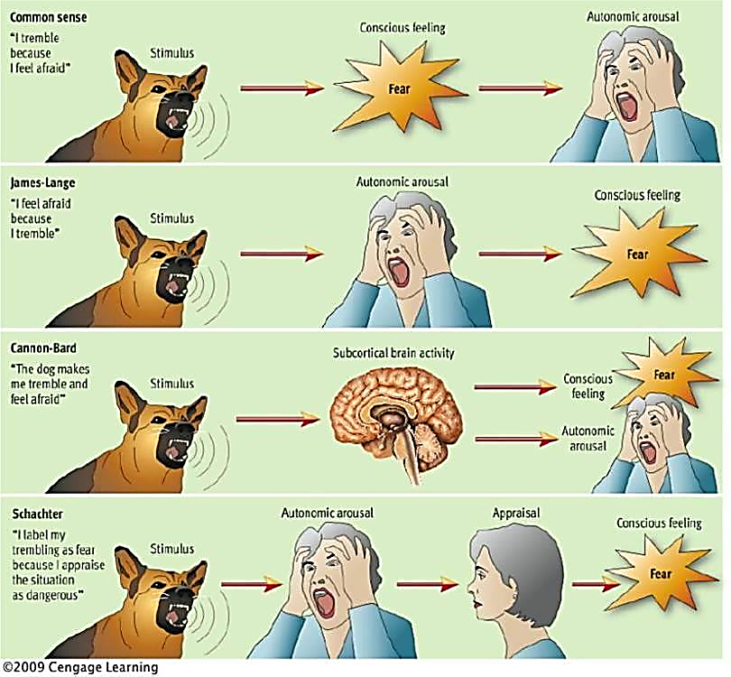

Slide 7
Practice:
You cry after watching The Notebook.
You experience fear as a stranger appears to be following you as you walk to your car in the parking lot.

Slide 8
Emotion & the Autonomic Nervous System
Emotion definitely involves the body.
Autonomic Nervous System controls physiological arousal
    Sympathetic division prepares the body for action (arousal)
      Releases epinephrine (adrenaline) & norepinephrine (noradrenaline)
    Parasympathetic division calms the body down
      Acetylcholine

Slide 9
Emotion & the Autonomic Nervous System

Slide 10
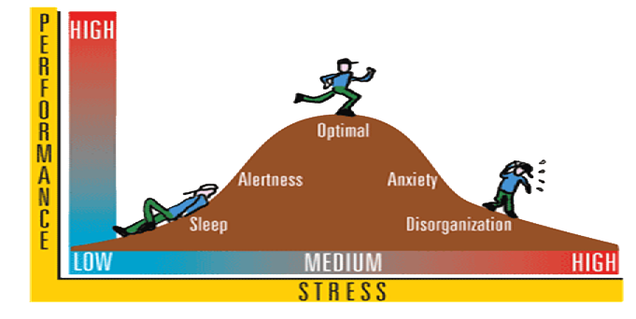
Arousal and Performance – Yerkes-Dodson Law
We perform best when we feel moderately aroused.
The level of arousal varies for different tasks.
Performance peaks at lower levels of arousal for difficult tasks and higher levels for easy or well-learned tasks.

Slide 11
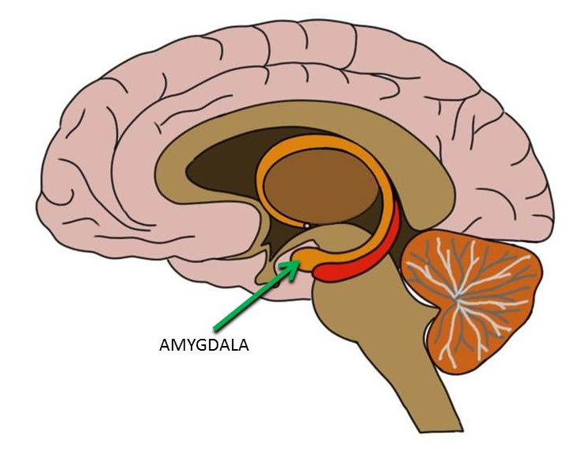
The Brain and Emotion
Amygdala - (limbic system) processes fear
Active with recognition of emotional expressions
Information passes through the cortex straight through to the amygdala
Interacts with the hypothalamus to send signals to release hormones
Damage to the amygdala = no fear & trouble reading emotions

Slide 12


The Brain and Emotion
Left Hemisphere:
Positive emotions
People show more left frontal lobe activity when they experience positive moods.
Many dopamine receptors
Right Hemisphere:
Negative emotions
Depression-prone people and people with negative personalities show more right frontal activity

Slide 13
Cognition can define emotion
Spillover Effect – (Schachter & Singer) Our arousal response to one event spills over into our response to the next event.
If you just finished running, then you receive exciting news, does the arousal from the run spill over into the new excitement about the good news?
Arousal from a soccer match can fuel anger, which can descend into rioting or other violent confrontations
Arousal fuels emotion: cognition channels it

Slide 14
Cognition Does Not Always Precede Emotion
Robert Zajonc – We sometimes experience emotional reactions apart from or even before we interpret a situation
Some emotions take the “low road” (shortcut) via neural pathways that bypass the cortex
Causes a quick reaction often outside of our conscious awareness
Example – see snake, message sent directly to amygdala for quicker response before intellect takes over

Slide 15
Cognitive Appraisal Theory
Richard Lazarus - Some emotional responses do not require conscious thinking, but even instantaneously felt emotions require some sort of appraisal of the situation
This quick appraisal may be effortless, we may not be conscious of it, but it is still a mental function that happens
Emotions arise when we appraise an event as beneficial or harmful to our well-being, whether we truly know it or not

Slide 16

Lie Detection
Polygraphs (lie detectors) - measure physical responses that may indicate a person is lying (changes in breathing, cardiovascular activity, perspiration)
  Response to critical questions compared to response to control questions
  Two problems:
        Our physiological arousal is much the same from one emotion to another
        Lie detectors err about 1/3 of the time, especially when innocent people respond with heightened tension to the accusations implied by relevant questions

Slide 17

Nonverbal Communication
We’re good at detecting nonverbal threats.
An angry face will “pop out” in a crowd faster than a happy one.
We read fear and anger mostly from the eyes, and happiness from the mouth.
Introverts are better at reading others’ emotions; extroverts are easier to read
Experience can sensitize us to particular emotions.

Slide 18

Gender, Emotion, and Nonverbal Behavior
Women generally are:
    better at reading people’s emotional cues
    better at spotting lies
    more emotionally responsive in both positive & negative situations
    have greater emotional literacy
    more likely to describe themselves as emphatic
    more likely to express empathy

Slide 19
Detecting & Computing Emotion
Hard-to-control facial muscles reveal signs of emotions you may be trying to conceal
Most people find it difficult to detect deceiving expressions
Eckman & O’Sullivan – found they could teach researchers to watch for signs of lying
Our brains can easily detect subtle expressions

Slide 20
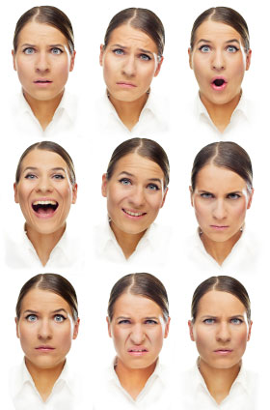
Culture and Emotional Expression
The meaning of gestures varies
Children all over the world cry, laugh, smile, etc.
Even isolated groups of people share universal facial expressions.
Facial expressions even among the blind are universal.
Evolutionary Psychology: Prehistoric ancestors without detailed languages had to rely on facial expressions to survive
Facial expressions are somewhat universal, but people differ in how much emotion they express

Slide 21
Which emotion is it?
• Anger
• Disgust
• Fear
• Happiness
• Sadness
• Surprise

Slide 23
The Effects of Facial Expression
William James – We can control emotions by going “through the outward movements” of any emotion we want to experience
Expressions not only communicate emotion, they also amplify and regulate it.
People instructed to mold their faces in ways that express other basic emotions also experienced those emotions
Facial feedback - When a facial expression intensifies emotional feelings

Slide 24
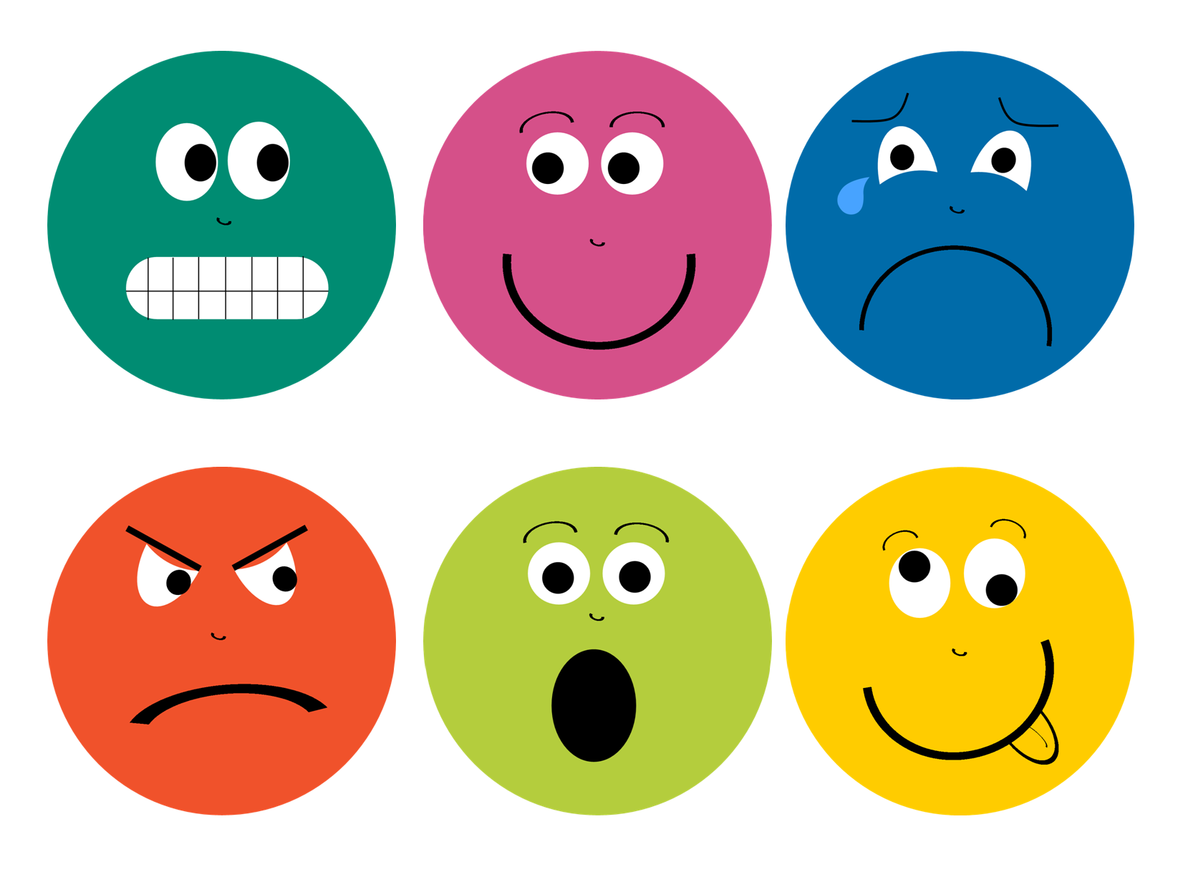
Experienced Emotion
Carroll Izard identified 10 basic emotions:
Joy | Disgust
Excitement | Contempt
Surprise | Fear
Sadness | Shame
Anger | Guilt

