Slide 1
Memory and Thought
Chapter 3

Slide 2
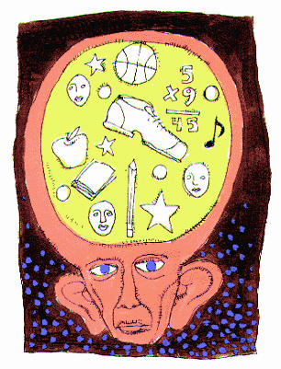
Memory
The storage and retrieval of what has been learned or experienced.

Slide 3
Information
Information Processing - All cognitive and mental activities
Involves three steps:
Input – information people receive from their senses
Central Processing – storing (in memory) and sorting (by thought) of this information in the brain
Output – refers to the ideas and actions that result from processing

Slide 4
Taking in Information – Selective Attention
Two processes help people narrow sensory inputs to a manageable number:
Selective Attention – Your ability to pick and choose among the various available inputs (1st step in narrowing input)
Selection Theory – attend to only one of the many channels of information reaching us at any time
Attentuation Theory – selective attention doesn’t completely block out other stimuli
We focus on a select few inputs and direct most of our conscious attention to them.

Slide 5
Taking in Information
What makes one input more important than another?
It satisfies our needs such as hunger
It is strange and novel
It sparks our interest

Slide 6
Taking in Information – Feature Extraction
Feature Extraction –involves locating the outstanding characteristics of incoming information (2nd step in narrowing input)
Being able to extract the significant features of an input helps a person to identify it and compare it to other inputs
Depends to some extent on experience
Evaluative process

Slide 7
Feature Extraction

Slide 8
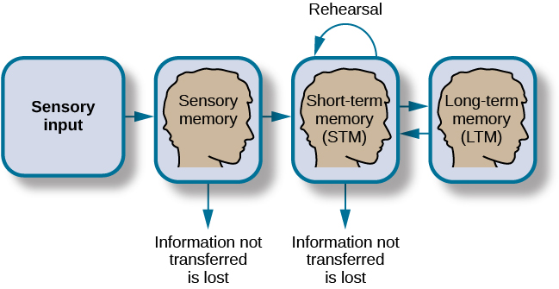
Storing Information - Memory
Memory – the storage of inputs
Three kinds of memory:
Sensory storage
Short-term memory
Long-term memory

Slide 9
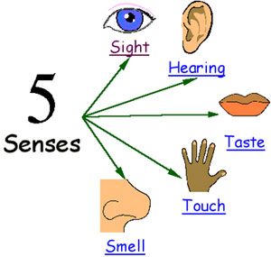
Storing Information – Sensory Storage
Very brief memory storage immediately following initial reception of a stimulus
Holds information only for only
a fraction of a second
Has not been analyzed or
narrowed down
Short lived but highly detailed

Slide 10
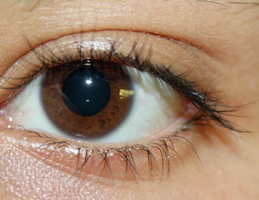
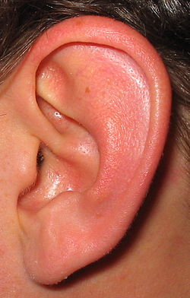
Types of Sensory Memory
Iconic Memory - Visual sensory memory
Holds visual information for up to a second
Echoic Memory - Auditory sensory memory
Holds auditory information for 1 - 2 seconds

Slide 11
Sensory Storage Activity
22 35
14 43
26 74
10 38
56 19

Slide 12
Storing Information – Short-Term Memory
Also referred to as your working memory
Things that you have in your conscious mind at any one moment are held here
Temporary – about 20 seconds without rehearsal
Does not necessarily involve paying close
attention
Limited to about 7 items (+ or – 2) and in
duration by the subject’s active rehearsal.

Slide 13
Storing Information – Short-Term Memory
Rehearsal – to keep information in short-term memory for more than a few seconds, you have to repeat it to yourself
Information worth holding onto must be rehearsed – with intent to learn – to transfer it to long-term memory
Chunking – The process of grouping items to make them easier to remember.
Even with chunking, storage in short-term is still temporary

Slide 14
Chunking Exercise -
CIAMTVFBINATOUSASAT

Slide 15
Chunking Exercise
CIA MTV FBI NATO USA SAT

Slide 16
Storing Information - Long-Term Memory
The storage of information for future use
Holds an unlimited amount of information
Stored by features – Information is organized, coded, and constantly revised
Involves all of the processes we have been describing

Slide 17
Types of Long-Term Memory
Explicit Memory – conscious, intentional remembering of info.
Declarative Memory– knowledge you call forth as you need it (dates, faces, words, events, and concepts)
Semantic Memory – Recall of general facts and our knowledge of language
Episodic Memory – Our memory of our own life – facts & events (personal things where time and place are important)

Slide 18
Types of Long-Term Memory cont.
Implicit memory - Does not require conscious recollection.
Procedural Memory –recall of how to perform an action, task, or skill
Often implicit - As we gain a skill, we often lose the ability to describe how
Behaviors learned through classical conditioning (such as a fear of bugs) are also considered to be procedural memory
Priming – different cues prompt the retrieval of memory – makes the retrieval process more efficient

Slide 20
Types of Memory

Slide 21
Which one is the real penny?

Slide 22
Memory Tasks: Identify the type of memory
Iconic Memory (Sensory memory)
Echoic Memory (Sensory memory)
Short Term (Working Memory)
Semantic Memory (Declarative)
Episodic Memory (Declarative)
Procedural Memory

Slide 23
Central Processing of Information
Thinking – changing and reorganizing the information stored in memory in order to create new information.

Slide 24
Central Processing of Information - Thinking
Units of thought –
Images – a mental representation of a specific event or object
Symbol – abstract unit of thought, sound
or design that represents an object or quality
Words are the most common symbols in thinking

Slide 25
Central Processing of Information - Thinking
Concept – a symbol that is used as a label for a class of objects or events with certain common attributes themselves
Allow us to chunk large amounts of info. so that we don’t have treat every new piece of info. as unique (ex. Cars, fruits, animals)
Rule – a statement of a relation between concepts
Images, symbols, concepts, and rules are the building blocks of mental activity.

Slide 26
Central Processing of Information – Kinds of Thinking
Directed thinking (Convergent thinking) - systematic and logical attempt to reach a specific goal
Relies heavily on symbols, concepts, and other rules
Deliberate and purposeful
Non-directed thinking (Divergent thinking) – thinking without a goal or a plan
Depends more on imagery and feelings
Often done when relaxing – may provide insights
Metacognition – thinking about thinking

Slide 27
Central Processing of Information – Problem Solving
Involves both directed and non-directed thinking
Strategies – specific methods for approaching problems
Break down into smaller, more easily solved problems
Work backward from the goal
Examine various ways of reaching a desired goal

Slide 28
Central Processing of Information – Problem Solving
We tend to do things the way we’ve done them before. “It worked once, it will work again.”
Set – when a particular strategy becomes a habit – You are “set” to treat problems in a certain way
Rigidity – when a set interferes with problem solving
Functional Fixedness – the inability to imagine new functions for familiar objects

Slide 29
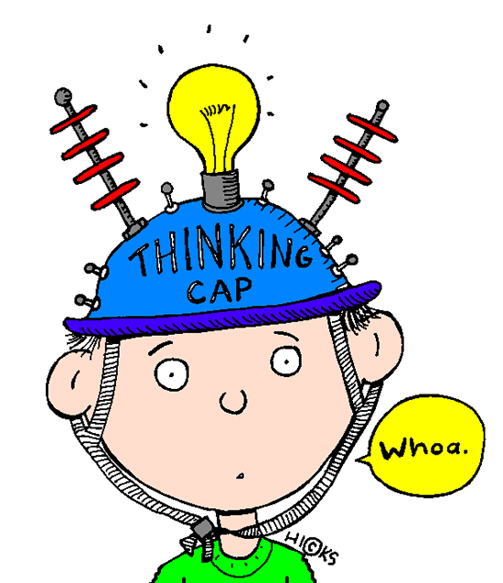
Central Processing of Information – Creativity
Creativity – the ability to use information in a way that results in new, original thinking
3 main characteristics of creative thinking:
Flexibility – the ability to overcome rigidity, to adopt
new ideas
Recombination – the elements of a problem are familiar but solution is not – use material we already know to come up with new solutions
Insight – sudden emergence of solutions –occurs when problems can’t be solved by other means. “Aha” experience

