Slide 1
Chapter 6: Perception
Pages 250-268

Slide 2
Perceptual Constancy
Perceptual Constancy - the ability to see an object as maintaining its original shape, color, or size without having to reinterpret it each time a change occurs (top-down process)
Examples:
Shape constancy
Size constancy
Color constancy
Brightness constancy

Slide 3
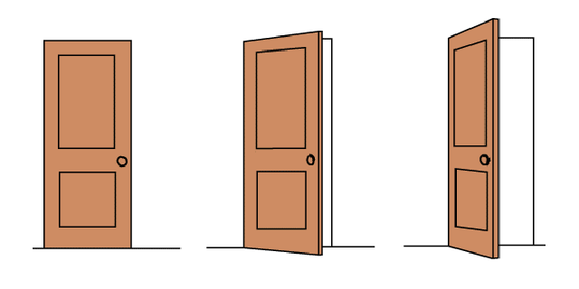
Perceptual Constancy
Shape Constancy - The tendency to see an object as keeping its form despite changes in orientation.
Door became more trapezoidal, but we still perceived a rectangle
Notes:
OBJECTIVE 9| Explain the importance of perceptual constancy.
Perceptual constancy denotes the tendency of animals and humans to see familiar objects as
having standard shape, size, colour, or location regardless of changes in the angle of
perspective, distance, or lighting. The impression tends to conform to the object as it is or is assumed
to be, rather than to the actual stimulus. Perceptual constancy is responsible for the ability to identify
objects under various conditions, which seem to be "taken into account" during a process of mental
reconstitution of the known image.
Even though the retinal image of a receding automobile shrinks in size, the normal, experienced person
perceives the size of the object to remain constant. Indeed, one of the most impressive features of
perceiving is the tendency of objects to appear stable in the face of their continually changing stimulus
features. Though a dinner plate itself does not change, its image on the retina undergoes considerable
changes in shape and size as the perceiver and plate move. What is noteworthy is stability in perception
despite gross instability in stimulation. Such matches between the object as it is perceived and the
object as it is understood to actually exist (regardless of transformations in the energy of stimulation) are
called perceptual constancies.
Dimensions of visual experience that exhibit constancy include size, shape, brightness, and colour.
Perceptual constancy tends to prevail for these dimensions as long as the observer has appropriate
contextual cues; for example, perception of size constancy depends on cues that allow one a valid
assessment of his distance from the object. With distance accurately perceived, the apparent size of an
object tends to remain remarkably stable, especially for highly familiar objects that have a standard size.
Psychologists have proposed several explanations for the
phenomenon of size constancy. First, people learn the general
size of objects through experience and use this knowledge to
help judge size. For example, we know that insects are smaller
than people and that people are smaller than elephants. In
addition, people take distance into consideration when judging
the size of an object. Thus, if two objects have the same retinal
image size, the object that seems farther away will be judged as
larger. Even infants seem to possess size constancy.
Another explanation for size constancy involves the relative sizes
of objects. According to this explanation, we see objects as the
same size at different distances because they stay the same size
relative to surrounding objects. For example, as we drive toward
a stop sign, the retinal image sizes of the stop sign relative to a
nearby tree remain constant - both images grow larger at the
same rate.
The experience of constancy may break down under extreme conditions. If distance is sufficiently great,
for example, the perceived size of objects will decrease; thus, viewed from an airplane in flight, there
seem to be "toy" houses, cars, and people below.

Slide 4
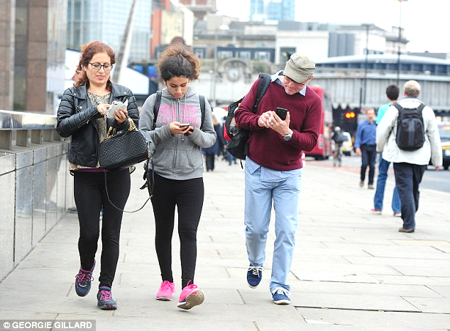
Perceptual Constancy
PERCEPTUAL CONSTANCIES
Size Constancy - The tendency to view an object as constant in size despite changes in the size of the retinal image.
Someone moving towards you is not
ACTUALLY growing!
Car 200 feet away vs. 20 feet away…

Slide 5
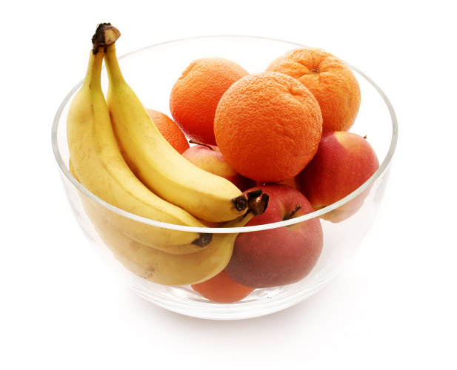
Color Constancy
Perceiving familiar objects as having consistent color even if the lighting conditions change
Our experience of color depends on an object’s context
Notes:
Not just wavelengths but experience that plays a role in color perception.

Slide 6
Lightness Constancy
Object has constant lightness/brightness even while illumination varies.
Look at black & white paper inside and outside; illumination changed but they still look black or white to us.

Slide 7
Context effects on lightness/brightness
The brightness of a stimulus depends not only on its own luminance but also on that of the surrounding stimulation (context).
The same gray square looks whiter against a dark background and blacker when placed in a bright surround.

Slide 8
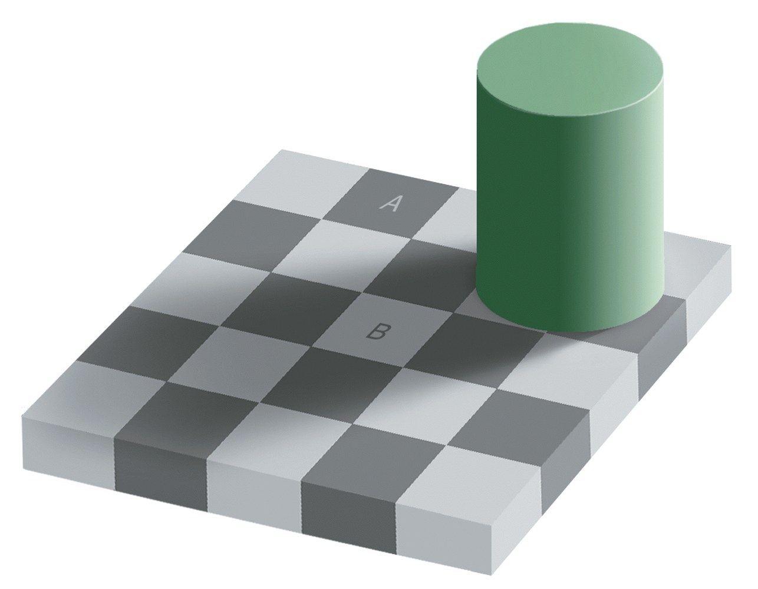
The color and brightness of square A and B are the same.

Slide 9
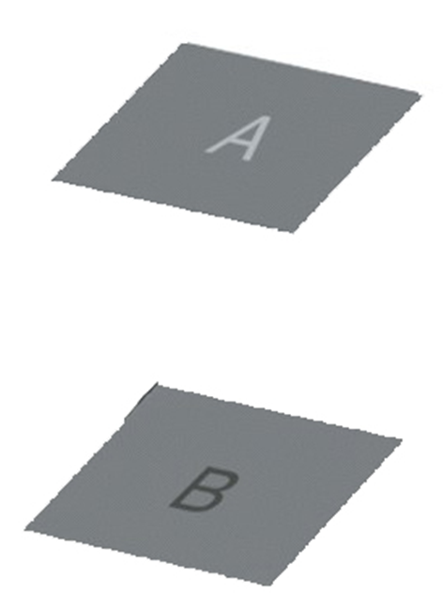
Lightness constancy depends on RELATIVE LUMINANCE, or the amount of light an object reflects relative to its surroundings!
So why is B perceived as lighter?
Notes:
Our perception is changed bc of surrounding context (light or dark squares)

Slide 10
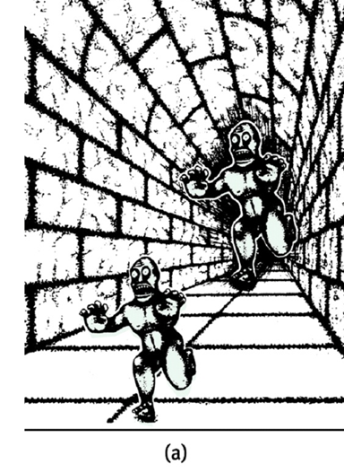
Perceived Size-Distance Relationship
A. Which 3 monocular cues are used in this illusion?
B. Explain why the monster in the background is perceived as farther away.
Relative Height
Linear Perspective
Relative Size
Because the artist did not follow the relative size cue, (we expect monster in back should be smaller) we perceive him as MUCH bigger when both are actually the same size.
Notes:
Which creature appears bigger? If you measure them you'll probably be surprised to find out that they
are both the same size. The creature appears to increase in size as it gets further away due to what is
called 'perspective'. Perspective is evoked in this image by the pattern, and the lines on the wall which
tend to converge on to a common point in the distance.

Slide 11
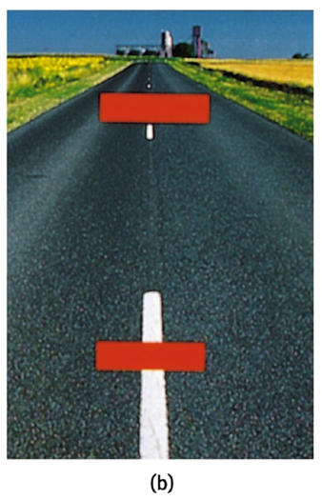
Perceived Size-Distance Relationship
Ponzo Illusion - Top red bar SHOULD look smaller if farther away…the perspectives don’t match because red lines were superimposed on top of perspective highway….therefore we believe top line is larger.
Notes:
Ponzo Illusion: 2 red bars cast identical-sized retinal images but our experience tells us more distant object can create the same size image as a nearer one only if it is actually larger. We perceive the bar that seems farther away as larger.

Slide 12
Size-Distance Relationship
The distant monster and the top red bar appear bigger because of distance cues.
Experience tells us that a more distant object can create the same-size image as a nearer one only if it is actually larger

Slide 13
Perceived Size-Distance Relationship
Ames Room - Both girls in the room are of similar height. However, we perceive them to be of different heights as they stand in the two corners of the room.
Both photos from S. Schwartzenberg/ The Exploratorium

Slide 14
Ames Room
The Ames room is designed to demonstrate the size-distance illusion. We perceive them to be the same distance from us.

Slide 15
Perceived size-Distance Relationship Moon Illusion
Context cues (trees/ houses/people/etc.) make the “horizon” moon appear LARGER than the moon high in the night sky
Night moon is surrounded by large expanses of empty sky, which makes it appear much smaller
Relative Size Theory: perceived size of an object depends not only on its retinal size, but also on the size of objects in its immediate visual environment
Notes:
Moon high in the sky has nothing around it; no context; no visual cues so when it is in horizon, you get visual cues (trees, buildings)
Horizon moon casts larger retinal image than night sky moon, therefore appears closer than night sky moon. Casts larger retinal image bc there are houses and trees etc to provide context.

Slide 16
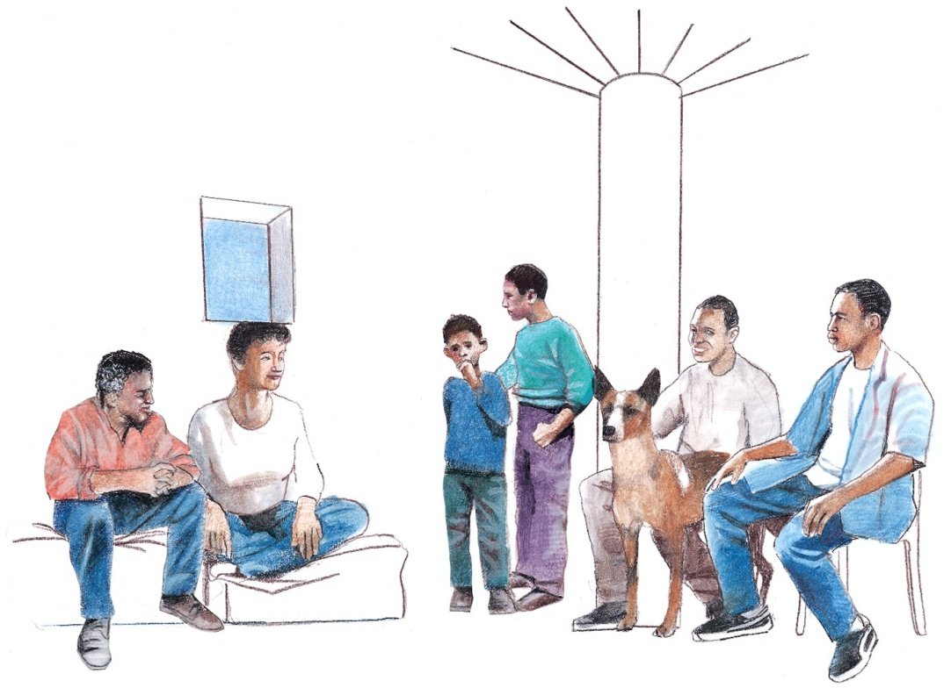
Cultural Context
Context instilled by culture also alters perception.
To an East African, the woman sitting is balancing a metal box on her head, while the family is sitting under a tree.

Slide 17
Muller-Lyer Illusion

Slide 18
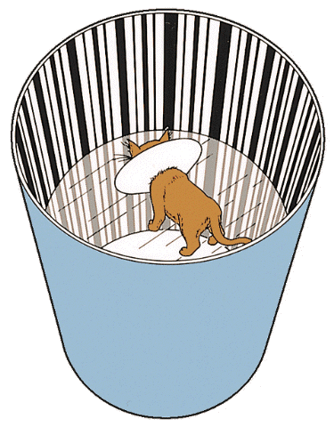
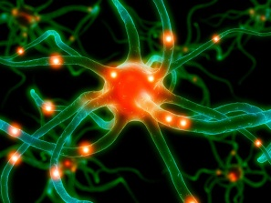
Sensory Deprivation
Blakemore & Cooper (1970):
If raised without normal sensory exposure, the brain will not develop normal connections.
CRITICAL PERIOD FOR SENSORY & PERCEPTUAL DEVELOPMENT!
Kittens raised with light diffuse goggles later had difficulty perceiving horizontal bars & shapes!
Eyes healthy but brain connections not normally developed.

Slide 19
Perceptual Adaptation
Visual ability to adjust to an artificially displaced visual field, e.g., prism glasses.
Courtesy of Hubert Dolezal
Notes:
Preview Question 22: How adaptable is our ability to perceive?

Slide 20
Perceptual set
Perceptual Set – a mental predisposition to perceive one thing and not another (based on our experiences, assumptions, and expectations)
Through experience, we form concepts, or schemas, that organize and interpret unfamiliar information.
Pre-existing schemas influence how we interpret ambiguous sensations with top-down processing.

Slide 21
Facial Recognition
Eyes and mouth play a dominant role in face recognition.
Courtesy of Christopher Tyler
Notes:
Portrait artists understood the importance of this recognition and therefore centered an eye in their paintings.

Slide 22
Extrasensory Perception
Perception without sensory input is called extrasensory perception (ESP).
Parapsychologists distinguish between three types of ESP:
Telepathy – Mind-to-mind communication
Clairvoyance – Perception of remote events
Precognition – Ability to see future events
A large percentage of scientists do not believe in ESP – no scientific demonstration.
Notes:
Preview Question 25: What are the claims of ESP, and what have most research psychologists concluded after putting these claims to the test?

Slide 23
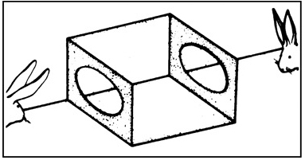
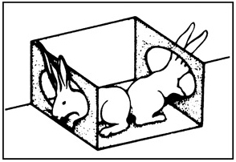
Context Effects
Context can radically alter perception.
Is the “magician cabinet” on the floor or hanging from the ceiling?

Slide 24
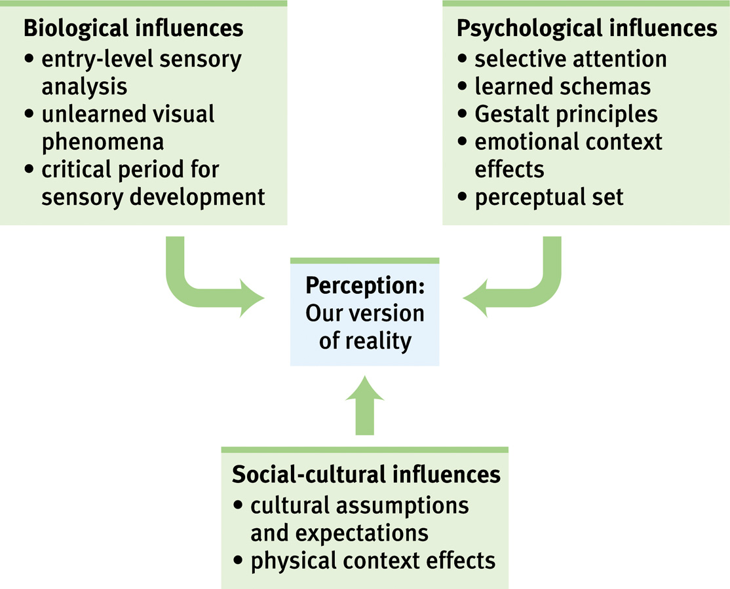
Perception is a biopsychosocial phenomenon
Notes:
Preview Question 24: How do human factors psychologists work to create user-friendly machines and work settings?

