Slide 1
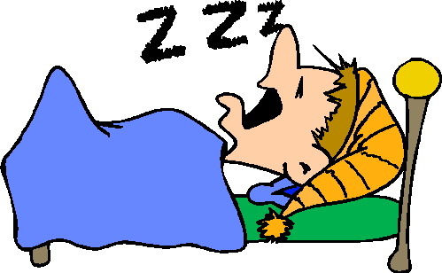
Chapter 7
States of Consciousness

Slide 2
Consciousness and Information Processing
  William James (father of American Psychology)
        First to study the conscious mind
        Believed it was a continuous process of thinking – “Stream of consciousness”
    1950-60’s advances in neuroscience
      EEG (electroencephalograph)

Slide 3

Consciousness and Information Processing
Conscious awareness – our subjective awareness of ourselves, our environment, our thoughts
  Brings varied info. to the surface
  Enables us to exert voluntary control & to communicate our mental states to others
  Conscious processing takes place in sequence and in a relatively slow, limited capacity

Slide 4

Consciousness and Information Processing
Dual processing (parallel processing) – 2 track mind, info is often processed simultaneously on separate conscious & unconscious tracks
Selective attention – the spotlight of our awareness
Automatic processing – occurs without our awareness (well-learned activities)
Our consciousness exists on a continuum - controlled processing to unconsciousness

Slide 5
Levels of Consciousness
Nonconcsious level – all the biological processes that are taking place internally & constantly without you noticing
Preconscious level – just below level of consciousness, easy to access when needed (what you did yesterday, directions, skills)
Subconscious level – Info. you have been exposed to but can’t recall – can & does influence your behavior
Unconscious level – (Psychoanalytic perspective - Freud) Hidden memories influence behavior but are never known to the conscious mind.

Slide 6
Sleep
When you sleep, you still experience sensation & perception – We process information
Move around in your bed to get comfortable
Don’t fall out of the bed
Baby cry or sound of your name can easily wake you up

Slide 7
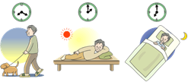
Biological Rhythms & Sleep
  Circadian Rhythms - Regular bodily rhythms that occur on a 24-hour cycle; your “biological clock”
Body temp. increases in morning, peaks during the day, dips in the early afternoon, drops again before going to bed
  Suprachiasmatic Nucleus – “internal clock” in hypothalamus that receives info. from the retina regarding lighting conditions
      Signals pineal gland to secrete melatonin (sleep-inducing hormone)
    When external cues are not present our circadian rhythms expand to a 25-hour cycle

Slide 8
Biological Rhythms & Sleep

Slide 10
Sleep Stages
Awake = Beta waves – awake and focused
Alpha waves – awake but more relaxed
  NREM sleep - dreamless sleep or Non-REM sleep
  Stage 1 (NREM-1)
  Periodic, natural loss of consciousness
  Lasts only a few minutes, may experience fantastic images like hallucinations
      May have hypnogogic sensations – feeling of floating or falling
      Brain produces theta waves

Slide 11
Sleep Stages
    Stage 2 (NREM-2)
      Lasts about 20 minutes, relax more deeply
      body temp. drops, heart rate slows, muscles relax
      theta waves & periodic appearance of sleep spindles (bursts of rapid, rhythmic brainwave activity) and K complexes (large, high-voltage waves)
      Can still be awakened without too much difficulty
      Spend ½ the night in Stage 2

Slide 12
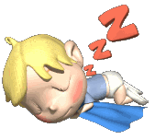
Sleep Stages
    Stage 3 (NREM-3)
      Transition from light sleep to deep sleep
      Brain emits large, slow delta waves (Delta Sleep)
      Muscles relax, blood pressure & breathing rate drop
      Lasts about 30 minutes
      Difficult to awaken
      Essential for good health
      Children may wet bed, sleep walk, or sleep talk

Slide 13

REM Sleep – Rapid Eye Movement
REM sleep- (Rapid Eye Movement)
  Dreaming occurs in this stage
  About an hour after falling asleep
  Heart rate increases, breathing rapid & irregular
          Paradoxical Sleep - Body is internally aroused but externally calm
          Brainstem blocks communication between cerebral cortex and motor neurons - near paralysis
          Prefrontal Cortex (thought & judgement) shuts down (why dreams don’t make sense)

Slide 15

Sleep Cycle
Repeats about every 90-110 minutes, approximately 4-5 times a night
Not in sequence - Stages 1-3, returns to stage 2, then REM, and then back to stage 2
Normal night’s sleep - Stage 3 gets shorter and REM and Stage 2 last longer as morning nears
REM Rebound – A person who does not get enough REM sleep will go right into REM sleep instead of the normal sequence of sleep

Slide 16
Sleep Theories – Why do we sleep?
  Adaptive Theory – Sleep protects, essential to survival. Based on evolutionary theories that humans and animals sleep when it is dangerous to be awake.
  Restorative Theory - Sleep helps us recuperate; our brain repairs and reorganizes itself during sleep. It is essential for physical/mental functioning. It stimulates the growth process.
  Behavioral Theory – We sleep because there is no more stimulation
  Helps us consolidate the information from the day and support long-term memory
  Feeds creative thinking

Slide 17
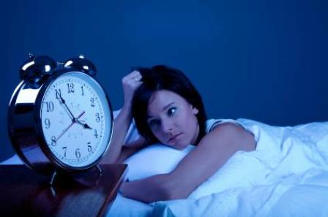
Sleep Disorders
  Insomnia- problems falling and staying asleep at night
      Most common sleep disorder (about 10%)
  Narcolepsy - Experience periodic, overwhelming, daytime sleep attacks
  Sleep Apnea - Stop breathing during sleep, gasp & snore
      Mostly overweight, middle-aged men
      Can be treated with a respiration machine

Slide 18
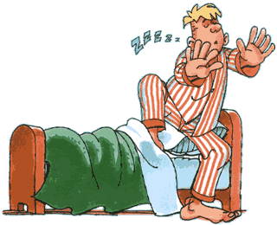
Sleep Disorders
  Night terrors - intense fear, targets mostly children
      Occurs within first few hours of the night
  Sleepwalking (Somnambulism)- occurs during stage 3
      children prone & seems to run in families.
      Rare after age 40, due to less time spent in later stages

Slide 19
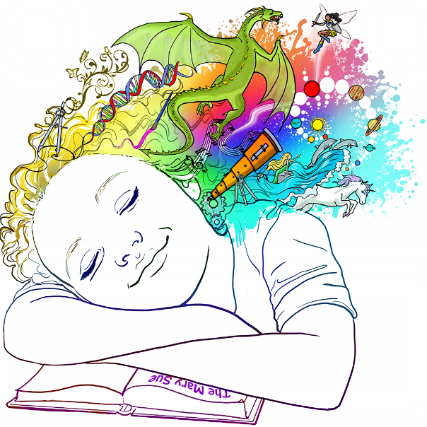
Dreams
Story-like episodes or “hallucinations of the sleeping mind”
Occur most vividly in REM sleep
Everyone dreams every night
Some simplistic dreaming may occur in deep sleep
Lucid dreaming – the individual has control over a dream’s storyline

Slide 20
Sigmund Freud Dream Interpretation
  Wish-Fulfillment Theory - Dreams provide a “psychic safety valve”– a way to express hidden wishes & desires that would be threatening if expressed directly
  Dreams are key to understanding our inner conflicts - the “royal road to the unconscious”
    Manifest content – The storyline of our dreams - what the dreamer remembers about the dream
    Latent content - The hidden, unconscious meaning of the dream

Slide 21
Other Dream Theories – Why we dream
Information Processing – Dreams help us sort out the day’s experiences in our memory and consolidate our memories.
  With more REM sleep, we have better memory the next day
Physiological Function – Dreams provide our sleeping brain with stimulation to help develop and preserve the brain’s neural pathways
  Brain needs periodic neural stimulation to keep pathways going, must stimulate through the night

Slide 22
Other Dream Theories – Why we dream
Activation–Synthesis theory – Dreams are random and bizarre.
  The brain is firing random signals throughout the night, but with no real external stimulation coming in
  Dreams are the brain’s attempt to make sense of it.

Slide 23
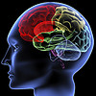
Other Dream Theories – Why we dream
Cognitive Theory –
  Dreaming can be understood by applying the same cognitive concepts used to study the waking mind.
  Dreams are essentially subconscious processing – thinking during dreams similar to thinking in waking life
  Ties brain activity that occurs during dreams to activity that occurs during waking life
  Viewed as dramatizations of our general life concerns
  The purpose of dreams is to process information, solve problems, & think creatively about issues we face in our daily lives.

Slide 25

Hypnosis
State of heightened suggestibility
An altered state of consciousness that could produce increased responsiveness to suggestions, which could in turn lead to changes in behavior and thinking
Does it work?
  To a degree everyone is suggestible – 20% are highly suggestible
  The real power of hypnosis is not in the hypnotist, but in the subject’s own openness to suggestion.

Slide 26

Can Anyone Experience Hypnosis?
Do you want to be hypnotized?
Are you creative?
Do you easily get absorbed into imaginative activities, books, or movies and quit paying any attention to the outside world?
Can you focus totally inward and imagine or entertain yourself with fantasies and believe them?

Slide 27
Can Hypnosis Enhance Recall of Forgotten Events?
Most people believe lost memories can be retrieved or relived through hypnosis (age regression)
  60 years of science dispute such claims
  Fake - act like a 6 year old, write in the handwriting of a 6 year old, but with good grammar
In reality, “hypnotically refreshed” memories often combine facts with fiction as the hypnotist asks leading questions like “Did you hear loud noises?”
Banned as evidence in America, Australia and England

Slide 28
Can Hypnosis Make People Act Against Their Will?
The short answer is no, not anymore than an authoritative figure can make someone who is not hypnotized act against their will.
  The control group in the acid experiment still did throw the acid
Hypnotized people don’t do anything that un-hypnotized people can’t also be convinced to do.
Studies show that an authoritative person in a legitimate context can induce people-hypnotized or not-to perform some unlikely acts.

Slide 29
Can Hypnosis be Therapeutic?
The short answer is yes….sometimes, kind of.
Posthypnotic suggestions - a suggestion made during hypnosis to be carried out when the subject is no longer hypnotized.
In some cases, clients whose therapy was supplemented with hypnosis showed greater improvement 70% of other patients.
Especially helpful in dealing with obesity, not so much for smoking, drinking, drugs
  No difference when patients were given the same positive reinforcement without hypnosis

Slide 30
Can Hypnosis Alleviate Pain?
Hypnosis can actually alleviate pain!
PET scans show that hypnosis reduces brain activity in a region that processes painful stimuli, but not in the sensory cortex that receives raw sensory input
Hypnosis does not block sensory input, but it MAY block our attention to those stimuli.
Disassociation – A split between levels of consciousness - hypnosis disassociates the physical stimulus of pain from the emotional suffering that defines our experience of pain

Slide 31
Hypnosis as a Social Phenomenon
Social Influence Theory –Hypnosis is a mix of normal consciousness and power of social influence
Are people faking it then? NO, compare it to a an actor that gets lost in his or her role
  People begin to behave in ways that good hypnotized people should behave
  The more they like and trust the hypnotist and feel motivated to demonstrate hypnotic behavior, the more they allow that person to direct their attention and fantasies.

Slide 32
Hypnosis as a Divided Consciousness
  Neodissociation Theory (Ernest Hilgard)
  People experience distinct multiple streams of consciousness
  The first stream of consciousness is tuned to the hypnotist’s suggestions, while the second stream (“hidden observer”) is so distinct from consciousness that it is unattainable to the subject
The divided-consciousness theory is controversial, but suggests we can run on autopilot for well rehearsed tasks, while consciously working on another task.

Slide 33
Psychoactive Drugs

Slide 34
Psychoactive Drugs
Chemicals that change perceptions and moods
In order for a drug to have an effect on the brain, it must pass the blood-brain barrier which helps to prevent certain substances form entering brain tissue
Once a drug does pass the blood-brain barrier, it is either an agonist (increase or mimic a neurotransmitter’s action) or an antagonist (inhibits or blocks a neurotransmitter’s action)

Slide 35
Psychoactive Drugs – Helpful Terminology
Neurons – the basic unit on which the entire brain and nervous system are built
Neurotransmitters – chemicals that are necessary to pass on signals, enable neurons to communicate
Synapse – small gap between the terminal buttons of one neuron & the dendrites of another

Slide 36
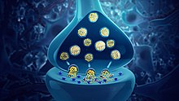
Neurotransmitters
  Serotonin – connected to mood (High levels = increased happiness, Low levels = depression, anger control), appetite, sleep, & sexual desire
  Dopamine – pleasure chemical of the brain, related to reward & motivation, also motor movement & alertness
  Epinephrine – associated with energy, response to high emotion situations such as emergencies (same chemical as adrenaline)
  Norepinephrine – higher levels increase alertness, blood pressure, and heart rate

Slide 37
Neurotransmitters
  GABA – inhibitory transmitter that slows things down, increases sleepiness & decreases anxiety
  Glutamate – major excitatory neurotransmitter, opposite of GABA, involved with thinking, learning, and memory
Endorphins – influence the perception of pain or pleasure

Slide 38
Psychoactive Drugs – Dependence & Addiction
  Tolerance - User experiences neuroadaptation - need more drugs to get the desired effect
  Physical Dependence - physiological need for a drug; experience withdrawals when drug is not used
  Psychological Dependence - Psychological need to use a drug….”I will feel better when I drink.”
  Withdrawal - discomfort and distress felt with discontinued use of drug (headaches, shaking, etc.)
  Addiction – compulsive craving for a substance despite adverse consequences

Slide 39
Psychoactive Drugs - Hallucinogens
  Hallucinogens – “psychedelics,” distort perceptions and create sensory images in the absence of sensory input
      LSD, marijuana, mescaline, ketamine
    LSD – (most potent)
      Chemically similar to serotonin & therefore block the actions of serotonin
      Marijuana – (THC – active ingredient)
      Anandamide - “bliss molecule” binds to THC receptors – perhaps controls pain

Slide 40

Psychoactive Drugs – Depressants
    Depressants - “downers,” reduce neural activity & slow down body functions.
      Alcohol –
      disrupts neurotransmitters
      Intensifies the effects of GABA (sluggish movement & slurred speech)
      Reduces glutamate (slowed reaction & impaired judgement)
      Causes the release of dopamine

Slide 41
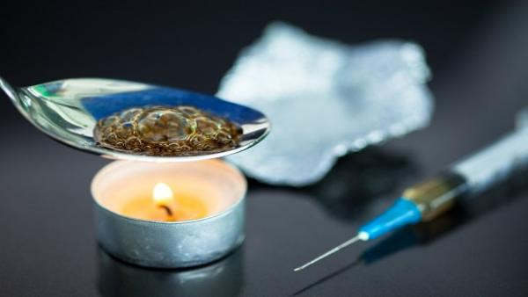
Psychoactive Drugs - Depressants
      Opiates - opium, heroin, morphine (highly addictive)
      Temporarily lessen pain and anxiety
      Reduce GABA which slows the release of dopamine. Brain releases excess dopamine, creating a euphoric feeling
      Repeated use - body to stops production of endorphins, its own natural opiates
      Result = extreme discomfort or withdrawal

Slide 42
Psychoactive Drugs - Stimulants
    Stimulants - “uppers,” drugs that excite neural activity and speed up body functions
      Amphetamines, nicotine, caffeine, cocaine, Ecstacy methamphetamine (speed)
      Cocaine – blocks the reuptake of dopamine, serotonin, & norepinephrine.
          Chemicals stay in the synapse, acting as an agonist
          Causes a dopamine dependency, boosting feelings of confidence with serotonin & generating more energy with epinephrine
          Result is immediate rush & eventual crash

Slide 43
Psychoactive Drugs - Stimulants
Ecstasy - MDMA
  Both a stimulant and mild hallucinogen
  Triggers the release of dopamine
  Releases stored serotonin & blocks its reabsorption, prolonging the feel-good feeling
  Long-term damage to serotonin-producing neurons = risk of permanent depression

Slide 44
Psychoactive Drugs - Stimulants
Methamphetamine – Super stimulant (faster acting, more potent, more dangerous)
  Increased serotonin levels in the synapses & block reabsorption
  Increased norepinephrine = energy
  Increased dopamine = euphoria
  Long-term reduces serotonin production, which may lead to depression

Slide 45
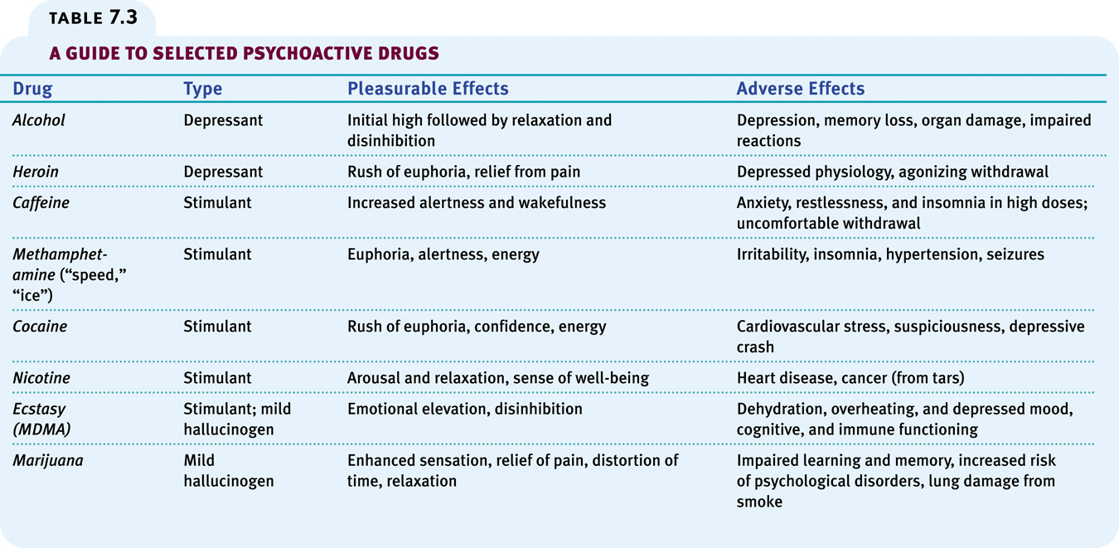

Slide 46
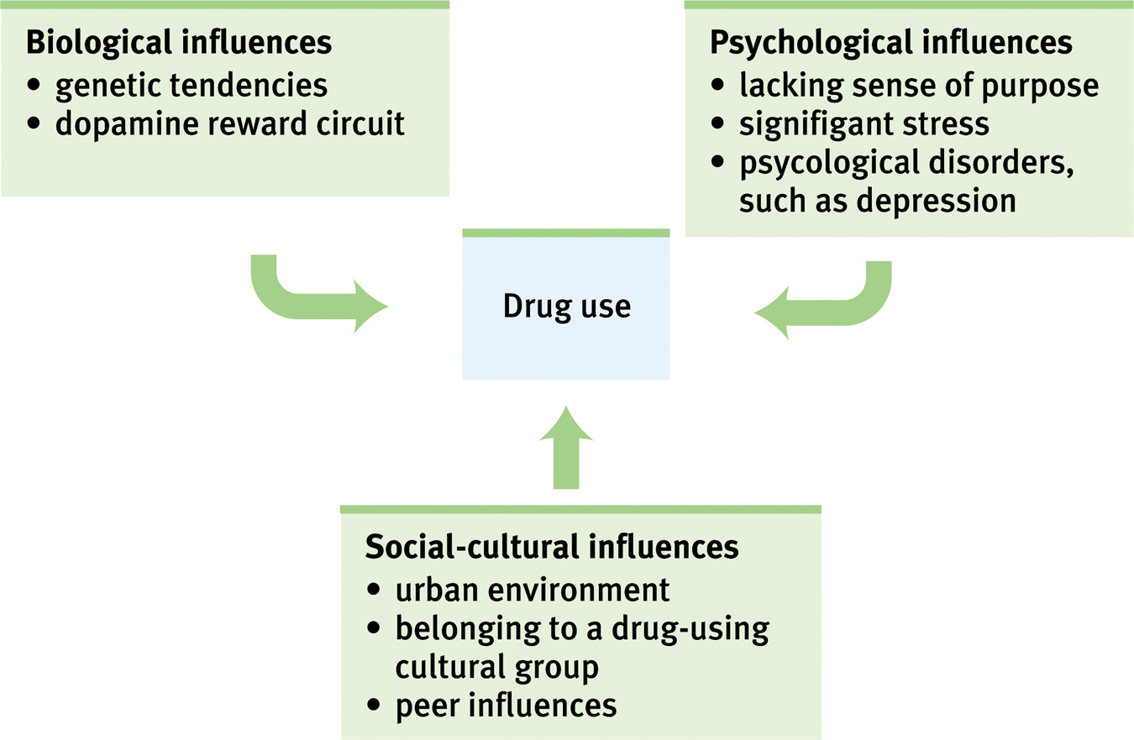
Influences on Drug Use
The use of drugs is based on biological, psychological, and social-cultural influences.

Slide 47

Near-Death Experiences
After a close brush with death, many people report an experience of moving through a dark tunnel with a light at the end. Under the influence of hallucinogens, others report bright lights at the center of their field of vision.
(From “Hallucinations” by R.K. Siegel. Copyright
© 1977 Scientific American, Inc. All rights reserved.)
Notes:
OBJECTIVE 21| Describe the near-death and the controversy over whether it provides evidence for mind-body dualism.

Slide 48
Near Death Experiences
Near-death experiences raise the mind-body issue. Can the mind survive the dying body?
Dualism: Dualists believe that mind (non-physical) and body (physical) are two distinct entities that interact.
Monism: Monists believe that mind and body are different aspects of the same thing.

