Slide 1
English 11 Bell work
1st Quarter – 2018

Slide 2
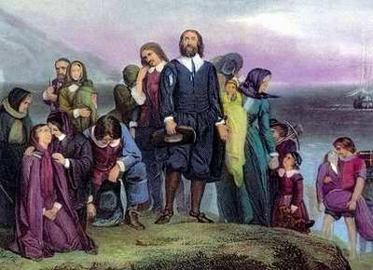
Monday, October 1
Write down 3 things that you can recall about the Puritans and their beliefs. (Think of the “Beginnings” section that you read.)

Slide 3
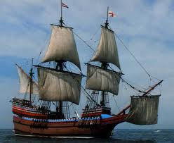
Tuesday, October 2
Write down 5 things that you can recall about the Pilgrims’ experience according to William Bradford’s account.

Slide 4
Wednesday, October 3
What are some of the challenges you would face if you had to leave everything you had ever known and start over in an unfamiliar land?
Your response should be written in 4-5 complete sentences.

Slide 5
Thursday, October 4
Identify the subject and the verb or verb phrase in the following sentences. Write the subject and verb or verb phrase on your bell work form.
Fruits and vegetables can spoil if they become too ripe.
He cooked the foods and poured them into clean glass bottles.
Kerry chose the plants for the garden.
Here is the delivery man with my pizza.
High temperatures will destroy organisms in food.

Slide 6
Friday, October 5
What do you know or what have you heard about The Crucible and the Salem witch trials?

Slide 7
Monday, October 8 – Find the agreement error
Few viewers of the film Superman: The Movie knows how Christopher Reeve soars through the air.
Credit for the flying scenes go to special-effects crews.
These masters of illusion creates tricks to make the impossible appear to happen.
Superman, together with Lois Lane, were suspended on wires from huge cranes.
The actors in the scenes were moving only their heads and arms while films of rushing scenery was projected onto large screens behind them.

Slide 8
Tuesday, October 9
Write down three details that you can recall from the portion of the Salem Witch Trials documentary that we watched yesterday.

Slide 9
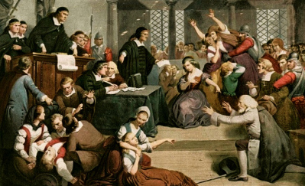
Wednesday, October 10
Write down three additional things that you have learned about the Salem Witch Trials from watching the History Channel documentary.

Slide 10
10/10 Today’s Assignment
Read the biography for Arthur Miller. Highlight or underline the details that you feel are most important as you read. You will be tested on this material next week.
Write a 1-2 sentence summary statement capturing the main ideas(s) for each paragraph on the Arthur Miller handout.
Answer the multiple choice questions that accompany the article.
Due tomorrow.

Slide 11
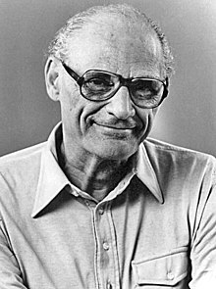
Thursday, October 11
Write down three things that you learned about Arthur Miller (besides “He wrote The Crucible”).

Slide 12
Thursday, October 11
Read “Witchcraft in Puritan New England.” Highlight any important details.
Read “Puritan Religion and Beliefs.” Highlight any important details and answer the multiple choice questions. You do NOT have to do #5 – article summary.
Read “The Red Scare and McCarthy Trials.” Highlight any important details. Write a 7-10 sentence summary of the article.
YOU WILL BE TESTED ON THIS INFORMATION NEXT WEEK!

Slide 13
Monday, October 15 – Select the correct verb form
Participating in athletics (is, are) popular at Mott High School.
The members of the jury (has returned, have returned).
The jury (has given, have given) its verdict.
The family (has given, have given) their contributions.
The family (has been, have been) to over five countries.
The public (demands, demand) a solution to the problem.
Physics (attempts, attempt) to explain matter, energy, and their interaction.

Slide 14
Subject-verb Agreement – Collective nouns
If the collective noun refers to the group as a unit, then it takes a singular verb.
The team is heading for practice this afternoon.
The family is coming for Christmas.
If it refers to the individuals in the group or the parts that make up the group, then the verb should be plural.
The team are eating with their families tonight.
The family were arguing throughout Christmas dinner.

Slide 15
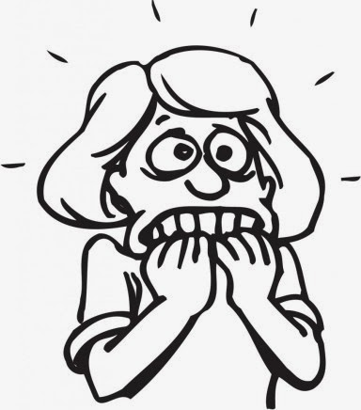
Tuesday, October 16
In what ways does fear affect people’s actions? Give a specific example. Explain!

Slide 16
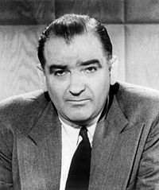
Wednesday, October 17
Write down five things that you recall about Joseph McCarthy and the Red Scare.

Slide 17
The Crucible – Big ideas
Fear/Hysteria
Intolerance
Peer Pressure/Conformity
Reputation
Integrity/Pride/Dignity
Revenge
Greed
Power/Authority
Corruption of justice

Slide 18
Thursday, October 18
Reread the paragraph that begins with “The Salem tragedy, which is about to begin…” at the bottom of page 6 and explain what it means to you.

Slide 19
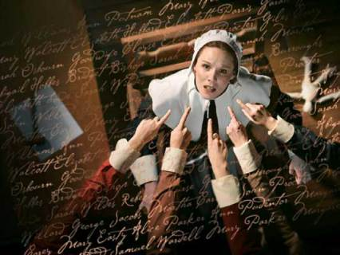
Friday, October 19
Fear and hysteria drove people to act irrationally in The Crucible. Can you think of any modern-day examples mass hysteria? Explain

Slide 20
Monday, October 22
Write a brief summary of what you can recall from what we have read so far in Act One.

Slide 21
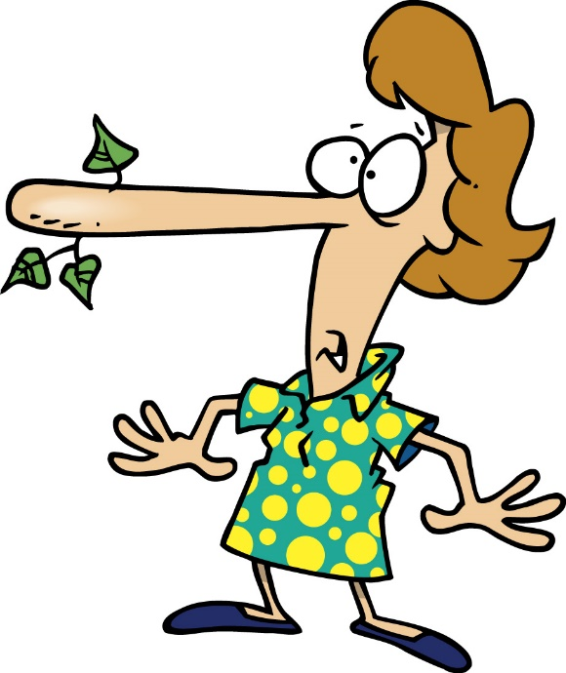
Tuesday, October 23
Write about a time when you or someone you know lied to get out of trouble. (4-5 sentences)

Slide 22
Wednesday, October 24
Provide one NEW FACT (not opinion) that you learned yesterday about each of the following characters:
John Proctor
Rebecca Nurse
Reverend Parris
Thomas Putnam
Act One Quiz tomorrow!

Slide 23
Thursday, October 25
Write about a time when you or someone you know was wrongly accused. What happened? How did you feel about it? Why do you suppose this happened?
Or
Write about a time when you wrongly accused someone. What was the accusation? Why did you make the accusation? Was the truth ever told?

Slide 24
When you are finished with the quiz, do the following:
Read and annotate the “Conformity” article. Underline or highlight any important details. Your annotations should focus on the purpose of each paragraph. You need at least one annotation per paragraph.
Answer the questions that accompany the article. Provide thorough responses written in complete sentences for the short answer questions.

Slide 25
Monday, October 29
Explain how the “Conformity” article relates to The Crucible. Use one quote from the article to support your position. (4-5 sentences)

Slide 26
Tuesday, October 30
Refer to the pages that you were assigned yesterday (pgs. 49-62). Describe the mood inside the Proctor household. Support your statement by providing specific examples from the text.

Slide 27
Wednesday, October 31
Write a 4-5 sentence summary of what you can recall from Act Two so far.

Slide 28
Thursday, November 1
Make one prediction for the following characters:
Elizabeth Proctor
John Proctor
Abigail Williams
Mary Warren
Reverend Parris

Slide 29
Friday, November 2
Choose three adjectives to describe Mary Warren. Provide an example from the play to support each adjective.
Act Two Quiz Monday

Slide 30
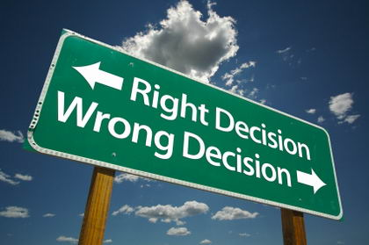
Monday, November 5
Describe Mary Warren’s dilemma at the end of Act Two. What would you do if you were in her situation?

Slide 31
Wednesday, November 7
Choose one of the following prompts to respond to. (4-5 sentences)
Write about a time when…
Your emotions prevented you from making a good choice
You found yourself “in over your head” because of a bad choice you made
You made a bad choice that you wish you could go back and change

Slide 32
Pronoun Case - Practice
(Who, Whose) bag is on the chair?
My sisters and (I, me) are buying our parents a dog for (their, they) anniversary.
Mom told you to give the package to (him, he)
The supervisor asked John and (he, him) to write a report.
She is much kinder than (he, him).

Slide 33
Thursday, November 8
Think about a typical courtroom trial today.
What types of things do we use as evidence in a trial?
What role do eyewitness testimonies, confessions, and character witnesses play in determining guilt or innocence?
Is there any type of proof that is typically required for conviction?

Slide 34
Friday, November 9
No Bell Work

Slide 35
Monday, November 12
Consider what happened at the end of Act Three. What are your thoughts about the following characters?
Abigail Williams
Mary Warren
John Proctor
Reverend Hale
Judge Danforth

Slide 36
Tuesday, November 13
Write about an incident during which you could have acted to make a difference but decided not to act.
Briefly describe the incident.
What could have been done?
What difference might your actions have made?
What happened as a result of your inaction?
How did you feel after the incident?

Slide 37
Wednesday, November 14
Which of the following characters, can you relate to the most? Consider their situation, their behavior, their personal qualities. Choose one and explain why. (3-4 sentences)
John Proctor
Elizabeth Proctor
Abigail Williams
Mary Warren
Reverend Parris
Reverend Hale

Slide 38
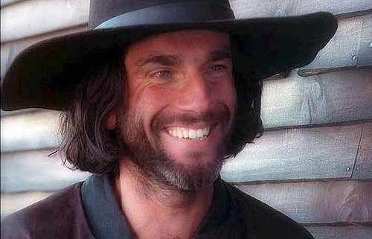
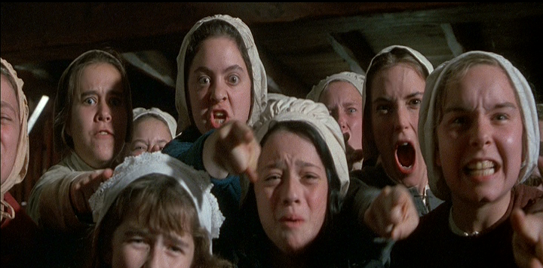
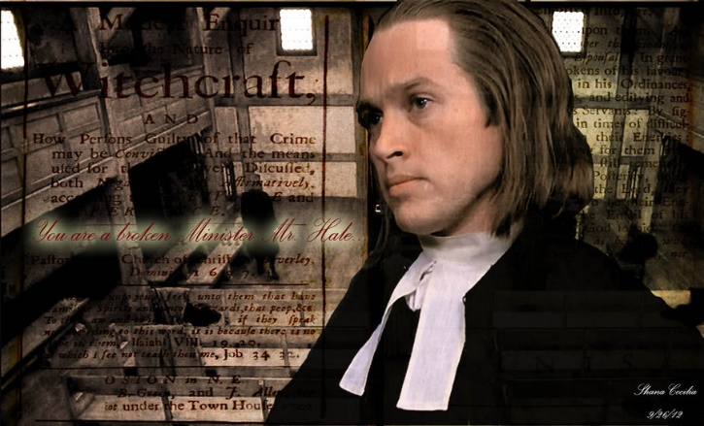
Thursday, November 15
Make three predictions for Act Four of The Crucible. Provide your rationale for each prediction.

Slide 39
Friday, November 16
No bell work today.

Slide 40
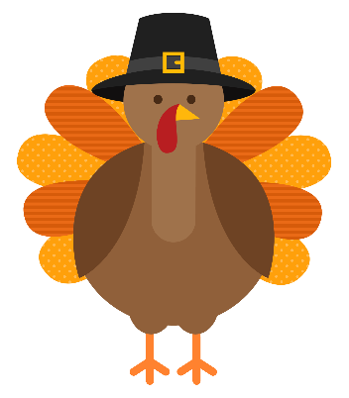
Monday, November 19
No bell work today.

Slide 41
Monday, November 19 Review Questions:
Both Parris and Hale ask Danforth to postpone the executions, but their reasons for wanting a postponement are vastly different. Clearly explain what motivates each of the men.
Explain Judge Danforth’s response to the men’s request and his reasoning for it.

Slide 42
Closing questions:
In a short paragraph, describe your overall reaction to The Crucible. What are your thoughts about these events, the characters, and their actions? (5-7 sentences)
In what ways do you feel The Crucible might still be relevant? Are there any lessons to be learned from it?

Slide 43
Big Ideas/Topics for The Crucible
Dignity/Self Respect/Pride
Honesty/Integrity
Peer Pressure/Conformity
Greed
Power
Revenge
Fear/Hysteria
Reputation

Slide 44
Monday, December 3
You should still have the back of the bell work paper from the week of Nov. 11-16 to use for this week’s bell work.
What are your biggest concerns about attending college and why?
If you do not plan to attend college, what concerns do you have for your immediate plans after high school?

Slide 45
Tuesday, December 4
Define the following terms in your own words as they relate to sentence structure:
Sentence
Independent clause
Dependent (subordinate) clause
Phrase
If you don’t know, take your best guess.

Slide 46
Wednesday, December 5
Complete “Summarize the Main Idea: Exercise 1.” (I will give you a copy after the bell rings)
Write your answers on the bell work paper. Do not write on the worksheet.

