Slide 1
Prologue
The Story of Psychology

Slide 2
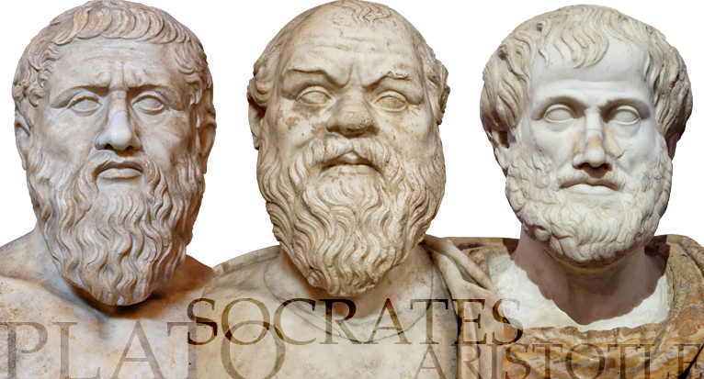
Prescientific Psychology
Socrates and Plato –
Viewed mind as separable from the from body
Dualism – mind and body are two different things that interact
Knowledge is innate (Nature)
Aristotle –
Mind and body are connected, not separate
Observation & data
Knowledge not innate, grows from our experiences (Nurture)

Slide 3
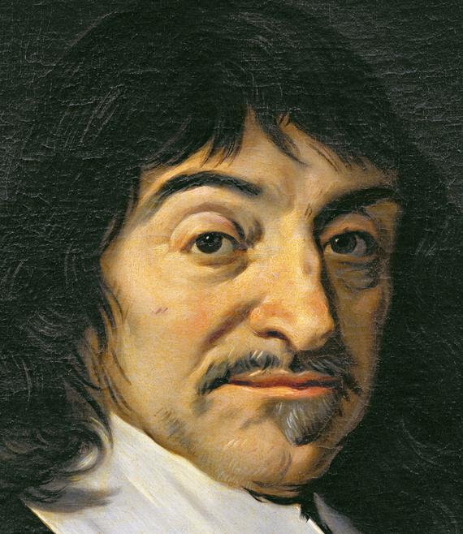
Prescientific Psychology
René Descartes –
Agreed with Socrates and Plato about innate ideas & the mind (soul) being distinct from the body but believed the two do interact to produce conscious experiences (Interactive Dualism)
Studied how the mind and the physical body communicate in animals
Human sensations & behaviors based on activity in the nervous system

Slide 4
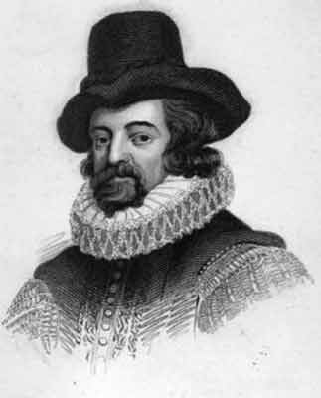
Prescientific Psychology
Francis Bacon –
one of the founders of modern science
relied on common sense and experiments
Believed that research should be based on experimental design & research
John Locke –
Tabula Rasa – The mind is a blank slate on which experience writes (Nurture)
Mind acts on what comes through the senses, don’t inherit knowledge or instinct
Empiricism – knowledge comes from experiences via the senses and science should be based on knowledge from experimentation and observation

Slide 5
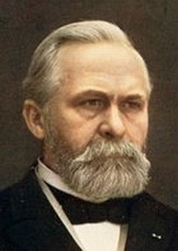
Wilhelm Wundt
German philosopher and physician
First psychological lab in Leipzig, Germany in 1879
Sought to measure the fastest and simplest mental processes (reactions to sensory stimuli)
Developed Introspection technique – look inward to measure conscious experience, people report their conscious experiences as they looked at objects

Slide 6
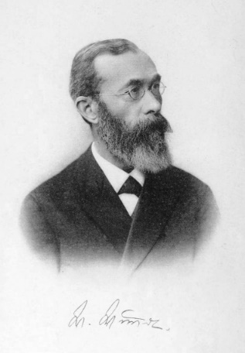
Edward Bradford Titchener
Student of Wilhelm Wundt
Introduced Structuralism –the idea that conscious experiences could be broken down into structures or parts – explore the elemental structure of the mind
Interested in showing how these parts were interrelated
Realized that introspection was not reliable – results vary from person to person

Slide 7
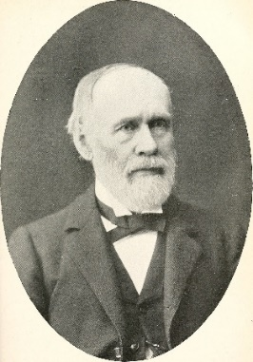
William James
1st American psychologist – started 1st American psychology lab at Harvard
Wrote 1st psychology textbook Principles of Psychology
Assumed that thinking was adaptive – helped our ancestors to survive and reproduce
Developed Functionalism – focused on how mental and behavioral processes enable the organism to adapt, survive, flourish
Followed the work of Charles Darwin and natural selection
Relied on natural observation not introspection

Slide 8
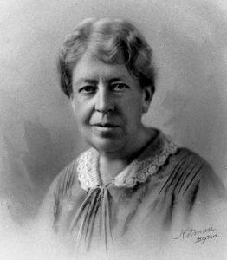
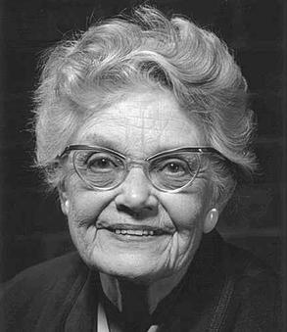
Legacy of William James
Mary Whiton Calkins
Student of James
Finished all work for Ph.D. but Harvard would not endorse, refused to accept degree from Radcliffe College
Later became 1st woman president of APA
Margaret Floy Washburn
Student of Titchener
First woman to receive Ph.D. in psychology from Harvard
2nd woman president of APA
Wrote The Animal Mind, which influenced the school of behaviorism

Slide 9
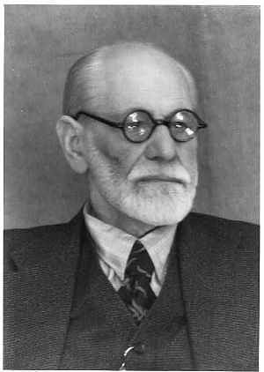
Sigmund Freud
Best known and most controversial
Influential theory of personality - believed we are motivated by unconscious instincts & urges that are not available to the conscious mind
Psychoanalytical approach – emphasized the role of the unconscious (the unconscious mind and childhood experiences affect our behavior)
Free Association – patient says whatever comes to mind

Slide 10
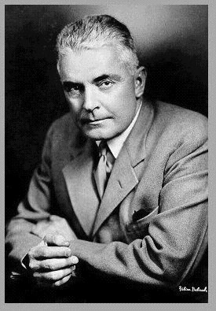
John B. Watson
Behaviorists - placed an importance on observable behavior, questioned the role and study of consciousness
Led to a scientific approach and psychology focusing on the science and study of behavior
Focused on how environmental stimuli could shape behavior – rewards & punishment
Dismissed the use of introspection

Slide 11
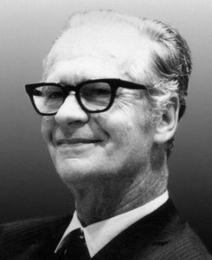
B.F. Skinner
Founded Behaviorism – only deal with observable events; stimuli from the environment and the organisms response to that environment
Studied how consequences shaped behavior
Focused on the role of reinforcement and punishment on directing behavior

Slide 12
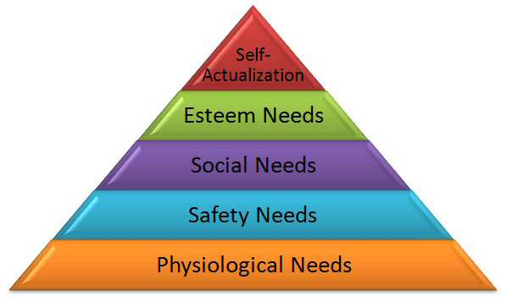
Carl Rogers & Abraham Maslow
Humanistic psychology – Emphasized the growth potential of healthy people; used personalized methods to study personality in hopes of fostering personal growth
Emphasized the importance of current environmental influences on our growth potential and the importance of meeting our needs for love and acceptance
Focused on how free will and human desire and potential could shape behavior
Believed that human potential is what separates humans from animals

Slide 13
Psychology’s Big Debate
Nature-nurture controversy - the longstanding controversy over the relative contributions that genes and experience make to the development of psychological traits and behaviors
Natural selection – (Darwin) Nature selects those that best enable an organism to survive and reproduce in a particular environment

Slide 14
Three Main Levels of Analysis
Levels of Analysis - The differing complementary views, from biological to psychological to social-cultural, for analyzing any given phenomenon
Biopsychosocial approach –
Provides vantage points for looking at a behavior
Considers the influences of biological, physical, and social-cultural factors
Offers a more complete picture of any given behavior or mental process

Slide 15
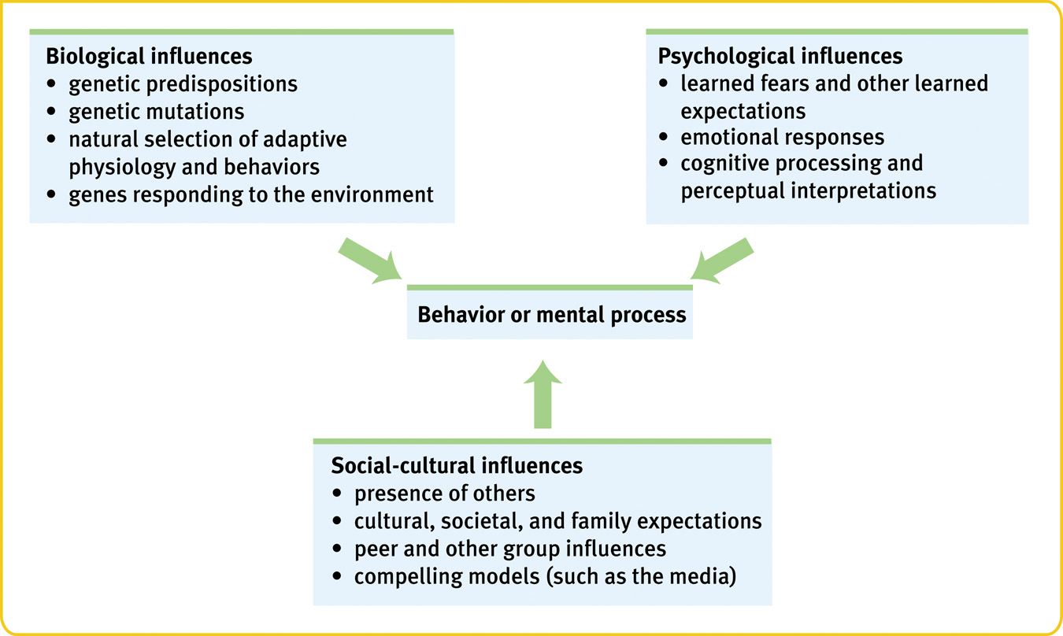
Biopsychosocial Approach

Slide 16
Biopsychosocial Approach – Practice Scenario
Jack is an adolescent male who is depressed and finds social interactions with his peer difficult.
Using the Biopsychosocial perspective, explain the cause of Jack’s difficulties.

Slide 17
Psychology’s Current Perspectives
Perspective | Focus | Sample Questions
Neuroscience | How the body and brain enables emotions? | How are messages transmitted in the body? How is blood chemistry linked with moods and motives?
Evolutionary | How the natural selection of traits the promotes the perpetuation of one’s genes? | How does evolution influence behavior tendencies?
Behavior genetics | How much our genes and our environments influence our individual differences? | To what extent are psychological traits such as intelligence, personality, sexual orientation, and vulnerability to depression attributable to our genes? To our environment?

Slide 18
Psychology’s Current Perspectives
Perspective | Focus | Sample Questions
Psychodynamic | How behavior springs from unconscious drives and conflicts? | How can someone’s personality traits and disorders be explained in terms of sexual and aggressive drives or as disguised effects of unfulfilled wishes and childhood traumas?
Behavioral | How we learn observable responses? | How do we learn to fear particular objects or situations? What is the most effective way to alter our behavior, say to lose weight or quit smoking?

Slide 19
Psychology’s Current Perspectives
Perspective | Focus | Sample Questions
Cognitive | How we encode, process, store and retrieve information? | How do we use information in remembering? Reasoning? Problem solving?
Social-cultural | How behavior and thinking vary across situations and cultures? | How are we — as Africans, Asians, Australians or North Americans – alike as members of human family? As products of different environmental contexts, how do we differ?

Slide 20
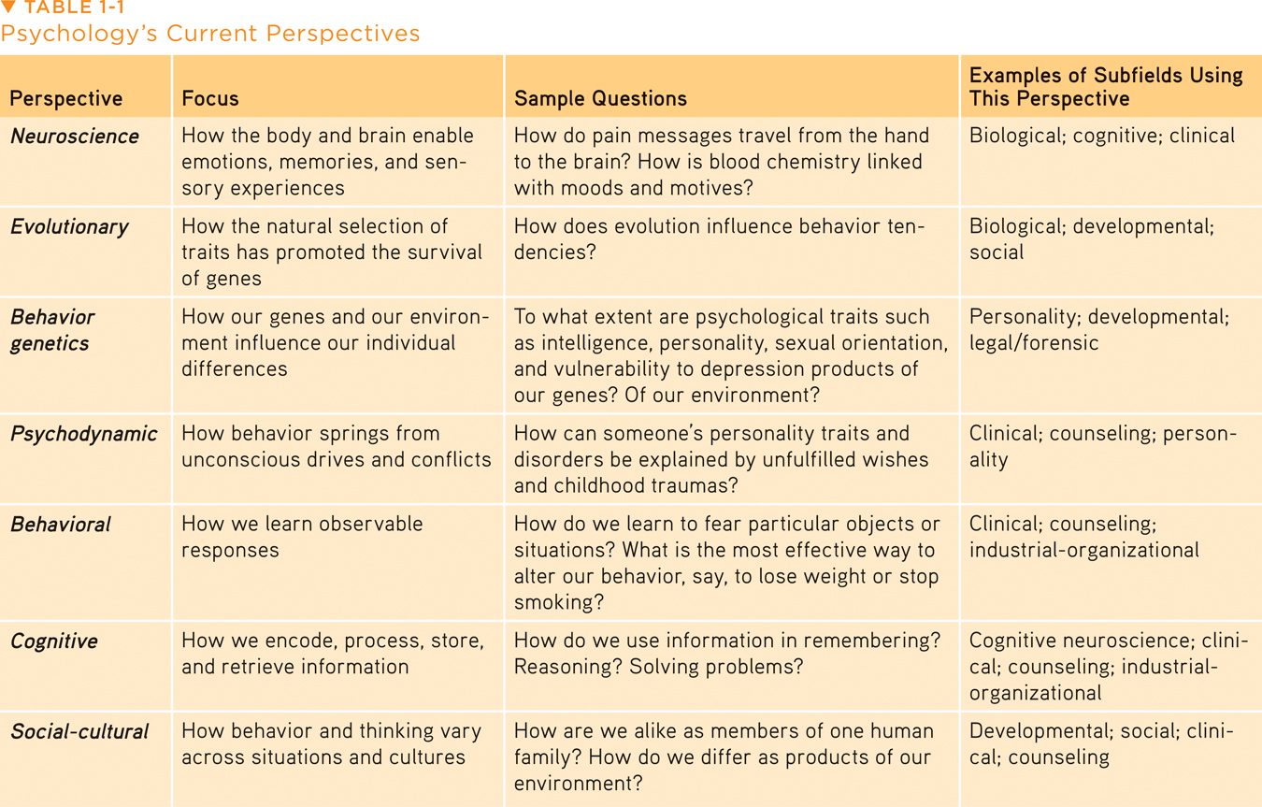
Table 1.1 Psychology’s Current Perspectives
David G. Myers and C. Nathan DeWall: Psychology, Eleventh Edition in Modules Copyright © 2015 by Worth Publishers

Slide 21
Psychology’s Subfields: Research
Psychologist | What she does
Biological | Explore the links between brain and mind.
Developmental | Study changing abilities from womb to tomb.
Cognitive | Study how we perceive, think, and solve problems.
Personality | Investigate our persistent traits.
Social | Explore how we view and affect one another.
Notes:
Preview Question 5: What are psychology’s main subfields?

Slide 22
Psychology’s Subfields: Research
Data: APA 1997

Slide 23
Psychology’s Subfields: Applied
Psychologist | What she does
Clinical | Studies, assesses, and treats people with psychological disorders
Counseling | Helps people cope with academic, vocational, and marital challenges.
Educational | Studies and helps individuals in school and educational settings
Industrial/ Organizational | Studies and advises on behavior in the workplace.

Slide 24
Psychology’s Subfields: Applied
Data: APA 1997

Slide 25
Clinical Psychology vs. Psychiatry
A clinical psychologist (Ph.D.) studies, assesses, and treats troubled people with psychotherapy.
Psychiatrists, on the other hand, are medical professionals (M.D.) who use treatments like drugs and psychotherapy to treat psychologically diseased patients.

