Slide 1
Psychological Disorders
Chapter 16

Slide 2
Diathesis Stress Model
The biopsychosocial model is useful in identifying factors that could contribute to a disorder, but less so in determining how the interaction of such factors leads to the disorder.
Diathesis-stress approach/model – the amount and type of stress play a crucial role in triggering genetic predispositions which could result in psychological disorders
  If two people have a genetic predisposition (diathesis) to a disorder, the one with more stress has a higher chance of developing the disorder.

Slide 3
Somatoform Disorders
Psychological problems in which there are symptoms of a physical disorder without a physical cause.
  NOT faking it - Caused by physical stress
Somatic Symptom Disorder (SSD) - extreme anxiety about physical symptoms that are interpreted as evidence of illness
Conversion disorder – conversion of extreme anxiety into a physical disorder
  Sensory and motor failure, blindness, deafness, paralyzed limbs with no identifiable cause
  Generally show little/no concern

Slide 4
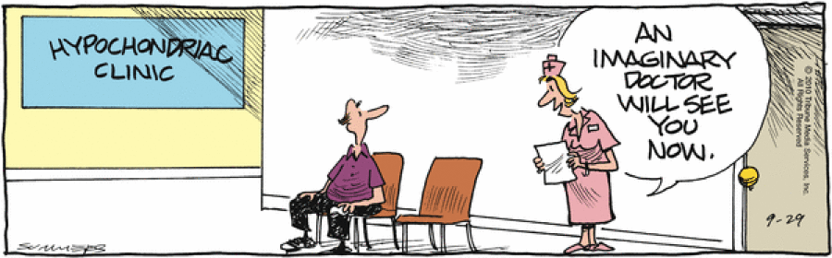
Somatoform Disorders
Illness Anxiety Disorder – preoccupation with getting a serious illness despite no indication of illness (absence of physical symptoms)

Slide 5
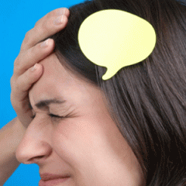
Dissociative Disorders
Rare occurrences that involve a sudden loss of memory (amnesia) or change in identity
Dissociative amnesia – sudden loss of memory for a traumatic event or a period of time that is too painful to remember
  Dissociative Fugue – sudden memory loss of their present life resulting in a new identity and a move to a new location
  Doesn’t recall previous life

Slide 6
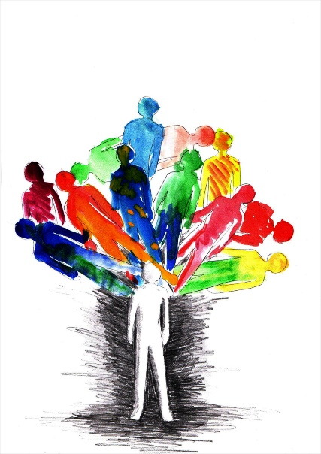
Dissociative Disorders
Dissociative Identity Disorder (DID) – (formerly called multiple personality disorder)
  Person exhibits more than one at least two distinct personalities
  Amnesia involved when alternate personalities take over
  Often a response to childhood trauma

Slide 7
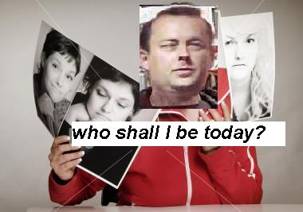
Dissociative Disorders
Dissociative Identity Disorder
  Causes:
    May be a defense mechanism against trauma or unacceptable impulses
    May be a detachment from reality of horrific life events
Controversy over whether it exists

Slide 8
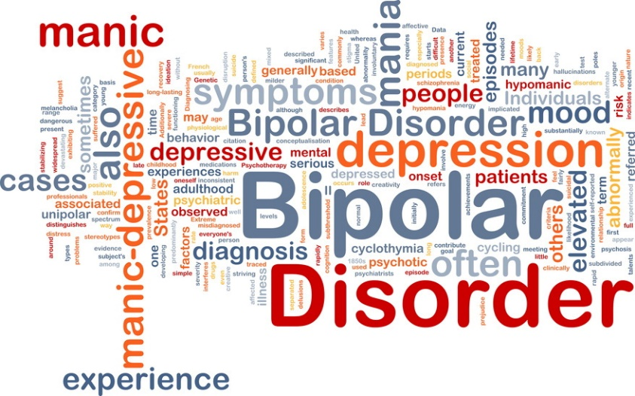
Mood Disorders
Condition where a person experiences extreme moods inappropriate for or inconsistent with situations
Two principal forms:
  Major depressive disorder
  Bipolar disorder

Slide 9
Mood Disorders – Major Depressive Disorder
“Common cold” of psychological disorders
Person experiences extreme depression, overwhelmed, hopeless for weeks or months
Can begin suddenly or slowly
Young adults and women most susceptible
Despite best efforts, everything from conversation to bathing is an unbearable, exhausting effort

Slide 10
Mood Disorders – Major Depressive Disorder
To be diagnosed, must experience 5 of following (usually for >2wks):
Persistent depressed mood most of the day
Loss of interest or pleasure in most activities
Significant weight loss or gain
Sleep changes
Speeding up or slowing down of physical & emotional reactions
Loss of energy
Feelings of worthlessness, guilt
Reduced concentration, inability to make meaningful decisions
Recurring thoughts of death/suicide

Slide 11

Related Mood Disorders
Dysthymic Disorder:
Sad mood, lack of interest, loss of pleasure
Like Major Depression but less intense and for longer period of time (must last at least 2 years to qualify)
Post-partum Depression: Major Depression following birth of a child
Seasonal Affective Disorder (SAD): Symptoms of depression connected to lack of sunlight in winter months

Slide 12

Mood Disorders – Bipolar Disorder
Characterized by mood swings alternating between periods of major depression and mania
Mania – extremely energetic, excessive talking, optimistic, euphoric, little need for sleep
May make impulsive/unwise decisions

Slide 13
Explaining Mood Disorders –
Many behavioral & cognitive changes accompany depression
Depression is widespread - Since so widespread, must have common causes, too
Trapped in negative cycle of depressed behavior & depressive thoughts
Women twice as likely to have major depression (internal), men more likely to have external disorders (lack of impulse, alcohol abuse)

Slide 14
Explaining Mood Disorders –
Most major depressive episodes self-terminate, even without professional help
Stressful events related to work, marriage, & close relationships precede depression
Depression strikes earlier & earlier and affects more & more people with each new generation

Slide 15
Schizophrenia – “Split Mind”
A severe and disabling pattern of extremely disturbed thinking, emotion, perception, and behavior that seriously impairs the ability to communicate and relate to others and disrupts most other aspects of daily functioning
      One of the most serious disorders
      Often involves loss of contact with reality – “split from reality”

Slide 16
Schizophrenia
1-2% of population
Appears equally in various ethnic groups & among males & females
Usually develops in adolescence, early adulthood
40% improve with treatment and function reasonably well. The rest have continuous or intermittent symptoms that permanently disrupt functioning
10-13% of homeless population have schizophrenia

Slide 17
Schizophrenia – Disorganized Thinking
Thinking is fragmented, bizarre & distorted
Delusions – false beliefs, often of persecution or grandeur, that may accompany psychotic disorders
Breakdown in selective attention - We can give undivided attention to one stimulus even though thousands of stimuli exist but schizophrenics can’t
“Word salad” - jumble of words reflecting utterly chaotic thoughts
Loose Associations – one thought not connected with another

Slide 18
Schizophrenia – Disturbed Perceptions
Hallucinations – false perceptions
Often auditory – voices which are hostile, violent, manipulative, abusive
Can also be sights, smells, taste, touch sensations without external stimuli

Slide 19
Schizophrenia – Inappropriate Emotions & Actions
Laugh, cry, express rage at inappropriate times
Flat affect – zombielike state of apparent apathy
Inappropriate motor behavior - Senseless, compulsive acts such as continually rocking or rubbing an arm
Catatonia – remain motionless for hours & then become agitated
    Lack motivation/social skills
    Inability to function in everyday situations

Slide 21
Categorizing Schizophrenia
Positive symptoms – presence of inappropriate behaviors such as:
  Disorganized thoughts
  Hallucinations
  Delusions
  Inappropriate emotions
The ADDITION of these symptoms makes them schizophrenic
Negative symptoms – absence of appropriate behaviors such as:
  lack of pleasure & motivation
  Toneless voices
  Expressionless faces
What they are MISSING makes them schizophrenic

Slide 22
Recovering From Schizophrenia
Chronic or Process Schizophrenia – slow-developing process
  Often exhibit negative symptoms
  Recovery is doubtful
Acute or Reactive Schizophrenia – a previously well-adjusted person develops it rapidly in reaction to particular life stresses
  Recovery is much more likely

Slide 23
Schizophrenia – Brain Abnormalities
Chemical Imbalance - Excess of receptors for dopamine,
High level may intensify brain signals in schizophrenia creating positive symptoms – hallucinations & paranoia
Drugs that block dopamine receptors lower symptoms
Drugs that increase dopamine (cocaine, meth) intensify them
Dopamine over-activity causes overreactions to external & internal stimuli

Slide 24
Abnormal Brain Activity & Anatomy
Low brain activity in the frontal lobes (reasoning, planning, & problem solving)
People with paranoia found to have increased activity in the amygdala
Shrinkage of cerebral tissue causing fluid filled areas of the brain to become larger and the thalamus smaller than normal

Slide 25
Additional Factors
Prenatal viruses - influenza during fetal development could be linked to schizophrenia
Parental age - if father is over 45 runs a higher risk for development
Genetic – chances higher if family member has it
Dysfunctional, highly critical families and environmental stress could also lead to schizophrenia
Vulnerability theory of schizophrenia- suggests that schizophrenia is the result of a biological predisposition and the amount of stress one encounters

Slide 26
Personality Disorders
Personality disorders are enduring or continuous inflexible patterns of thinking, feeling, and acting that impair one’s social functioning
Common features of all personality disorders
  Distorted thinking
  Interpersonal difficulties
  Problems with impulse control
  Problems with emotional responses

Slide 27
Types of Personality Disorders
Grouped into 3 clusters based on common attributes.
Cluster A: “Odd Suspicious, and Eccentric” – disorders that show a pattern of paranoia, social isolation cognitive or perceptual distortions, and eccentric behaviors – dominated by distorted thinking
Schizoid Personality Disorder (SPD): eccentric behaviors, emotionless disengagement
    Can’t communicate with others
    Solitary lifestyle, secretiveness, emotional coldness, and apathy.
    Cold and indifferent

Slide 28
Types of Personality Disorders
Cluster B: “Dramatic, Emotional, Erratic” – disorders that cause significant disruption, even harm to self and others
Histrionic Personality Disorder – displays shallow, attention-getting emotions and goes to great lengths to gain others’ praise and reassurance – “drama queens”
Narcissistic Personality Disorder: Grandiose sense of self importance and preoccupation with fantasies of success

Slide 29
Types of Personality Disorders
Borderline Personality Disorder (BPD): Unstable and extreme impulses and intense emotions without clear reasoning.
    Problems with relationships and self-image
    Intense fears of abandonment
    Intense anger and irritability
    High sensitivity to and constant thinking about rejection and abandonment

Slide 30
Types of Personality Disorders - Antisocial Personality Disorder (formerly called a sociopath or psychopath)
Superficial charm
High intelligence
No anxiety or personal responsibility
No guilt or regret
Liar, insincere, manipulative
Poor judgment
Does not learn from experience
Cannot form lasting relationships

Slide 31
Types of Personality Disorders
Cluster C: “anxious and fearful”– disorders include symptoms of inadequacy, submission, clinginess orderliness, hypersensitivity
Avoidant Personality Disorder: anxiety, fearful sensitivity to social rejection, so person is withdrawn

Slide 32
Types of Personality Disorders

